Slide 1
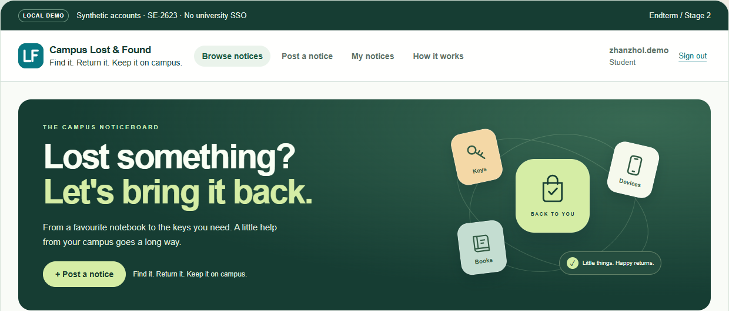
ICT FINAL PROJECT · SE-2623 · WEEK 10
Lost it on campus?
Find it in one place.
Campus Lost & Found — the finished, tested system, and what three of us learned building it.
Real screenshot of the final build · synthetic demo data · runs locally
Mengdigerey Zhanzhol
Galitskiy Daniil
Bisengaliev Daulet
Notes:
SPEAKER: Mengdigerey Zhanzhol · about 0:20 · slide 1 of 12
Good morning. We are team SE-2623: I am Zhanzhol, with Daniil and Daulet. Our project is Campus Lost & Found — one place on campus to report, find and close lost items.
In the next nine minutes each of us will show part of the finished system live, the final test results, and what we would do differently.
→ Transition: 'First, why does this matter?'
FACTS: screenshot captured from commit a7e5c74 on 8 Nov 2026; all accounts and notices are synthetic.

Slide 2
Lost items wait for days because notices are scattered
Zhanzhol · 0:40
4 of 10
TODAY
WITH CAMPUS LOST & FOUND
Group chats
posts scroll away
One board
search by title and category
students in our survey said getting an item back took more than three days
Paper notes
only seen in one corridor
University accounts
everyone knows who posted
9 of 10 said a shared, searchable board would be useful
Guard desk
no one knows it is there
Email the author
one click from the notice
No status
is it already returned?
Returned badge
closed notices stay honest
Stage 1 survey, October 2026 · n = 10 · convenience sample of fellow students — a signal that the problem exists, not a measurement of its size.
Notes:
SPEAKER: Zhanzhol · about 0:40
When someone loses a notebook or keys on our campus, the message ends up in a group chat, on a paper note, or at the guard desk. Each channel reaches only part of campus, chat messages scroll away, and nobody knows when the item is back.
In our Stage 1 survey four of ten students said a return took more than three days, and nine of ten said a shared searchable board would help. That is only ten people — a convenience sample — so we treat it as a signal, not a statistic.
Our answer: one board, tied to university-style accounts, with a clear Returned status.
→ Transition: 'So what did we promise in Stage 1, and what did we deliver?'
SOURCE: Stage 1 report p. 2 (survey, 10 responses: 9/10 useful, 4/10 returns > 3 days).

Slide 3
9 of 11 Musts done; university sign-in is the gap
Zhanzhol · 0:45
FUNCTIONAL (F) · F3 is the only Should
NON-FUNCTIONAL (N)
F1
F2
F3
F4
F5
F6
F7
F8
N1
N2
N3
N4
partly
done
done
done
done
done
done
done
done
partly
done
done
University sign-in
Publish
One photo
Browse + details
Search + filter
Email author
Edit + returned
Admin removes
Search ≤ 2 s
Identity + rights
360 px + keyboard
30-min demo
Why F1 and N2 are only partly done
Evidence for every row
Final/Requirements/Requirements_Status.md lists the test, screenshot or measurement behind each status. All were re-run on 8 Nov 2026 on the final code.
Accounts are local. Registration only accepts an @astanait.edu.kz address, passwords are scrypt-hashed and owner/admin rights are enforced.
Microsoft sign-in code is ready (OpenID Connect + PKCE, 11 tests on simulated Microsoft), but it needs an app registration in the university’s Entra tenant — only IT can create it. Until a real account signs in, it stays “partly”.
Notes:
SPEAKER: Zhanzhol · about 0:45
Stage 1 gave us eleven Must requirements and one Should. 9 Musts are fully done, and the photo upload — our only Should — is done as well.
The two amber ones, F1 and N2, are the same problem: identity. Our accounts are local. We only accept astanait.edu.kz addresses, hash passwords with scrypt and enforce owner and admin rights on the server — but anyone can type a well-formed university address. For the Final we added the Microsoft sign-in code: OpenID Connect with PKCE, state and nonce, signature and issuer checks, and only @astanait.edu.kz accounts. It passes 11 tests against simulated Microsoft responses. But it needs an app registration in the university Entra tenant, which only IT can create, so we do not count F1 as done until a real account signs in.
Every status in this row has a test, screenshot or measurement behind it in our requirements table.
→ Transition: 'Let me show you the student side live.' (switch to the browser)
SOURCES: Stage 1 report pp. 3–4; Final/Requirements/Requirements_Status.md; Evidence/test_suite_final.log; Final/SSO/Microsoft_Entra_SignIn_Status_and_Setup.md.

Slide 4
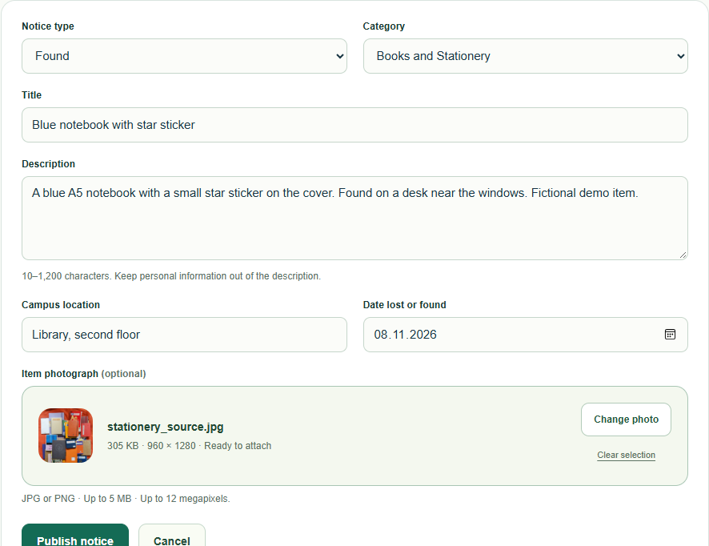
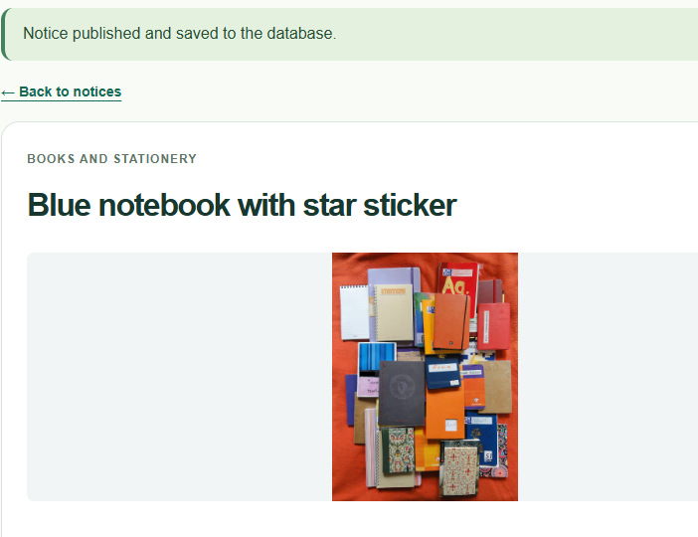
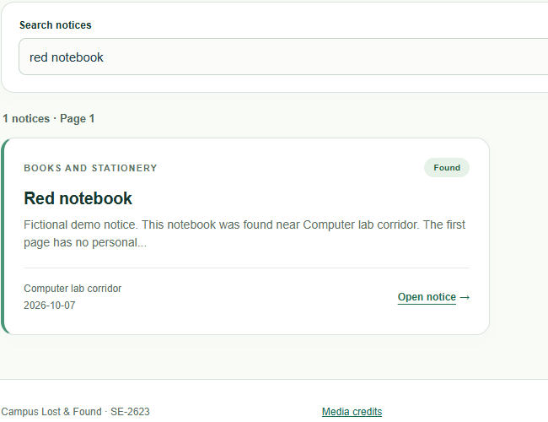
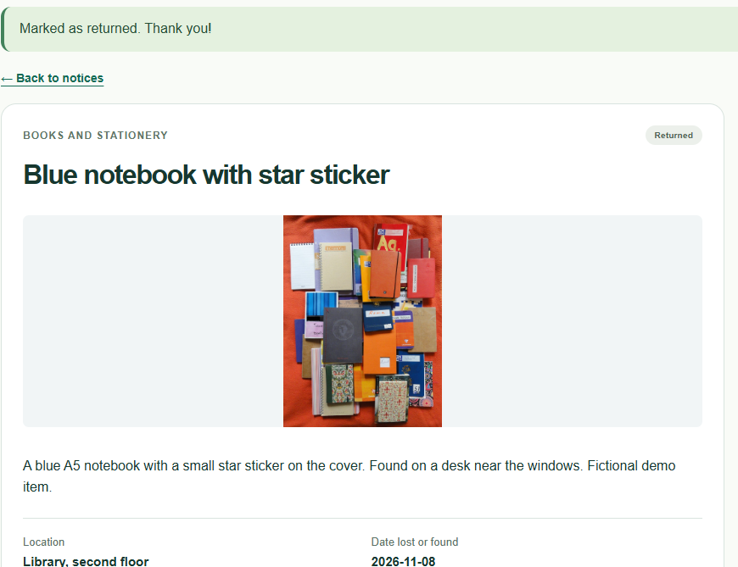
Live demo · a student goes from “I found it” to “Returned”
Zhanzhol · 1:15
LIVE DEMO
1 Publish
2 Saved
3 Find
4 Close
Type, category, title, place, date, one photo
Stored in SQLite; photo re-encoded and private
Search “red notebook” + category → 1 result
Email the author, then mark it Returned
All four frames are real captures of the final build (8 Nov 2026). If the live demo fails, talk through these frames.
Notes:
SPEAKER: Zhanzhol · about 1:15 · LIVE DEMO in the browser (normal window, student)
DEMO STEPS (sign in first as zhanzhol.demo@astanait.edu.kz / CampusDemo!2026 BEFORE the talk):
1. Click 'Post a notice'. Choose Found, Books and Stationery, title 'Blue notebook (live demo)', location 'Library, second floor', today's date. Choose a photo (Sources/stationery_source.jpg). Click Publish notice.
SAY: 'The notice is saved in SQLite. The photo is checked, re-encoded so GPS metadata is removed, and given a random name. Only signed-in users can open it.'
2. Go to Browse notices. Type 'red notebook', choose Books and Stationery, Search. Open the result.
SAY: 'Search uses a parameterised LIKE query; the category filter narrows it to one result.'
3. Point at 'Contact author' — 'This opens an email draft to the person who posted it. The site itself never sends email.' (Do not actually send.)
4. Open 'My notices' → your new notice → 'Mark as returned'. SAY: 'The badge changes to Returned and the change is saved — only the owner can do this; another student gets a 403.'
IF THE DEMO FAILS: stay on this slide and narrate the four frames; they are real screenshots of the same steps.
→ Hand-over: 'Daniil will now show what the administrator sees.'
FACTS: browser run on 8 Nov 2026 created notice #123, search returned exactly 1 result (Red notebook, #4), mailto pointed at the stored owner.

Slide 5
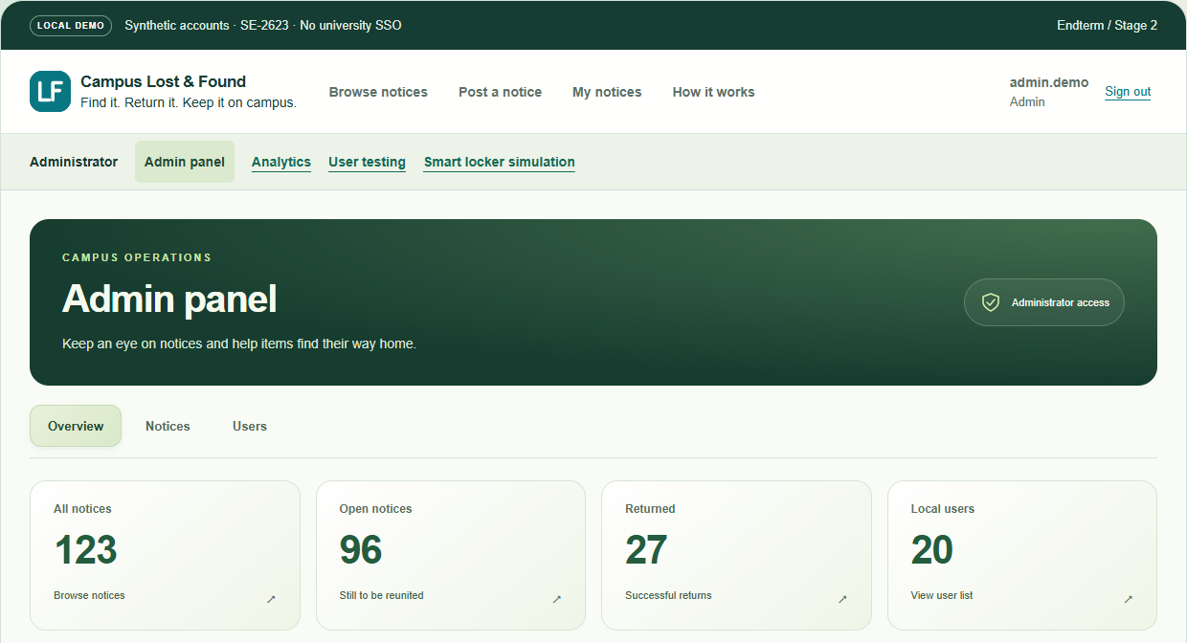
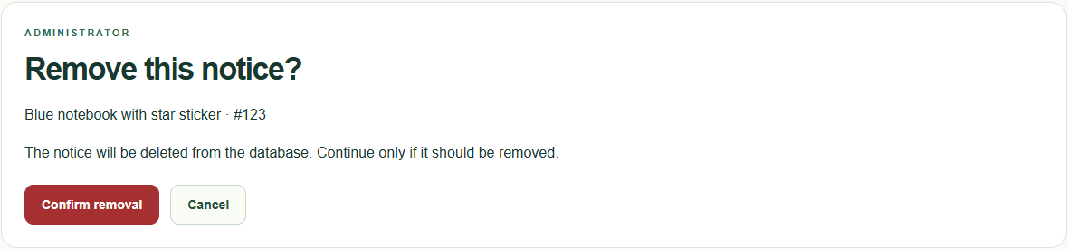
Live demo · the admin keeps the board clean
Daniil · 1:10
LIVE DEMO
1
Live counts from SQLite
Notices, open, returned and users are counted on every visit — nothing is typed in by hand.
2
Remove with a confirmation step
Opening the page deletes nothing; only “Confirm removal” does. A student gets 403.
3
Analytics on the same data
Three SQL questions with CSV export, clearly labelled “synthetic teaching data”.
Admin pages return 403 to all three student accounts and 200 to the administrator (checked 8 Nov 2026).
Notes:
SPEAKER: Galitskiy Daniil · about 1:10 · LIVE DEMO (private window, administrator)
DEMO STEPS (sign in BEFORE the talk in a private window as admin.demo@astanait.edu.kz / CampusDemo!2026):
1. Open Admin panel. SAY: 'These counts are read from SQLite on every visit. If Zhanzhol just posted a notice, All notices went up by one.'
2. Notices tab → search 'Blue notebook' → open Zhanzhol's live-demo notice → 'Remove notice'. SAY: 'Opening this page changes nothing. Only the POST with a CSRF token deletes the row and its photo.' Click Confirm removal.
3. Open Analytics. SAY: 'Three SQL questions: open backlog by category, lost and found by location, and events per week. It is synthetic teaching data and the page says so. The CSV export neutralises spreadsheet formulas.'
4. (Optional, if time) Show that a student opening /admin gets 403.
→ Transition: 'How do we know it works beyond a demo? Here are the measurements.'
FACTS: account_checks.json — /admin, /admin/notices, /admin/users, /admin/analytics, /admin/research, /admin/smart-locker: 403 for zhanzhol/daniil/daulet demo students, 200 for admin.

Slide 6
The final code passed every automated and security check
Daniil · 0:50
94 / 94
N1 · Search response, 10 users at once (95th percentile)
measured
44.9 ms
target
2,000 ms
automated tests passed on the final code — logins, CSRF, ownership, photos, analytics, backup, locker
Same scale. 100 searches from 10 signed-in sessions over local HTTP; page images and drawing time not included.
Ran 94 tests in 29.6 s — OK · 8 Nov 2026
5 / 5
20 / 20
These are software checks. They are never counted as human testers — that is the next slide.
invalid-access attempts blocked (SC3): wrong domain, wrong password, anonymous, foreign edit, student removal
availability checks passed, spread over 30 minutes (N4), plus offline → retry in the browser
Notes:
SPEAKER: Daniil · about 0:50
We re-ran everything on the final code on 8 November.
94 of 94 automated tests pass: authentication, CSRF, owner and admin rights, photo validation, analytics, backup, the locker simulation and the new Microsoft sign-in code against simulated responses.
Our Stage 1 performance target was search under 2 seconds for 10 users at once. The 95th percentile was 44.9 milliseconds — but honestly, that is on a laptop over local HTTP, without images or rendering.
All five invalid-access attempts were blocked, and 20 of 20 availability checks over 30 minutes passed.
Important: none of this is a user test. Automated checks and AI reviews never count as people.
→ Transition: 'So here is what real people outside our team did.'
SOURCES: Evidence/test_suite_final.log; search_performance_final.json (p95, max, median); sc3_final.json; stability_30min_final.json; browser_checks.json (offline/retry).

Slide 7
3 people outside the team re-tested our user criteria
Daniil · 0:45
target 120 s
3/3
met (≥ 80 %)
SC1 · Publish
0 s
160 s
target 60 s
3/3
met (≥ 80 %)
SC2 · Find
0 s
80 s
Criterion | Stage 2 result | Final result | Met?
SC1 · post within 2 min (≥ 4/5) | Report: Pending · team-reported 5/5, no raw record | 3/3 | ✓ Yes
SC2 · find within 1 min (≥ 4/5) | Report: Pending · team-reported 5/5, no raw record | 3/3 | ✓ Yes
SC3 · invalid access blocked (5/5) | 5/5 | 5/5 (8 Nov) | ✓ Yes
Each dot is one person’s first attempt (green = correct, unassisted, within target). 3 people outside the team, 2026-11-06 and 2026-11-07; Windows 11 / Chrome, Windows 11 / Microsoft Edge, Android / Chrome. Small sample: one person = 33 percentage points.
Notes:
SPEAKER: Daniil · about 0:45
We re-tested SC1 and SC2 with 3 people outside our team, using the same two task cards. 3 of 3 published within two minutes; 3 of 3 found the red notebook within one minute. The sample is small, so we report counts.
Method: the same two task cards as Stage 2, real volunteers outside the team who agreed to take part, the timer runs from handing over the card to the participant saying 'done', the first attempt counts, no coaching, failures stay in the results.
About Stage 2: our submitted Stage 2 report says Pending for SC1 and SC2. After submission the team reported five people with publish times 70–92 s and find times 45–53 s, but we have no raw record of that session, so we show it only as team-reported history.
→ Hand-over: 'Daulet will explain how the system is built and where its boundary is.'
SOURCES: Testing/TASK_CARDS_EN.txt; Final/Testing/Final_Test_Protocol.md; Final/Testing/final_test_results.csv; Final/Testing/stage2_team_reported.csv; Stage 2 report p. 11.

Slide 8
One laptop; the security boundary is its Windows account
Daulet · 0:45
SECURITY BOUNDARY · demo laptop
OUTSIDE THE BOUNDARY
Other devices
cannot connect — server binds 127.0.0.1
Browser
student and admin sessions, same laptop
Waitress + Flask
session, CSRF, rate limit, owner/admin checks, scrypt hashes
app.py · admin_panel.py
analytics_routes.py
stage2_features.py
Local disk
campus.sqlite3
uploads/ photos
research.sqlite3
telemetry.sqlite3
backups/
not encrypted by the app
HTTP
127.0.0.1
no TLS
Email app
“Contact author” opens a draft; site sends nothing
Microsoft Entra ID
sign-in code ready, off until IT registers the app
Operator tools
START, TESTS, BACKUP, read-only DB inspector
Smart locker LF-01
SIMULATED events only — no sensor, no door
GitHub
public source with synthetic data only
Notes:
SPEAKER: Bisengaliev Daulet · about 0:45
This is the system as built, not as planned in Stage 1. Browser and server are on the same laptop and talk over 127.0.0.1 port 5055. The server refuses other host names, so a phone on the same Wi-Fi cannot reach it.
Inside: Waitress runs the Flask app; every request goes through the signed session cookie, the CSRF token on every POST, the rate limit and the owner/admin checks. Passwords are scrypt hashes. Data lives in three SQLite files and an uploads folder on the local disk — not encrypted by the app.
The security boundary is the laptop's Windows account: anyone who can log in to the laptop can copy the database. Outside the boundary are the email app, Microsoft Entra — our sign-in code is ready but switched off because there is no university registration — and GitHub, which holds only synthetic data.
Changes from Stage 1: SSO code ready but not connected, no HTTPS, local hosting, three databases instead of one, and the locker simulation was added.
→ Transition: 'Next: does it work on a phone, with a keyboard and after a network drop?'
SOURCES: app.py lines 29–33 (cookie flags, TRUSTED_HOSTS) and 388 (host 127.0.0.1); Final/Architecture/as_built_architecture*.svg; report Section 4.

Slide 9
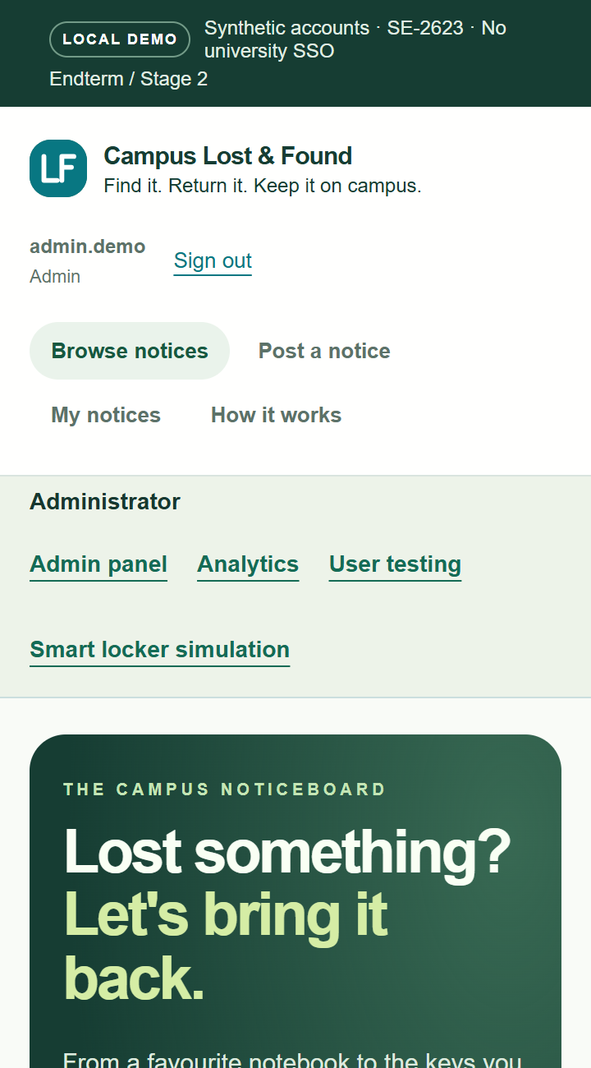
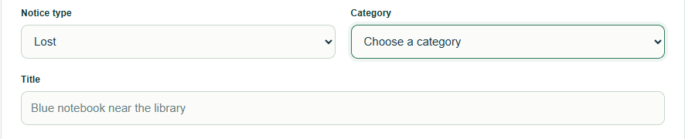
Works on a 360 px phone, by keyboard and after a drop
Daulet · 0:35
12 / 12 pages
no sideways scrolling at 360 × 760 px — student, admin, sign-in and locker pages
Keyboard
Tab follows the screen order to “Publish notice”; every field has a label; focus is visible
Offline → retry
network cut: a clear message, no double submit; reconnect: “Status refreshed”
Automated checks in Microsoft Edge on 8 Nov 2026 — not an accessibility audit with real assistive-technology users.
Notes:
SPEAKER: Daulet · about 0:35
N3 and N4 were only partly done at Stage 2, so we re-checked them in the browser.
At 360 pixels wide, none of the twelve pages we checked scrolls sideways. Tabbing through the post form follows the screen order, every field has a label, and the focus ring is visible.
For availability, we cut the network in the middle of the locker page: the page tells you the result could not be confirmed and never re-sends the form automatically. After reconnecting, Refresh status works again.
One honest limitation: on a phone the header and menus take most of the first screen. It works, but a collapsible menu would be better.
→ Transition: 'Now the smart extension — live.'
SOURCES: Evidence/browser_checks.json (N3_360px, N3_labels, N3_keyboard_post_form, N4_offline_retry); screenshots M01–M04, K01, S18.

Slide 10
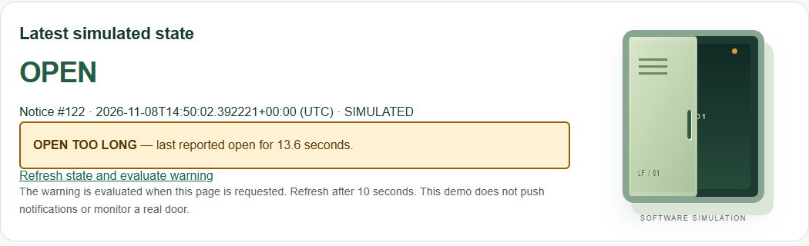
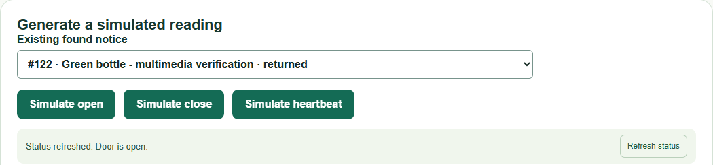
Live demo · a simulated locker warns when it is left open
Daulet · 0:55
LIVE DEMO
Simulate open
SOFTWARE SIMULATION
No sensor, no door, no network device. Every reading is stored as SIMULATED and a notice is never closed automatically — a person checks the locker.
Wait 10 s
Refresh status
OPEN TOO LONG
Simulate close
Buttons update the page in place (fetch with CSRF token, no reload). Physical version proposed: reed switch + Wi-Fi controller, HTTPS, device keys.
Notes:
SPEAKER: Daulet · about 0:55 · LIVE DEMO (admin private window, /admin/smart-locker)
SAY FIRST: 'This is a software simulation. There is no physical locker or sensor.'
1. Choose a Found notice in the list. Click Simulate open. SAY: 'The reading is saved in a separate telemetry database, labelled SIMULATED, without reloading the page.'
2. Keep talking for 10 seconds: 'In a real pilot, a reed switch and a Wi-Fi controller would send this event over HTTPS with a device key.'
3. Click Refresh status → OPEN TOO LONG appears. SAY: 'The warning is evaluated when the page is requested, after 10 seconds in the demo.'
4. Click Simulate close. SAY: 'The warning clears. The notice is never marked returned automatically — staff must still check who is collecting the item.'
IF IT FAILS: narrate the two screenshots on this slide; they show the same states from 8 Nov 2026.
→ Transition: 'To finish: what is still limited, and what we learned.'
FACTS: browser_checks.json locker_simulation — alert after 13.6 s, updated_without_page_reload = true, status 'Reading saved. Door is closed.'

Slide 11
What we would build next, and what we learned
Daulet · 0:40
LIMIT NOW
NEXT STEP
University sign-in not connected
Code is ready: IT registers the app, we set 3 variables and test a real sign-in
Lessons
Evidence beats claims — the requirement table separated “passes a test” from “a person used it”.
Cutting chat and matching kept the core flow stable; SSO is built but honestly marked “not connected”.
One upload commit hid our individual work — next time, one commit per feature.
Start testing with real users in week 7, not week 10.
One laptop, local HTTP
Host in a Kazakhstan data centre with HTTPS — personal data must stay in Kazakhstan
SQLite, one writer
PostgreSQL + object storage before 10,000 users
Free-text locations
A fixed list of campus places for cleaner analytics
Notes:
SPEAKER: Daulet · about 0:40
Four limits matter most. University sign-in: the OpenID Connect code is ready, but it needs an Entra app registration from university IT before anyone can really sign in. One laptop over local HTTP — the next step is hosting in a Kazakhstan data centre with HTTPS, because under Article 12 of the personal data law, personal data must be stored in a database located in Kazakhstan. SQLite allows one writer at a time — fine for a demo, not for ten thousand users. And free-text locations made our analytics split one place into two.
What we learned: evidence beats claims; cutting scope kept the core stable; our single upload commit hid who did what — next time, one commit per feature; and real users should come much earlier.
→ Transition: 'Thank you — we are ready for questions.'
SOURCES: report Section 9; Law RK No. 94-V Art. 12(2) (adilet.zan.kz, checked 8 Nov 2026); sqlite.org/whentouse.html.

Slide 12
Thank you
Questions — about any part of the system — are welcome.
Repository
github.com/zondbebox/SE-2623_Endterm · branch main · commit a7e5c74
Run it
Campus_Lost_Found\START.bat → http://127.0.0.1:5055
Demo accounts (synthetic)
student zhanzhol.demo@astanait.edu.kz · admin admin.demo@astanait.edu.kz · shared demo password in the README
Mengdigerey Zhanzhol
Galitskiy Daniil
Bisengaliev Daulet
Notes:
SPEAKER: Daulet (closing line) · about 0:10 · then all three take questions
'Thank you. We are happy to answer questions about any part of the system — each of us can explain all of it.'
Keep the browser open on the admin panel in the private window and the code editor on app.py in case the instructor asks for a live change.
Backup slides follow: B1 demo fallback, B2 personal data and Kazakhstan law, B3 10,000 users, B4 sources.

Slide 13
Backup · if the live demo fails, we keep going
Backup B1
Server stopped
Close the window, double-click START.bat again, sign in (30 s).
Port 5055 busy
Stop the old window with Ctrl+C, or run python\python.exe app.py --port 5056.
Laptop or browser fails
Narrate slides 4, 5 and 10 — every frame is a real capture of the final build.
Need motion
Local MP4 Video/SE-2623_Campus_Lost_Found_A4.mp4 (2:14) or youtu.be/76M3hSqR-7w — older interface, student flow only; say so.
Notes:
BACKUP — use only if the demo fails. Full fallback plan: Final/Demo/Demo_Plan_and_Backup.md. The A4 video shows the earlier white/teal interface without the admin panel, analytics or locker; tell the audience that before playing it.

Slide 14
Backup · where personal data lives, and why the law cares
Backup B2
Where it is now
Emails, password hashes and notices: data/campus.sqlite3. Photos: data/uploads/. Backups: backups/. All on the demo laptop’s disk, in Kazakhstan, not encrypted by the app. GitHub holds synthetic data only.
What the law says
Law RK No. 94-V “On Personal Data and Their Protection”: Art. 12(2) storage in a database located in Kazakhstan; Arts. 7–8 consent; Art. 22 protection; Art. 25(2)(8) breach notice within one working day (Russian text, as amended 14 Sep 2026).
If we went public
Kazakhstan data centre · HTTPS · university sign-in · consent text · retention period · incident procedure. We do not claim legal compliance.
Notes:
BACKUP for defense question 5. Source: adilet.zan.kz/rus/docs/Z1300000094 (checked 8 Nov 2026). The law does not name the ministry; the Ministry of AI and Digital Development publishes personal-data guidance (gov.kz/org/maidd). Interpretation only — not legal advice.

Slide 15
Backup · with 10,000 users, access fails first, then writes
Backup B3
1 · Reachability
Loopback only: nobody else can open the site
2 · Writes
SQLite = one writer; Waitress = 4 threads; uploads up to 6 MB queue
3 · Storage
Photos on one disk; in-memory rate limit resets on restart
4 · Identity
Local accounts cannot prove 10,000 real students
Plan: host in Kazakhstan with HTTPS → PostgreSQL → object storage for photos → several app instances behind a load balancer with a shared rate limiter → Entra sign-in → load-test before launch. Our 45 ms p95 is for 10 users on a laptop and does not predict 10,000.
Notes:
BACKUP for defense question 8. Source: report Section 9; sqlite.org/whentouse.html.

Slide 16
Backup · sources for the facts in this talk
Backup B4
Stage 1 report (9 Oct 2026) — survey n = 10, requirements F1–F8, N1–N4, SC1–SC3
Stage 2 report (1 Nov 2026) — Stage 2 statuses; SC1/SC2 recorded as Pending
Final/Evidence (8 Nov 2026) — test_suite_final.log, search_performance_final.json, sc3_final.json, stability_30min_final.json, browser_checks.json, account_checks.json, screenshots
Final/Testing — Final_Test_Protocol.md, final_test_results.csv, stage2_team_reported.csv
Law RK No. 94-V, adilet.zan.kz (checked 8 Nov 2026); Microsoft Learn — Entra app registration and OpenID Connect; SQLite — Appropriate uses; OWASP cheat sheets
Code: github.com/zondbebox/SE-2623_Endterm, commit a7e5c74 (only commit, uploaded from the zondbebox account)
Notes:
Full APA reference list: report Section 10.

