Slide 1
Taking a Website Live
Alex Loddengaard
(alexloddengaard@gmail.com)
(http://www.alexloddengaard.com)

Slide 2
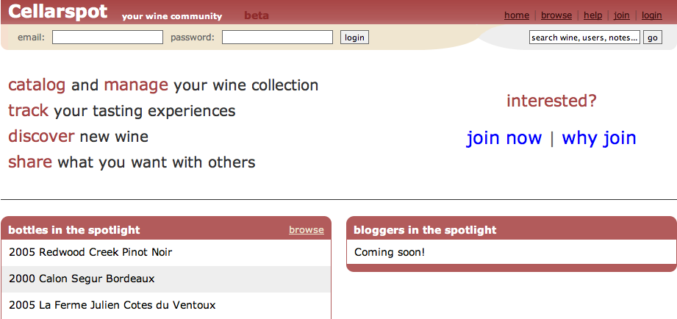
About Me
Previously a CSE 143/190L TA
Product Manager at Redfin
Created www.cellarspot.com
  Social network for wine connoisseurs

Slide 3
What is Cellarspot?
Social network for wine connoisseurs
  Taste notes, collections, friends, etc
Rewrote the whole site 3 times in a year
  In PHP at first, then two rewrites in JSP (Java)
Was my first money-making website
Was in your shoes when I started
Got the idea from my Dad; I don’t like wine

Slide 4
Enough about Me
Let’s talk about you …

Slide 5
What’s after 190m?
Webster is shutting down at end of quarter
Where will you continue to tinker?
  Use your UW student space
    http://www.washington.edu/computing/web/publishing/students.html
  Install MySQL on Dante
    http://www.washington.edu/computing/web/publishing/mysql-install.html
  Visit http://students.washington.edu/youruwnetid
  Or setup PHP, Apache, MySQL on your PC

Slide 6
What if you want more?
What if you want your own .com name?
What if you want to make some money?
What if you want to take web development to the next level?

Slide 7
The Truth
The gap between a legitimate website and a personal project is small - this is the beauty of the web
All of you are capable of making something that people will use
Examples:
  Cellarspot.com
  Facebook.com
  Rememberthemilk.com
  Craigslist.org
  Mobaganda.com
All websites that started off simple

Slide 8
The Next Level is Hosting
Buy a domain name
  Example: martystepp.com
Buy web space from a hosting company
  They provide you with PHP, MySQL, etc
You can buy a domain name and web space from the same company
Good companies:
  Dreamhost.com (Marty’s recommendation)
  Godaddy.com
  Westhost.com
  Wingsix.com

Slide 9
Hosting Gotchas
Make sure that your host provides the services you need
  Some hosts only provide PHP + MySQL
  Some only provide Ruby on Rails, etc
One-stop shops are convenient
  Buy the domain and web space from the same company
  Dreamhost is awesome

Slide 10
OK, you’re live
Refine your website

Slide 11
Research
First step to refinement is research
  Research will tell you more about the problem you’re solving
  Understand your users
  Understand use cases
Research by interviewing, surveying, etc
In my opinion, Cellarspot was solving a fake problem
  I didn’t research enough
  I didn’t know enough about wine connoisseurs
Research increases the likeliness of your website being used
It’s more fun when your website is used :)

Slide 12
Cellarspot Focuses
Original focus was on functionality
  “Let’s make a website with awesome functionality; the look is less important.”
Original focus was bad
  We should have focused on a core feature set with an attractive and grabbing look
  Wine connoisseurs need attractive websites
  Had I done research upfront I would have known this earlier

Slide 13

Privacy
Be upfront with your user
  Specify your privacy policy in a “Terms” page
  Facebook’s “Terms” page is ~8 pages
  Twitter had a big problem with this recently
Bonus screenshot from Facebook:

Slide 14
You got a good idea
Track and evaluate your website

Slide 15
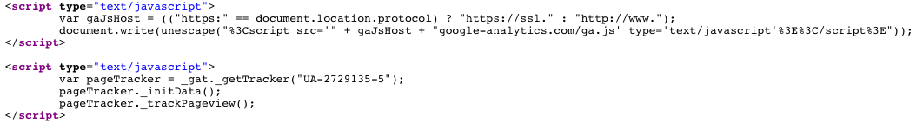
Have you looked at the 190m source?
What’s this?
Turns out Marty knows more about you than you think … he’s got Google Analytics

Slide 16
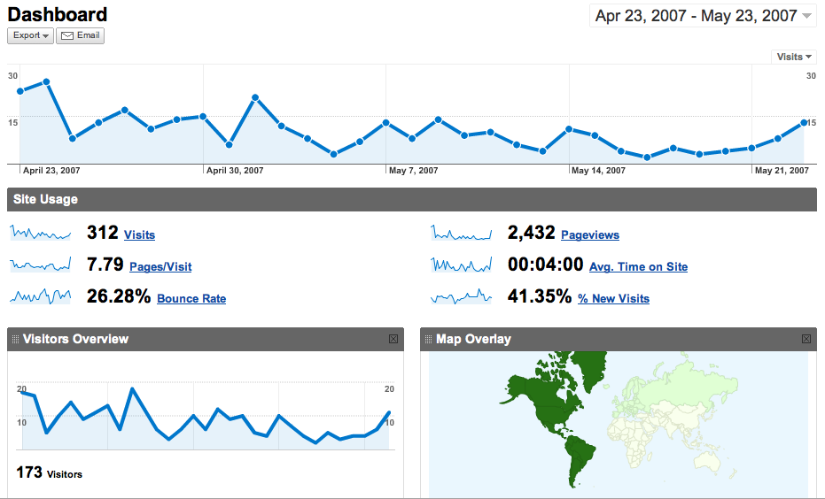
Google Analytics (GA)
Sign up here: http://www.google.com/analytics
Then just install the JavaScript they give you
GA gives you insane statistics about your site

Slide 17
Revenue Models
Make some money

Slide 18

Advertisements on Your Site
Google AdSense
  Automatically displays relevant ads
  Paid per click (usually ~$.10-3.00)
  Customizable look and feel
  Any fool with a website can install these!
  Just sign up and install the JavaScript
  www.google.com/adsense

Slide 19
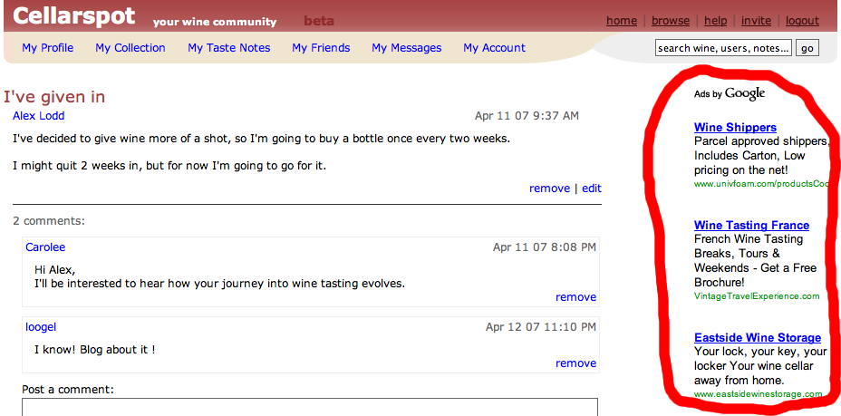
Cellarspot AdSense Example

Slide 20
Referrals
Website owner gets commission from referred sale
  Many e-commerce sites offer this
  Amazon.com, Bestbuy.com, etc
  Commission ranges between 5-10%
  Look for “Join Associates” on Amazon.com

Slide 21
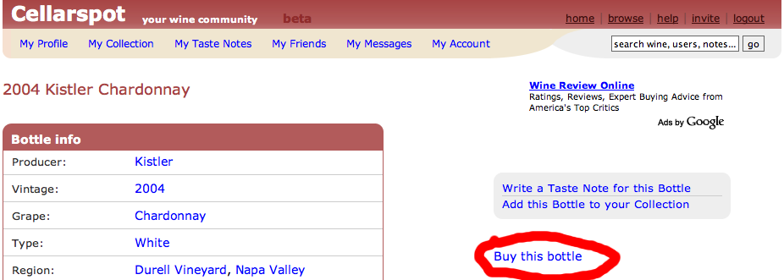
Cellarspot Referral Example

Slide 22
E-Marketing
Market your site and get users onboard

Slide 23
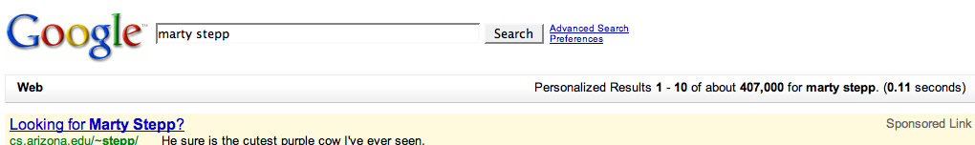
Google AdWords
You can produce ads that show up as Google AdSense ads on relevant websites
Keywords can be purchased that make you the “sponsored link” on the Google search page
Cost per Click (CPC ~$.10-3.00)
http://adwords.google.com

Slide 24
Remember those stupid <meta> tags?
No one really uses those, right?
Let’s learn about SEO …

Slide 25
But first
If you were Google, how would you determine if one website was better than another?
Do you determine the most popular person by what they say about themselves?

Slide 26
Search Engine Optimization (SEO)
The way your site performs in search engines
Learn more here:
  http://en.wikipedia.org/wiki/PageRank
  http://en.wikipedia.org/wiki/Nofollow
  http://en.wikipedia.org/wiki/Search_engine_optimization
Include the appropriate <meta> tags
  Description, keywords, etc
Use a descriptive <title>
  Look at Amazon’s title -- it’s huge

Slide 27
SEO (cont.)
See each search engine’s recommendations
  Yes, they specify them
  http://www.google.com/support/webmasters/
Most important:
  Get people to link to you
  Get bloggers to blog about you
    Google likes bloggers

Slide 28
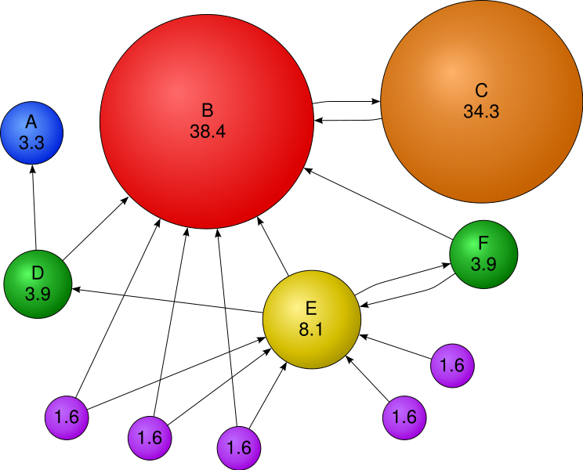
Google PageRank
Bubbles are websites, arrows are links

Slide 29
SEO (cont.)
Typically your website will be keyworded based on the anchor text of incoming links
  Also keyworded by <title>, <meta> and content
Footer of Trulia.com:
Notes:
_x0010_

Slide 30
Google Bombs
Before Google got smart, they keyworded mostly by anchor text
Bloggers linked to whitehouse.gov/president with anchor text “miserable failure”
Googleing “miserable failure” showed whitehouse.gov/president as the first link
Google has since fixed this
http://en.wikipedia.org/wiki/Google_bomb

Slide 31
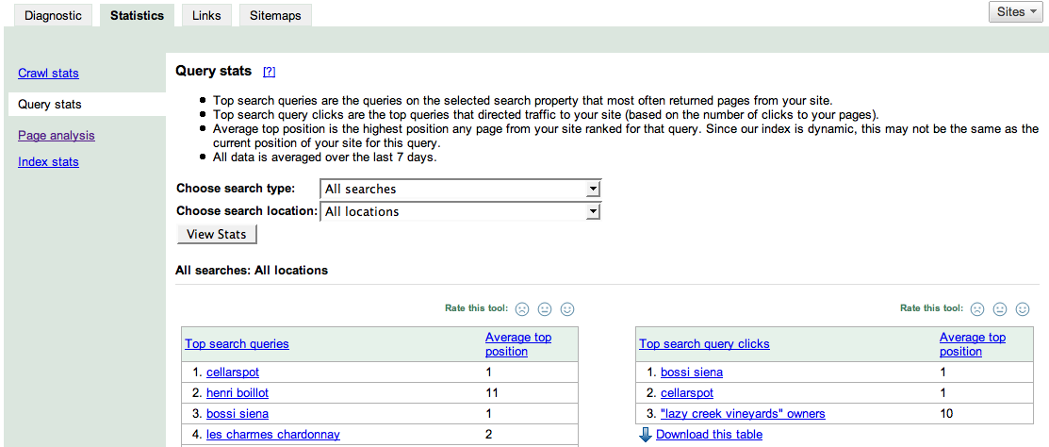
A Useful SEO tool
Google Webmaster Tools
  http://www.google.com/webmasters
  Useful information about your site in Google’s search engine

Slide 32
Conclusion
Making your own site is an indefinite success
Cellarspot …
  Didn’t make much money
  Was used in every single one of my interviews at Google, Redfin, etc
  Is prominently on my resume
  Was a great experience
  Was insanely exciting!

Slide 33
Questions?
Cellarspot?
General web development?
Jobs?
Etc?

Slide 34
Overflow

Slide 35
Cellarspot in Academics
Pursued in 4 different classes (15 credits)
  CSE 403 - Software Engineering (4 credits)
    CSE majors only
    Opportunity to work on a large project
    Absolutely recommended (esp. with Marty)
  ENTRE 475/476 - Planning a Business
    4 credits each
    Contact John Castle (castlej@u) if interested
    Absolutely recommended
  CSE 490H - Distributed Systems (3 credits)
    CSE majors only

Slide 36
Legal Info
Don’t get shutdown or sued

Slide 37
Intellectual Property
Copyright ©
  Establishes ownership of content
  Images, reviews, etc
Trademark ™
  Establishes exclusive usage of a logo, name, or phrase
Patent
  Establishes ownership and exclusive usage of a product, algorithm, etc
  Very complicated

Slide 38
Copyright
Don’t violate it
Don’t use someone else’s
  Images
  Code snippets
    Unless the license agreement says you can
  Any other data on any website
Copyrights don’t need to be specified
  They are implicit

Slide 39
Protect Yourself
As an individual running a website, your private assets are not protected
Protect your private assets by either
  Registering a Limited Liability Company
  Becoming incorporated
Dependent on the state you operate in
  http://www.secstate.wa.gov/corps/
This probably isn’t necessary unless you’re doing something that might be borderline illegal

Slide 40
Software Development
Make good code decisions
  Will make improving / fixing your code MUCH easier
  Try to build a team of developers, because multiple heads are better than one
Take CSE 403

