Slide 1
AIDFL: An Information Theory-Based Anomaly Detector in Decentralized Federated Learning
MSc Thesis – Midterm Presentation
Xiao Chen
21-742-820
Supervisors:
Chao Feng, Dr. Alberto Huertas Celdran

Slide 2
Table of Contents
Introduction
Design
Implementation
Evaluation
Summary

Slide 3

Introduction
Situations
Leakage of sensitive information
Violation of privacy
Federated Learning (FL)
a privacy-preserving distributed ML framework
train local models on their own devices
send updates to a central server without sharing data

Slide 4
Background
Federated Learning / Decentralized Federated Learning
Poisoning Attacks
Information Theory

Slide 5
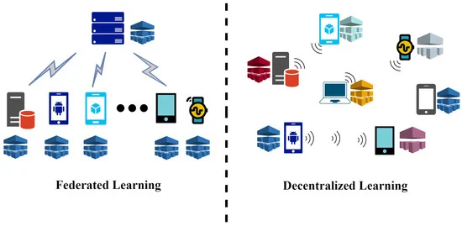
Decentralized Federated Learning (DFL)
Central server
Federated Learning (FL):
Local training on edge devices
Decentralized FL:
Eliminate traditional client-server architecture of FL
Solution to data heterogeneity
Improvement:
Reducing overload
Enhancing transmission speed
P2P network

Slide 6
Decentralized Federated Learning (DFL) - Approaches
Key characteristics | Definition
Scalability | Resilience to node and new participants join failures
Communication architecture | P2P networks capacities
Data distribution handling | Methods to tackle non-IID data
Privacy & security measures | Blockchain integration or secure aggregation protocols

Slide 7
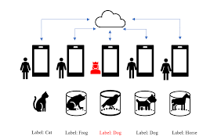
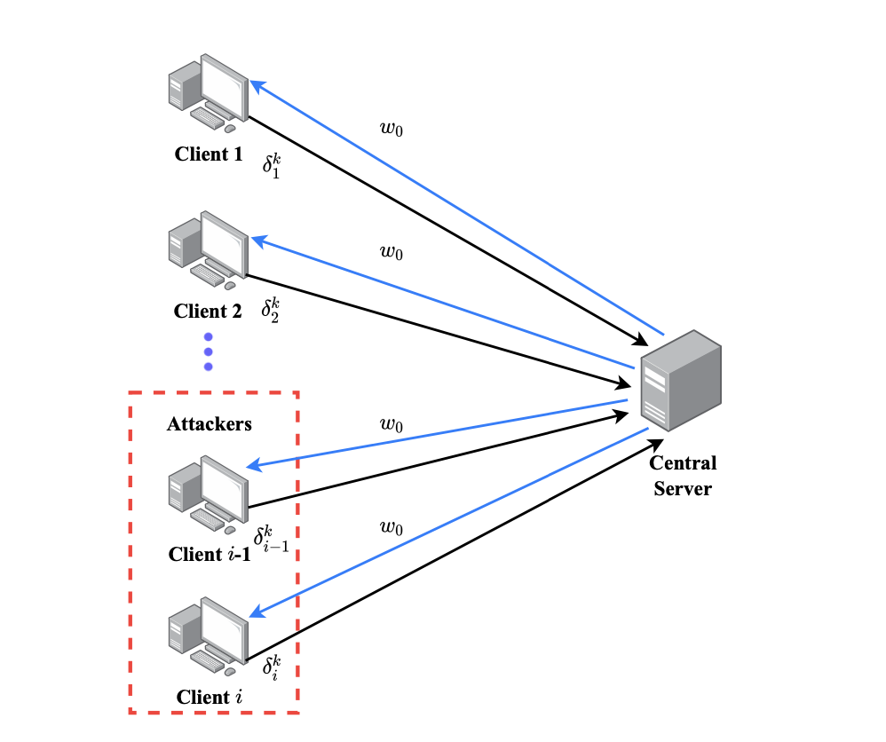
Poisoning Attacks
By target areas:
Data poisoning attacks
Label-flipping attacks: label birds as “Dog”
Poisoning samples attacks: alter the data features
Difference: labels vs. features
Model poisoning attacks
Optimization methods: maximize the impact, minimize difference
Random weights generation: assigning randomly created weights
to crafted data
By target objectives: untargeted vs. targeted (backdoor)

Slide 8
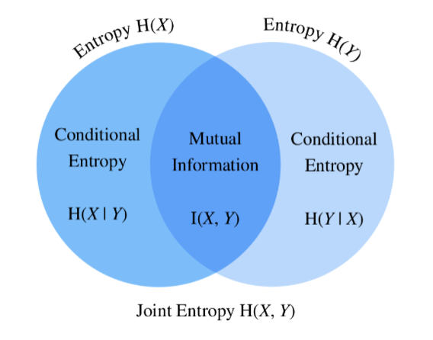
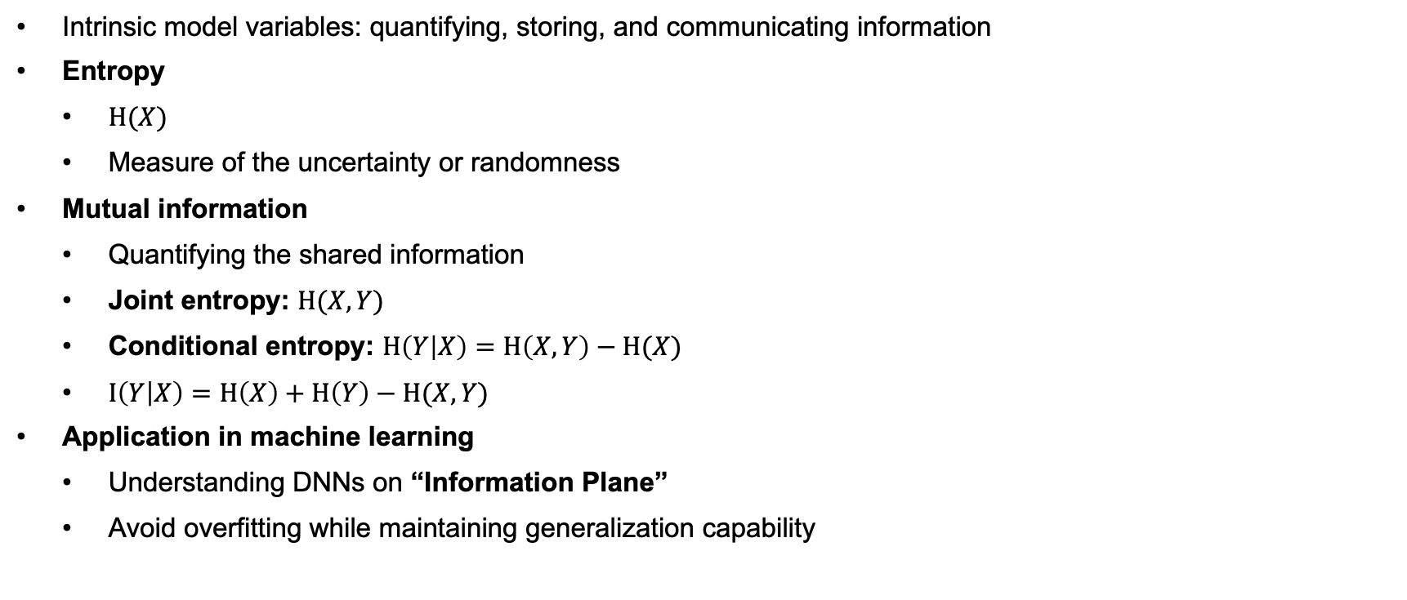
Information Theory
Intrinsic model variables: quantifying, storing, and communicating information
Entropy
$H(X)$
Measure of the uncertainty or randomness
Mutual information
Quantifying the shared information
Joint entropy: $H(X,Y)$
Conditional entropy: $H\left(Y | X\right)=H\left(X,Y\right)−H(X)$
$I\left(Y | X\right)=H\left(X\right)+H\left(Y\right)−H(X,Y)$
Application in machine learning
Understanding DNNs on “Information Plane”
Avoid overfitting while maintaining generalization capability

Slide 9
Related Work
Existing defense mechanisms
Robust Aggregation
Anomaly Detection
Baseline Defenses:
VFedAD
Sageflow

Slide 10
Related Work – Defense Overview
 | Definition | DFL Examples | Approaches
Robust Aggregation | Mitigate the impact of poisoning attacks | TrimmedMean Krum | Euclidean distance
Anomaly Detection | Identify and eliminate these abnormal updates | (FL) FLDetector Sniper | FL: gradient-based anomaly scoring, quasi-newton

Slide 11
Motivation
Current: exogenous factors
Misidentification of outliers
Develop an endogenous and data-independent defense mechanism under non-IID
Information theory – endogenous

Slide 12
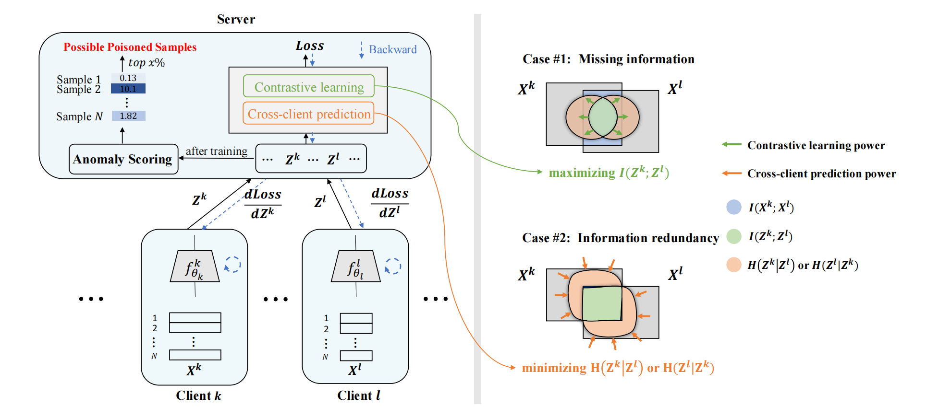
Related Work – Baseline Defenses
VFedAD (Vertical Federated Anomaly Detection)
Capture semantic information
Maximize the mutual information
Minimize the conditional entropy
Anomaly scoring measurement
Neighbor consistency score (SNC)
Client consistency score (SCC)
S = SNC + SCC
Limitation：
VFL structure: representations of clients are uploaded to central server

Slide 13
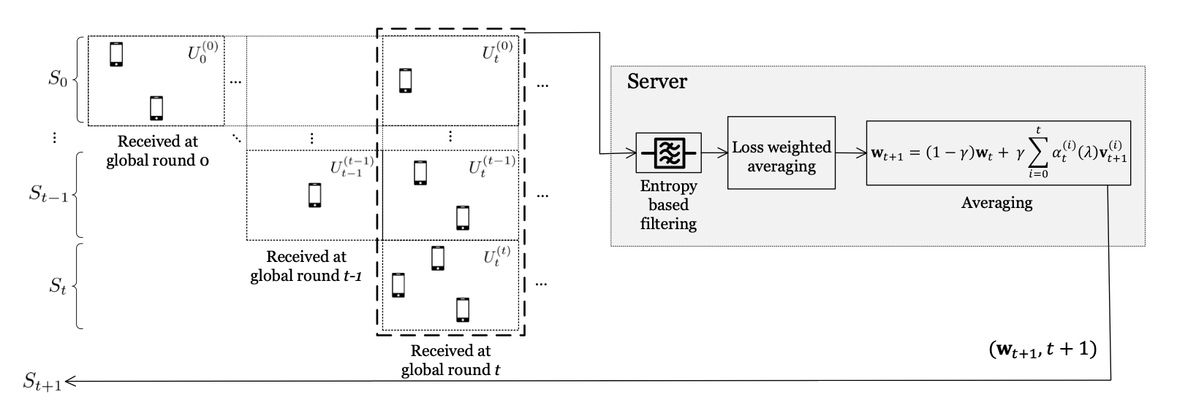
Related Work – Baseline Defense
Sageflow
Updates are categorized into different sets depending on when they are received
Entropy-based filtering
Loss-weighted averaging
Limitations:
Filter out outliers
The behavior of categorizing
updates depends on the
structure of the FL

Slide 14
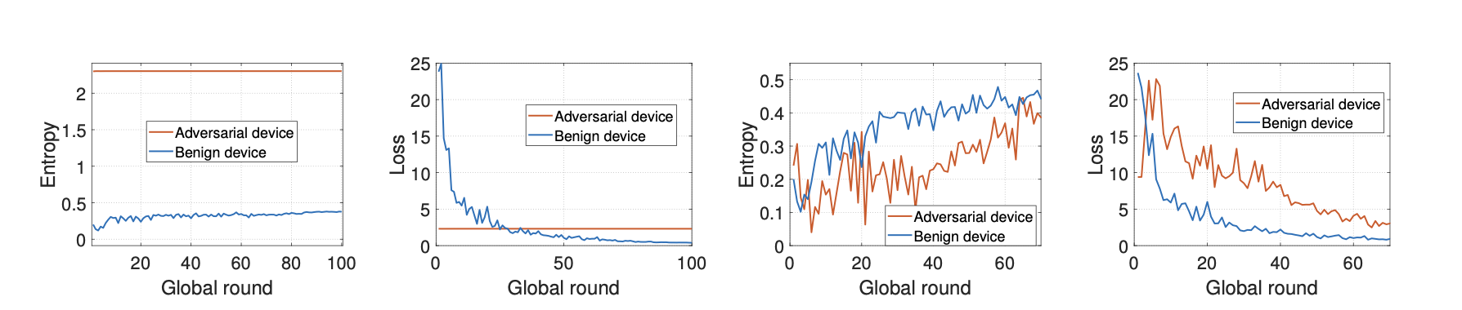
Related Work – Baseline Defense
Model poisoning attacks Data poisoning attacks

Slide 15
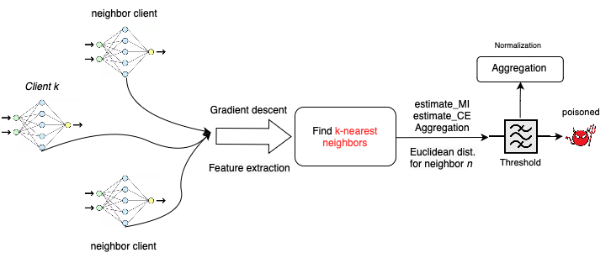
Current Design – AIDFL
Basic ideas:
An anomaly detector by scoring the abnormal values and eliminate them
Maximize mutual information
Minimize conditional entropy
Extension (novel):
Trying to capture more semantic information in DFL settings based on VFedAD

Slide 16
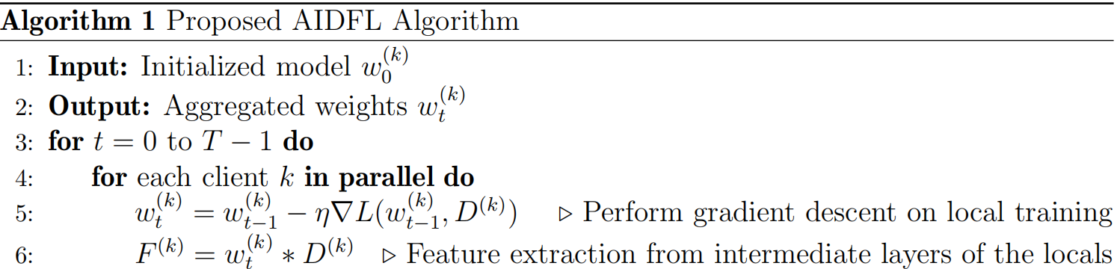
Current Design
Perform gradient descent on local data to update weights
Extract features from local data using intermediate layer of the local model

Slide 17
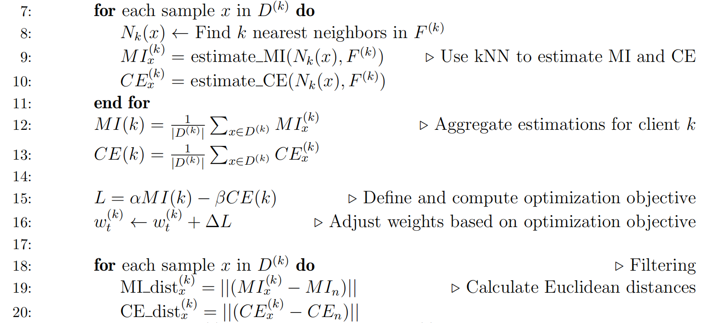
Current Design
Find the k-nearest neighbors of x
Estimate MI: distributional differences
Estimate CE: uncertainty in the conditional distribution
Aggregate MI & CE on each client across all samples
Define optimization objective
Maximize MI
Minimize CE
MI distances: determine whether a sample is anomaly

Slide 18
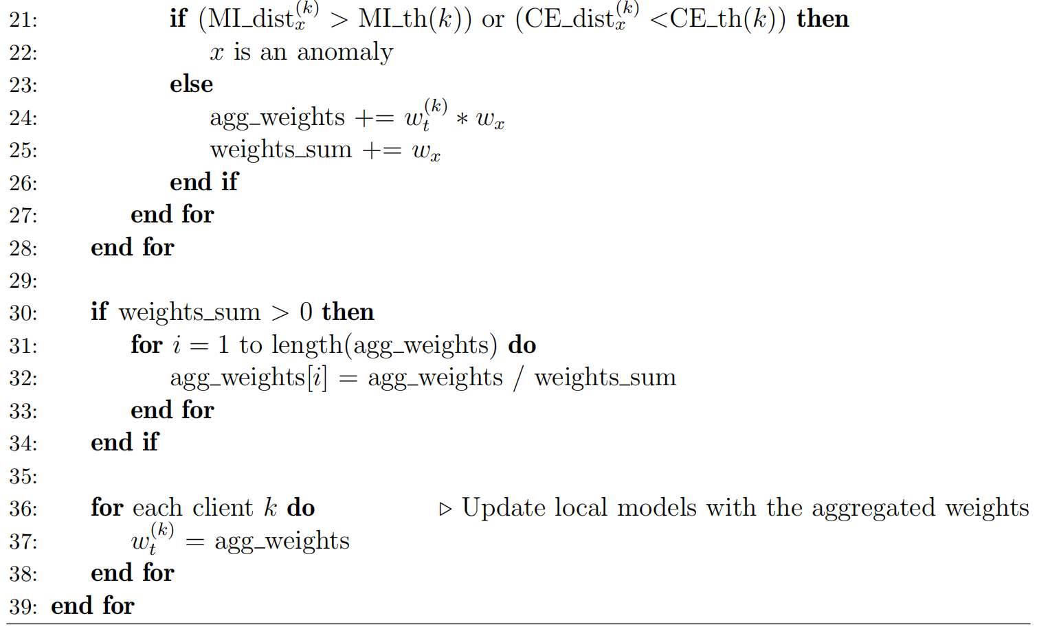
Current Design
Setting a threshold for MI and CE respectively
Distances outside the threshold will be
treated as anomalies
Aggregation: non-anomalous
Normalization:
By sum of the weights if > 0
Ensure the aggregated update is properly scaled

Slide 19
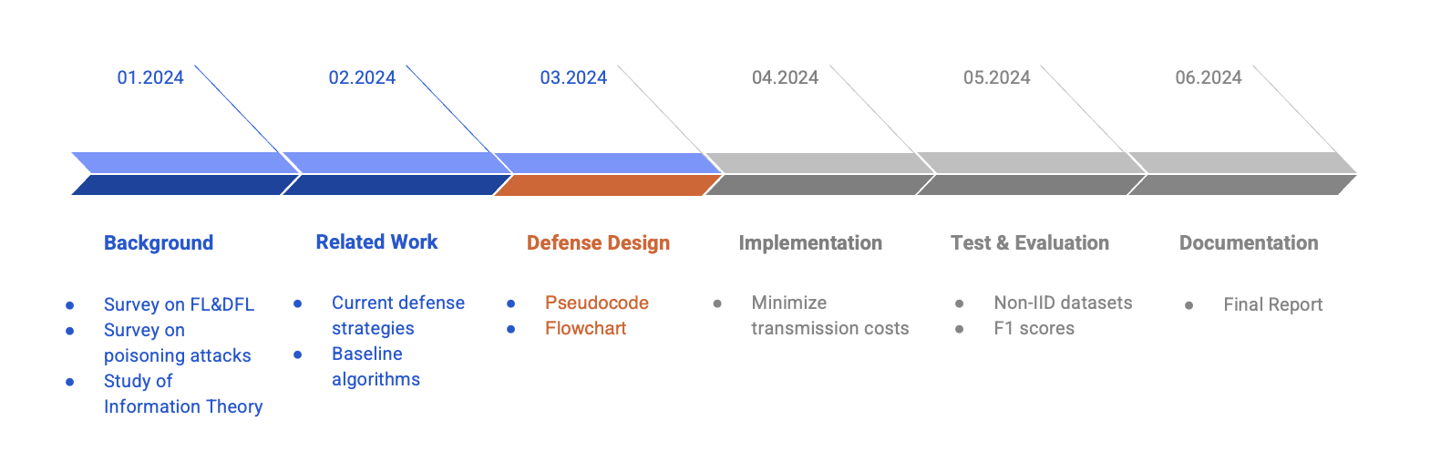
Future Work

Slide 20
Thank you!
Q&A

