Slide 1




CHOCO SURVIVOR
BY CHOCO LATTE
START
TEAM MEMBERS:
Law Zong Han
Muhammad Nur Fadzly Bin Zulkifli
Dalton Koh

Slide 2

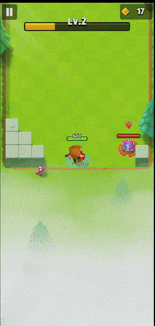
INSPIRATION

Slide 3


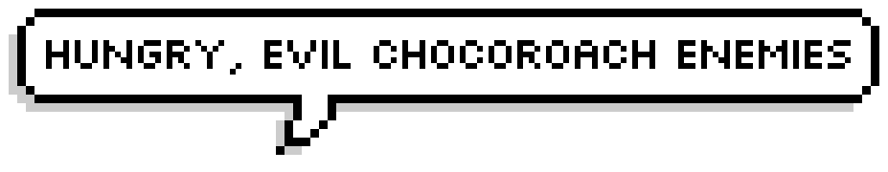
THEME

Slide 4
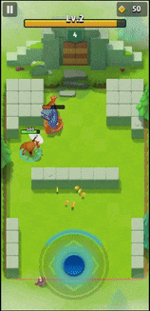

PRODUCT VISION
Simple Roguelike Shooter
Stackable Player Enhancements
Play
Die
Kill & Defend
Progress & Power Up

Slide 5
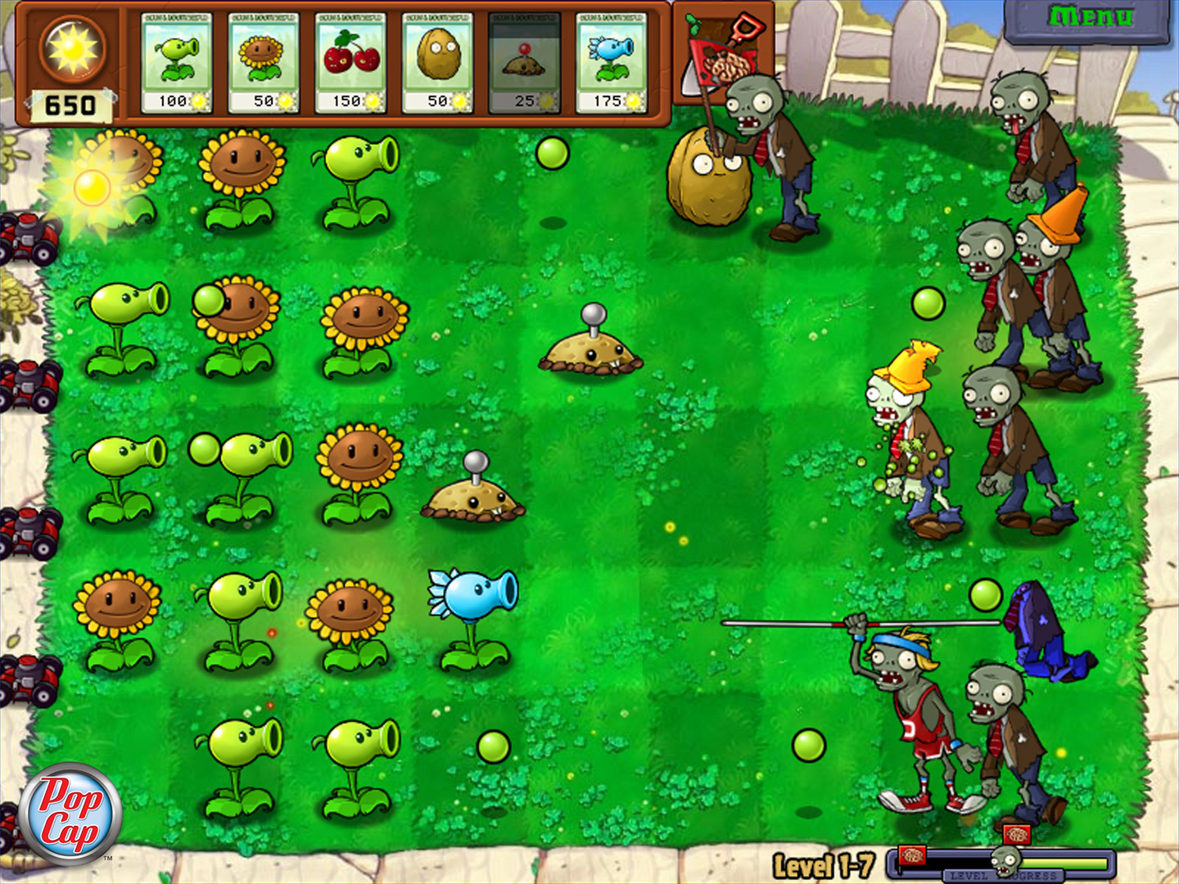


UNIQUE SELLING POINT
DEFEND YOUR CHOCOLATE!
PLANTS VS. ZOMBIES

Slide 6



UNIQUE SELLING POINT
DEFEND & SURVIVE
Build Barricades
Deploy Allies
Keep Chocoroaches Away!

Slide 7
GAME MECHANICS
LOSE CONDITIONS
GAME OVER!
Player

Slide 8
GAME MECHANICS
WIN CONDITIONS
Next Wave Incoming!
Double bullet
Player
Buff Meter

Slide 9



GAME MECHANICS
ENEMY BOSS
3rd Boss
3 waves
3 waves
2nd Boss
3 waves
1st Boss
Unique attack patterns
Special drops

Slide 10



GAME MECHANICS
SHOP MENU – PLAYER
In-game Currencies
Press B to buy
Shop Items
Upgrades
Health
01/10
Attack
01/10
Fire Rate
01/10
Speed
01/10
Level up
Level up
Level up
Level up
Notes:
Shop to purchase - active, passive buffs, NPCs and barriers.
Barrier – type of buff (higher level = stronger barrier and more quantity).
Passive buffs – health up, damage up, fire rate up.
Active buffs – Makeshift Foil, Foil Repair, Adhesive Shots, Smart Pistol, Spiked Foil.
NPCs – variants of different NPCs, stronger ones require more currency.

Slide 11
GAME MECHANICS
SHOP MENU – DEFENSE
In-game Currencies
Press B to buy
Shop Items
Defense
Choco bar
01/10
Barrier
01/10
Allies
01/10
Level up
Level up
Level up
Notes:
Shop to purchase - active, passive buffs, NPCs and barriers.
Barrier – type of buff (higher level = stronger barrier and more quantity).
Passive buffs – health up, damage up, fire rate up.
Active buffs – Makeshift Foil, Foil Repair, Adhesive Shots, Smart Pistol, Spiked Foil.
NPCs – variants of different NPCs, stronger ones require more currency.

Slide 12

GAME MECHANICS
BARRICADES
Press Q to build barricade
Notes:
Player presses the key to quick-build a barricade, use cursor to guide the game where to build
Slight delay when left click is registered, represented by the falling animation
Once down, the barricade can withstand numerous hits from enemies (health and damage based)
After taking hits more than it can withstand, it will break, allowing enemies through

Slide 13
FEASIBILITY
DELIVERY PLAN
Week | Goal | Time (hrs)
8 | Main menu, Map Boundaries, Collision, Player & enemy movement, Pitch Presentation, Plan Review. | 24
9 | Horizontal panning camera view, health and damage system, level backgrounds, buff meter and slots | 24
10 | Enemy attacking logic and drops, boss mechanics. Supporting allies, barricades | 24
11 | Different shot mechanics (buffs), shop and pause menu overlays, user interface and refining sprites. | 24
12 | Damage effect, credits, icons and design, music, SFX, backgrounds, Playtesting. | 24
13 | Cleaning up code, bug fixing and submission prep. | 24

Slide 14
FEASIBILITY
RISKS IDENTIFIED & MITIGATIONS
RISKS
MITIGATIONS
Horizontal panning camera view
Static camera view
A* Pathfinding algorithm
Focus on simpler code so enemy will move to nearby target, destroying obstacles in its way
Different attack types
Focus on one attack type and damage
Notes:
Risk: A star pathfinding algorithm
Mitigations: Enemy does not detour and moving towards direction of player or defense target, destroying every barriers that blocks the way.
Risk: Boss Attack Mechanism
Mitigations: Increase the stats of boss and only focus on melee attack.

Slide 15
FEASIBILITY
RISKS IDENTIFIED & MITIGATIONS CONT’D
RISKS
MITIGATIONS
Varying level layouts
Increase enemies’ stat values and count per level
Unique boss attack patterns
Increase subsequent boss’ stat values
Notes:
Risk: A star pathfinding algorithm
Mitigations: Enemy does not detour and moving towards direction of player or defense target, destroying every barriers that blocks the way.
Risk: Boss Attack Mechanism
Mitigations: Increase the stats of boss and only focus on melee attack.

Slide 16

THANK YOU
QUIT

