Slide 1

Cost function
Neural Networks: Learning
Machine Learning

Slide 2







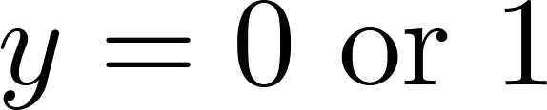
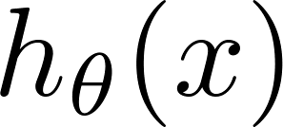
Training data 训练集
Neural Network (Classification)
total no. of layers in network
L=4
no. of units (not counting bias unit) in layer
eg.s1=3, s2=5…
Layer 1
Layer 2
Layer 3
Layer 4
Binary classification
1 output unit
Multi-class classification (K classes)
K output units
E.g. , , ,
pedestrian car motorcycle truck

Slide 3
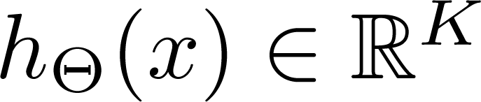
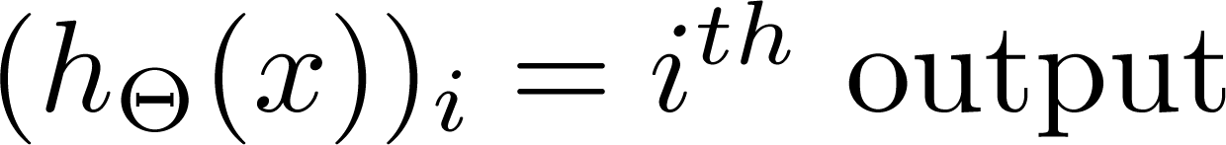
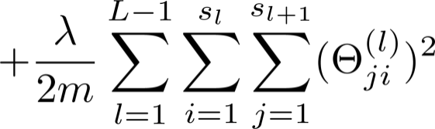
Cost function in neuron network
Logistic regression:
Neural network:
二分类
多
分
类
正则项从1开始，不考虑偏置项的正则。

Slide 4
Backpropagation algorithm
Neural Networks: Learning
目的:使得代价函数最小

Slide 5
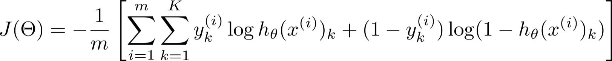
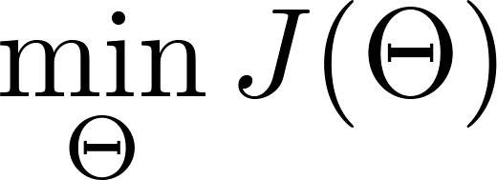
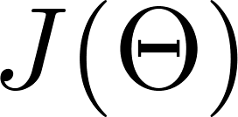
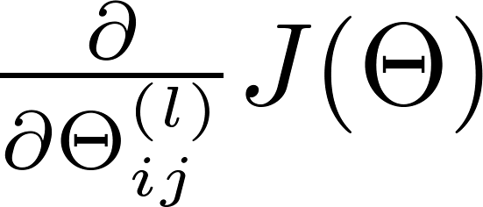
Gradient computation
Need code to compute:

Slide 6


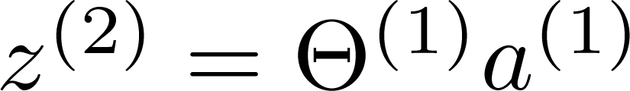
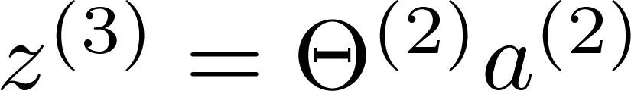
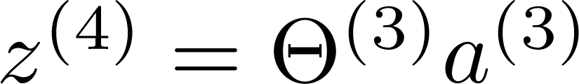
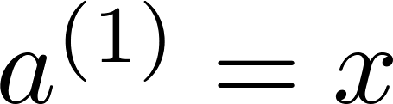
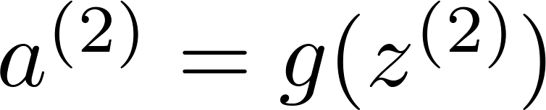
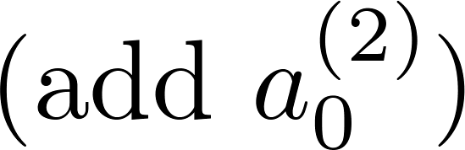
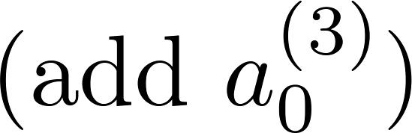
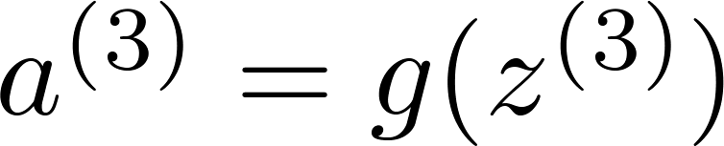
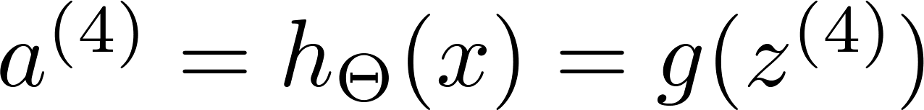
Gradient computation
Given one training example ( , ):
Forward propagation前向算法:
Layer 1
Layer 2
Layer 3
Layer 4

Slide 7
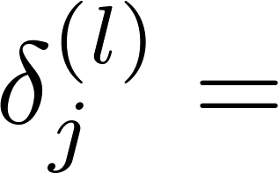

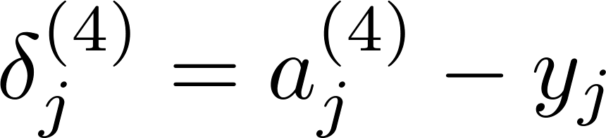
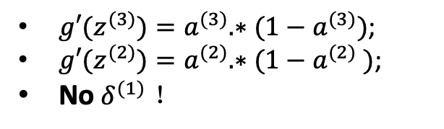


Gradient computation: Backpropagation algorithm
Intuition: “error” of node in layer .
For each output unit (layer L = 4)
$${(h_{θ}(x))}_{j}$$
写成向量的形式：
Layer 1
Layer 2
Layer 3
Layer 4
$$δ^{(4)}=a^{(4)}−y$$
${g′(z}^{(3)})=a^{(3)}.∗(1−a^{(3)})$;
${g′(z}^{(2)})=a^{(2)}.∗(1−a^{(2)}$ $)$;
No $δ^{(1)}$ ！

Slide 8
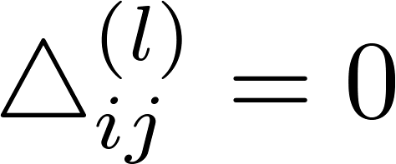


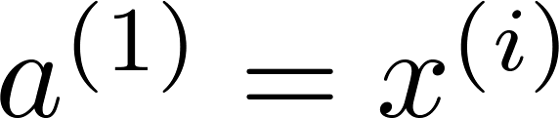

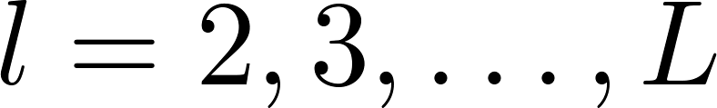

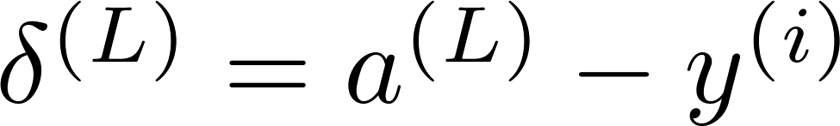
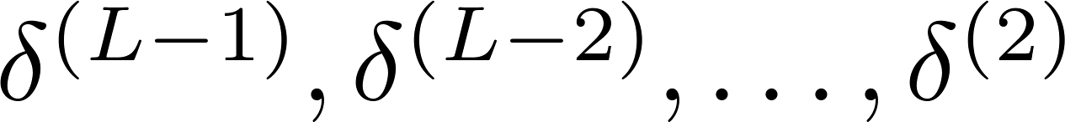
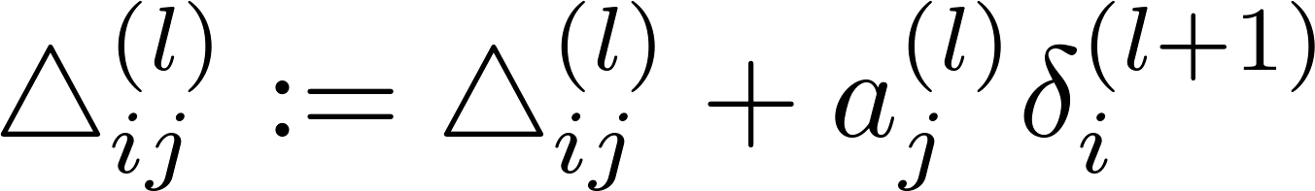
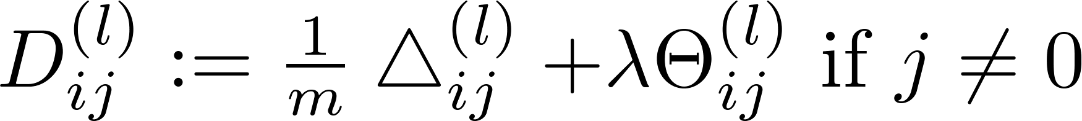
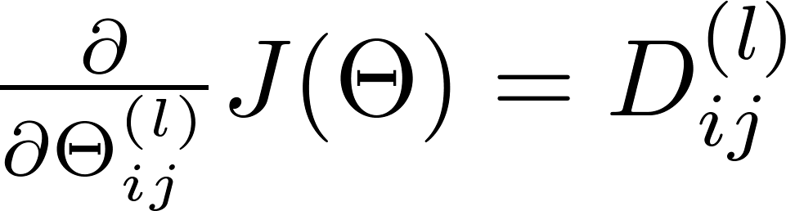
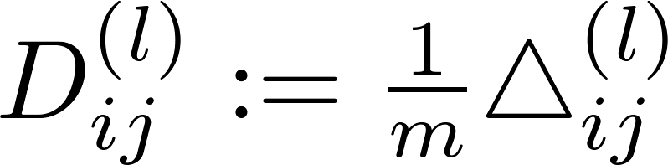

Backpropagation algorithm
Training set
Set (for all ).
(Used to compute )
For
Set
Perform forward propagation to compute for
Using , compute
Compute

Slide 9
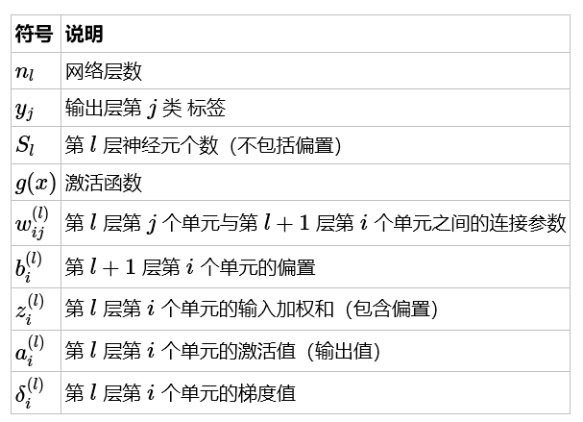
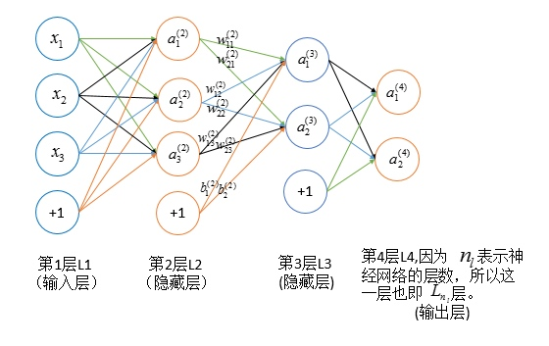
反向传播公式推导
神经网络中权重 的改变将影响到接下来的网络层,直到输出层,最终影响损失函数。

Slide 10
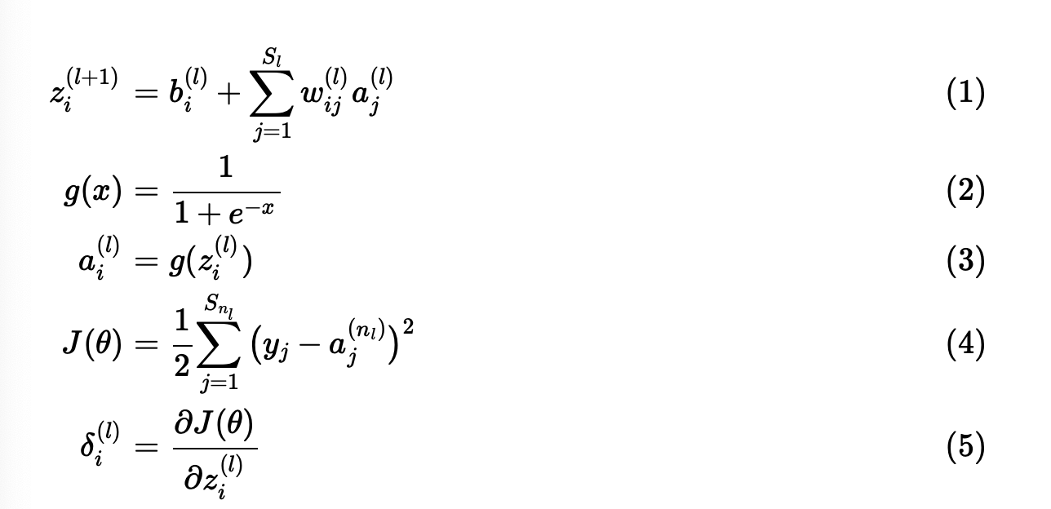
基本公式

Slide 11
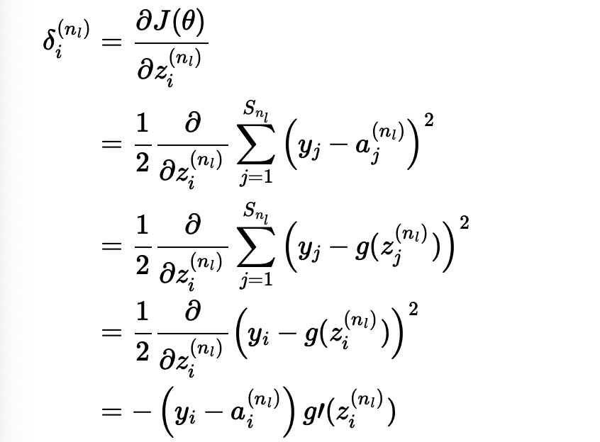
梯度反向传播公式推导
初始条件

Slide 12
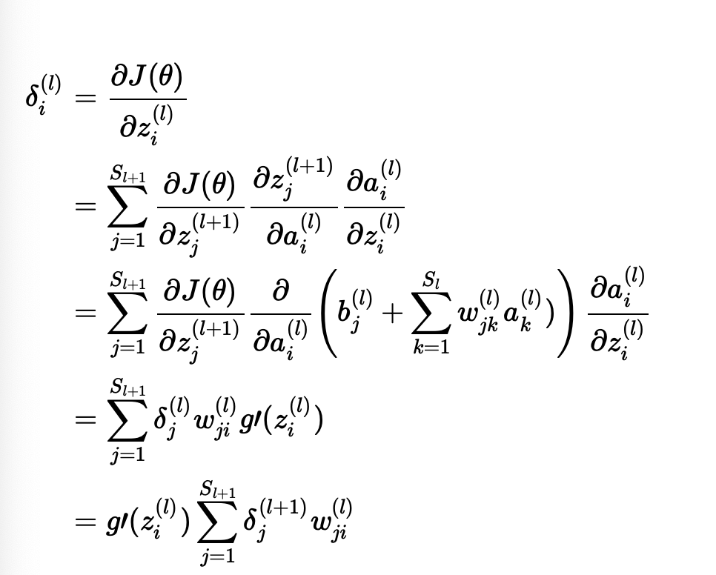
递推公式

Slide 13
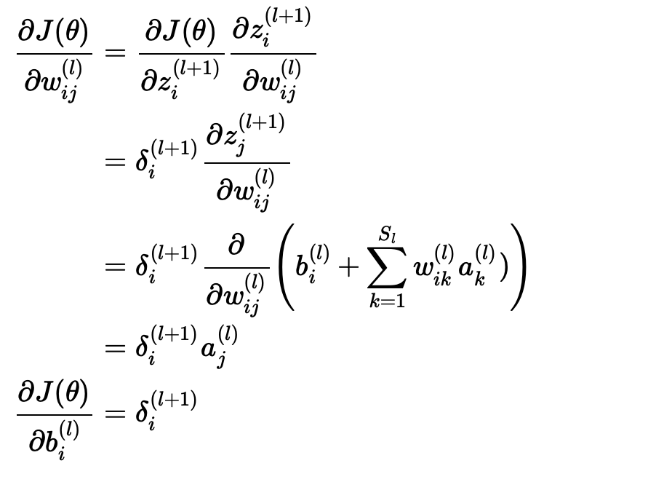
损失函数关于权重和偏置的导数

Slide 14
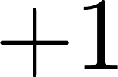


Forward Propagation

Slide 15











Forward Propagation
$$Θ_{10}^{(2)}$$
$$Θ_{11}^{(2)}$$
$$z_{1}^{(2)}→a_{1}^{(2)}$$
$$z_{1}^{(3)}→a_{1}^{(3)}$$
$$z_{1}^{(4)}→a_{1}^{(4)}$$
$$Θ_{12}^{(2)}$$
$$z_{2}^{(2)}→a_{2}^{(2)}$$
$$z_{2}^{(3)}→a_{2}^{(3)}$$
$${(x}^{(i)},y^{(i)})$$
$z_{1}^{(3)}=Θ_{10}^{(2)}+Θ_{11}^{(2)}$ $a_{1}^{(2)}+Θ_{12}^{(2)} a_{2}^{(2)}$
$${a_{1}^{(3)}=g(z}_{1}^{(3)})$$

Slide 16
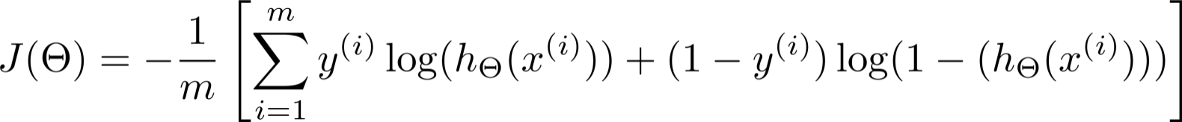
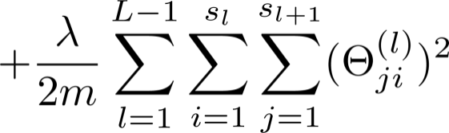


What is backpropagation doing?
Focusing on a single example , , the case of 1 output unit, and ignoring regularization ( ),
(Think of )
I.e. how well is the network doing on example i?

Slide 17







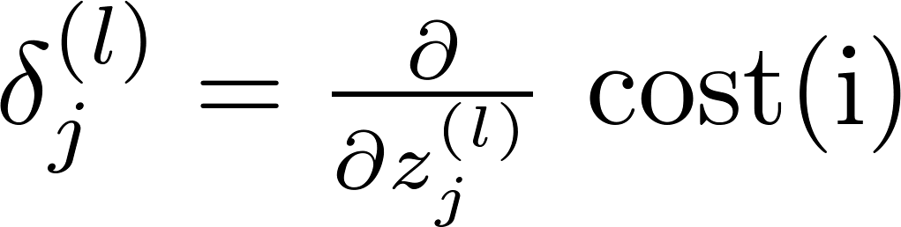












Forward Propagation
$$δ_{1}^{(4)}=y^{(i)}−a_{1}^{(4)}$$
$$δ_{0}^{(3)}=0$$
$$δ_{2}^{(2)}=δ_{1}^{(3)}Θ_{12}^{(2)}+δ_{3}^{(3)}Θ_{22}^{(2)}$$
$$δ_{1}^{(2)}$$
$$δ_{1}^{(3)}$$
$$δ_{1}^{(4)}$$
$$Θ_{12}^{(2)}$$
$$δ_{2}^{(3)}=δ_{1}^{(4)}Θ_{12}^{(3)}$$
$$δ_{2}^{(2)}$$
$$Θ_{22}^{(2)}$$
$$δ_{2}^{(3)}$$
“error” of cost for (unit in layer ).
Formally, (for ), where

Slide 18
Implementation note: Unrolling parameters
Neural Networks: Learning
Machine Learning

Slide 19
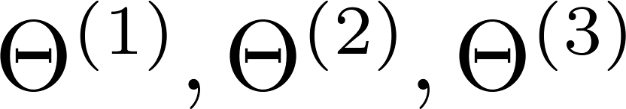
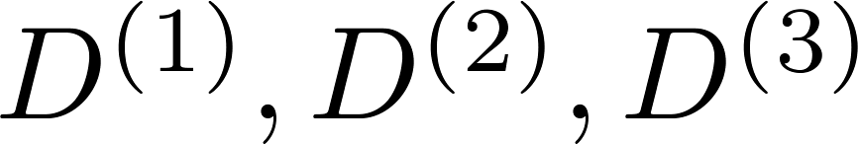

Advanced optimization
function [jVal, gradient] = costFunction(theta)
optTheta = fminunc(@costFunction, initialTheta, options)
…
Neural Network (L=4):
- matrices (Theta1, Theta2, Theta3)
- matrices (D1, D2, D3)
“Unroll” into vectors

Slide 20

Example
thetaVec = [ Theta1(:); Theta2(:); Theta3(:)];
DVec = [D1(:); D2(:); D3(:)];
Theta1 = reshape(thetaVec(1:110),10,11);
Theta2 = reshape(thetaVec(111:220),10,11);
Theta3 = reshape(thetaVec(221:231),1,11);

Slide 21

Learning Algorithm
Have initial parameters .
Unroll to get initialTheta to pass to
fminunc(@costFunction, initialTheta, options)
function [jval, gradientVec] = costFunction(thetaVec)
From thetaVec, get .
Use forward prop/back prop to compute and .
Unroll to get gradientVec.

Slide 22
Gradient checking
Neural Networks: Learning
Machine Learning

Slide 23
Gradient checking
反向传播算法有很多细节,在实现的时候会有些复杂;
实现反向传播的时候会遇到许多细小的错误,但当与梯度
下降算法或者其他优化算法一起使用时,可能看起来可以正
常运行,但直观并无法察觉,当然最后训练出来的神经网络就
是不正确的.

Slide 24

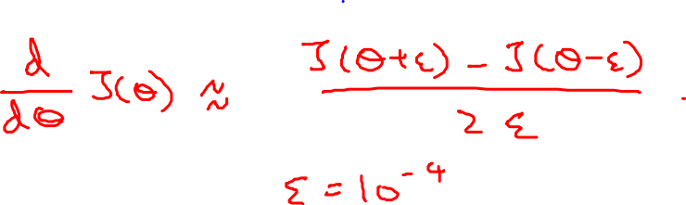
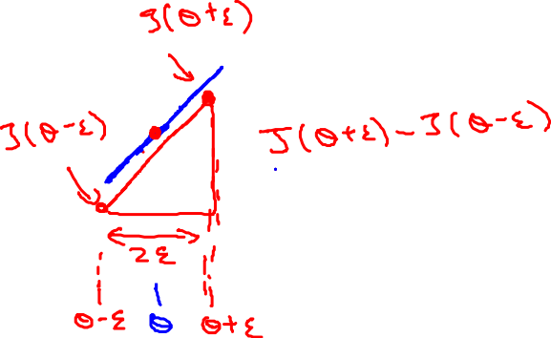
Numerical estimation of gradients
梯度的数值估计方法(theta是一个实数的情况)
Implement: gradApprox = (J(theta + EPSILON) – J(theta – EPSILON)) /(2*EPSILON)

Slide 25

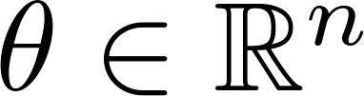
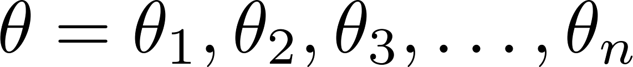

Parameter vector (theta为向量的情况)
(E.g. is “unrolled” version of )

Slide 26
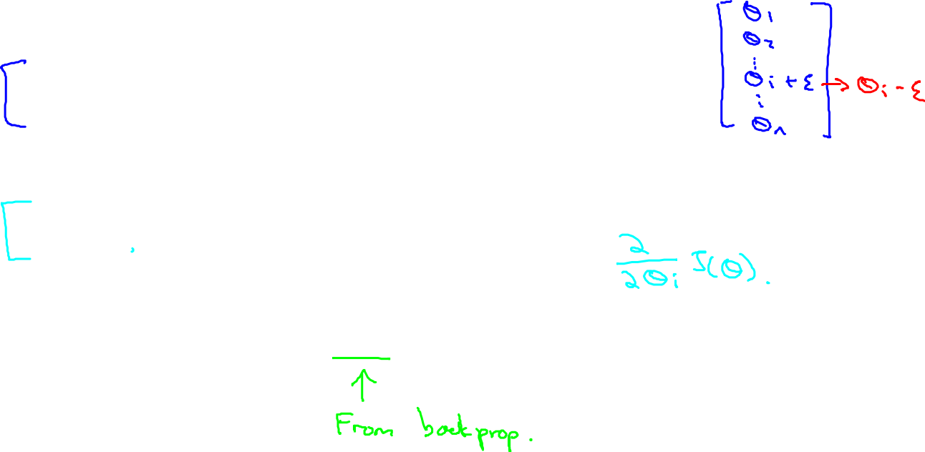
for i = 1:n,
thetaPlus = theta;
thetaPlus(i) = thetaPlus(i) + EPSILON;
thetaMinus = theta;
thetaMinus(i) = thetaMinus(i) – EPSILON;
gradApprox(i) = (J(thetaPlus) – J(thetaMinus))
/(2*EPSILON);
end;
Check that gradApprox ≈ DVec

Slide 27
Implementation Note总的算法实现流程:
Implement backprop to compute DVec (unrolled ).
Implement numerical gradient check to compute gradApprox.
Make sure they give similar values.
(check Dvec ? = gradApprox)
Turn off gradient checking. Using backprop code for learning.
Important:
Be sure to disable your gradient checking code before training your classifier. If you run numerical gradient computation on every iteration of gradient descent (or in the inner loop of costFunction(…))your code will be very slow.
一旦验证了反向传播的实现是正确的,则要确定在训练前将验证关闭,否则算法会特别慢.

Slide 28
Random initialization
Neural Networks: Learning
Machine Learning

Slide 29

Initial value of
For gradient descent and advanced optimization method, need initial value for .
optTheta = fminunc(@costFunction, initialTheta, options)
Consider gradient descent
Set ?
initialTheta = zeros(n,1)
这种全零的处值对于逻辑回归算法是实用的,但对于训练神经网络是否适用?

Slide 30
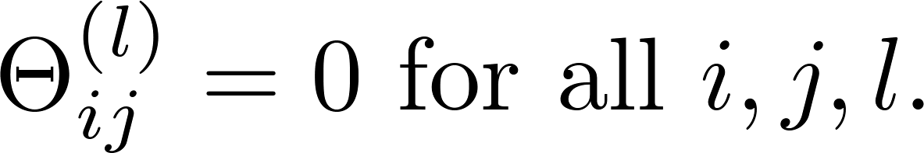



Zero initialization
After each update, parameters corresponding to inputs going into each of two hidden units are identical.
所有的隐藏单元都学习了某一个特征,这样会阻止其他有趣特征的学习;

Slide 31
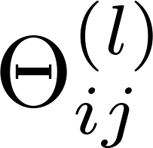
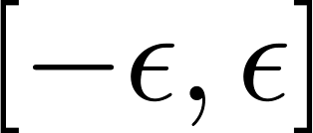

Random initialization: Symmetry breaking
Initialize each to a random value in
(i.e. )
E.g.
Theta1 = rand(10,11)*(2*INIT_EPSILON)
- INIT_EPSILON;
Theta2 = rand(1,11)*(2*INIT_EPSILON) - INIT_EPSILON;

Slide 32
Putting it together
Neural Networks: Learning 总结

Slide 33

Training a neural network
1. Pick a network architecture (connectivity pattern between neurons)
No. of input units: Dimension of features
No. output units: Number of classes
Reasonable default: 1 hidden layer, or if >1 hidden layer, have same no. of hidden units in every layer (usually the more the better)
如果有10个分类,
如果要表示第5类,不能直接用y=5!

Slide 34








Training a neural network
Randomly initialize weights(一般随机初始化为很小的值)
Implement forward propagation to get for any
Implement code to compute cost function
Implement backprop to compute partial derivatives
for i = 1:m
Perform forward propagation and backpropagation using example
(Get activations and delta terms for ).

Slide 35


Training a neural network
Use gradient checking to compare computed using backpropagation vs. using numerical estimate of gradient of . Then disable gradient checking code.
Use gradient descent or advanced optimization method with backpropagation to try to minimize as a function of parameters
$J\left(Θ\right)$non-convex

