Slide 1

Advice for applying machine learning
算法诊断
Machine Learning

Slide 2
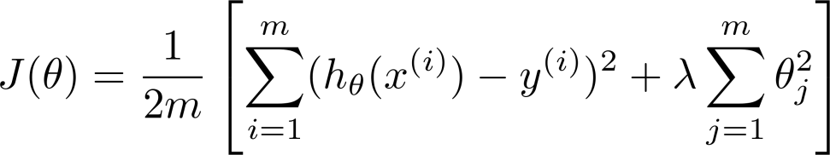
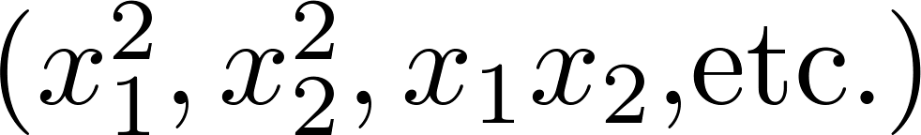
Debugging a learning algorithm(机器学习算法诊断):
Suppose you have implemented regularized linear regression to predict housing prices.
However, when you test your hypothesis on a new set of houses, you find that it makes unacceptably large errors in its predictions预测效果差. What should you try next?
Get more training examples(增加更多训练样本)
Try smaller sets of features(减少输入特征)
Try getting additional features(增加输入特征)
Try adding polynomial features
Try decreasing (增大正则化系数)
Try increasing (减小正则化系数)
通常做法:凭感觉!

Slide 3
Machine learning diagnostic:
Diagnostic: A test that you can run to gain insight what is/isn’t working with a learning algorithm, and gain guidance as to how best to improve its performance.
Diagnostics can take time to implement, but doing so can be a very good use of your time.

Slide 4
1. Evaluating a hypothesis
Machine learning diagnostic

Slide 5
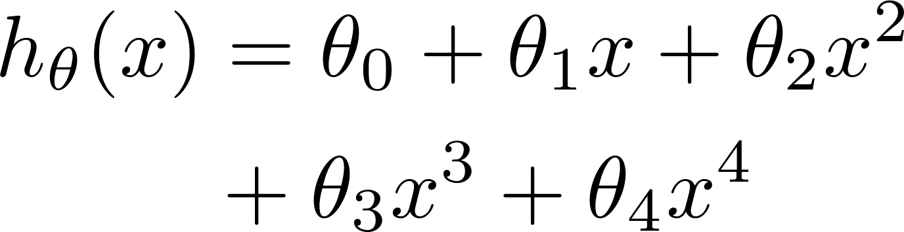
Evaluating your hypothesis
Fails to generalize to new examples not in training set.
price
Q: How to evaluate whether the overfitting appears?
size
How about high-dimension features?

Slide 6






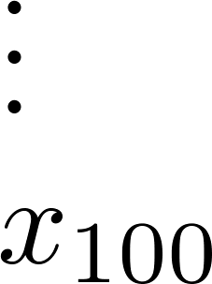
Evaluating your hypothesis
Fails to generalize to new examples not in training set.
price
size of house
no. of bedrooms
no. of floors
size
age of house
average income in neighborhood
kitchen size

Slide 7






Evaluating your hypothesis
Dataset:
Size | Price
2104 | 400
1600 | 330
2400 | 369
1416 | 232
3000 | 540
1985 | 300
1534 | 315
1427 | 199
1380 | 212
1494 | 243
一般地,假设分为m个训练集, m_test个测试集
Training set
70%
Testing set
30%

Slide 8

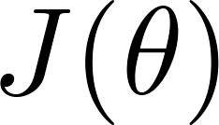
Training/testing procedure for linear regression
1. Learn parameter from training data (minimizing training error )
2. Compute test set error:

Slide 9
Training/testing procedure for logistic regression
1. Learn parameter from training data
2. Compute test set error:
3. Misclassification error (0/1 misclassification error),即在测试集上计算误判率;

Slide 10
2. Model selection and training/validation/test sets
Machine learning diagnostic

Slide 11
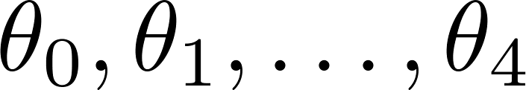
Overfitting example
Once parameters
were fit to some set of data (training set), the error of the parameters as measured on that data (the training error xxxxx) is likely to be lower than the actual generalization error.
price
size
overfitting

Slide 12
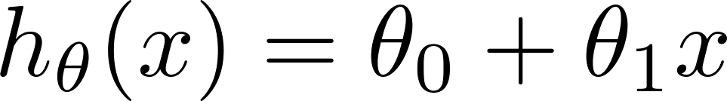
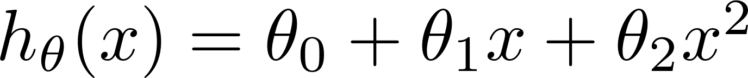
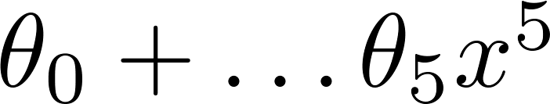
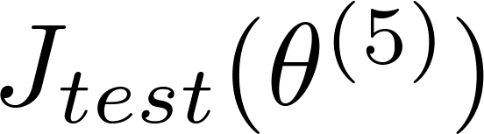

Model selection
1.
2.
3.
10.
If Choose
How well does the model generalize? Report test set error .
Problem: is likely to be an optimistic estimate of generalization error. I.e. our extra parameter ( = degree of polynomial) is fit to test set.对泛化误差的估计过于乐观.

Slide 13





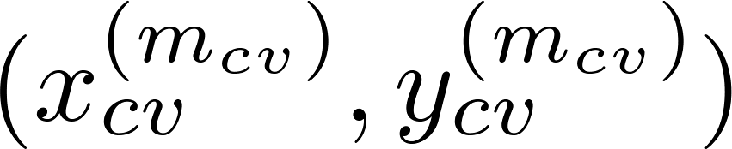
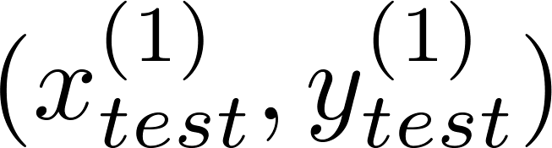
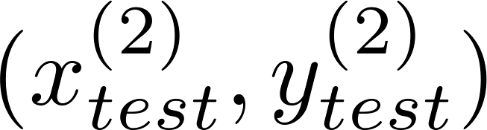
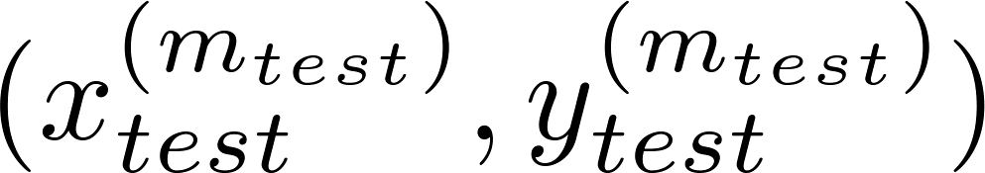
Evaluating your hypothesis
Dataset:
60%
一般地, 分为m个训练集,
m_cv个交叉验证集,
m_test个测试集.
Size | Price
2104 | 400
1600 | 330
2400 | 369
1416 | 232
3000 | 540
1985 | 300
1534 | 315
1427 | 199
1380 | 212
1494 | 243
Training set
20%
Cross Vadidation
20%
Testing set

Slide 14
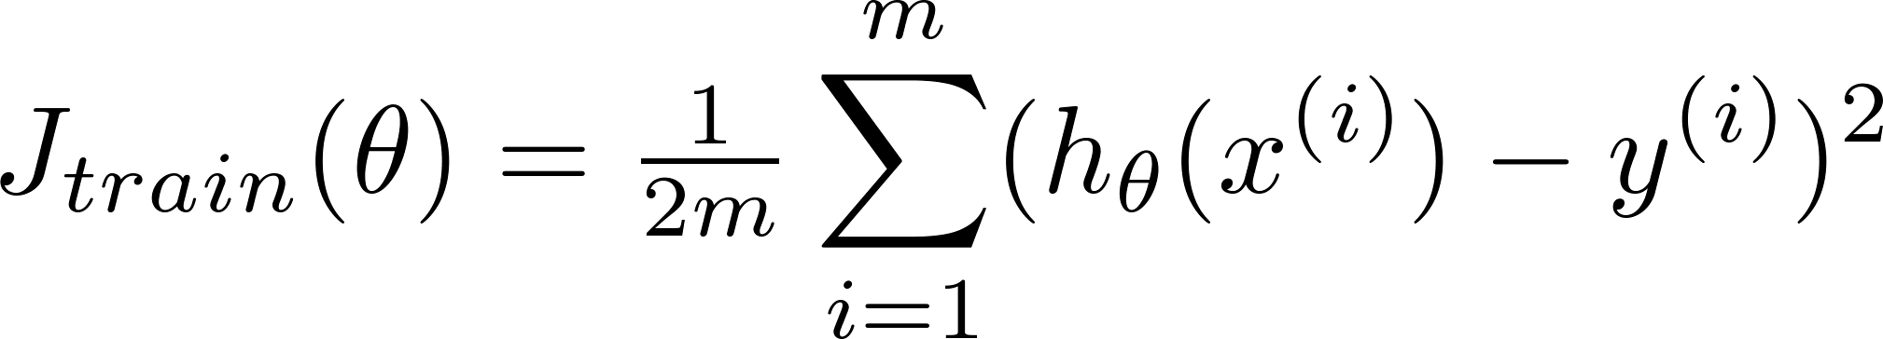
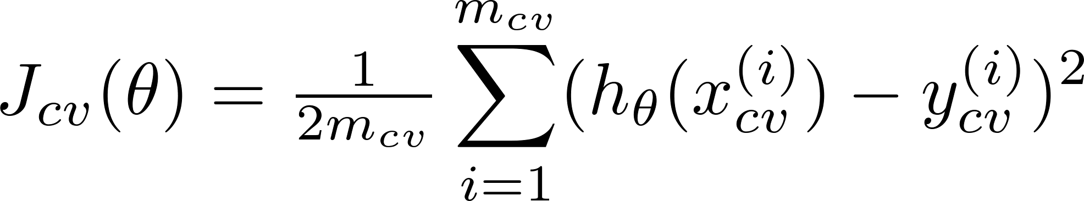
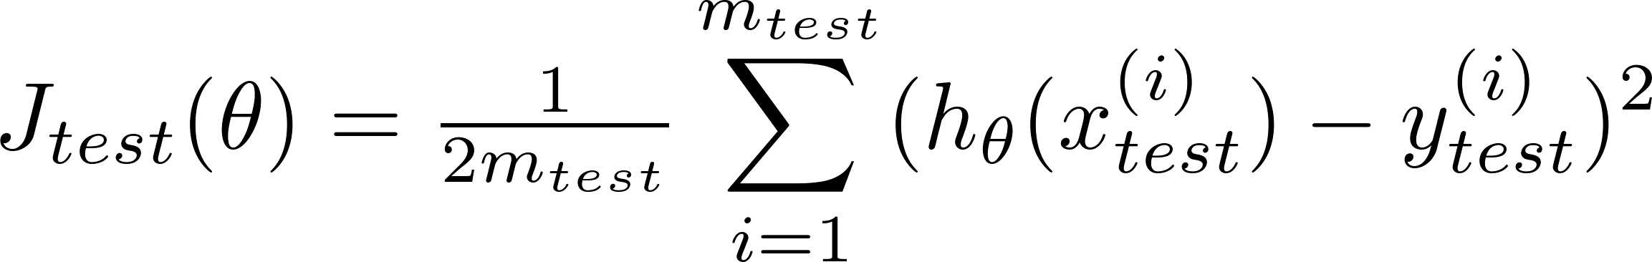
Train/validation/test error
Training error:
Cross Validation error:
Test error:

Slide 15
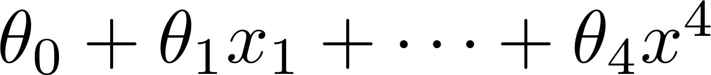
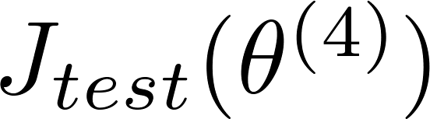
Model selection
1.
2.
3.
10.
Pick
Estimate generalization error for test set

Slide 16
Diagnosing bias vs. variance 偏差,方差诊断
Advice for applying machine learning

Slide 17
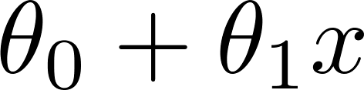
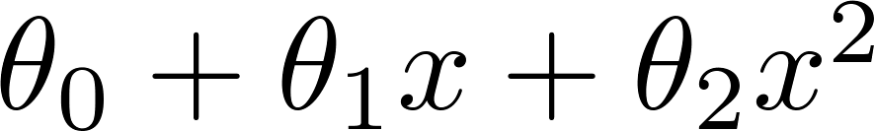
Bias/variance
Price
Price
Price
Size
Size
Size
High bias
(underfit)
“Just right”
High variance
(overfit)

Slide 18
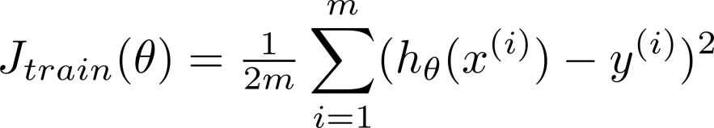
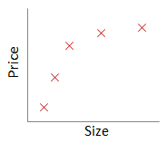
Bias/variance
Training error:
Cross validation error:
error
degree of polynomial d

Slide 19
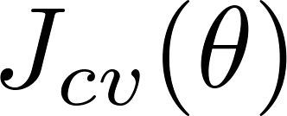
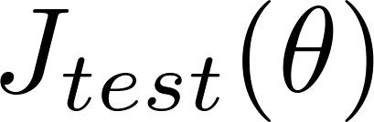


Diagnosing bias vs. variance
Suppose your learning algorithm is performing less well than you were hoping. ( or is high.) Is it a bias problem or a variance problem?
Bias (underfit):
(cross validation
error)
will be high;
error
Bias (underfit)
Variance (overfit):
(training error)
will be low;
degree of polynomial d

Slide 20
Regularization and bias/variance
Diagnosing bias vs. variance

Slide 21
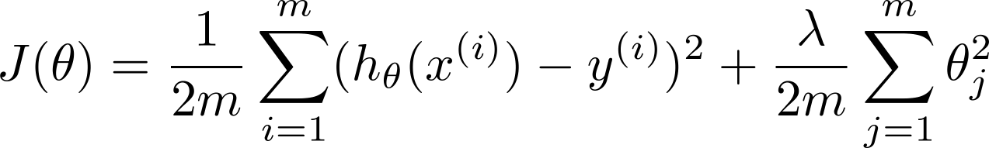


Linear regression with regularization
Model:
Price
Price
Price
Size
Size
Size
Large xx
High bias (underfit)
Intermediate
“Just right”
Small xx
High variance (overfit)

Slide 22
Choosing the regularization parameter
不含正则项 xx

Slide 23
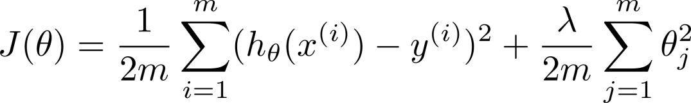







Choosing the regularization parameter
Model:
Try
Try
Try
Try
Try
Try
Pick (say) . Test error
(5)

Slide 24
Bias/variance as a function of the regularization parameter
“Just right”

Slide 25
Learning curves 学习曲线
Advice for applying machine learning

Slide 26
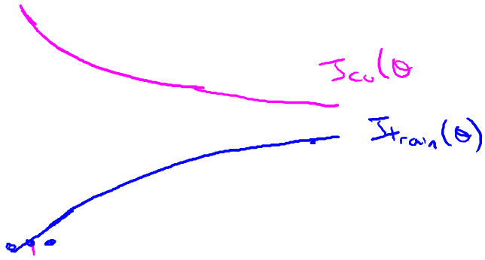
Learning curves
error
(training set size)

Slide 27

High bias
price
error
size
(training set size)
price
If a learning algorithm is suffering from high bias, getting more training data will not (by itself) help much.
size

Slide 28
High variance
(and small )
error
price
gap
size
(training set size)
price
If a learning algorithm is suffering from high variance, getting more training data is likely to help.
size

Slide 29
Deciding what to try next (实践: 当算法在测试集效果不好,如何调整)
Advice for applying machine learning

Slide 30
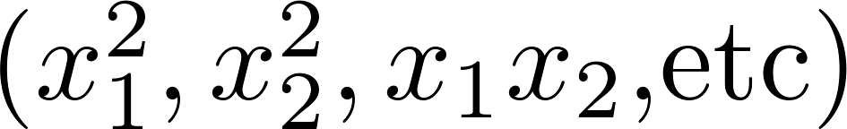
Debugging a learning algorithm:
Suppose you have implemented regularized linear regression to predict housing prices. However, when you test your hypothesis in a new set of houses, you find that it makes unacceptably large errors in its prediction. What should you try next?
Get more training examples
Try smaller sets of features
Try getting additional features
Try adding polynomial features
Try decreasing
Try increasing
适合: 高方差,high variance
适合: 高方差,high variance
适合: 高偏差,high bias
适合: 高偏差,high bias
适合: 高偏差,high bias
适合: 高方差,high variance

Slide 31
Neural networks and overfitting
“Small” neural network
(fewer parameters; more prone to underfitting)
“Large” neural network
(more parameters; more prone to overfitting)
Computationally cheaper
Computationally more expensive.
Use regularization ( ) to address overfitting.

Slide 32
Prioritizing what to work on: Spam classification example
Machine learning system design
Machine Learning

Slide 33
Building a spam classifier
From: cheapsales@buystufffromme.com
To: ang@cs.stanford.edu
Subject: Buy now!
Deal of the week! Buy now!
Rolex w4tchs - $100
Med1cine (any kind) - $50
Also low cost M0rgages available.
From: Alfred Ng
To: ang@cs.stanford.edu
Subject: Christmas dates?
Hey Andrew,
Was talking to Mom about plans for Xmas. When do you get off work. Meet Dec 22?
Alf
Spam(1)
Non-Spam(0)

Slide 34


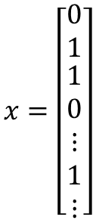


Building a spam classifier
Supervised learning. features of email. spam (1) or not spam (0).
Features : Choose 100 words indicative of spam/not spam.
E.g. deal, buy, discount, Andrew, now…..
$$x=\left[\begin{matrix}0 \\ 1 \\ \begin{aligned}1 \\ 0 \\ ⋮ \\ 1 \\ ⋮\end{aligned}\end{matrix}\right]$$
Andrew
buy
$$x∈R^{100}$$
deal
discount
From: cheapsales@buystufffromme.com
To: ang@cs.stanford.edu
Subject: Buy now!
Deal of the week! Buy now!
$$⋮$$
now
$$⋮$$
Note: In practice, take most frequently occurring words ( 10,000 to 50,000) in training set, rather than manually pick 100 words.

Slide 35
Building a spam classifier
How to spend your time to make it have low error?
Collect lots of data
E.g. “honeypot” project.
Develop sophisticated features based on email routing information (from email header).
Develop sophisticated features for message body, e.g. should “discount” and “discounts” be treated as the same word? How about “deal” and “Dealer”? Features about punctuation?
Develop sophisticated algorithm to detect misspellings (e.g. m0rtgage, med1cine, w4tches.)

Slide 36
Error analysis
Machine learning system design
Machine Learning

Slide 37
Recommended approach
Start with a simple algorithm that you can implement quickly. Implement it and test it on your cross-validation data.
Plot learning curves to decide if more data, more features, etc. are likely to help.
Error analysis: Manually examine the examples (in cross validation set) that your algorithm made errors on. See if you spot any systematic trend in what type of examples it is making errors on.

Slide 38

Error Analysis
500 examples in cross validation set
Algorithm misclassifies 100 emails.
Manually examine the 100 errors, and categorize them based on:
What type of email it is
What cues (features) you think would have helped the algorithm classify them correctly.
Pharma:
Replica/fake:
Steal passwords:
Other:
Deliberate misspellings:
(m0rgage, med1cine, etc.)
Unusual email routing:
Unusual (spamming) punctuation:

Slide 39
The importance of numerical evaluation
Should discount/discounts/discounted/discounting be treated as the same word?
Can use “stemming” software (E.g. “Porter stemmer”)
universe/university.
Error analysis may not be helpful for deciding if this is likely to improve performance. Only solution is to try it and see if it works.
Need numerical evaluation (e.g., cross validation error) of algorithm’s performance with and without stemming.
Without stemming: With stemming:
Distinguish upper vs. lower case (Mom/mom):

Slide 40
Error metrics for skewed classes
Machine learning system design
Machine Learning

Slide 41



Cancer classification example
Train logistic regression model . ( if cancer, otherwise) Find that you got 1% error on test set.
(99% correct diagnoses)
Only 0.50% of patients have cancer.
function y = predictCancer(x)
y = 0; %ignore x!
return

Slide 42
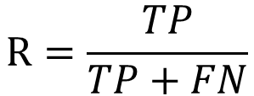
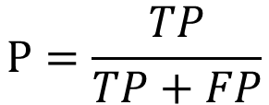
Precision/Recall
in presence of rare class that we want to detect
分母不同，一个分母是预测为正的样本数，另一个是原来样本中所有的正样本数
精确率是针对我们预测结果而言的，它表示的是预测为正的样本中有多少是真正的正样本。那么预测为正就有两种可能了，一种就是把正类预测为正类(TP)，另一种就是把负类预测为正类(FP).
Precision
(Of all patients where we predicted , what fraction actually has cancer?)
$$P=\frac{TP}{TP+FP}$$
召回率是针对我们原来的样本而言的，它表示的是样本中的正例有多少被预测正确了。那也有两种可能，一种是把原来的正类预测成正类(TP)，另一种就是把原来的正类预测为负类(FN)
Recall
(Of all patients that actually have cancer, what fraction did we correctly detect as having cancer?)
$$R=\frac{TP}{TP+FN}$$

Slide 43
Precision/Recall
举例：假设我们手上有60个正样本，40个负样本，我们要找出所有的正样本，系统查找出50个，其中只有40个是真正的正样本，计算上述各指标。
TP: 将正类预测为正类数 40
FN: 将正类预测为负类数 20
FP: 将负类预测为正类数 10
TN: 将负类预测为负类数 30
准确率(accuracy) = 预测对的/所有 = (TP+TN)/(TP+FN+FP+TN) = 70%；
精确率(precision) = TP/(TP+FP) = 80%；
召回率(recall) = TP/(TP+FN) = 2/3
除此之外，还有ROC曲线，PR曲线，AUC等机器学习评价指标!!请大家自行查阅相关资料。
链接：https://www.jianshu.com/p/54ed63a7f816

