Slide 1

线性回归算法
Linear regression with one variable
Machine Learning

Slide 2
目标
线性回归算法概况
了解监督学习过程完整的流程

Slide 3
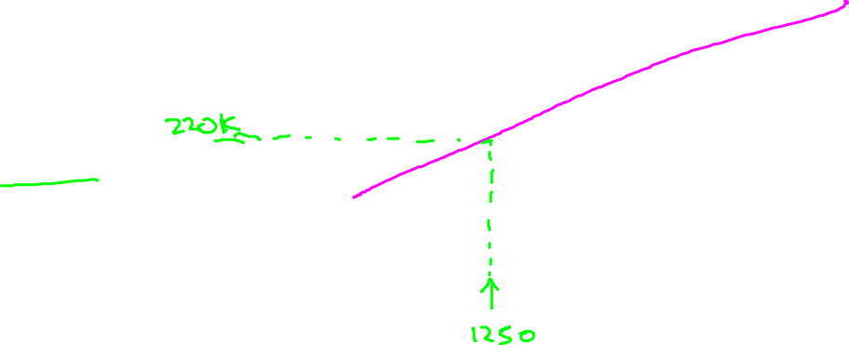
例子：预测住房价格
问题：当房屋的尺寸是1250平方英尺时，预测房屋价格。
Price
(in 1000s of dollars)
Size (feet²)
Supervised Learning（监督学习）
Given the “right answer” for each example in the data.
Regression Problem（回归问题）
Predict real-valued output

Slide 4
在监督学习中，我们有一个数
据集，称为训练集(training set)。
Notation:
m ：训练样本的数目 (m=47)
x’s ：输入变量/特征
y’s ：输出变量/目标变量
(x, y) ： 训练集中的实例，
e.g.，(x^{(i)},y^{(i)} ) 代表第 i 个观察实例
h ： 学习算法的解决方案或函数也称为假设（hypothesis）。
Size in feet² (x) | Price ($) in 1000's (y)
2104 | 460
1416 | 232
1534 | 315
852 | 178
… | …

Slide 5
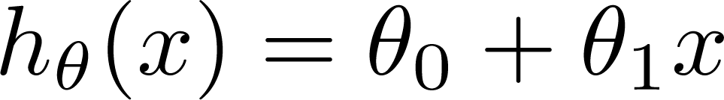
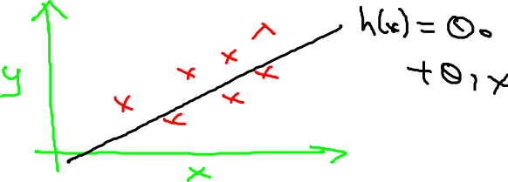
Training Set
How do we represent h ?
Learning Algorithm
Size of house
h
Estimated price
h：由x到y的函数映射，是由算法学习得到。
单变量现象回归问题
（Linear regression with one variable.
Univariate linear regression）.

Slide 6
代价函数 Cost function
Linear regression with one variable
Machine Learning

Slide 7

训练集
Size in feet² (x) | Price ($) in 1000's (y)
2104 | 460
1416 | 232
1534 | 315
852 | 178
… | …
定义代价函数的概念，这有助于我们弄清楚如何把最有可能的直线与我们的数据相拟合。
Hypothesis:
‘s: Parameters
How to choose ‘s ?

Slide 8
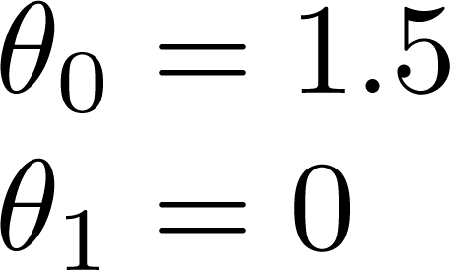
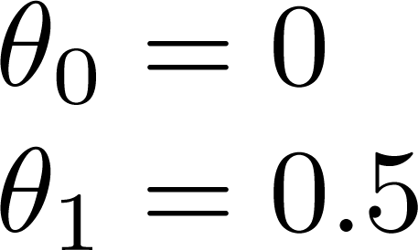
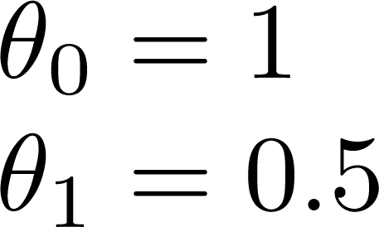



h$\left(x\right)=1.5+0x$
h$\left(x\right)=0+1.5x$
h$\left(x\right)=1 +0.5x$

Slide 9
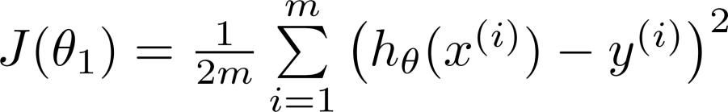
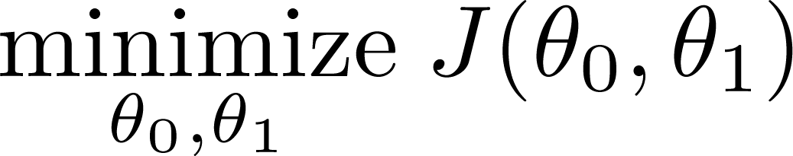
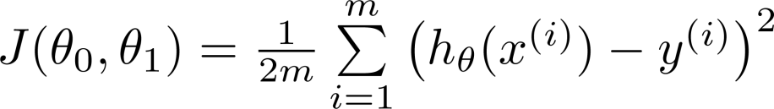
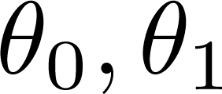


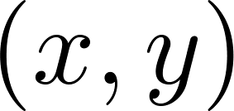
训练集数量
y
x
代价函数
Idea: Choose so that is close to for our training examples
平方误差函数，建模误差（modeling error）

Slide 10
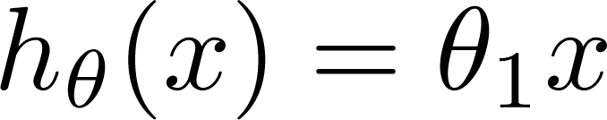

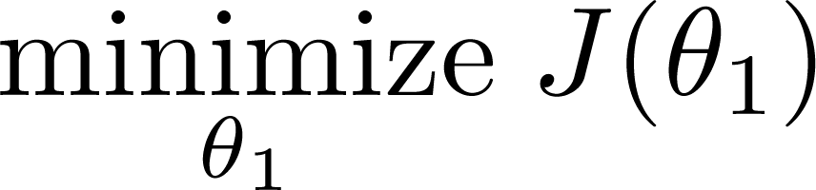


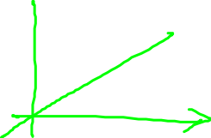
Simplified
Hypothesis:
Parameters:
Cost Function:
Goal:

Slide 11









(for fixed , this is a function of x)
(function of the parameter )
y
$$θ=0.5?$$
x
1
$$=0$$
$$J(0.5)=?$$

Slide 12





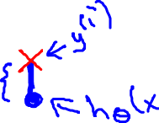
(for fixed , this is a function of x)
(function of the parameter )
y
x
$$J(0.5)=0.68$$
$$J(0)=?$$

Slide 13


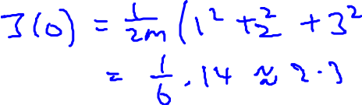



(for fixed , this is a function of x)
(function of the parameter )
y
x

Slide 14
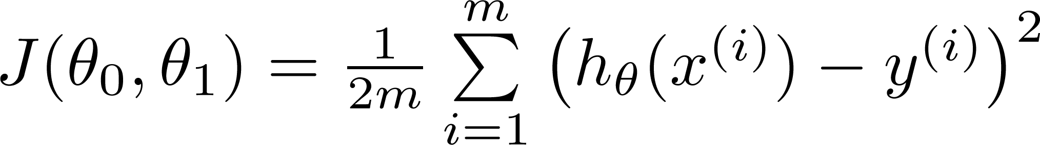
Hypothesis:
Parameters:
Cost Function:
Goal:

Slide 15
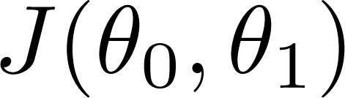


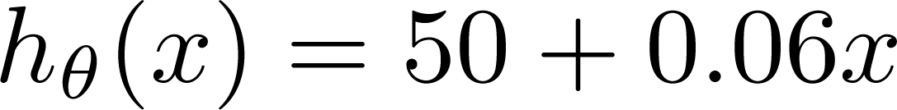
(for fixed , this is a function of x)
(function of the parameters )
Price ($)
in 1000’s
Size in feet² (x)

Slide 16
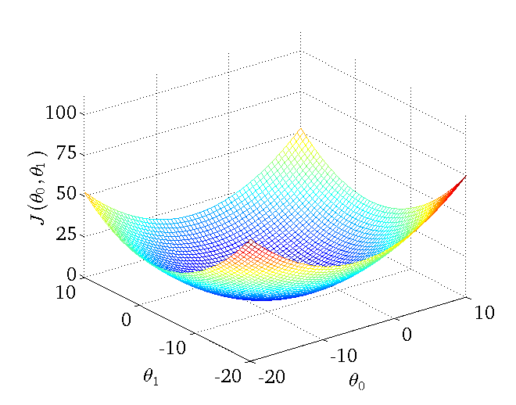

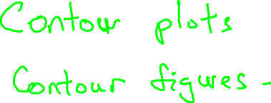


Slide 17
我们真正需要的是一种有效的算法，能够自动地找出这些使代价函数 J 取最小值 的参数 θ0 和 θ1 来。
我们也不希望编个程序把这些点画出来，然后人工的方法来读出这些点的数值，这很明显不是一个好办法。我们会遇到更复杂、更高维度、更多参数的情况，而这些情况是很难画 出图的，因此更无法将其可视化。
下一部分，我们将介绍一种算法，能够自动地找出能使代价函数J 最小化的参数 θ0 和 θ1 的值。

Slide 18
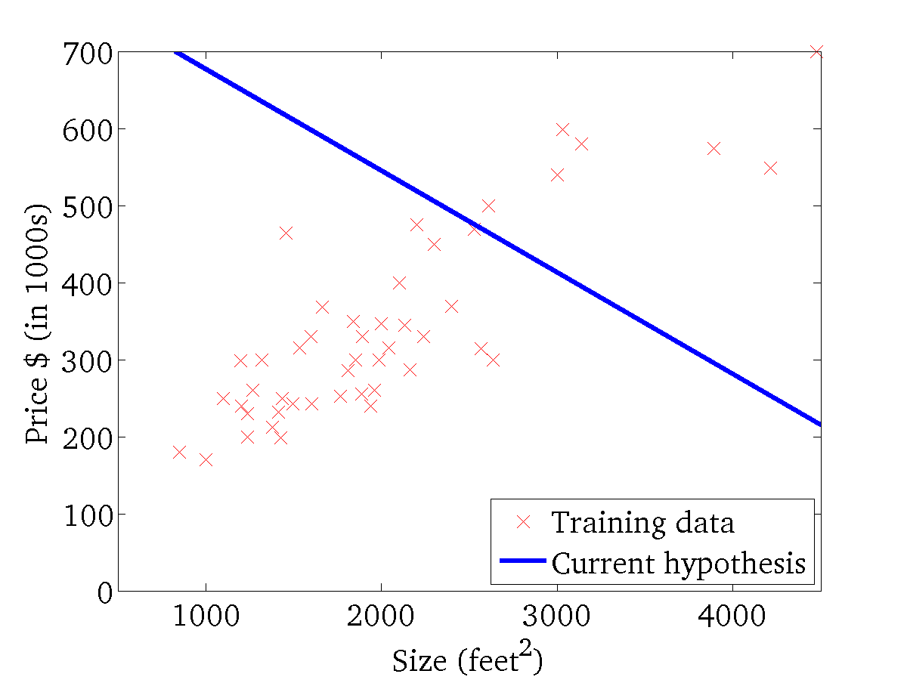
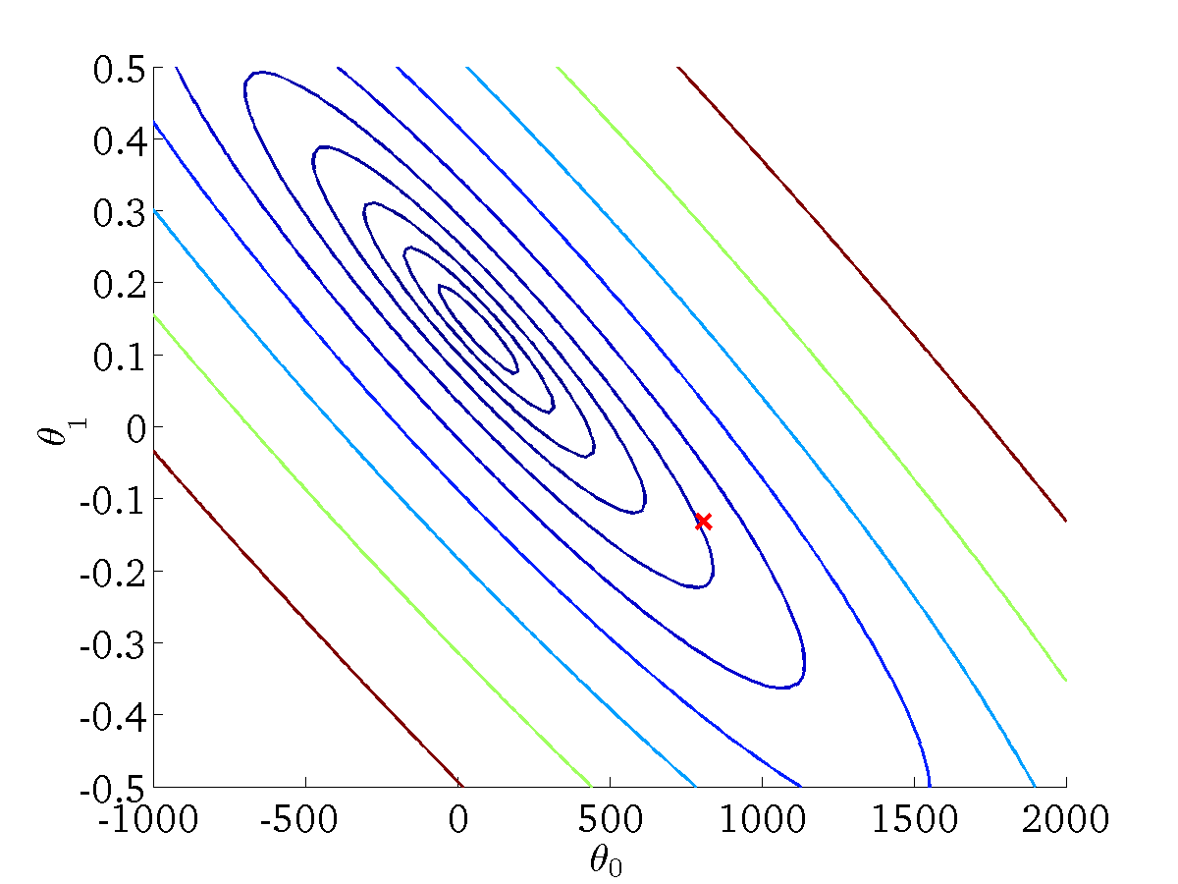

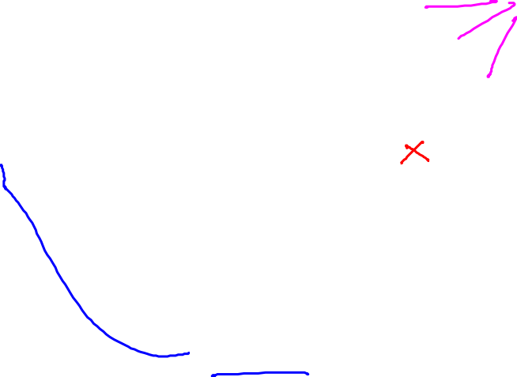


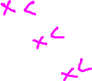


(for fixed , this is a function of x)
(function of the parameters )

Slide 19
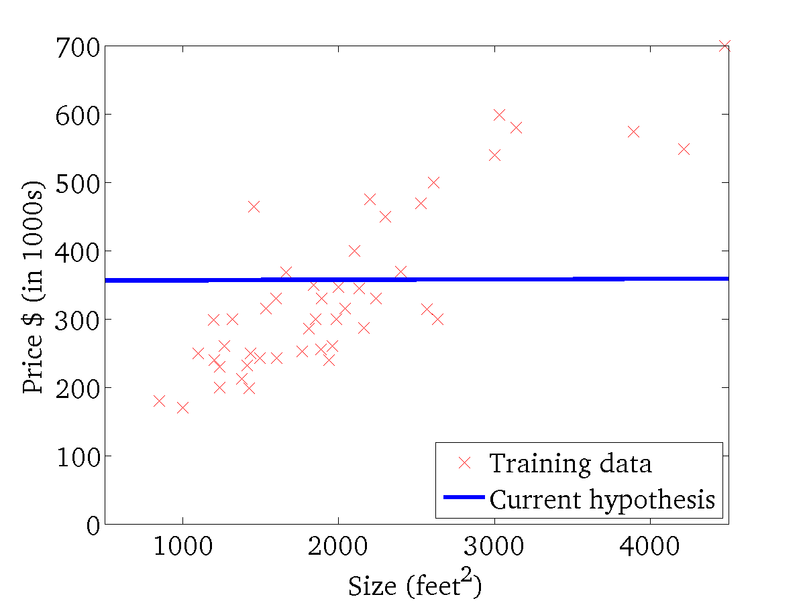
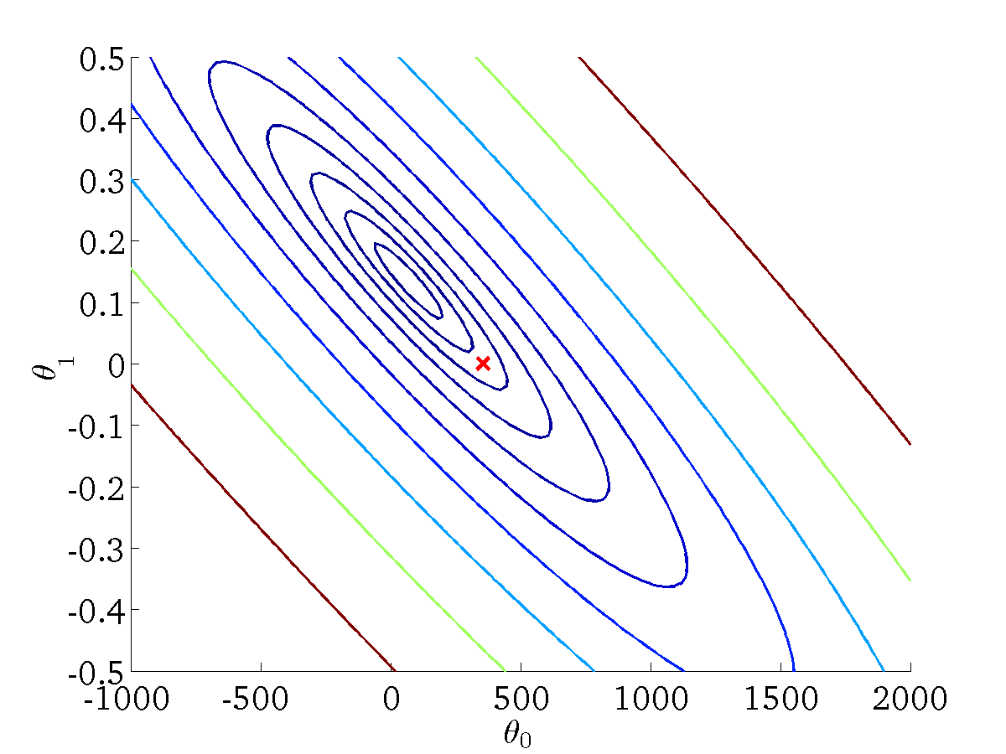
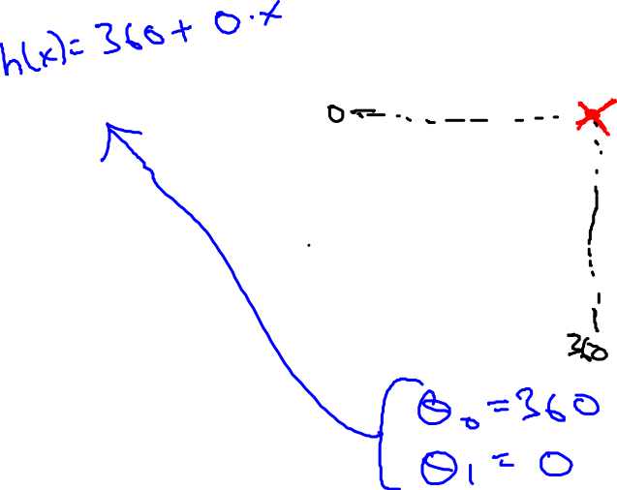
(for fixed , this is a function of x)
(function of the parameters )

Slide 20
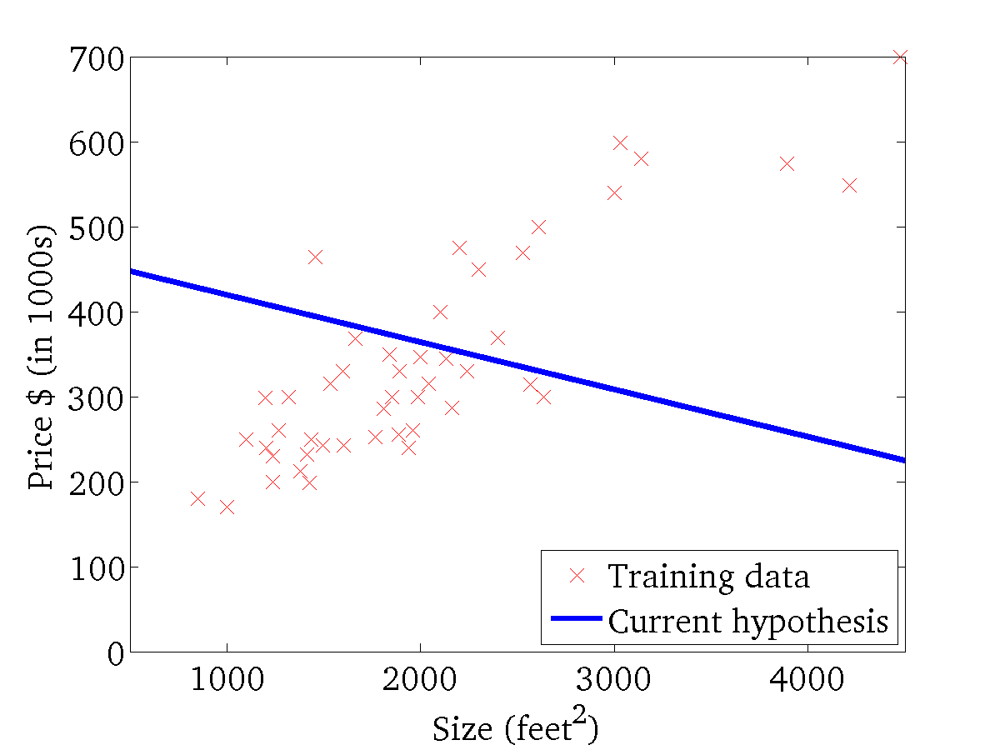

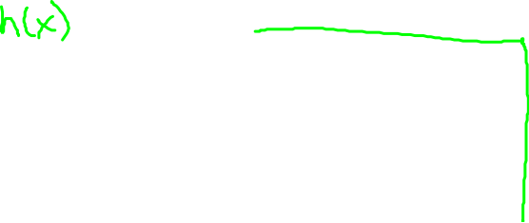
(for fixed , this is a function of x)
(function of the parameters )

Slide 21
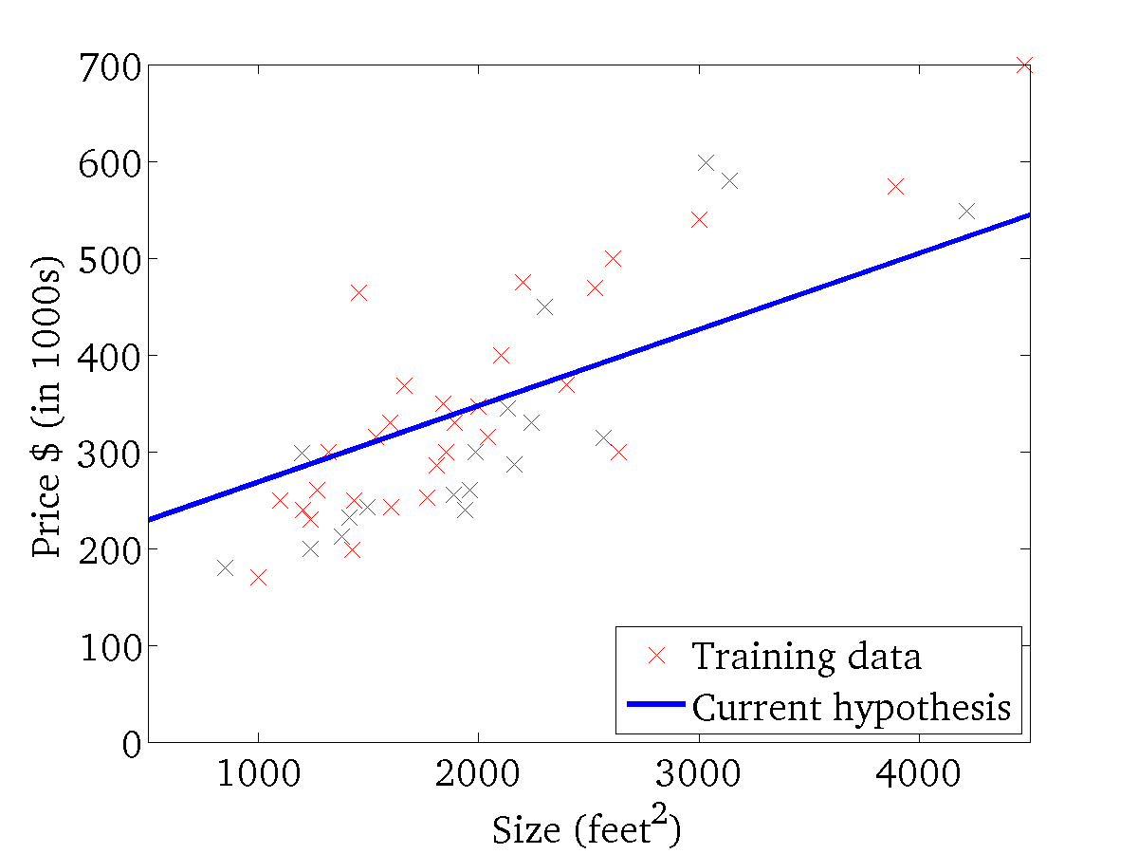
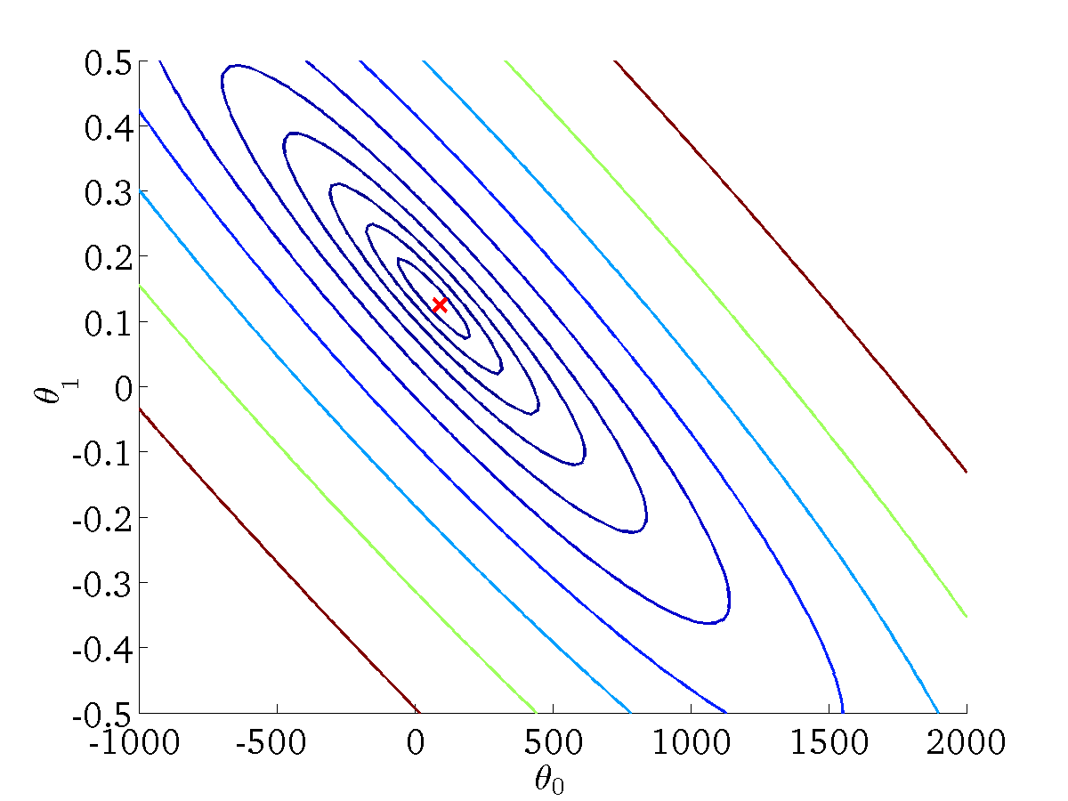
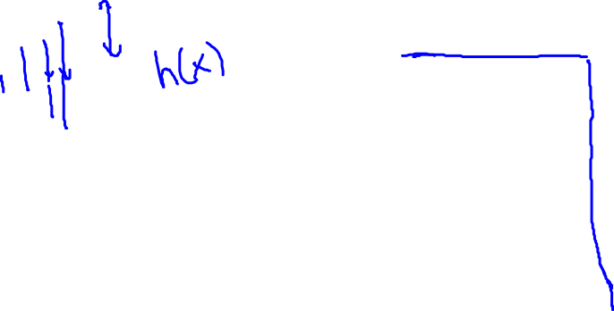
(for fixed , this is a function of x)
(function of the parameters )

Slide 22
梯度下降算法 Gradient descent
Linear regression with one variable
Machine Learning

Slide 23
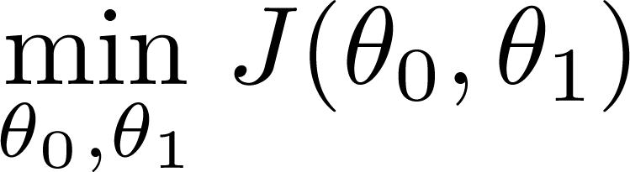

Have some function
Want
Outline:
Start with some
Keep changing to reduce until we hopefully end up at a minimum

Slide 24
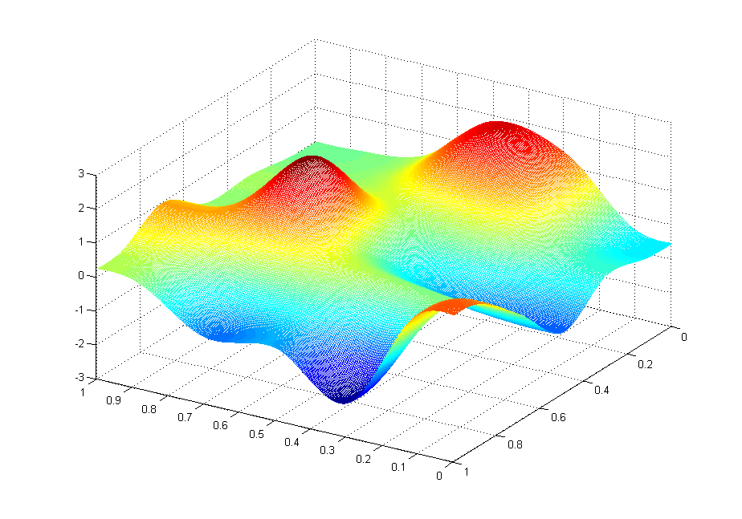
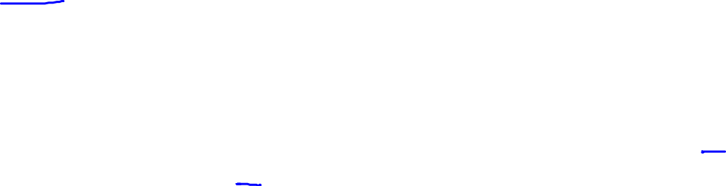
J(θ₀,θ₁)
θ₁
θ₀

Slide 25
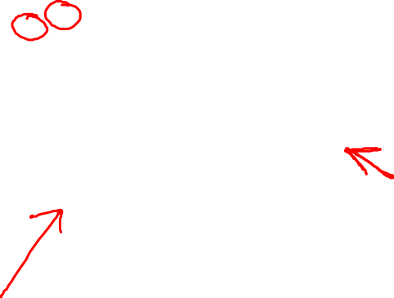
J(θ₀,θ₁)
θ₁
θ₀

Slide 26
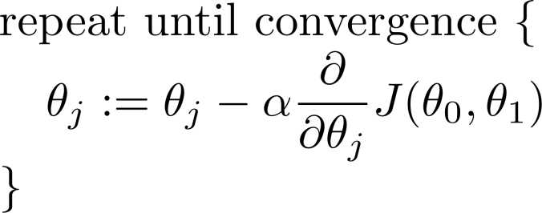
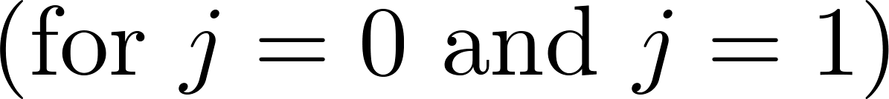
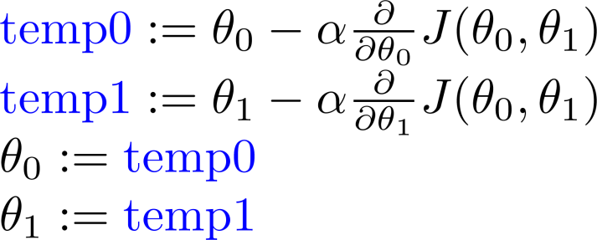
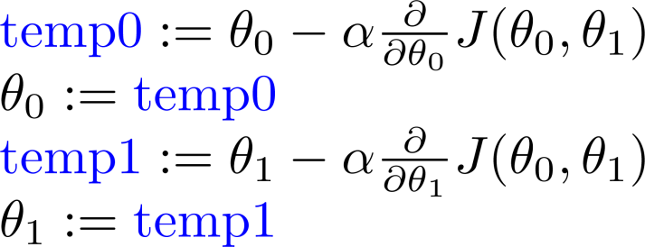
Gradient descent algorithm
Correct: Simultaneous update
Incorrect:

Slide 27
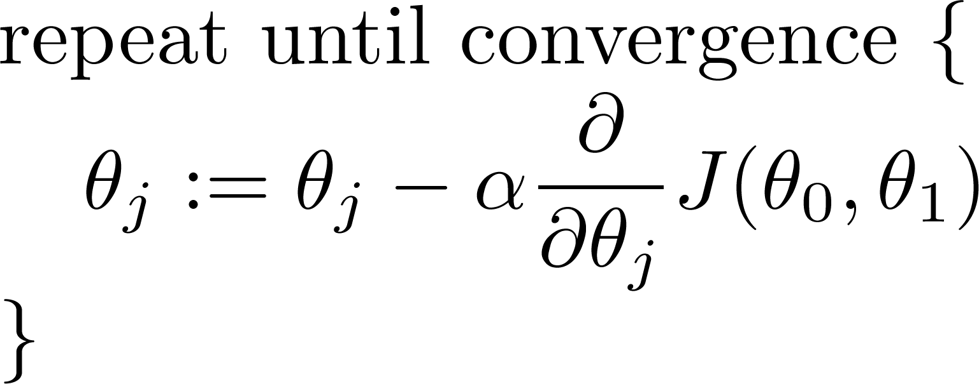
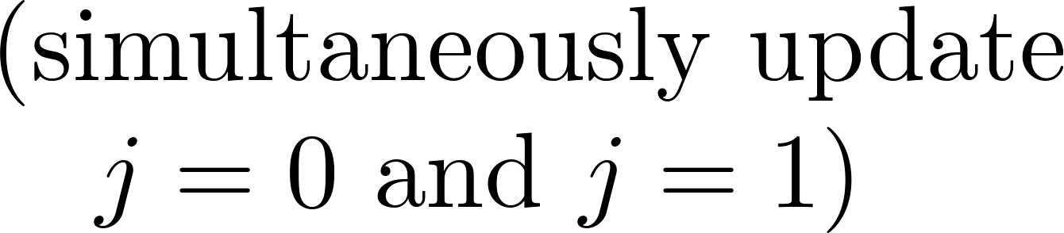


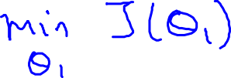



Gradient descent algorithm

Slide 28
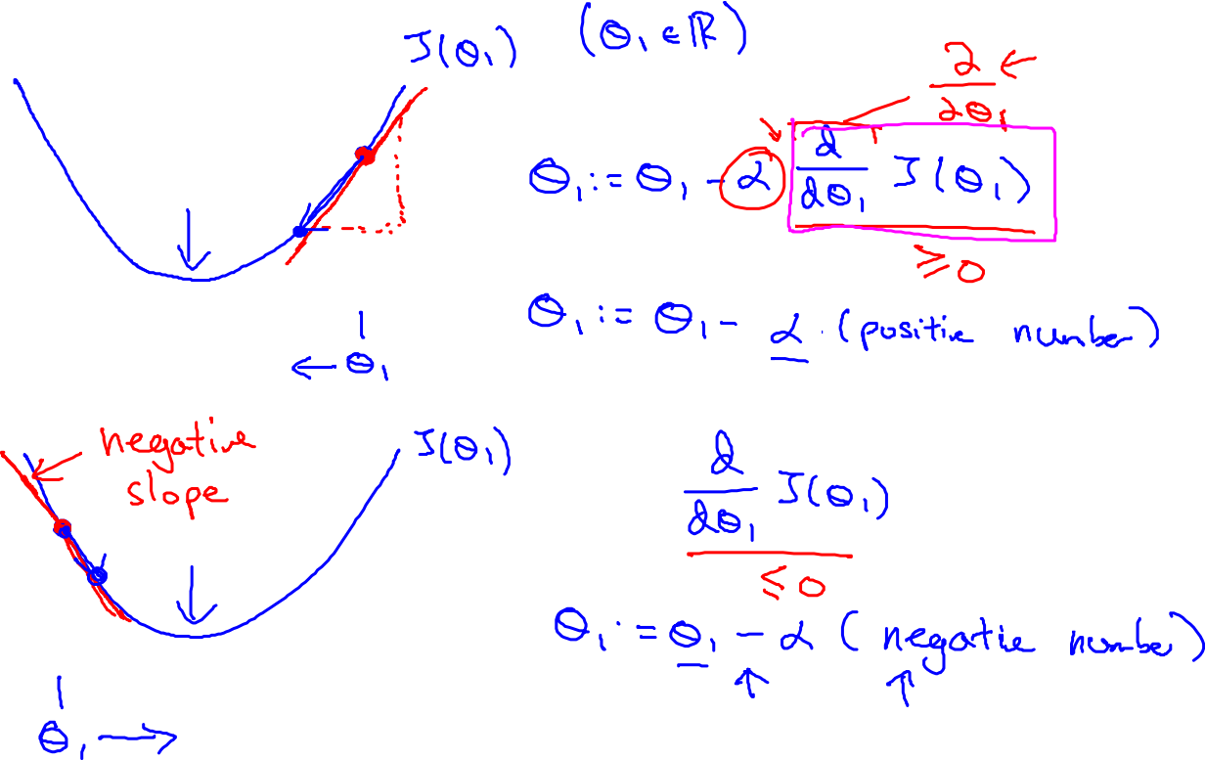

Slide 29
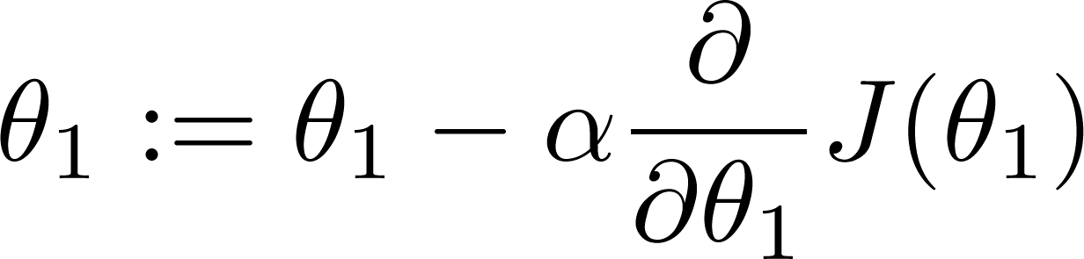


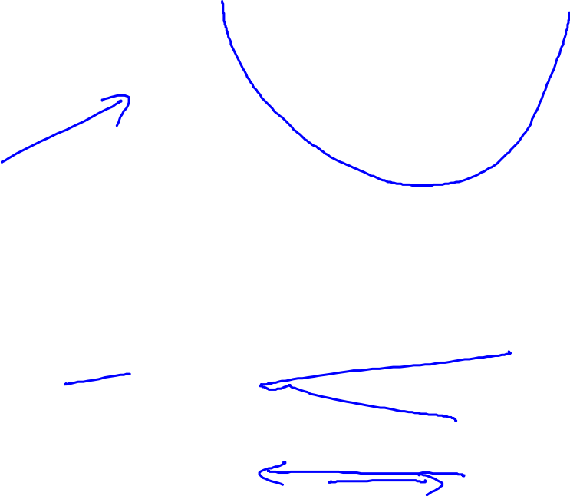

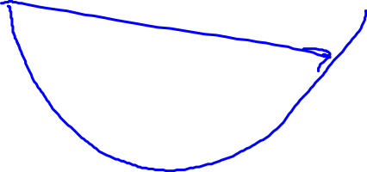


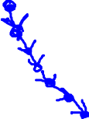



If α is too small, gradient descent can be slow.
If α is too large, gradient descent can overshoot the minimum. It may fail to converge, or even diverge.

Slide 30

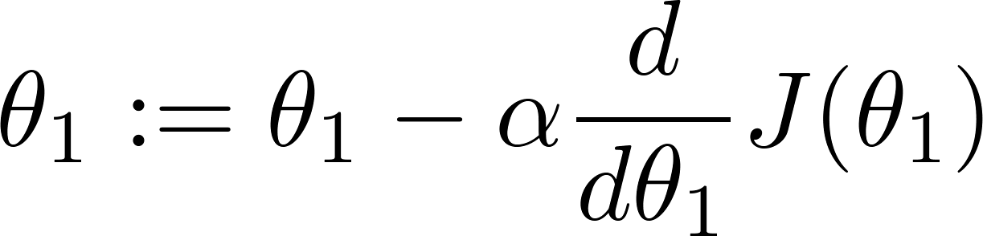
at local optima
Current value of

Slide 31



Gradient descent can converge to a local minimum, even with the learning rate α fixed.
As we approach a local minimum, gradient descent will automatically take smaller steps. So, no need to decrease α over time.

Slide 32
Gradient descent for linear regression
Linear regression with one variable
Machine Learning

Slide 33


Gradient descent algorithm
Linear Regression Model

Slide 34








Slide 35



Gradient descent algorithm
update
and
simultaneously

Slide 36

J(θ₀,θ₁)
θ₁
θ₀

Slide 37
J(θ₀,θ₁)
θ₁
θ₀

Slide 38


Slide 39



(for fixed , this is a function of x)
(function of the parameters )

Slide 40

(for fixed , this is a function of x)
(function of the parameters )

Slide 41


(for fixed , this is a function of x)
(function of the parameters )

Slide 42


(for fixed , this is a function of x)
(function of the parameters )

Slide 43

(for fixed , this is a function of x)
(function of the parameters )

Slide 44

(for fixed , this is a function of x)
(function of the parameters )

Slide 45


(for fixed , this is a function of x)
(function of the parameters )

Slide 46

(for fixed , this is a function of x)
(function of the parameters )

Slide 47



(for fixed , this is a function of x)
(function of the parameters )

Slide 48

“Batch” Gradient Descent
“Batch”: Each step of gradient descent uses all the training examples.

