Slide 1

  Presented by the
  American Statistical Association

Slide 2
What Is Statistics?
American Heritage® Dictionary: “The mathematics of the collection, organization, and interpretation of numerical data, especially the analysis of population characteristics by inference from sampling.”
Statisticians collect and analyze data, then calculate results using a specific design. They draw conclusions and make decisions in the face of uncertainty.

Slide 3
Business
Economics, Engineering,
Marketing,
Computer Science
Physical
Sciences
Astronomy,
Chemistry, Physics
Areas where
STATISTICS
are used
Health &
Medicine
Genetics, Clinical Trials,
Epidemiology,
Pharmacology
Environment
Agriculture,
Ecology, Forestry,
Animal Populations
Government
Census, Law,
National Defense

Slide 4
Why Study Statistics?
Collecting data on subsets of the population (samples) can give valid information about the whole population.
Knowing what has happened in the past can help answer questions about the present and future.
Knowledge helps plan future tests, determines resource allocation, and improves quality.

Slide 5
What Do Statisticians Do?
Study the safety of nuclear power plants
Evaluate the environmental impact of pollution
Determine the effectiveness of new drugs
Estimate the U.S. unemployment rate
Analyze consumer demand for products
Plan and analyze agricultural experiments

Slide 6
What Can I Do
With A Degree in Statistics?

Slide 7

Business and Industry
Manufacturing
  Build products and deliver services that satisfy consumers and increase the corporation’s profit margin

Slide 8

Business and Industry
Marketing
  Design experiments for new products, conduct focus groups and sample surveys, and perform field experiments in test markets to determine product viability

Slide 9

Business and Industry
Engineering
  Make a consistent product, detect problems, minimize waste, and predict product life in electronics, chemicals, aerospace, pollution control, construction, and other industries

Slide 10
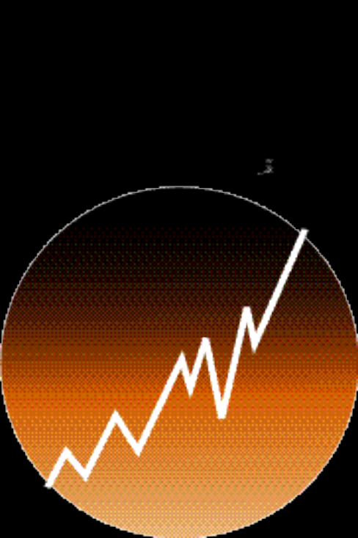
Business and Industry
Statistical Computing
  Work in software design and development, testing, quality assurance, technical support, education, marketing, and sales to develop code that is both user-friendly and sufficiently complex

Slide 11
“
I love that statistics is very multi-disciplinary. It involves problem solving in a group environment and it involves many skills and talents. I love the ability to be a mathematician, computer scientist, teacher, quizmaster, sleuth, and devil’s advocate all rolled into one.
”
Linda Quinn, Private Industrial Consultant

Slide 12
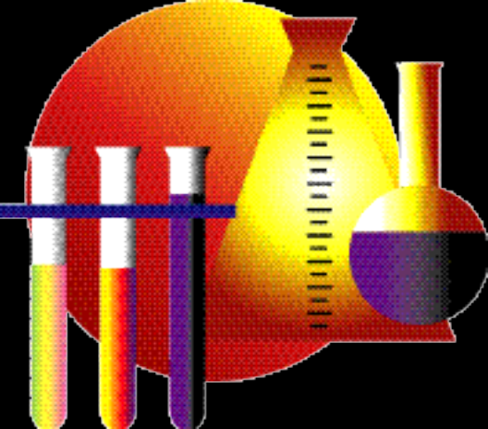
Health and Medicine
Epidemiology
  Work on calculating cancer incidence rates, monitor disease outbreaks, and monitor changes in health-related behaviors such as smoking and physical activity

Slide 13

Health and Medicine
Public Health
  Prevent disease, prolong life, and promote health through organized community efforts, including sanitation, hygiene education, diagnoses, and preventative treatment

Slide 14

Health and Medicine
Pharmacology
  Work in drug discovery, development, approval, and marketing, to ensure the validity and accuracy of findings at all stages of the process

Slide 15
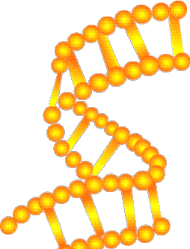
Health and Medicine
Genetics
  Label possible indicators of genetic abnormalities, such as birth defects and early aging, or breed desirable characteristics in plant offspring

Slide 16
“
  Last year when I began applying to medical schools, the fact that I majored in statistics was always a good conversation point in interviews and made me more unique as an applicant.
”
  Amy Elise Derrow, Medical Student

Slide 17

Learning
Education
  Teach K-12 through post-graduate students, assess teacher effectiveness, or develop statistical models to represent student learning

Slide 18

Learning
Science Writing & Journalism
  Work with mass media, universities, and corporations to produce news briefs, articles, news releases, and other reports

Slide 19

Research
Government
  Work in regulations for stock trading, pollution, and drug approvals, or testify in court proceedings, congressional hearings, and lobbying arguments

Slide 20
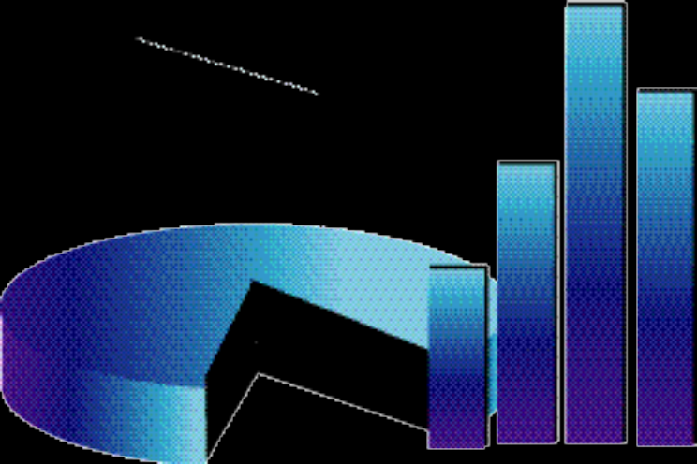
Research
Survey Methods
  Collect data in the social sciences, education, law, forestry, agriculture, biology, medicine, business, and
  e-commerce, and for the government

Slide 21
“
I found that statistics used more reasoning and logic skills than the mathematics courses I had previously taken. The more I did statistics, the more I liked the “alternative” application of mathematics that it provided. I especially liked being able to use a lot of data and a little common sense to figure out problems.
”
Tiffany T. Sundelin, Quality Control Engineer

Slide 22

Social Statistics
Law
  Analyze data in court cases, including DNA evidence, salary discrepancies, discrimination law suits, and disease clusters

Slide 23

Social Statistics
Consulting
  Work on a temporary basis on a variety of projects including quality improvement, pharmaceuticals, ecology, and engineering

Slide 24

Natural Resources
Agriculture
  Study chemical pesticides, hydrogeology, veterinary sciences, genetics, and crop management in order to ensure optimal yield

Slide 25

Natural Resources
Ecology
  Address questions about the earth’s natural environment, including animal populations, agricultural protections, and fertilizer and pesticide safety

Slide 26
“
  I became involved with statistics because mathematics did not provide the avenue to cross into other areas of science and continue to learn about topics that interested me. I have stayed in statistics because of the diversity that it offers and because of the rational approach it provides to seek solutions to problems.
”
Dan Mowrey, Senior Research Scientist

Slide 27
How Do I Become
A Statistician?

Slide 28
Education
High School
  Study statistics, mathematics, science, computer science, and English
College
  Major in statistics, applied mathematics, or a closely related field (i.e. epidemiology, engineering)
Post-Graduate
  Many career fields require a Master’s degree or PhD in a specialized statistical field

Slide 29
Skills
Quantitative Skills
  Statistics, Mathematics, Science
Problem Solving Skills
  Analysis, Teamwork
Communication Skills
  Verbal, Written
Computer Programming Languages
Foundation in Field of Application

Slide 30
Opportunities
Diversity
  Pure Research
  Interdisciplinary Teams
Advancement
  Experience, education, and communication skills lead to professional advancement
Versatility
  Challenging and Exciting Fields of Application

Slide 31
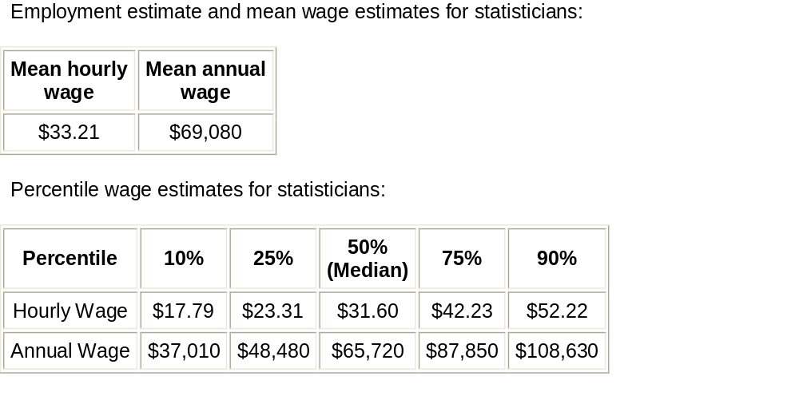
Salary Information
Salary Information
Source: Bureau of Labor Statistics May 2006

Slide 32
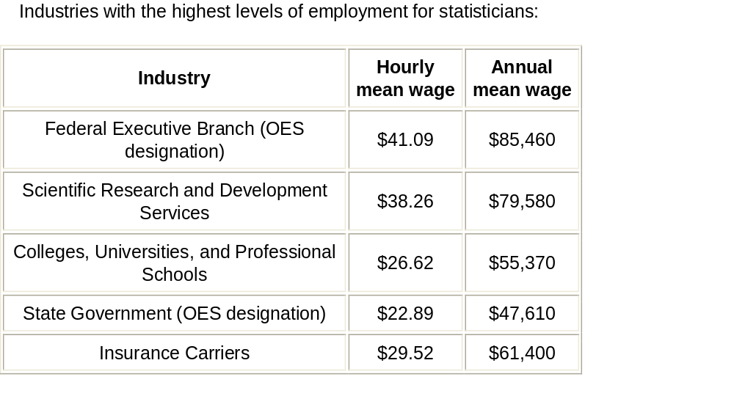
Salary Information
Salary Information
Salary Information
Source: Bureau of Labor Statistics May 2006

Slide 33
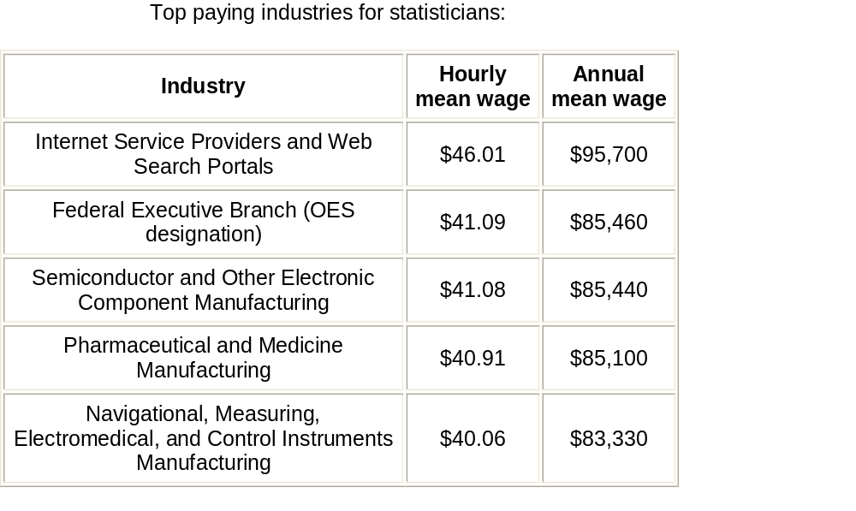
Salary Information
Salary Information
Salary Information
Source: Bureau of Labor Statistics May 2006

Slide 34

About the ASA
Career Services
  Salary Reports, Job Ads, Articles
Education
  Continuing Education, Workshops, Seminars
Awards and Honors
  Scholarships, Fellowships
Meetings
  Joint Statistical Meetings, Local Meetings
Publications
  Journals, Magazines, Research Guides

Slide 35
Contact the ASA for more information:
ATTN: Customer Service
732 North Washington Street
Alexandria, VA 22314
Phone: (703) 684-1221
FAX: (703) 684-2037
Email: asainfo@amstat.org
Web: www.amstat.org

