Slide 1

The problem of overfitting
Regularization
Machine Learning

Slide 2
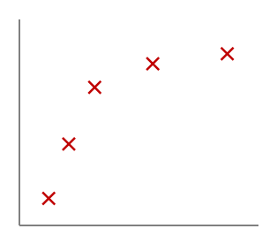
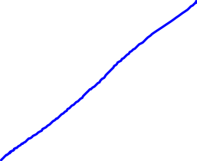
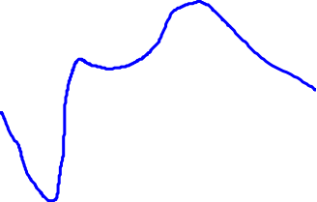
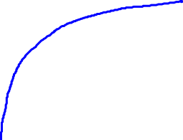

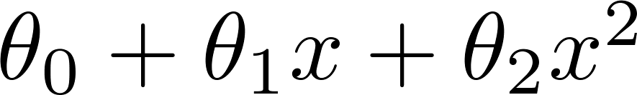
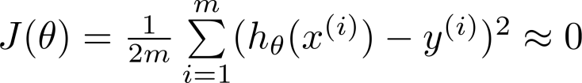
Example: Linear regression (housing prices)
Price
Price
Price
Size
Size
Size
Underfitting 欠拟合
High bias 高偏差
Just right
好的拟合
Overfitting
过拟合
High various
高方差
Overfitting: If we have too many features, the learned hypothesis may fit the training set very well ( ), but fail to generalize to new examples (predict prices on new examples).

Slide 3
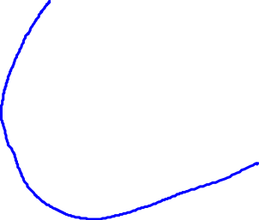
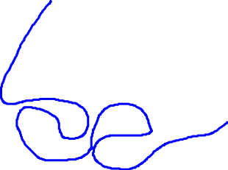
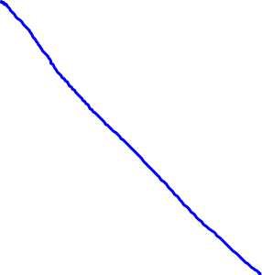
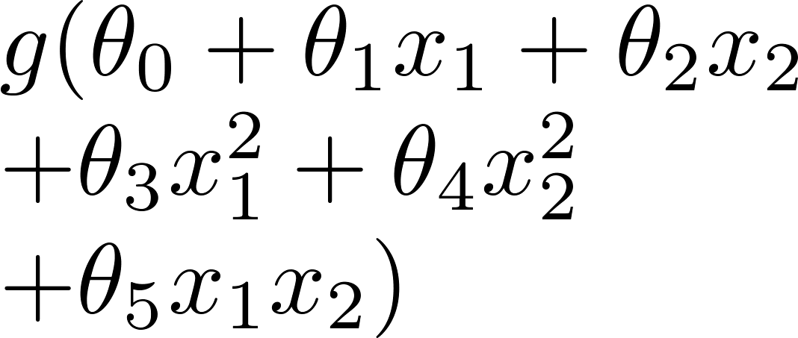
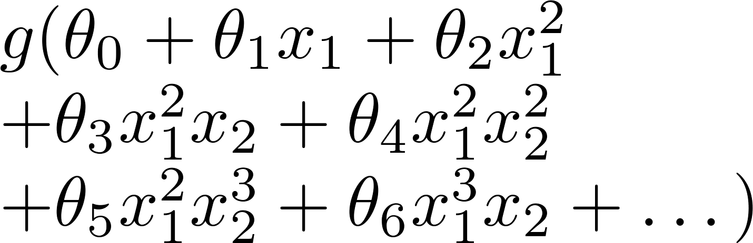
Example: Logistic regression
x₂
x₂
x₂
x₁
x₁
x₁
( = sigmoid function)
Underfitting 欠拟合
Just right
好的拟合
Overfitting
过拟合

Slide 4
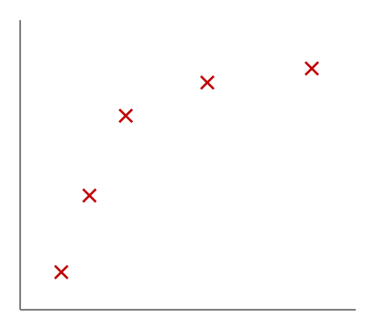
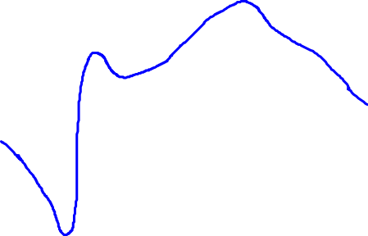






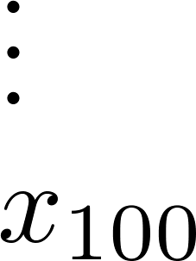
Addressing overfitting:
size of house
no. of bedrooms
Price
no. of floors
age of house
average income in neighborhood
Size
kitchen size

Slide 5


Addressing overfitting:
Options:
  Reduce number of features.
    Manually select which features to keep.
    Model selection algorithm (later in course).
  Regularization.
    Keep all the features, but reduce magnitude/values of parameters .
    Works well when we have a lot of features, each of which contributes a bit to predicting .

Slide 6
Cost function
Regularization
Machine Learning

Slide 7
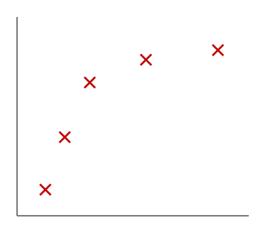
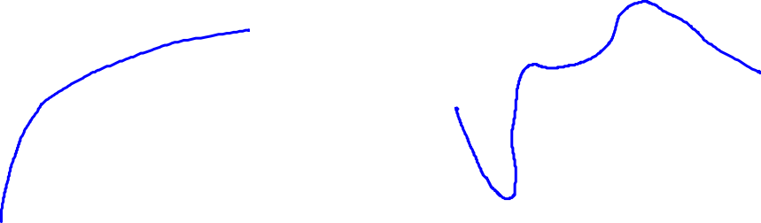
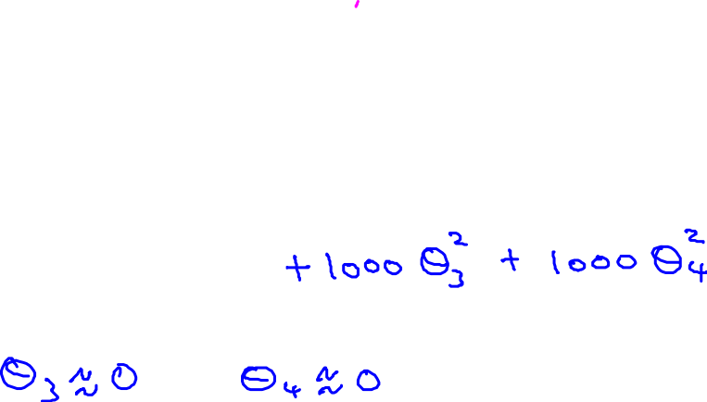


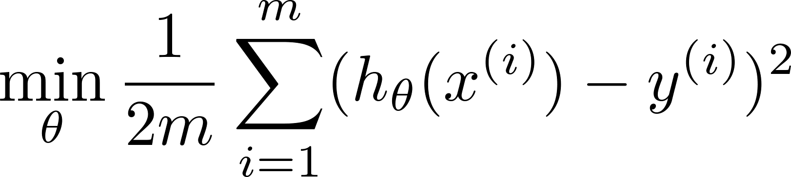
Intuition
Price
Price
Size of house
Size of house
Suppose we penalize and make , really small.

Slide 8
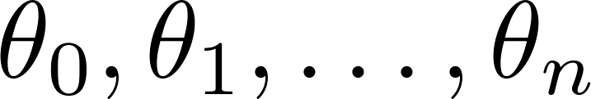
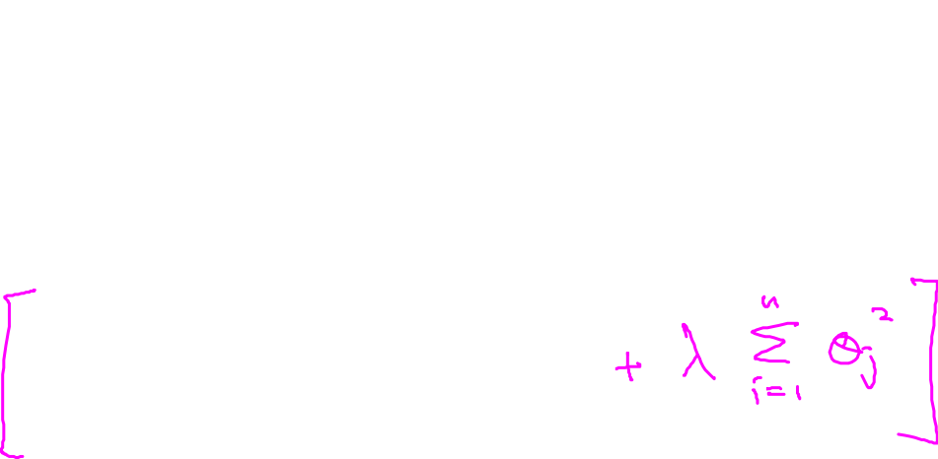
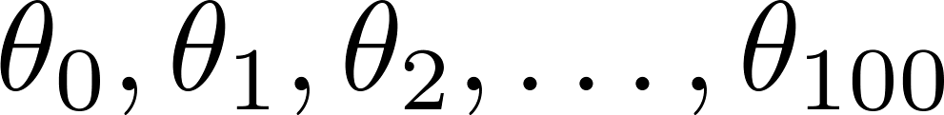
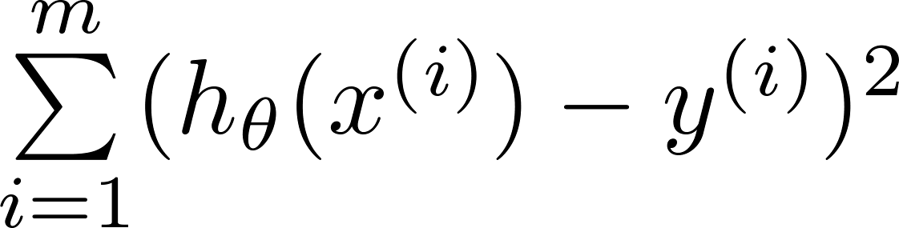
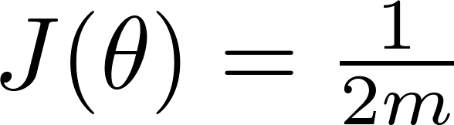
Regularization
Small values for parameters
  “Simpler” hypothesis
  Less prone to overfitting
Housing:
  Features:
  Parameters:
正则参数!
常数项不处理

Slide 9
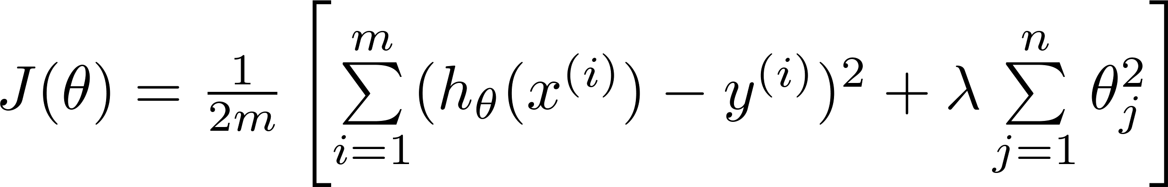
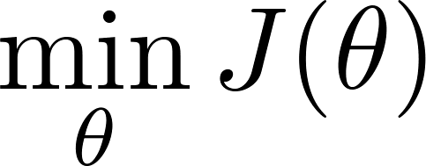
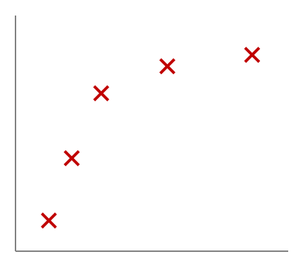
Regularization.
Price
Size of house

Slide 10
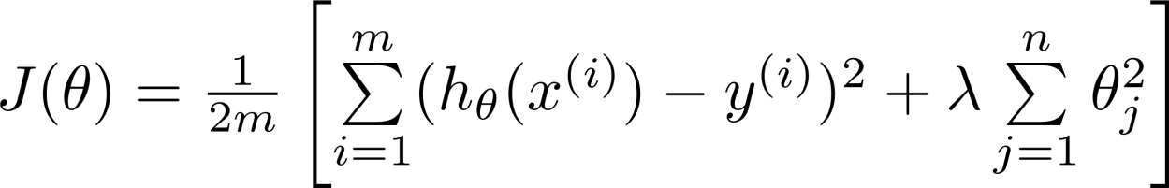

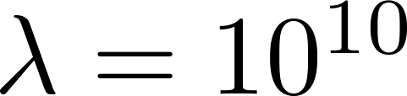
In regularized linear regression, we choose to minimize
What if is set to an extremely large value (perhaps for too large for our problem, say )?
Algorithm works fine; setting to be very large can’t hurt it
Algortihm fails to eliminate overfitting.
Algorithm results in underfitting. (Fails to fit even training data well).
Gradient descent will fail to converge.

Slide 11


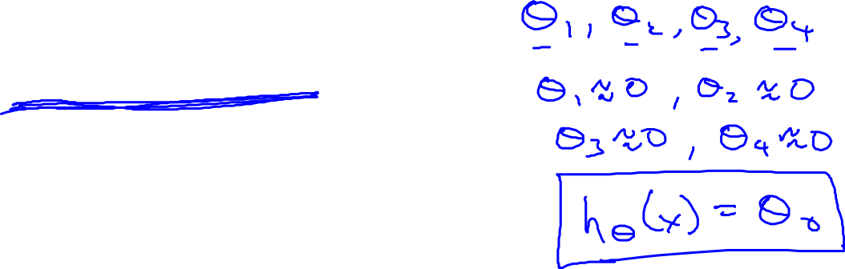
In regularized linear regression, we choose to minimize
What if is set to an extremely large value (perhaps for too large for our problem, say )?
Price
Size of house

Slide 12
Regularized linear regression
Regularization
Machine Learning

Slide 13
Regularized linear regression

Slide 14

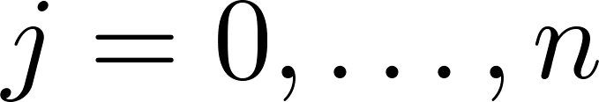
Gradient descent

Slide 15
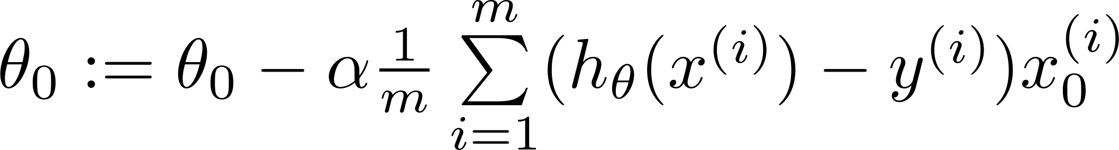
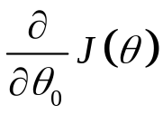
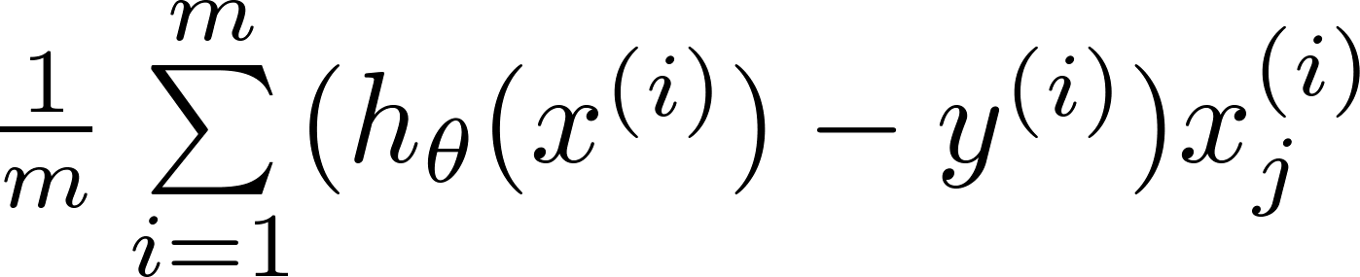
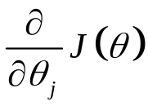
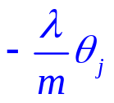
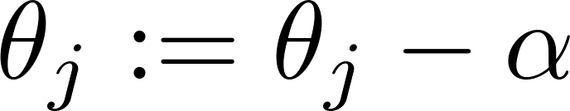


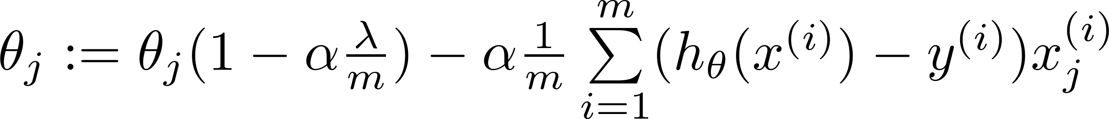
Gradient descent
Repeat

Slide 16
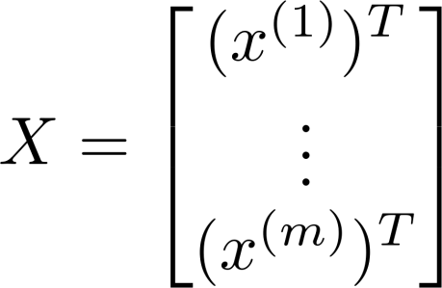
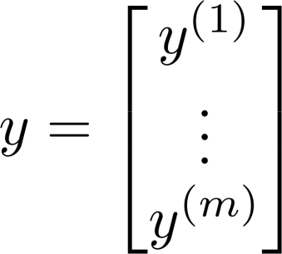
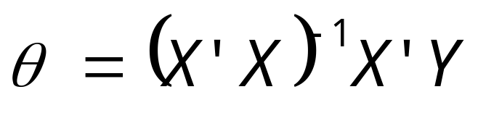
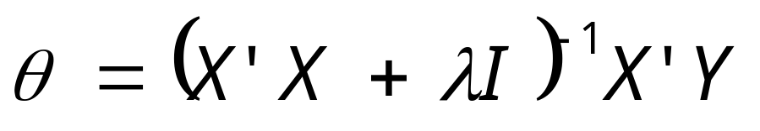
Normal equation
Non-invertible
invertible

Slide 17
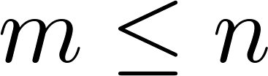
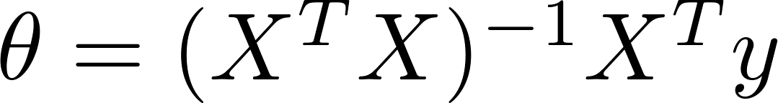

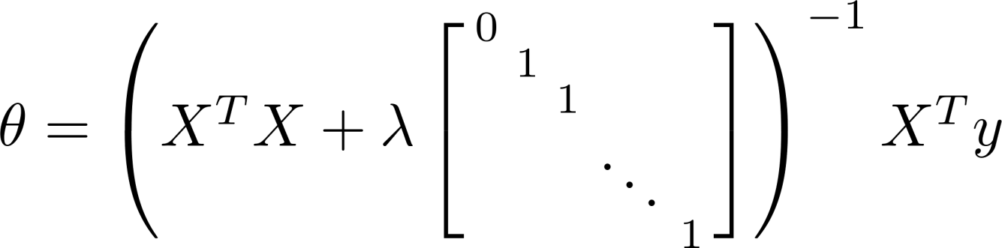
Non-invertibility (optional/advanced).
Suppose ,
(#examples) (#features)
岭回归
If ,

Slide 18
Regularized logistic regression
Regularization
Machine Learning

Slide 19
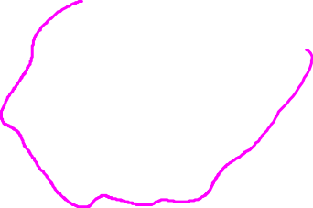
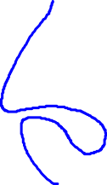
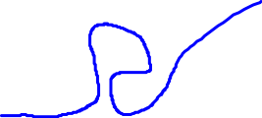
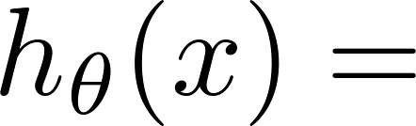
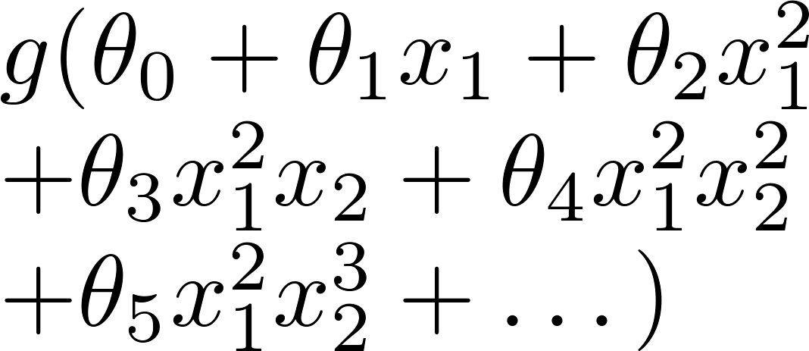
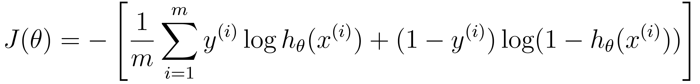



Regularized logistic regression.
x₂
x₁
Cost function:

Slide 20



Gradient descent
Repeat

Slide 21













Advanced optimization
function [jVal, gradient] = costFunction(theta)
code to compute
jVal = [ ];
code to compute
gradient(1) = [ ];
code to compute
gradient(2) = [ ];
code to compute
gradient(3) = [ ];
code to compute
gradient(n+1) = [ ];

Slide 22



小结:1.在训练数据不够多时，或者over-training时，经常会导致over-fitting（过拟合）。其直观的表现如下图所所示:
随着训练过程的进行，模型复杂度，在training data上的error渐渐减小。可是在验证集上的error却反而渐渐增大——由于训练出来的网络过拟合了训练集，对训练集以外的数据却常常无效。
在机器学习算法中，我们经常将原始数据集分为三部分：训练集（training data）、验证集（validation data）、测试集（testing data）.
2.防止过拟合方法主要有：
(1).正则化（Regularization）（L1和L2）
(2).数据增强（Data augmentation），也就是增加训练数据样本
(3).Dropout,2012年.
(4).early stopping提前终止:迭代次数截断
(5).从数据预处理角度
a.对原始数据通过PCA， t-SNE等降维技术进行降维处理
b.平衡不同类数据的权重等
---------------------
本文来自 https://blog.csdn.net/u010899985/article/details/79471909?utm_source=copy

