Slide 1

CULTURE-SPORT INDICATORS
CARL-VIRT-DATA-PT-11-2021-U-B-TTH
Carleton U-boot camp, apr 2022
Final project BY hulya gunay
Provincial and Territorial Culture & sport Indicators data analysis

Slide 2
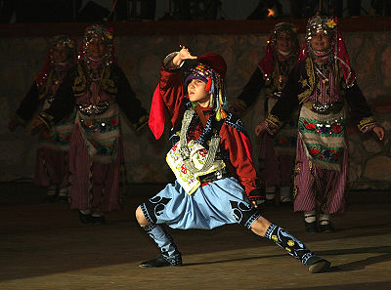
Introduction
The Provincial and Territorial Culture Satellite Account (PTCSA) measures the economic importance of culture and sport to provincial and territorial economies by estimating the production of culture and sport goods and services and their contribution to output, GDP, and jobs.
Reports are generated quarterly discussing the scope of the study and highlight the results of the culture satellite indicators by province and territory for reference since the year 2010.
This Photo by Unknown Author is licensed under CC BY-SA

Slide 3
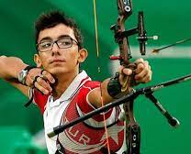
Culture and Sport data
Within the Culture Satellite Account, culture is defined as a creative artistic activity and the goods and services produced by this creative activity and the preservation of heritage.
Sport is defined as an individual or group activity, often pursued for fitness in leisure time, fun or competition.
Culture GDP is the value added related to the production of culture goods and/or services across the economy regardless of the producing industry.

Slide 4
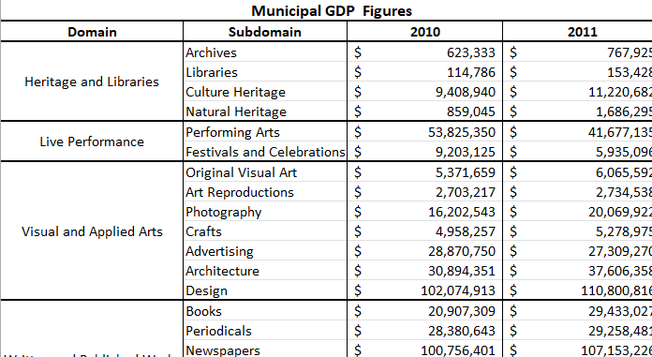
Culture and Sport data
CSA output tables detail the production, use and consumption of all goods and services in the provincial and territorial economies. They measure economic activity by industry and by product.
The Culture Indicators project uses the summary data provided by the CSA. The data has GDP values for Culture and Sports sector from 2010 to 2019 for twelve different domains and twenty-two subdomains as seen in the table.

Slide 5
Scope of Culture Indicators
The cultural domain GDPs fluctuate each year. The client is concerned that many municipalities do not really use the data that they receive from the CSS. It could be because many municipal culture staff aren't sure how to interpret the data and may need some help seeing the stories.
The scope of the Culture Indicators project is to provide data analysis and visualizations for one or more domains and make the data become easier to understand and subsequently, be used more extensively.

Slide 6
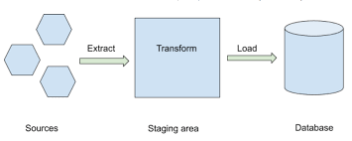
Requirements
- Receive data and extract, transform and load

Slide 7
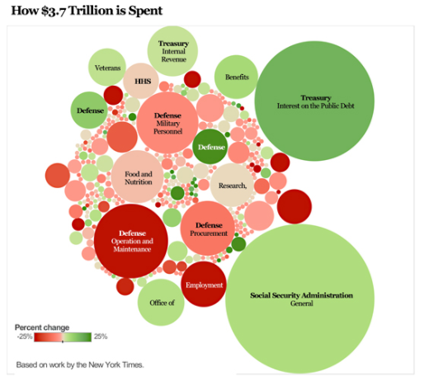
Requirements
- Visualize data

Slide 8
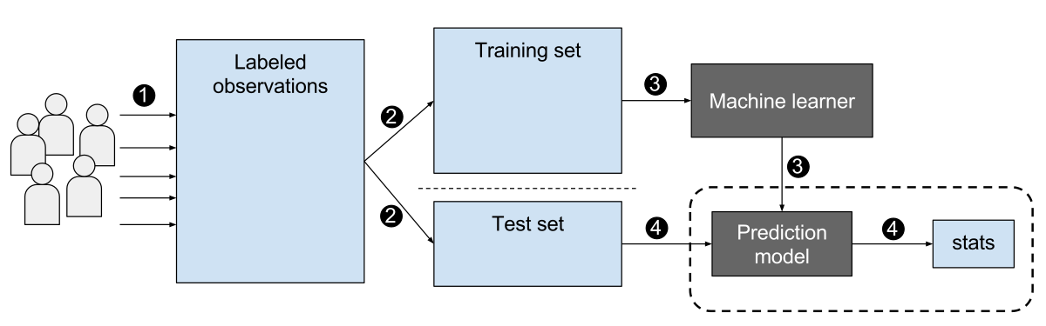
Requirements
- Use Machine Learning Algorithms to analyze data and evaluate results

Slide 9
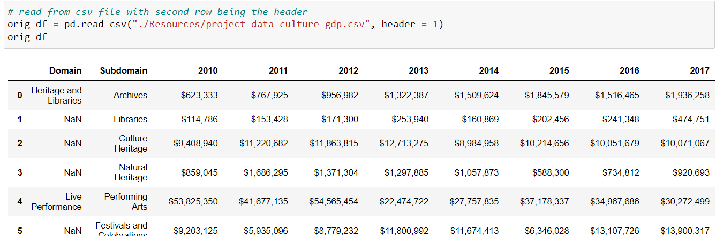
Extracting, transforming, loading data: An environment consisting of Python, postgreSQL, Jupyter notebooks, and pgAdmin is used for this process. The following image shows the data received from the client.

Slide 10
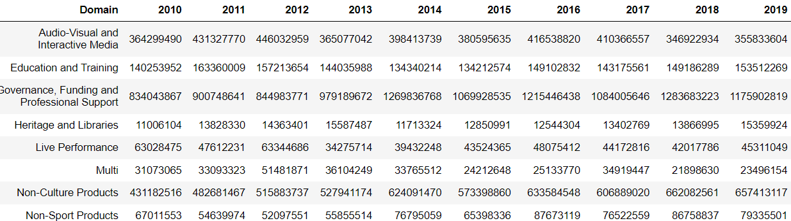
Extracting, transforming, loading data: This image shows the data after cleaning from null values, unwanted characters in integer cells. GDP values for each domain are grouped and a total GDP is calculated.

Slide 11
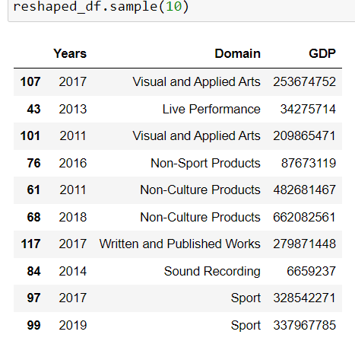
Extracting, transforming, loading data: This image shows the dataset where data is prepared for Machine Learning algorithms. Swap, melt and transform operations are used to create a new dataset that consist of domain name, year and GDP columns.

Slide 12
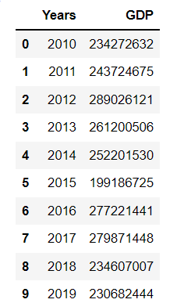
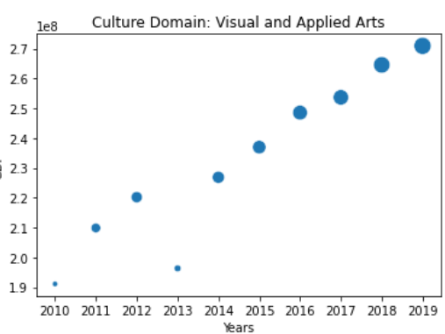
Visualizing data: Matplotlib, numpy, seaborn, pandas libraries and Python language in Jupyter notebooks are used for data visualization. This image show the data and plot for Visual and Applied Arts domain and its GDP since 2010. As seen the GDP brings more income and since 2014 there is a trend of increase. In 2013 there was a big decrease compared to previous years.

Slide 13
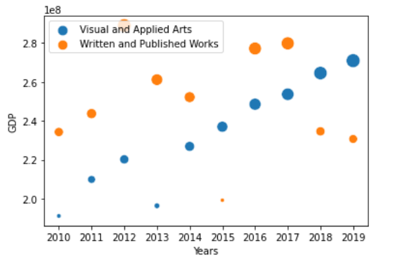
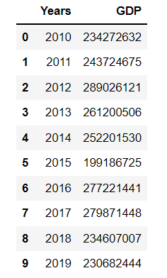
Visualizing data: These images show the datasets and plot for ‘Visual and Applied Arts’ and ‘Written and Published Works’ domains and its GDP since 2010 in the same plot. As seen below the GDP brings more income since 2014 for Visual and Applied Arts and there is a trend of increase. In 2013 there was a big decrease compared to previous years. As for the “Written and Published Works’ culture domain the GDP increases until 2018 except for very low GDP for 2015. Since 2018 there is a big loss in GDP.

Slide 14
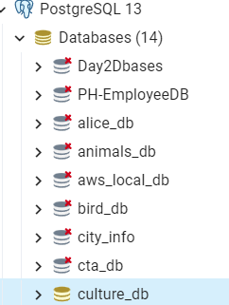
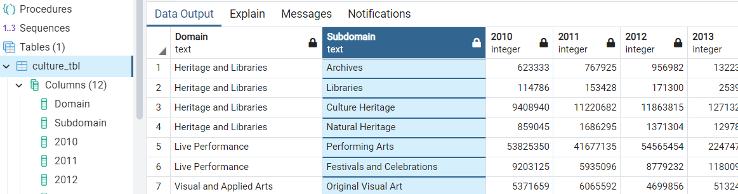
Loading Data-SQL
Using a sqlchemy library the data is saved by creating the database engine, loaded dataset to a SQL table. pgAdmin is used to run postgreSQL queries on the table and exported as a new .csv table. The first table is culture_tbl after the initial ET process. This table is exported as culture_table.csv and used for data wrangling.

Slide 15
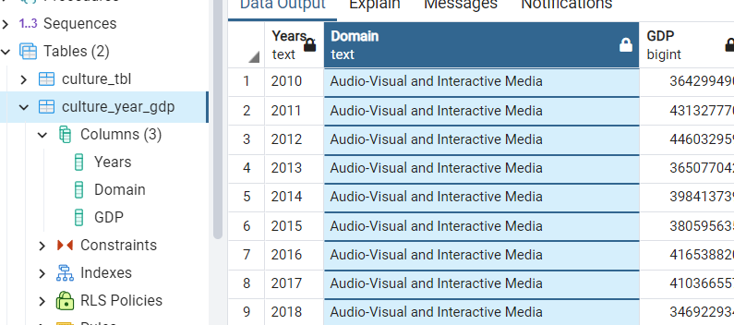
Loading Data - SQL
Using sqlchemy library the data is saved by creating the database engine, loaded dataset to a SQL table. pgAdmin is used to run SQL queries on the table and exported as a new .csv table. The second table is culture_year_gdp table that has a cleaner data for using Machine Learning. This table is exported as culture_year_gdp.csv and used for data wrangling.

Slide 16
Machine Learning Simple Linear Regression Supervised ML algorithm
The regression predicts continuous value outputs. Dataset has 22 subdomains meaning 22 different culture branches that the GDP is collected for. I grouped the data under the given domains. My focus is on one of the 12 culture domains. This domain has data for ten years of GDP figures.
I demonstrated my study with simple linear regression using Scikit-Learn library. The reason I’ve chosen the linear regression theory is that I have a small amount of data and need to draw a relationship between years and GDP.
I want to be able to find out given the number of years for a culture domain how high of GDP can the domain achieve?
X axis: number of years y axis: GDP values

Slide 17
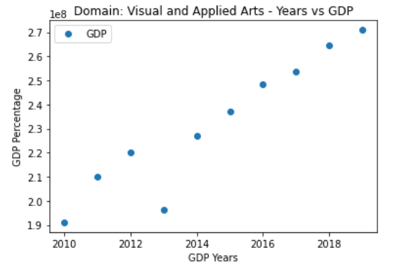
Machine Learning Simple Linear Regression Supervised ML algorithm
The Linear regression model finds the best value for the intercept and slope, which results in a line that best fits the data as shown in the figure below. As one can clearly see, there is a positive linear relation between the number of years and percentage of GDP score for Visual Arts domain.
# The target variable is GDP and input is the Years, meaning that the goal of the linear regression model is to predict GDP based on years of past GDP.

Slide 18
Machine Learning Simple Linear Regression Supervised ML algorithm
I have run the following algorithms on my dataset;
# Create and train the model
# Generate predictions
# Score Data
# retrieve the intercept
# making predictions with all the predicted values for the input values in the X_test series.
# compare the actual output values for X_test with the predicted values, execute the following script:
# evaluate the performance of algorithm
# for regression algorithms, do the three evaluation metrics
# find the mean of the dataset to compare to the mean squared error
# Display the visualization of the Confusion Matrix
# Prepare data :
The Attributes are the independent variables; labels are dependent variables whose values are to be predicted.
X: Years – attribute
y: GDP to be predicted – labels
# Test data:
splits 80% of the data to training set while 20% of the data to test set using the argument” test_size=0.2”

Slide 19


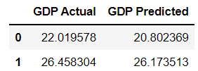

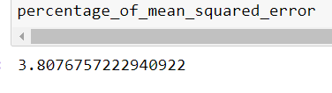

Machine Learning Simple Linear Regression Supervised ML algorithm
Explanation of the values from ML linear Regression Test:
As seen in the images below, the predicted percentages are close to the actual ones in the table, GDP Actual 22M vs GDP Predicted 20M. Using the slope of 8.9 and intercept values predicted y values which are calculated as 2.08-23692 for input year X.
The value of root mean squared error is 8.83, which is less than 4% of the mean. The value of the percentages of all the GDP's 231.9 as seen below. This means that the algorithm did a decent job.
# Data Shape is 10X2
# Training Score: 89% accuracy
# Testing Score: 84%
# Given the linear regression model the machine is predicting at an accuracy of 84%
# Mean square error is extremely high and my accuracy are above 80%
# My model overfitting my data set meaning that the machine is memorizing the trend and not actually learning

Slide 20
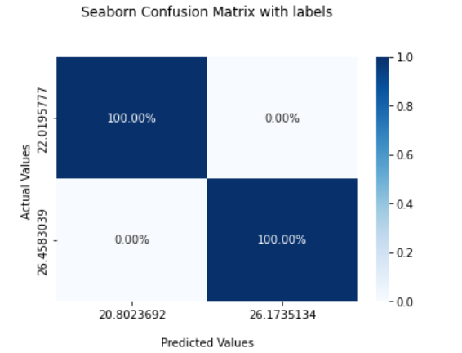
Machine Learning Simple Linear Regression Supervised ML algorithm
Display the visualization of the Confusion Matrix
Confusion matrix visualizes the performance of the models as seen in the image. Predicted values are Positive and Negative and actual values are True and False. Prediction was 26M positive and it is True. Actual GDP was 22M predicted and it is false. This model is imported as a pickle file.
Result: My model overfitting my data set, meaning that the machine is memorizing the trend and not actually learning

Slide 21
Machine Learning Random Forest Supervised ML algorithm
The regression predicts continuous value outputs focus on one of the 12 culture domains. This domain has data for ten years of GDP values. I used one of the domains to do ML algorithm. Otherwise my data becomes too noisy with all the domains.
I demonstrated my study with random forest algorithm using Scikit-Learn library. I used the following steps for the RF algorithm;
Split data into Train and Test sets
Create a Standard Scaler and scale the data
Create a random Forest classifier and fit the model
Score the data and make predictions, calculating accuracy score and confusion matrix
Make the predictions and plot the confusion matrix

Slide 22

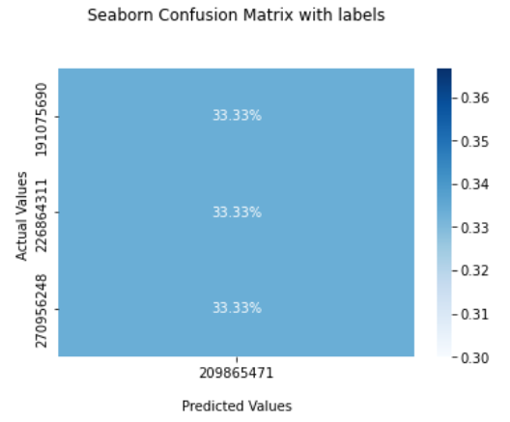

Machine Learning Random Forest Supervised ML algorithm
Random Forest data gave normal results for training the data but testing data it gave 0% accuracy result as seen in the images.
This result tells me that my model is underfitting my data set. It fits exactly against its training data. Random Forest algorithm can’t perform accurately against unseen data, defeating its purpose.

Slide 23
Culture Statistics Dashboard
Visualization is a big trend in reproducible data science and data journalism. I am using plotly, D3.js, web APIs, functional Javascript, math library, HTML. I created an interactive data visualization for the web. VSCode is used as text editor to create html and Javascript files. This part of the project will show interactive data visualization. Data is manipulated, transformed using Javascript, and event handlers are used in Javascript to add interactivity to my data visualization.
For the interactive visualization of the project I ran python on http server and open a browser to the local port address. The axis were based on years and GDP.
X: Year (2010-2019) y: GDP in CAD

Slide 24
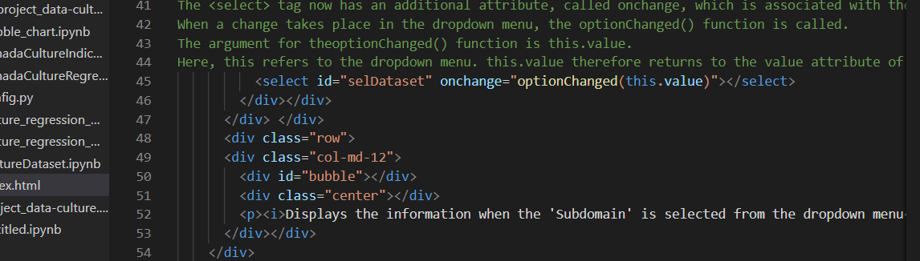
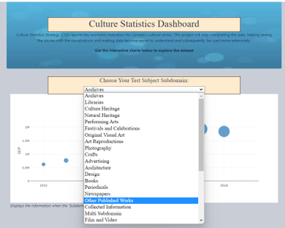
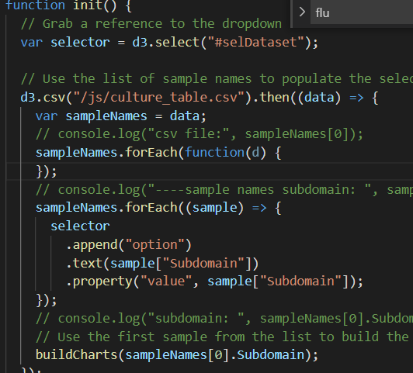
Culture Statistics Dashboard
I used d3.selectall method to create an event listener on select option from the drop down list as seen in the image below for the index.html file. The user can choose the subdomain for culture and sport account and it displays the dynamic plotly graph. The X axis data remain the same however y-axis values depend on which dropdown menu option was selected in html document. The following image on the left shows a sample of the code that creates a dropdown menu of ID numbers dynamically. Using plotly as seen in the image on the right, D3, web APIs and math library data is manipulated which added interactivity to the visualization of culture statistics dataset.

Slide 25
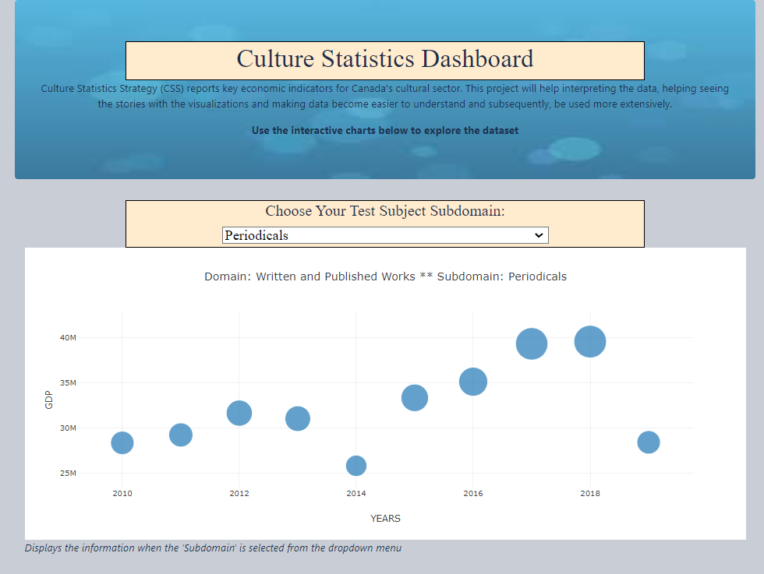
In summary; dynamic visualization of subdomains for the culture and sports dataset were created in functional javascript, d3, & html. Plot is displaying Year - GDP values which shows the fluctuating revenue for each year. The linear algorithm did a decent job but the model overfitting the dataset. As for the Random Forest model it is underfitting the dataset, the testing score is 0%.

