Slide 1

A2 — ns-3 Built-in Traffic Model
Notes:
The presentation first introduces the integrated lifecycle and then organizes research gaps by lifecycle stage.
[1] A. Leivadeas and M. Falkner, “A survey on intent-based networking,” IEEE Commun. Surveys Tuts., vol. 25, no. 1, pp. 625–655, 1st Quart., 2023, doi: 10.1109/COMST.2022.3215919.
[2] K. Mehmood, K. Kralevska, and D. Palma, “Intent-driven autonomous network and service management in future cellular networks: A structured literature review,” Comput. Netw., vol. 220, Art. no. 109477, 2023, doi: 10.1016/j.comnet.2022.109477.
[3] M. Gharbaoui, F. Sciarrone, M. Fontana, P. Castoldi, and B. Martini, “Assurance and conflict detection in intent-based networking: A comprehensive survey and insights on standards and open-source tools,” IEEE Trans. Netw. Service Manag., vol. 23, pp. 1891–1912, 2026, doi: 10.1109/TNSM.2026.3651896.
[4] Y. Wang, C. Yang, T. Li, Y. Ouyang, X. Mi, and Y. Song, “A survey on intent-driven end-to-end 6G mobile communication system,” IEEE Commun. Surveys Tuts., vol. 28, pp. 882–915, 2026, doi: 10.1109/COMST.2025.3575041.

Slide 2

2
Built-in HTTP traffic model
ThreeGppHttpClient
ThreeGppHttpServer
Requests a main web object
Requests embedded objects
Waits for reading time
Repeats the browsing cycle
Accepts the HTTP connection
Generates response object sizes
Segments objects into packets
Returns content to the client

Slide 3
3
Simulation topology
Node 0
Point-to-point channel
Node 1
HTTP client
HTTP server
100 Mbps | 10 ms delay | IPv4
Simulation time = 60 s • Start client at 0.1 s • Random seed = 7

Slide 4
4
Source code and measurement
ThreeGppHttpServerHelper serverHelper(serverAddress);
serverHelper.Install(nodes.Get(1));
ThreeGppHttpClientHelper clientHelper(serverAddress);
clientHelper.Install(nodes.Get(0));
httpClient->TraceConnectWithoutContext(
"Rx", MakeCallback(&ClientRx));
The callback records packet size, arrival time, and inter-arrival time into CSV.

Slide 5
5
Configured variables and output files
ThreeGppHttpVariables
Evidence files
Configured main object mean = 102,400 B
Configured main object std. dev. = 40,960 B
Embedded-object count and reading time
HTTP request/response behavior
built_in_packet_samples.csv
built_in_pages.csv
built_in_summary.txt
a2-built-in-http-0-0.pcap

Slide 6
6
Result from the built-in run
441,503
307
0.0589
received bytes
received packets
throughput (Mbps)
Run command
./ns3 run 'a2-traffic-model-built-in --outputDir=.../results'

Slide 7
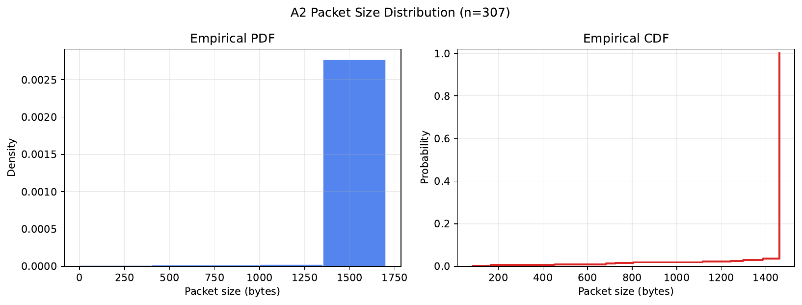
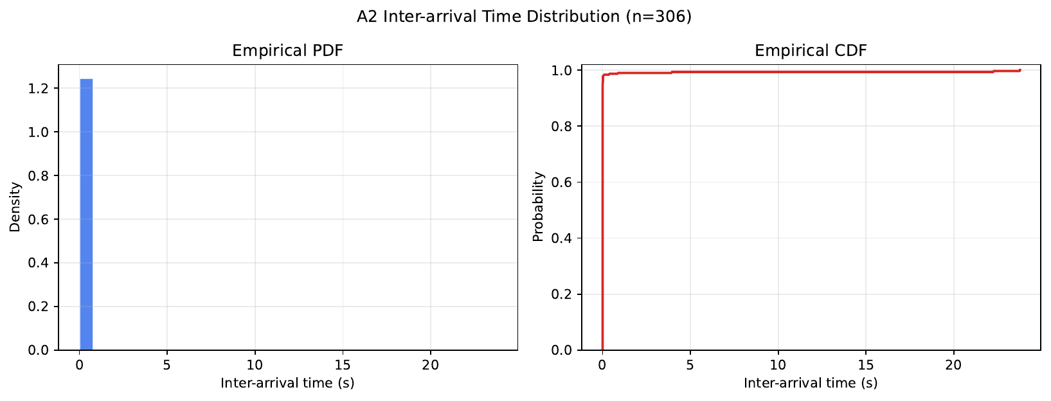
7
Distribution evidence
Packet sizes reflect HTTP object segmentation.
Inter-arrival times come from received packets.
n = 307 packet-size samples | n = 306 inter-arrival samples

