Slide 1
A2 — ns-3 Built-in Traffic Model
Using ThreeGppHttpClient / ThreeGppHttpServer
Henry | M11502205
ns-3.46.1 • Ubuntu 22.04
60-second simulation
Goal: run a built-in model and prove it with measured traffic.
A2 | 1

Slide 2
Why use the built-in model
The assignment explicitly allows an ns-3 built-in traffic model.
ThreeGppHttpClient
ThreeGppHttpServer
Requests a main web object
Requests embedded objects
Waits for reading time
Repeats the browsing cycle
Accepts the HTTP connection
Generates object sizes with ThreeGppHttpVariables
Segments objects into packets
Returns content to the client
A2 | 2

Slide 3
Simulation topology
A controlled two-node path isolates application traffic.
Node 0
Point-to-point channel
Node 1
HTTP client
HTTP server
100 Mbps | 10 ms delay | IPv4
simulation time = 60 s • start client at 0.1 s • random seed = 7
A2 | 3

Slide 4
What the source code does
The scenario is mostly ns-3 built-in helpers and trace callbacks.
ThreeGppHttpServerHelper serverHelper(serverAddress);
serverHelper.Install(nodes.Get(1));
ThreeGppHttpClientHelper clientHelper(serverAddress);
clientHelper.Install(nodes.Get(0));
httpClient->TraceConnectWithoutContext("Rx", MakeCallback(&ClientRx));
The callback records packet size, arrival time, and inter-arrival time into CSV.
A2 | 4

Slide 5
Built-in variables and outputs
The model generates browsing behavior instead of a hand-written packet loop.
ThreeGppHttpVariables
Evidence files
Main object size mean = 102,400 B
Main object size std. dev. = 40,960 B
Embedded-object count and reading time are built in
HTTP request/response behavior is built in
built_in_packet_samples.csv
built_in_pages.csv
built_in_summary.txt
a2-built-in-http-0-0.pcap
A2 | 5

Slide 6
Result from the built-in run
The built-in application generated measurable HTTP traffic.
441,503
307
0.0589653
received bytes
received packets
throughput (Mbps)
Run command
./ns3 run 'a2-traffic-model-built-in --outputDir=.../results'
A2 | 6

Slide 7
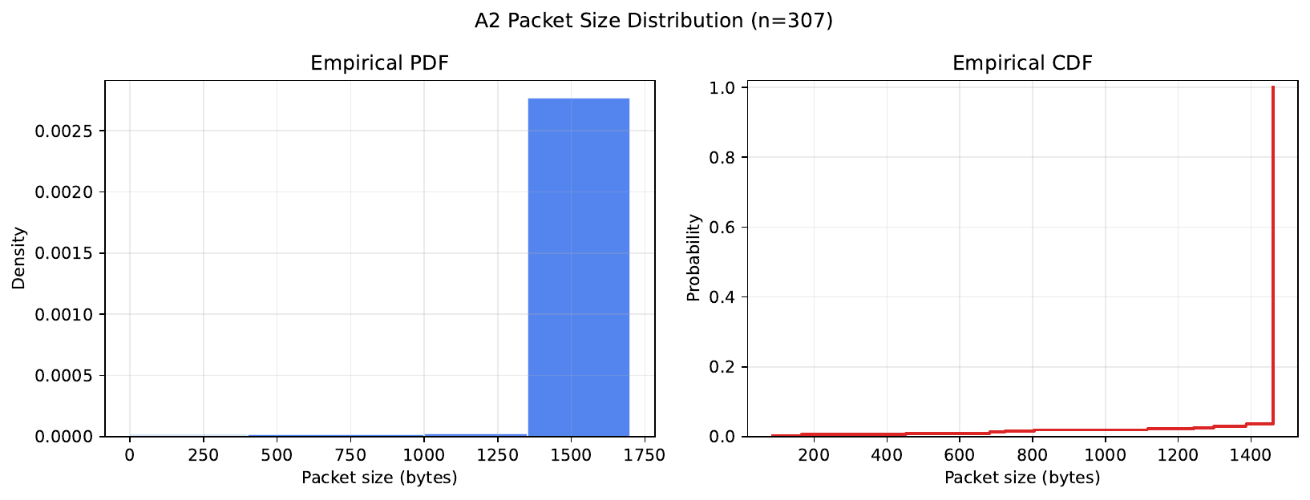
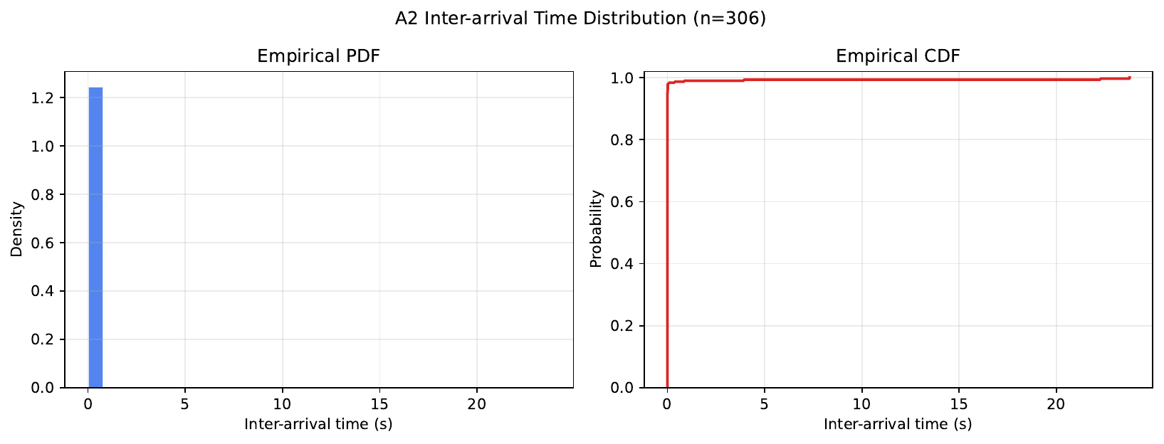
Distribution evidence
The plots are empirical distributions measured from built-in model packets.
Packet sizes come from HTTP object segmentation.
Inter-arrival times come from received packets.
A2 | 7

Slide 8
Submission checklist
What to show during the 10-minute presentation.
Three required items
One-sentence conclusion
study_note.md — setup and model
a2-traffic-model-built-in.cc — source and run command
results — numbers, plots, and PCAP
The ns-3 built-in ThreeGppHttp model successfully generated web-browsing traffic, and the measured throughput, distributions, and PCAP prove that the simulation ran.
Next: show the PCAP in Wireshark.
A2 | 8

