Slide 2
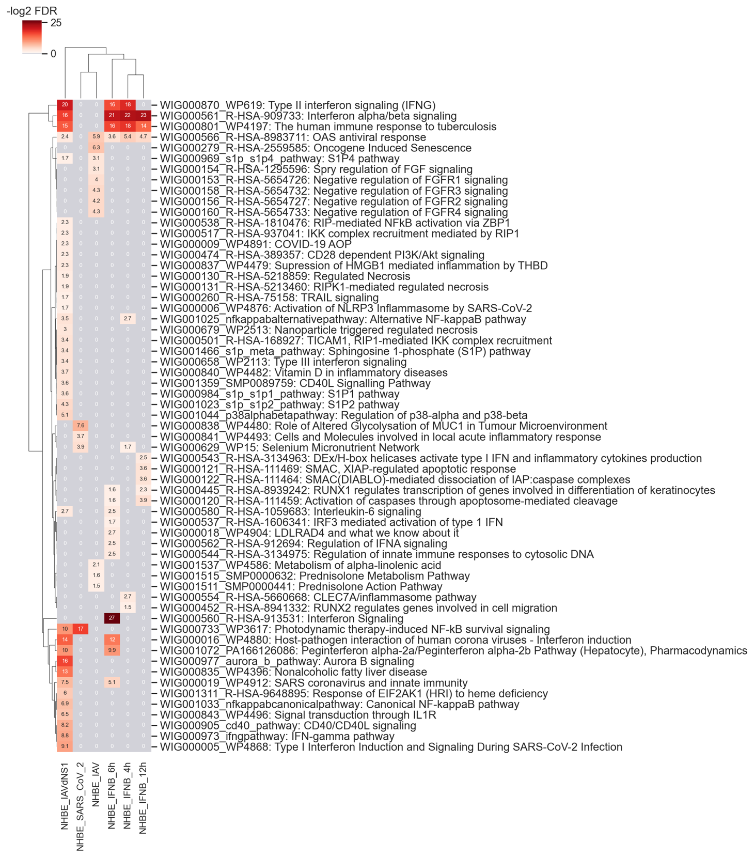
NHBE: Primary human lung epithelium.

