Slide 2
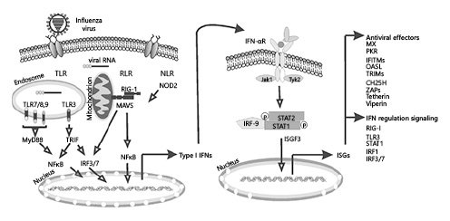
https://www.karger.com/Article/Fulltext/508379

Slide 3
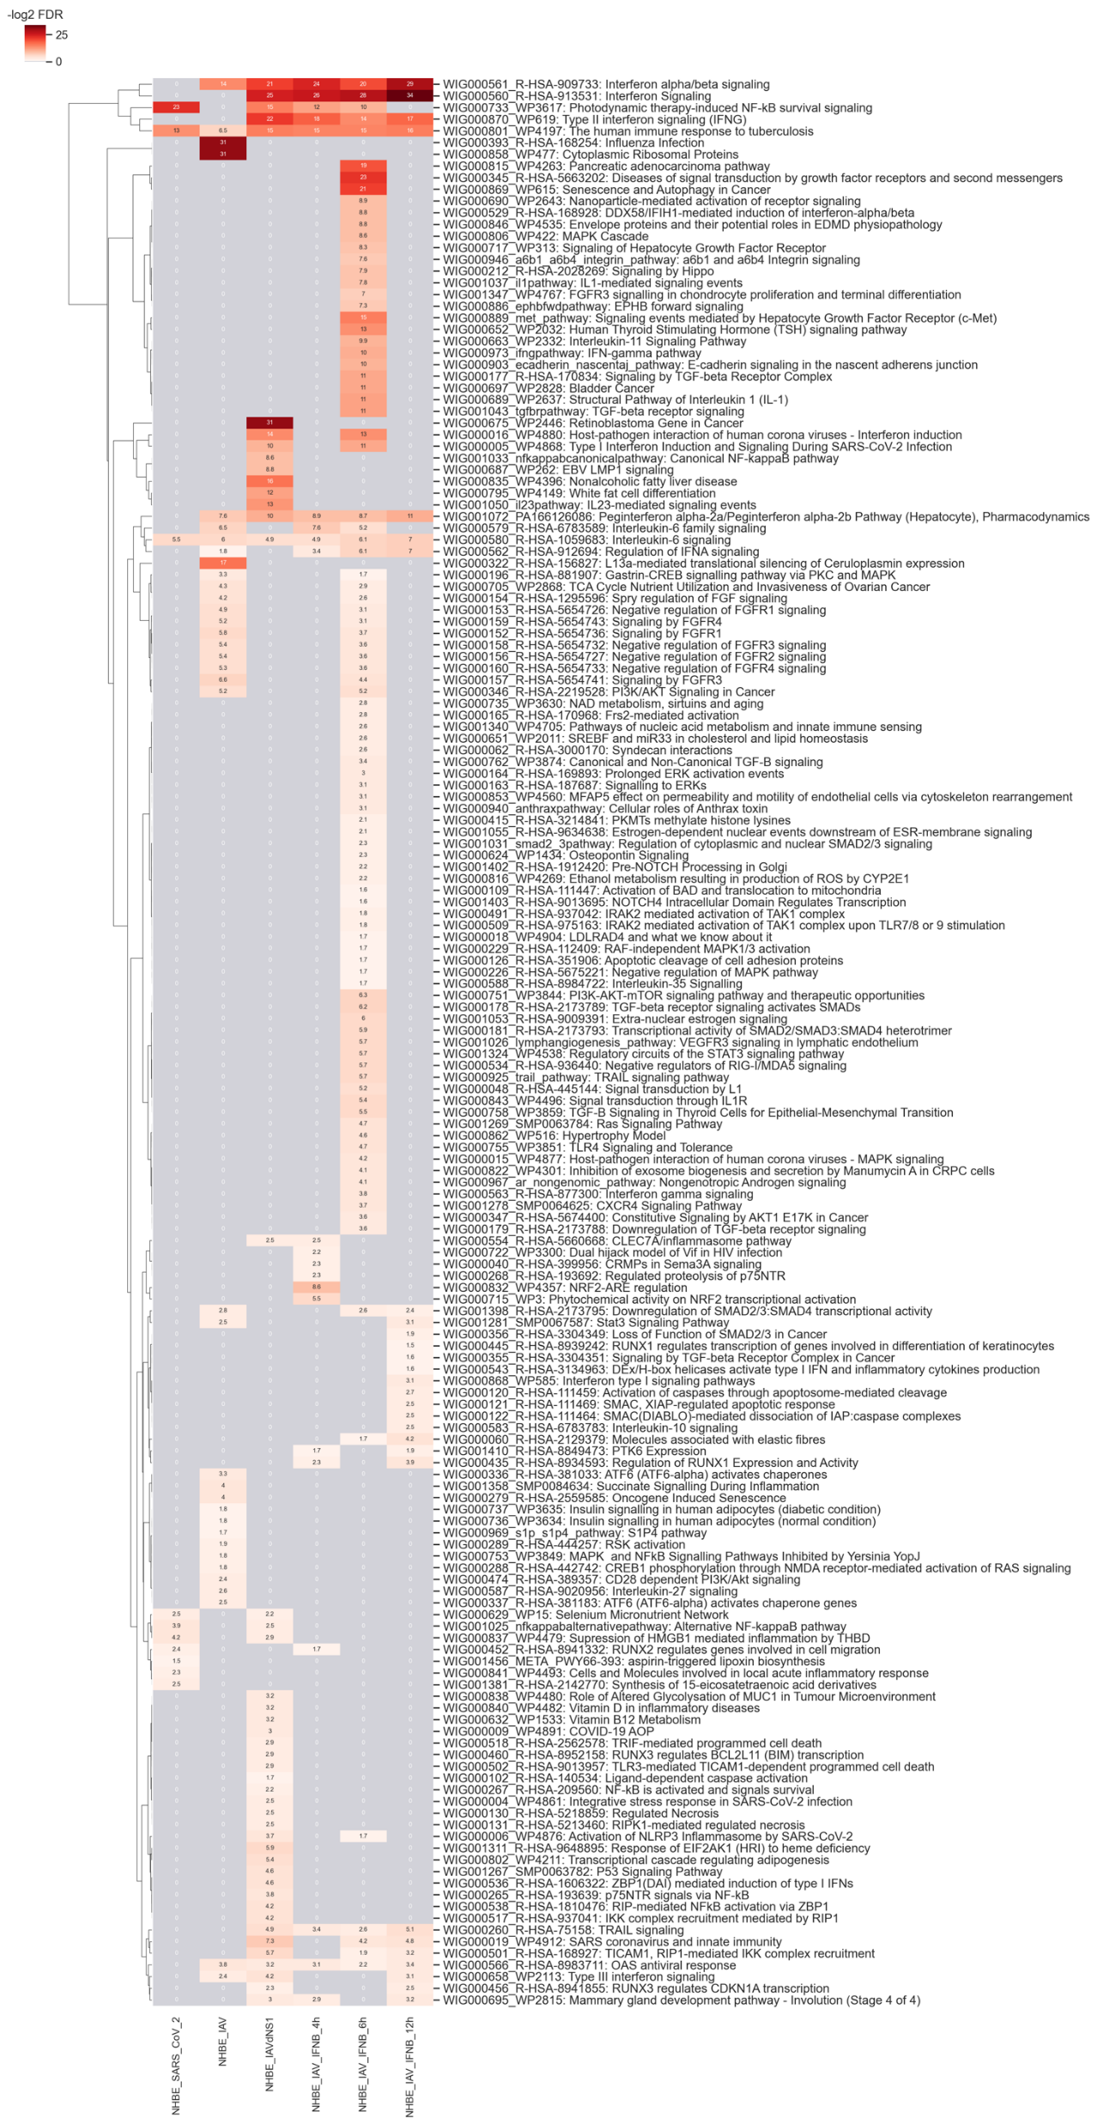
NHBE: Primary human lung epithelium.
Key discovery:

