Slide 2
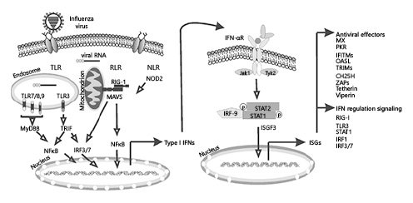
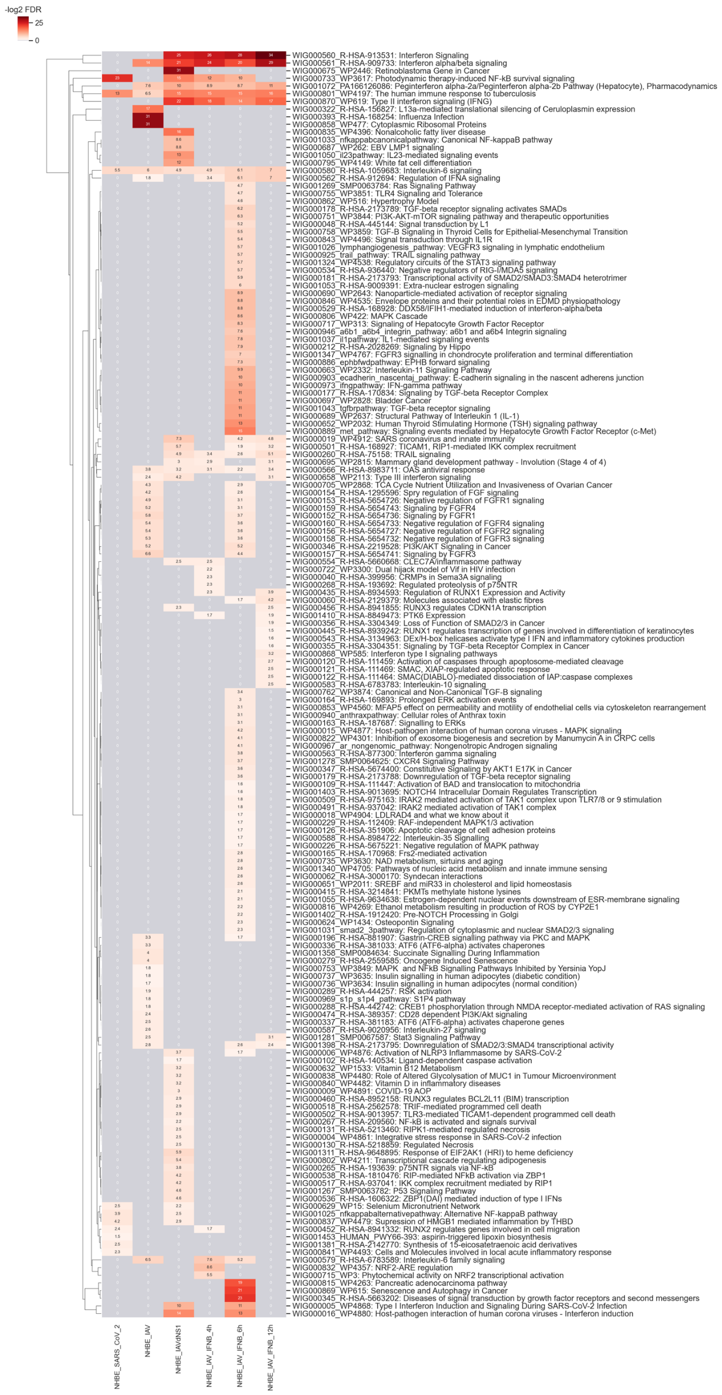
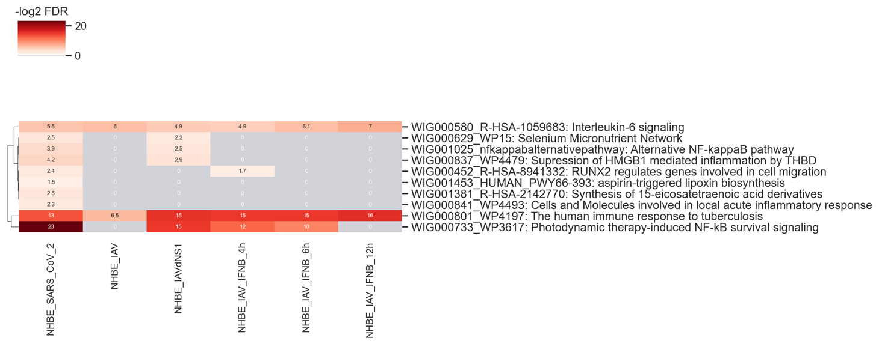
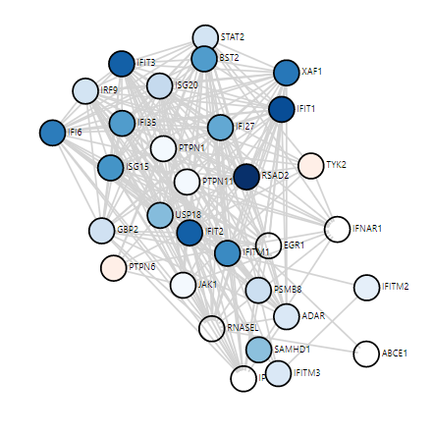
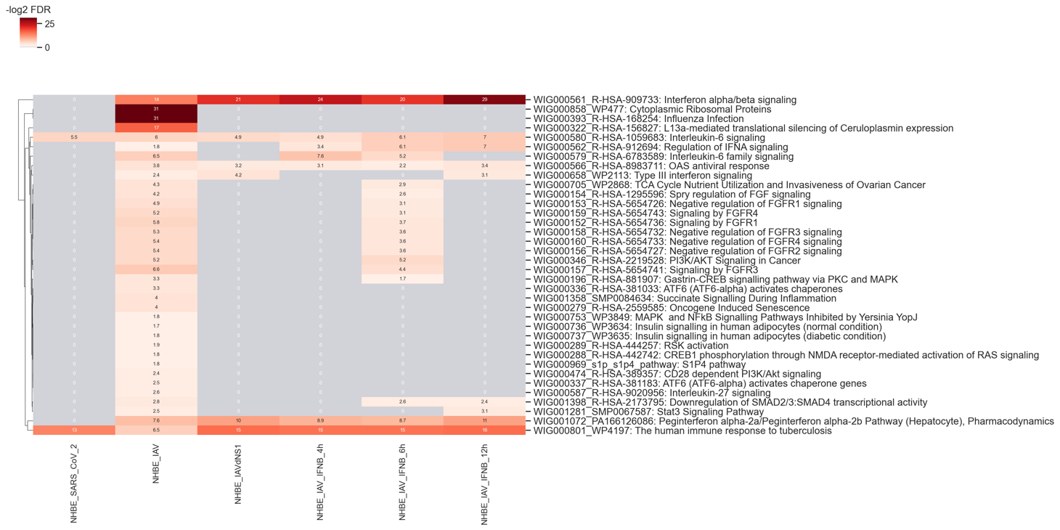
IFN role in the anti-viral infection
NHBE: Primary human lung epithelium.
NHBE_SARS_CoV2_pathway
https://www.karger.com/Article/Fulltext/508379
NHBE_IAV_pathway
Interferon alpha/beta signaling

Slide 3
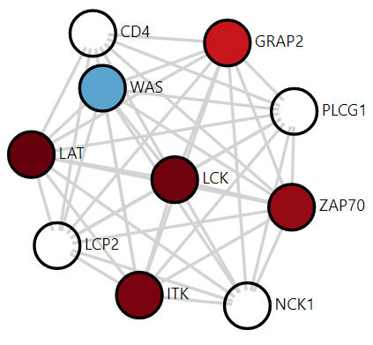
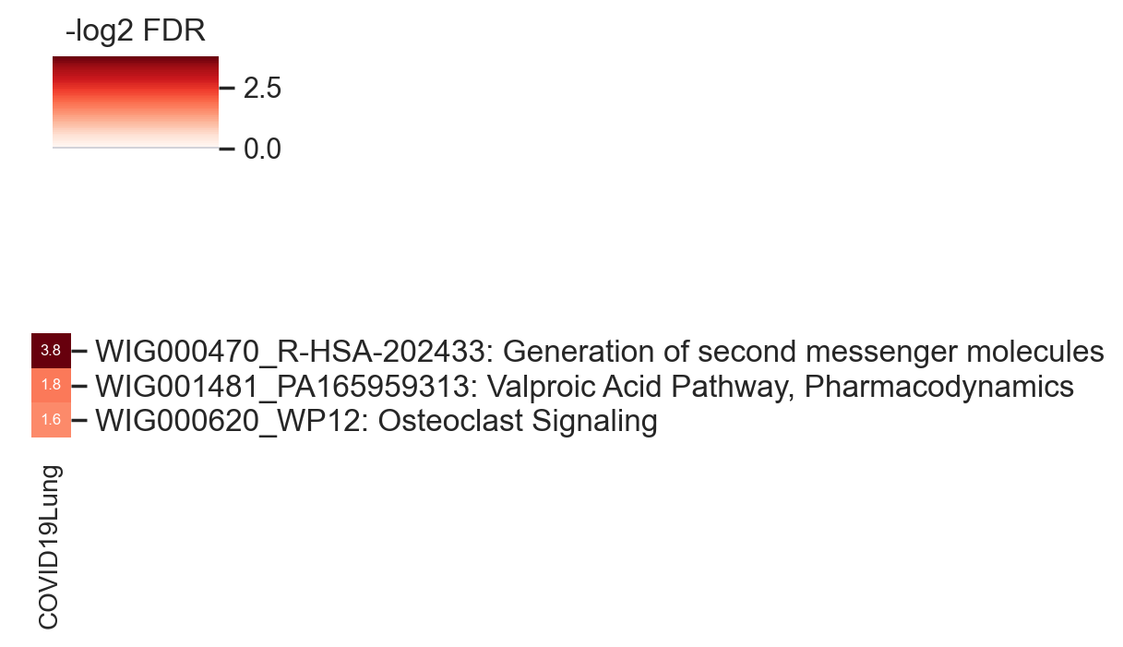
Lung
Generation of second messenger molecules's gene network

Slide 4
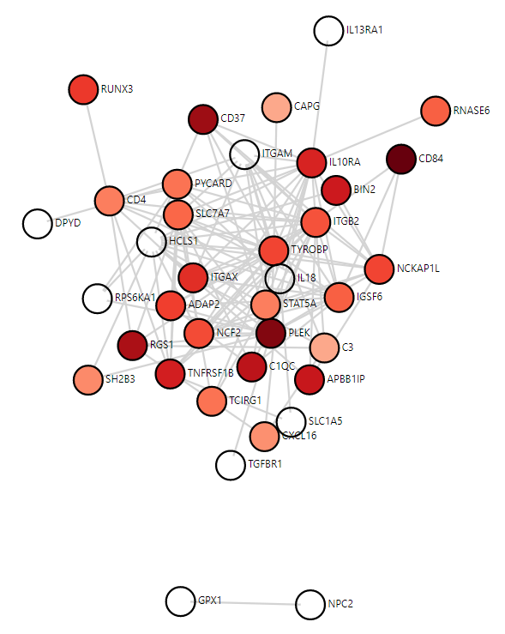
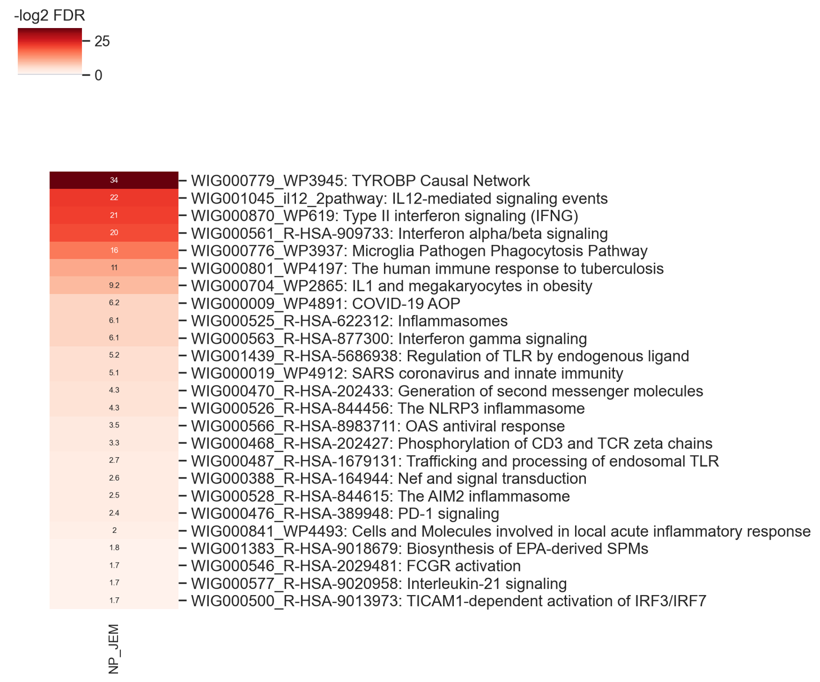
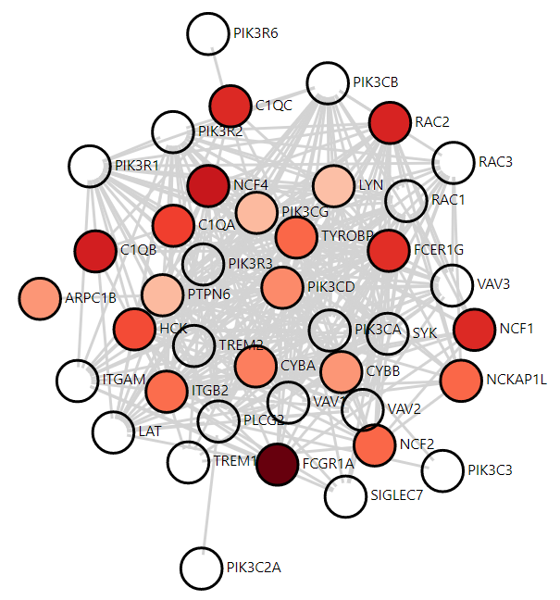
Nasopharyngeal (NP)
TYROBP Casual Network
Microglia Pathogen Phagocytosis Pathway

