Slide 2
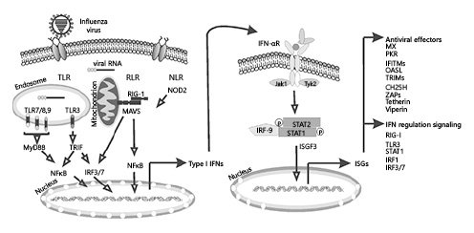
IFN role in the anti-viral infection
NHBE: Primary human lung epithelium.
https://www.karger.com/Article/Fulltext/508379

Slide 3
NHBE: Primary human lung epithelium.
Key discovery:

