Slide 1
PAGER-CoV Run: A flexible platform for COVID19 functional enrichment analysis across cell types and tissues
Zongliang Yue, Nishant Batra, and Jake Y. Chen

Slide 2
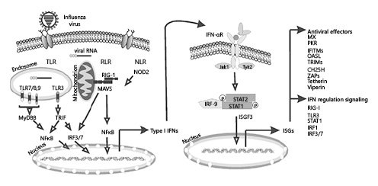
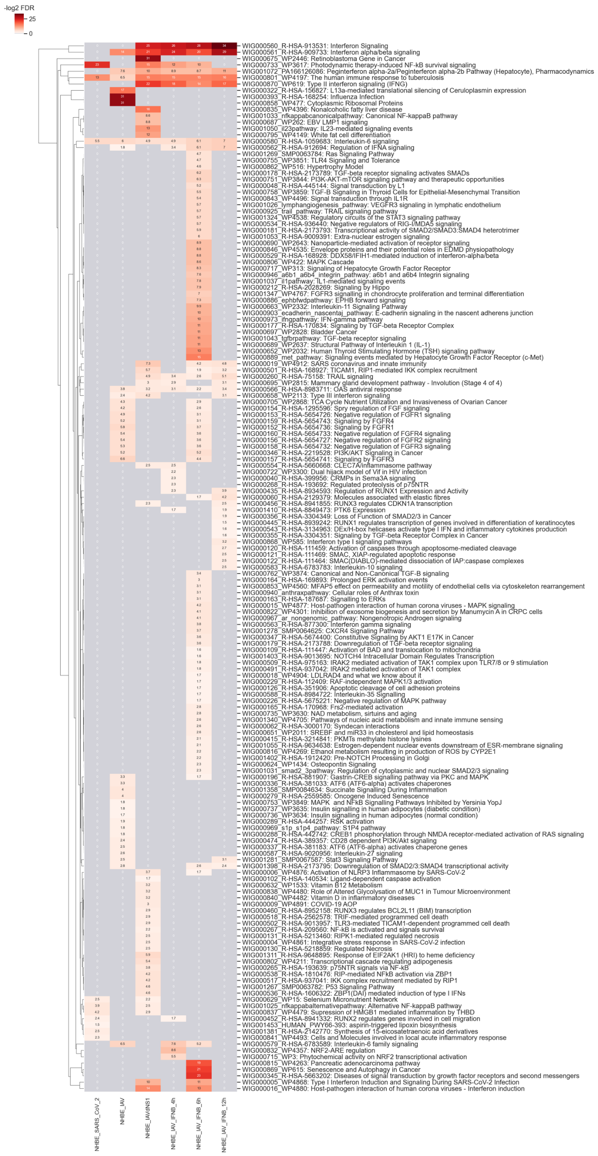
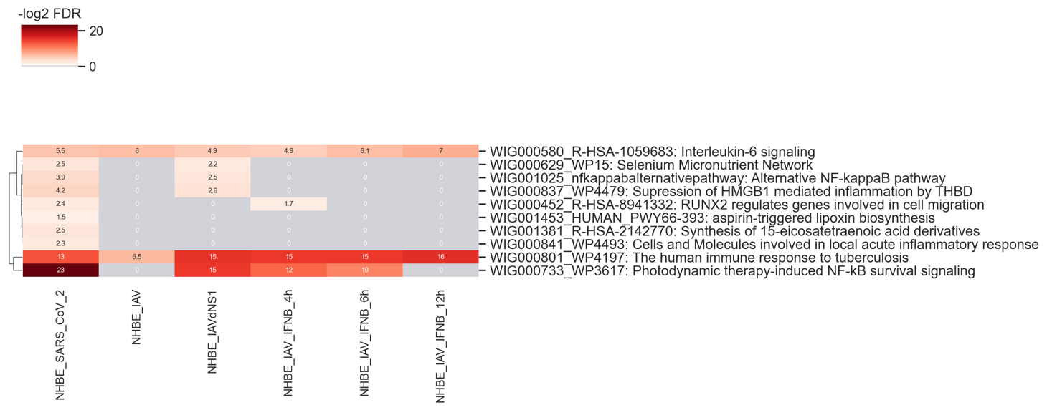
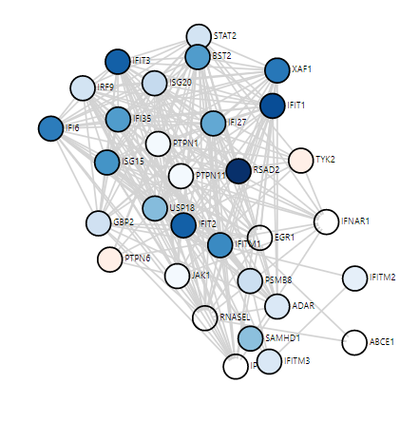
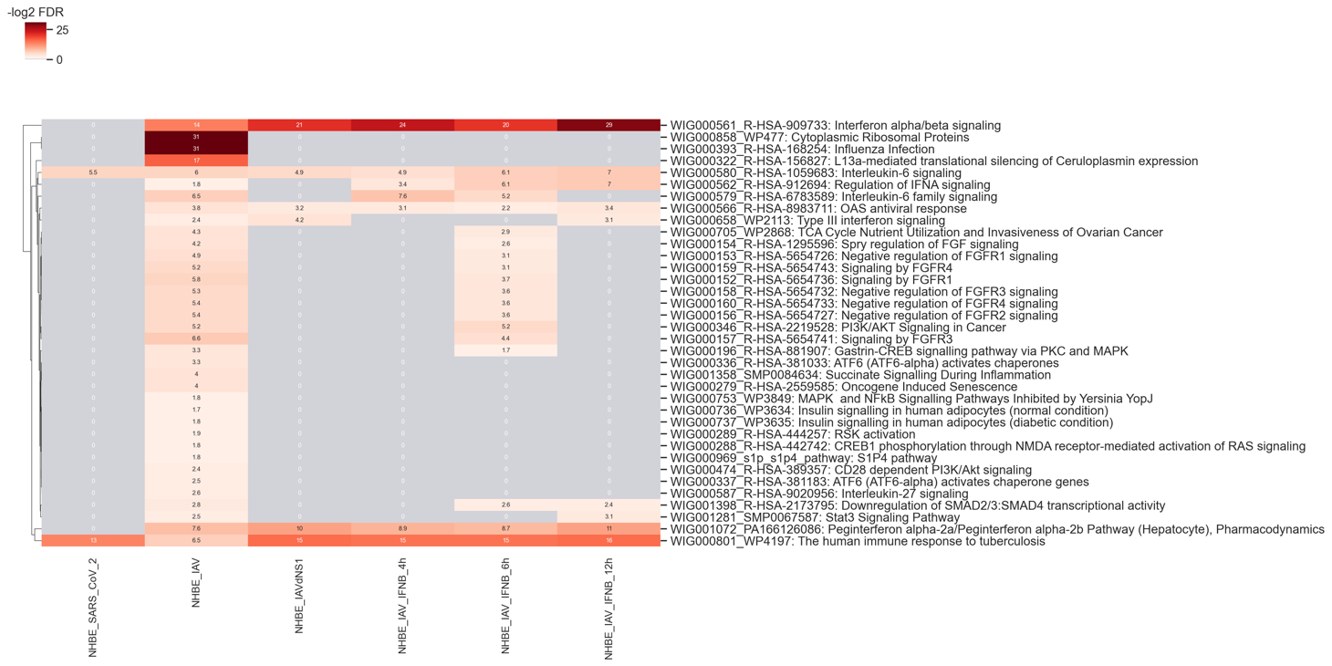
IFN role in the anti-viral infection
NHBE: Primary human lung epithelium.
NHBE_SARS_CoV2_pathway
https://www.karger.com/Article/Fulltext/508379
NHBE_IAV_pathway
Interferon alpha/beta signaling

Slide 3
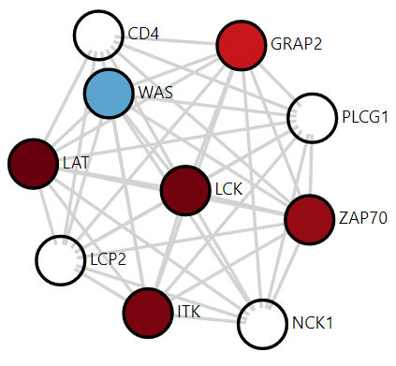
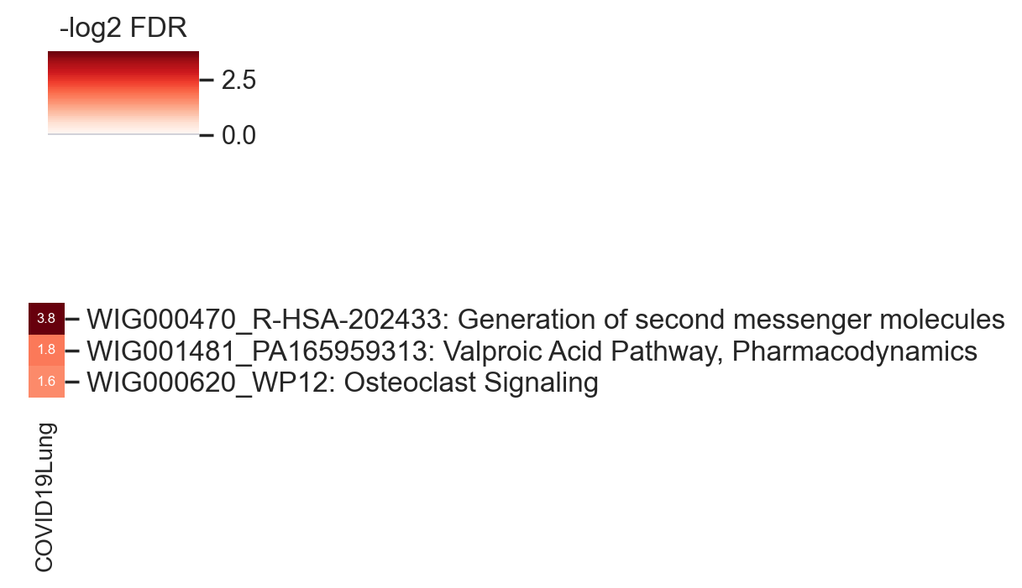
Lung
Generation of second messenger molecules's gene network

Slide 4
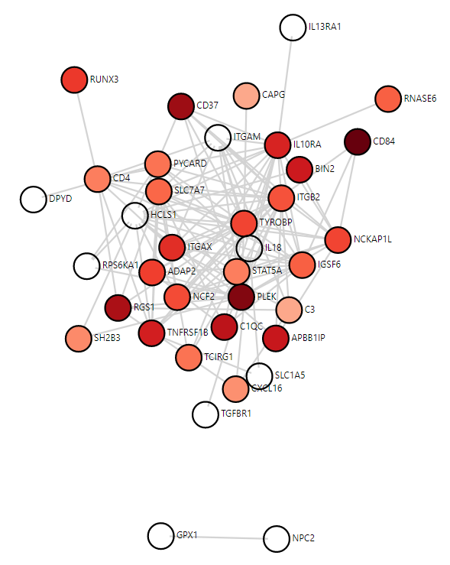
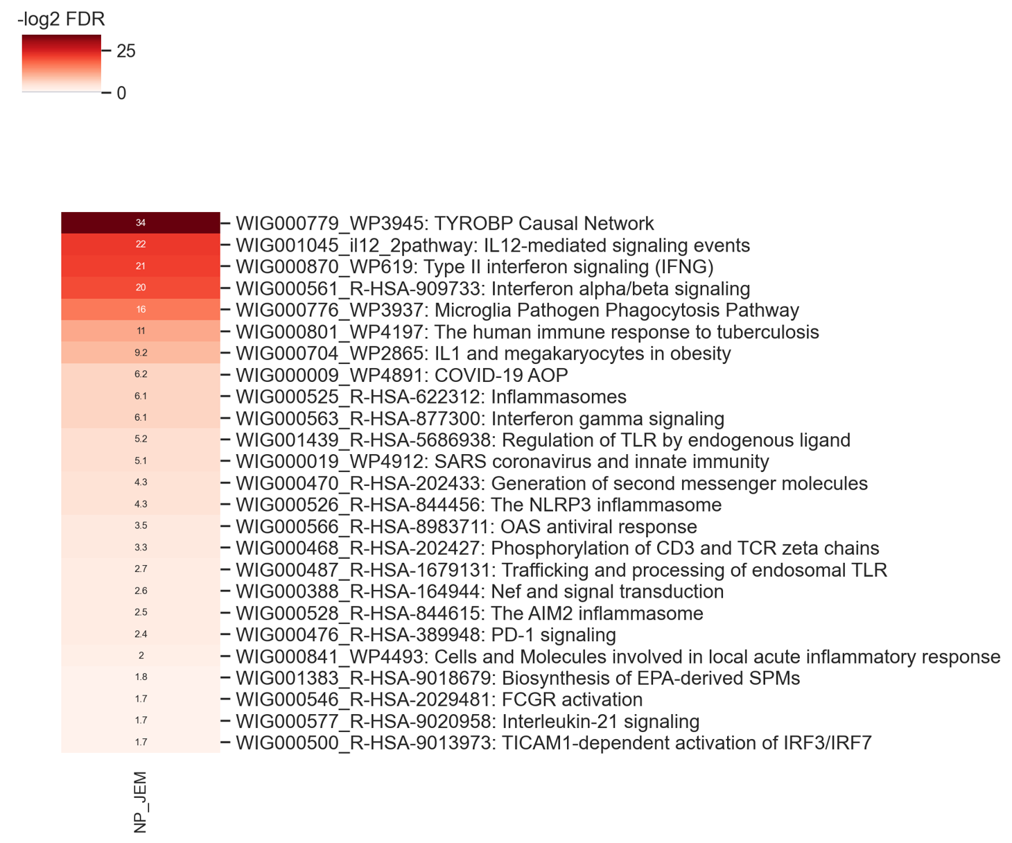
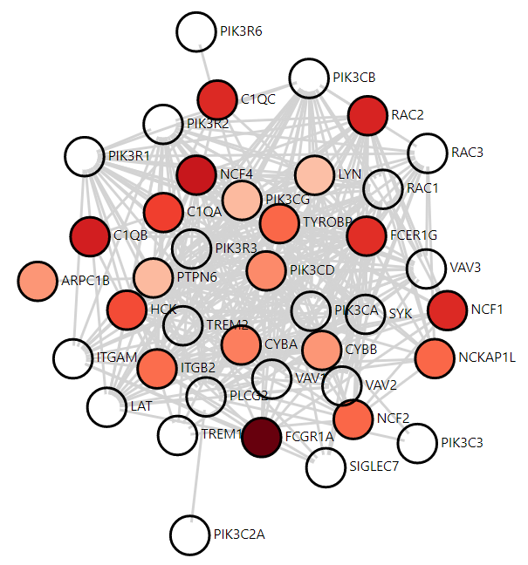
Nasopharyngeal (NP)
TYROBP Casual Network
Microglia Pathogen Phagocytosis Pathway

