Slide 1
ROCm Platform & HIP Introduction
zongzel@amd.com

Slide 2
Outline
Introduction to ROCm and HIP model
HIP detail
HIP demo

Slide 3
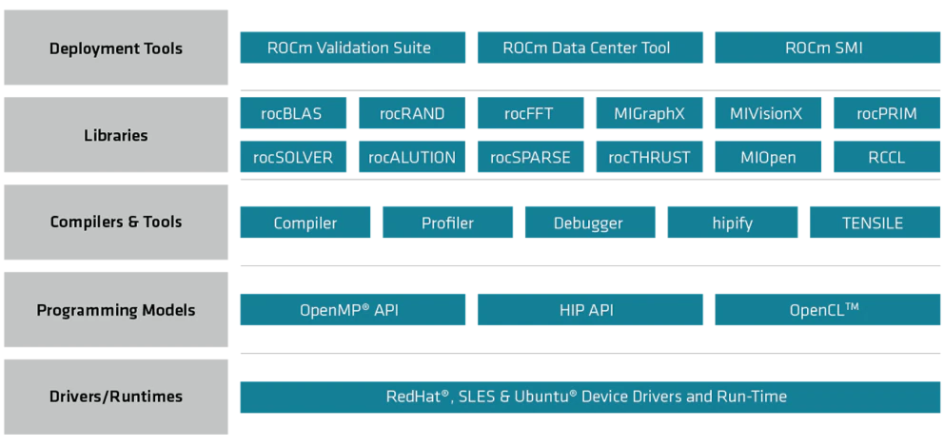
What is Rocm
ROCm (Radeon Open Compute) is an open source software platform designed to provide a general-purpose, high-performance computer programming environment for developing accelerated applications on AMD GPUs and CPUs.

Slide 4

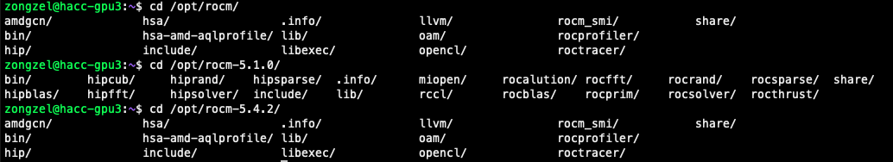
Deployment tools
ROCm Validation Suite Guide :
The ROCm Validation Suite (RVS) is a system administrator's and cluster manager's tool for detecting and troubleshooting common problems affecting AMD GPUs running in a high-performance computing environment, enabled using the ROCm software stack on a compatible platform. It is a collection of tests, benchmarks, and qualification tools, each targeting a specific subsystem of the ROCm platform.
ROCm Data Center Tool
The ROCm Data Center Tool (RDC) simplifies the administration and addresses key infrastructure challenges in AMD GPUs in cluster and data center environments.
ROCm System Management Interface
This is a tool for system monitoring and management that allows users to easily monitor and tune the performance of their GPU.

Slide 5
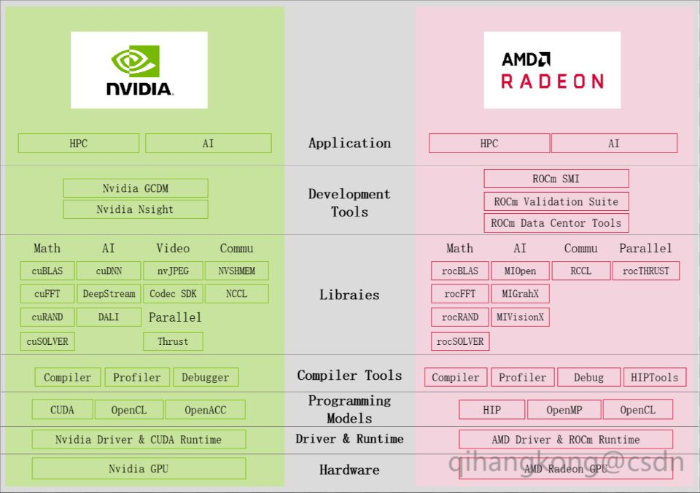
NVIDIA vs. AMD

Slide 6
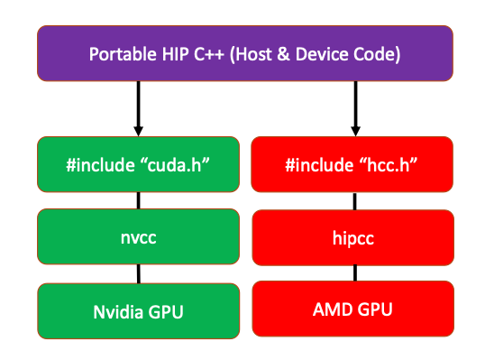
What is HIP
HIP (Heterogeneous-Compute Interface for Portability) is an open-source programming model from AMD that allows developers to write code once that can be compiled and executed on both CPUs and GPUs.
To be more specific, HIP is a C++ Runtime API and kernel language that allows developers to create portable applications for AMD and NVIDIA GPUs from a single source code.
HIP can compile code into intermediate code that can be executed on both CPUs and GPUs, and dynamically call the corresponding functions based on the device type at runtime. Therefore, developers can use HIP to write code once and deploy it on different devices, simplifying code development and maintenance.
In HIP model, the part run on CPU called host, the part run on accelerator(GPU) called device.
Host part code is CPU code. Entry function is main(). Hip use Runtime API allocate device memory, manage memory copy on host and device, run core function on device…
Device part is accelerator. It’s code run on GPU. The code is Extensive - C/C++. Essential part is core function.

Slide 7
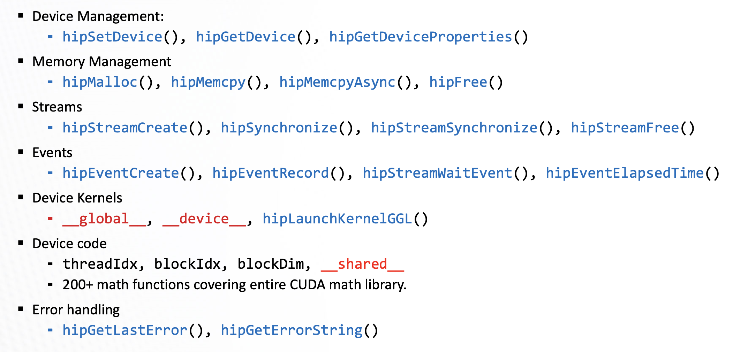
HIP API

Slide 8
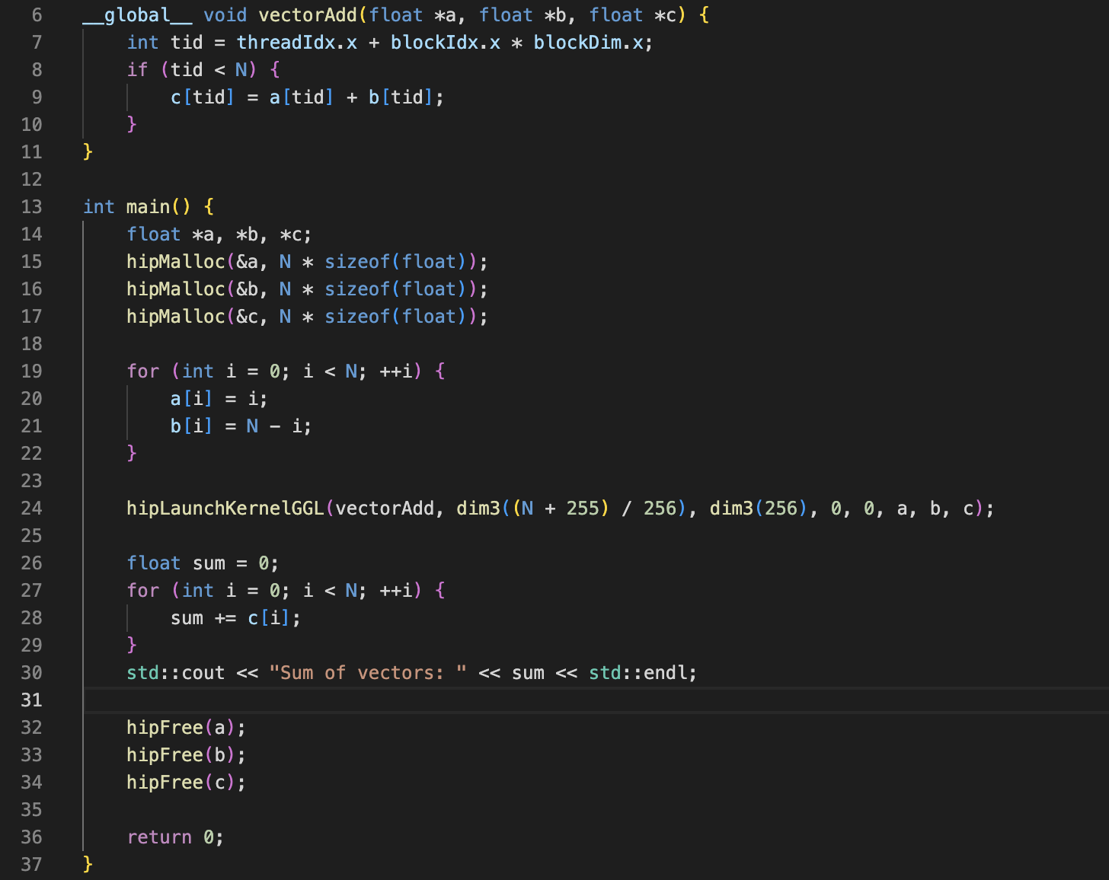
Simple HIP programming example
Check if the ROCm environment :
/opt/rocm/bin/rocminfo
Check if the HIP environment :
/opt/rocm/bin/hipconfig --cpp_config
Here is HIP programing sample source :
https://github.com/ROCm-Developer-Tools/HIP/tree/main/samples

Slide 9
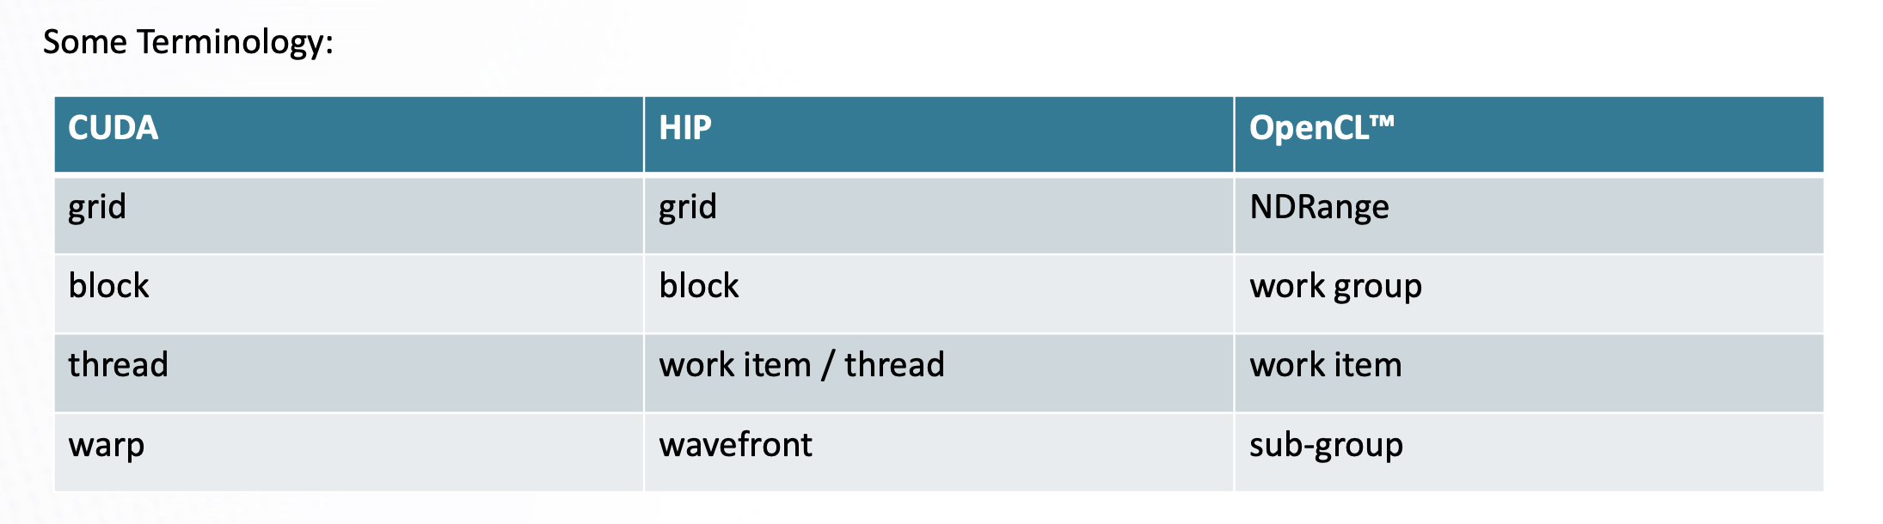
Kernels, memory, and structure of host code
▪ In HIP, kernels are executed on a 3D ”grid”
▪ The “grid” is what you can map your problem to ⁃ It’s not a physical thing, but it can be useful to think that way
▪ AMD devices (GPUs) support 1D, 2D, and 3D grids, but most work maps well to 1D
▪ Each dimension of the grid partitioned into equal sized “blocks” ▪ Each block is made up of multiple “threads” ▪ The grid and its associated blocks are just organizational constructs
⁃ The threads are the things that do the work ▪ If you’re familiar with CUDA already, the grid + block structure is very similar in HIP

Slide 10
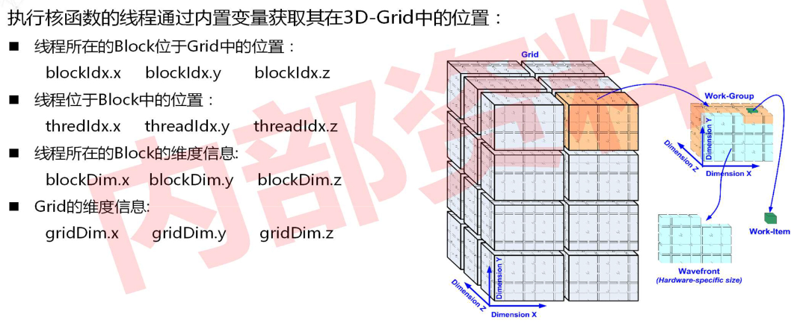

Slide 11
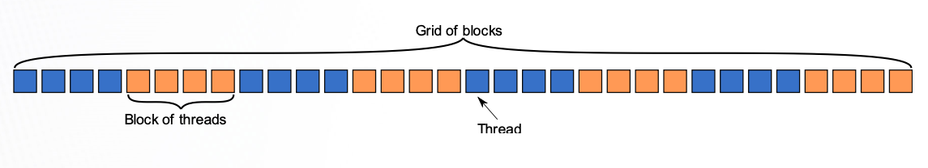
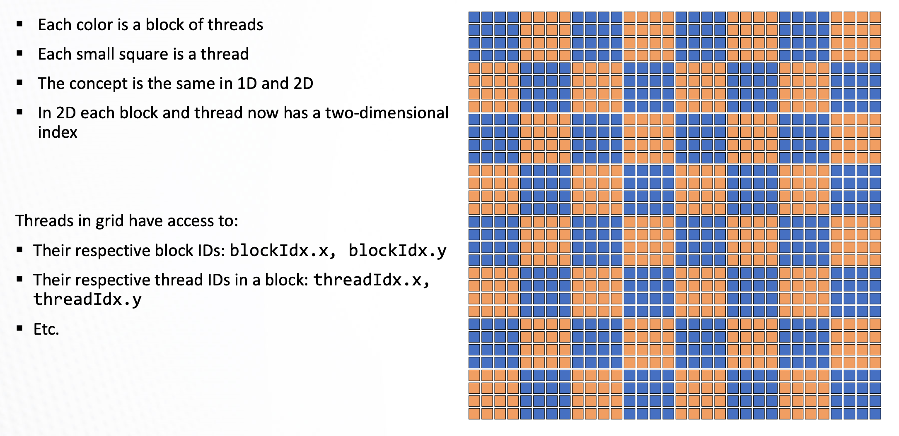
1D and 2D
int idx = blockDim.x * blockldx.x + threadldx.x
int idx = blockDim.x * blockldx.x + threadldx.x
int idy = blockDim.y * blockldx.y + threadldx.y

Slide 12
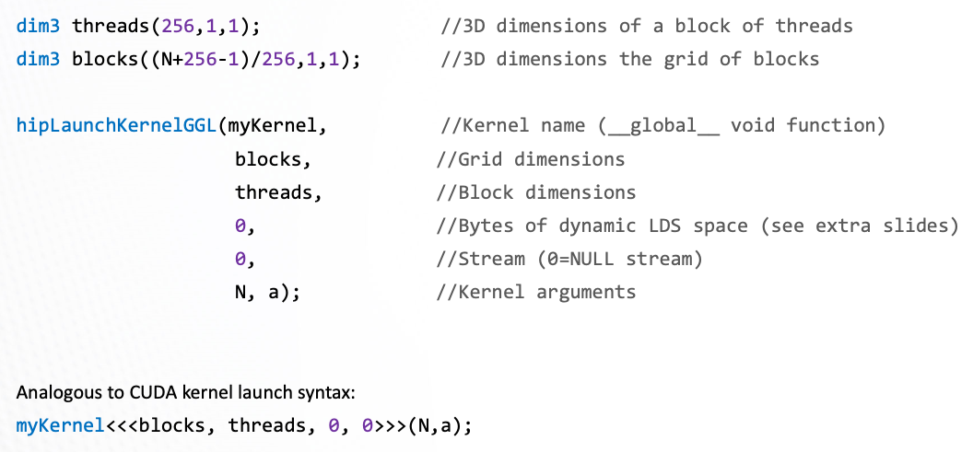
Kernel Function
▪ A device function that will be launched from the host program is called a kernel and is declared with the __global__ attribute
▪ Kernels should be declared void
▪ All threads execute the kernel’s body “simultaneously”
▪ Each thread uses its unique thread and block IDs to compute a global ID

Slide 13
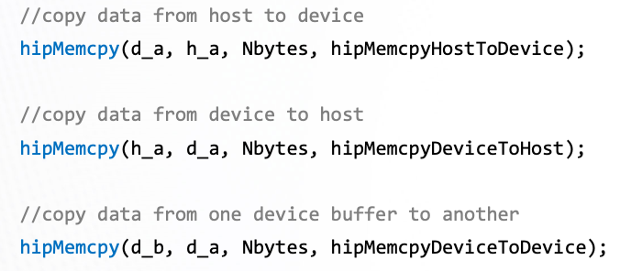
Memory Transfer

Slide 14
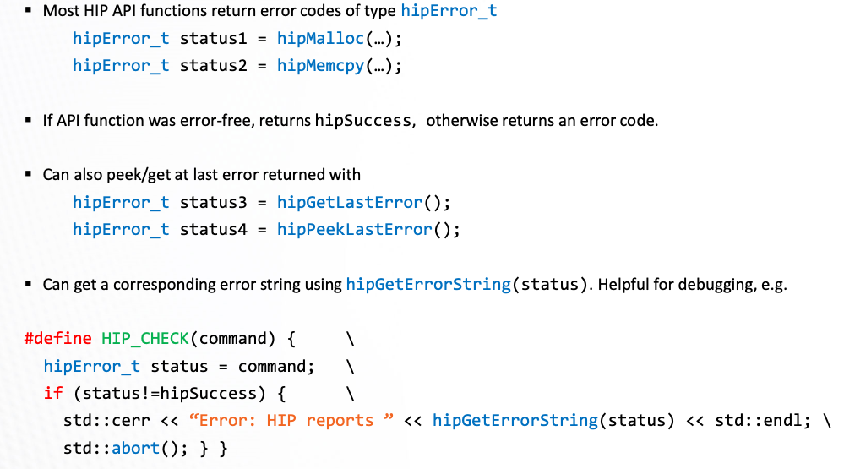
Error Checking

Slide 15
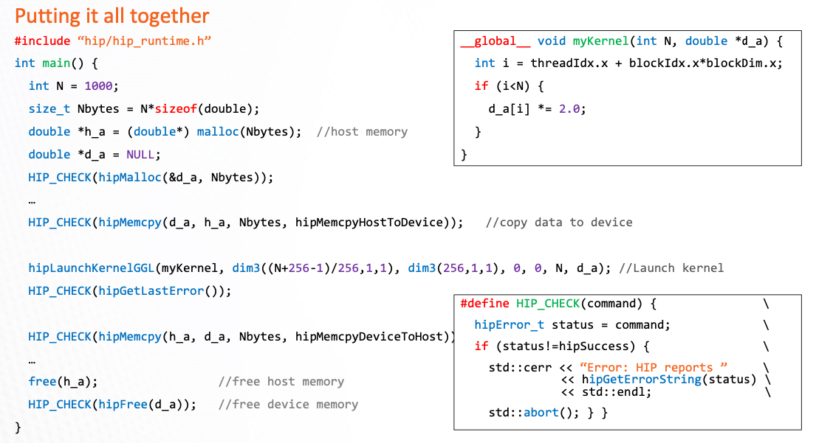
Integrative Example

Slide 16
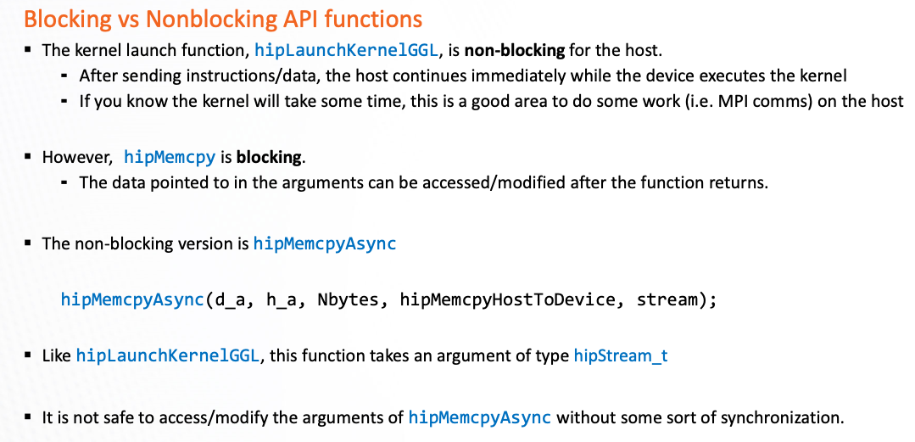
Blocking vs. Unblocking

Slide 17
Stream
The main purpose of setting stream is to make better use of various computing resources in heterogeneous computing systems, including CPU, GPU and other accelerators. By using stream, different computing tasks can be assigned to different computing resources, achieving more efficient concurrent computing and better performance.
▪ A stream in HIP is a queue of tasks (e.g. kernels, memcpys, events).
Tasks enqueued in a stream complete in order on that stream.
Tasks being executed in different streams are allowed to overlap and share device resources.
▪ Streams are created via:
hipStream_t stream;
hipStreamCreate(&stream);
▪ And destroyed via: hipStreamDestroy(stream);
▪ Passing 0 or NULL as the hipStream_t argument to a function instructs the function to execute on a stream called the ‘NULL Stream’ :
No task on the NULL stream will begin until all previously enqueued tasks in all other streams have completed.
Blocking calls like hipMemcpy run on the NULL stream.

Slide 18
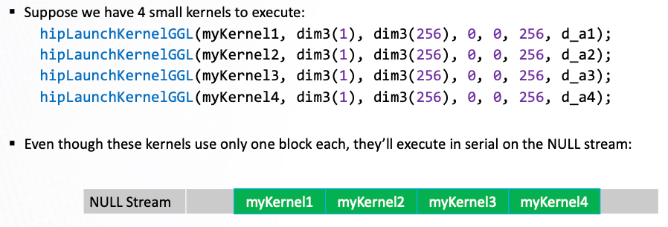
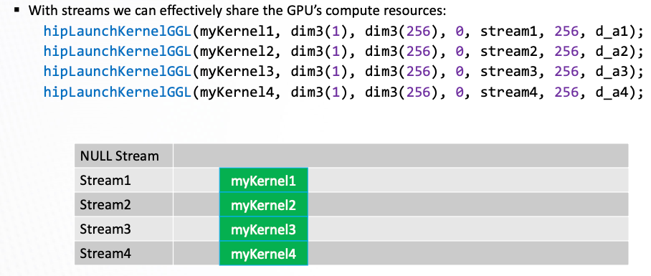

Slide 19
▪ There is another use for streams besides concurrent kernels:
⁃ Overlapping kernels with data movement.
▪ AMD GPUs have separate engines for:
⁃ Host -> Device memcpys ⁃ Device -> Host memcpys ⁃ Compute kernels.
▪ These three different operations can overlap without dividing the GPU’s resources.
⁃ The overlapping operations should be in separate, non-NULL, streams.
⁃ The host memory should be pinned.
Pinned Memory
Host data allocations are pageable by default. The GPU can directly access Host data if it is pinned instead.
▪ Allocating pinned host memory :
double *h_a = NULL; hipHostMalloc(&h_a, Nbytes);
▪ Free pinned host memory: hipHostFree(h_a);
▪ Host<->Device memcpy bandwidth increases significantly when host memory is pinned.

Slide 20
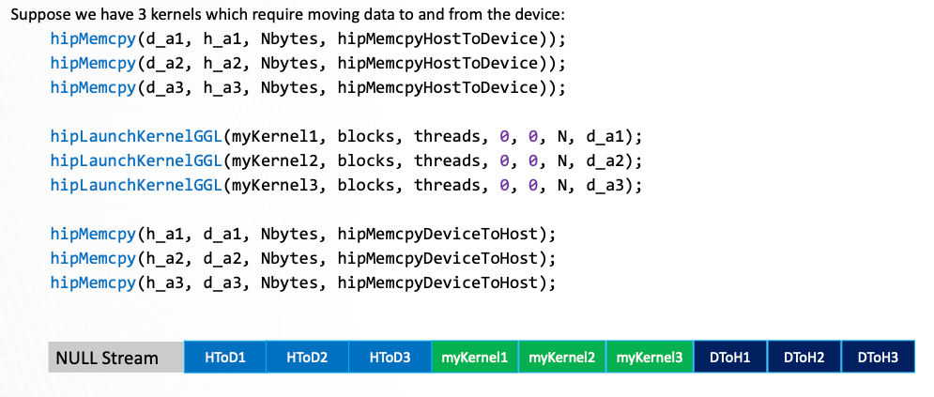
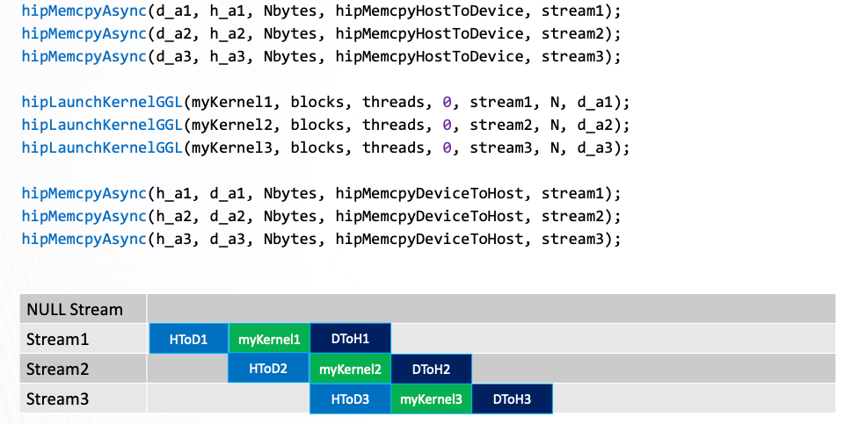

Slide 21
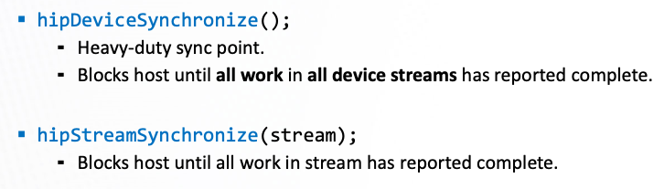
Synchronization
Stream_sync (coordinate execution on device streams with host execution)

Slide 22
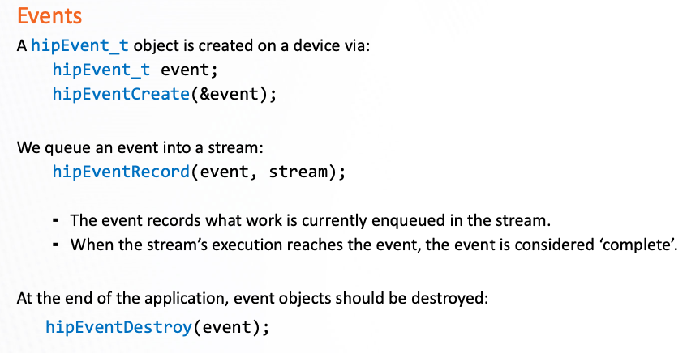
Stream_sync (coordinate execution among streams)

Slide 23
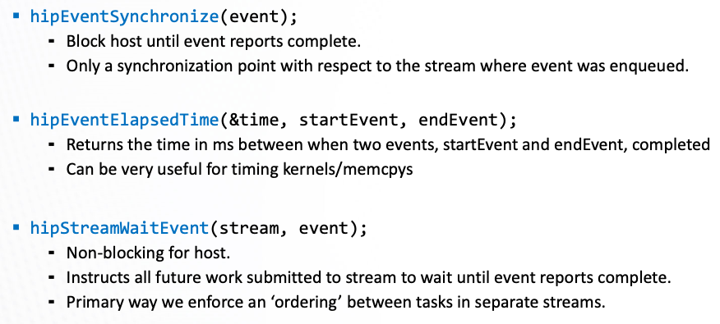
Fine-grained Sync
Time Recorder
Stream
Sync

Slide 24
Demo Part

