Slide 1
Discussion 12 SIMD and OpenMP
lizz@shanghaitech.edu.cn

Slide 2
Parallelism

Slide 3
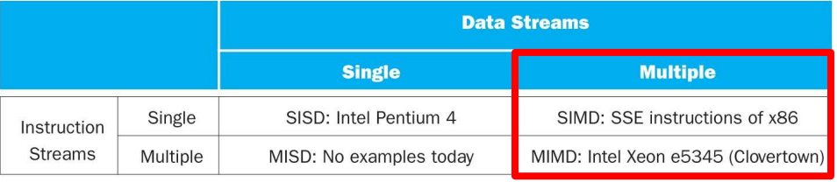

Slide 4
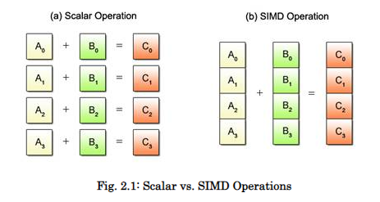
Scalar v.s. SIMD
The conventional sequential approach using one instruction to process each individual data is called scalar operations.

Slide 5
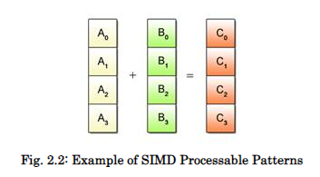
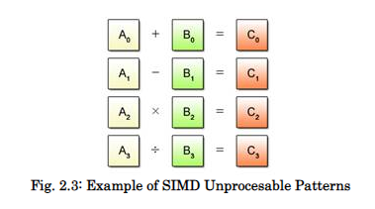
Despite the advantage of being able to process multiple data per instruction, SIMD operations can only be applied to certain predefined processing patterns.

Slide 6


If you are a C++ programmer, you are probably familiar with the basic types: char, short, int, float, and so on. Each of these have specific sizes: 8 bits for a char, 16 for short, 32 for int and float. Bits are just bits, and therefore the difference between a float and an int is in the interpretation.
An alternative way to achieve this is using a union:

Slide 7
This time, a small array of four chars overlaps the 32-bit integer value a4. We can now access the individual bytes in a4 via array a[4]. Note that a4 now basically has four 1-byte ‘lanes’, which is somewhat similar to what we get with SIMD.
We could even use a4 as 32 1-bit values, which is an efficient way to store 32 boolean values.

Slide 8
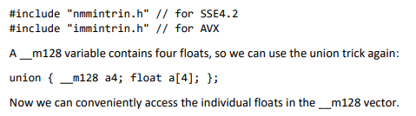

Slide 9
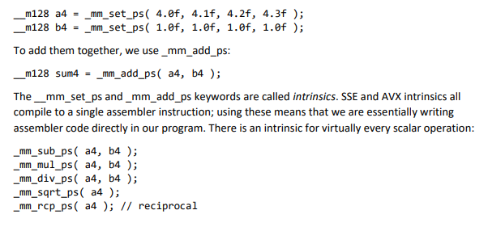

Slide 10
OpenMP
Parallel Programming Standards
Thread Libraries :
- Win32 API / Posix threads
Compiler Directives :
- OpenMP (Shared memory programming)
Our focus
Message Passing Libraries :
- MPI (Distributed memory programming)

Slide 11
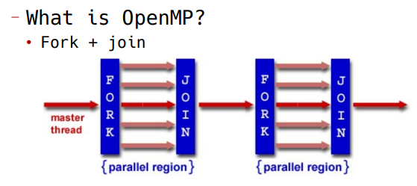
Most of the constructs in OpenMP are compiler directives or pragmas.
– For C and C++, the pragmas take the form:
#pragma omp construct [clause [clause]…]
Include files :
#include “omp.h”

Slide 12
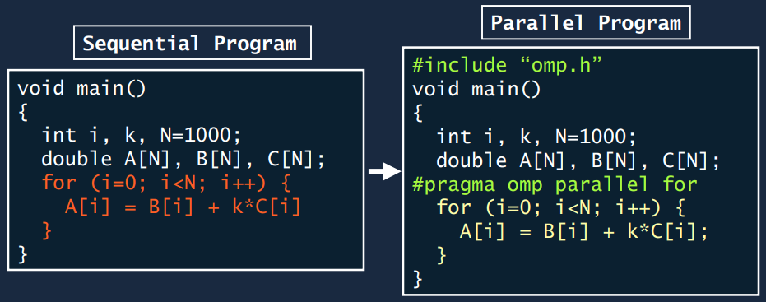
OpenMP is usually used to parallelize loops:
• Find your most time consuming loops.
• Split them up between threads.

Slide 13
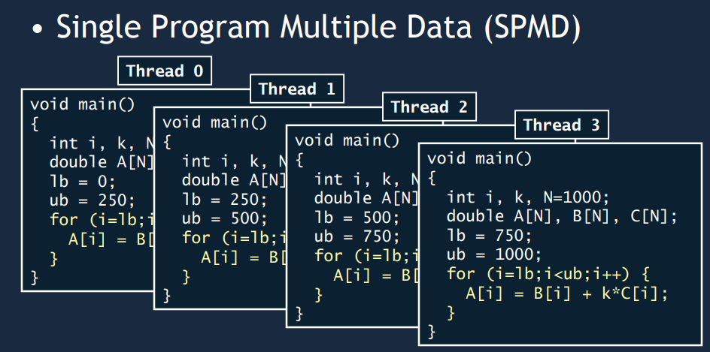

Slide 14
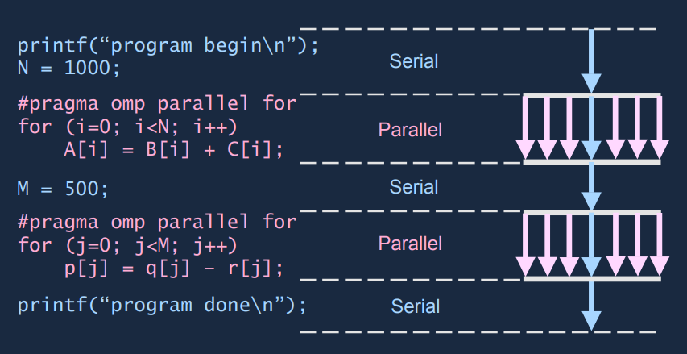
OpenMP Fork-and-Join model
Implicit “barrier” synchronization at end of for loop.

Slide 15
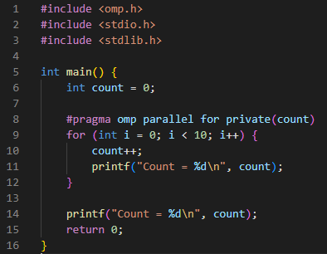
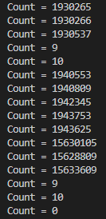
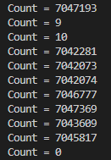
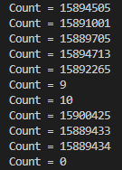
Directives
Private: This directive is used to create a private copy of a variable for each thread, so that each thread can work on its own copy of the variable without interfering with other threads.
Reduction: This directive is used to perform a reduction operation on a variable across multiple threads, and then store the result in a single variable. The supported reduction operations include addition, subtraction, multiplication, bitwise AND/OR/XOR, and logical AND/OR.

Slide 16
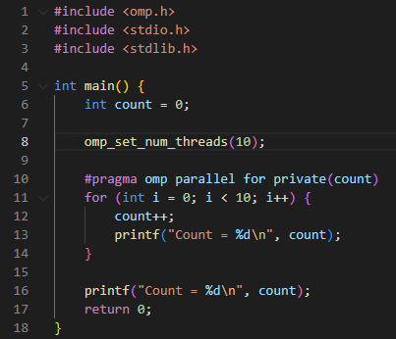
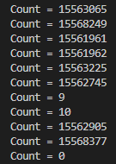
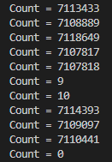
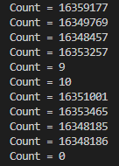
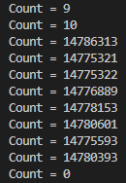

Slide 17
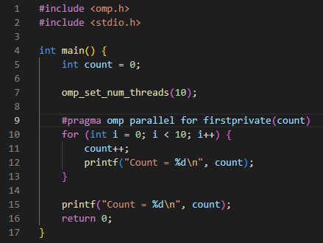

The private directive declares that a variable is private to each thread, meaning that each thread has its own instance of the variable and does not share the value of the variable among all parallel parts in each thread. The firstprivate directive also declares a variable to be private, but it also initializes the variable to its value in the serial part.

Slide 18
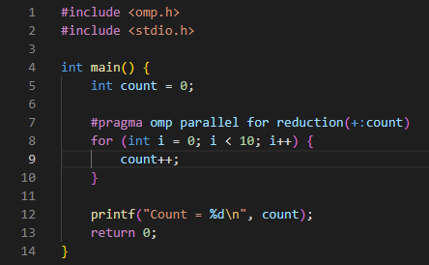
Count = 10

Slide 19
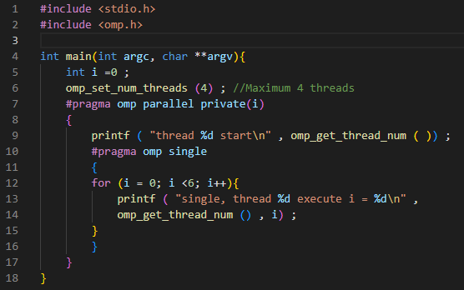
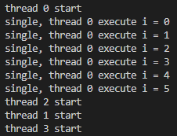
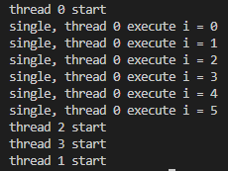
Single: This directive is used to specify a block of code that should be executed by only one thread, while the other threads wait for it to complete.

Slide 20
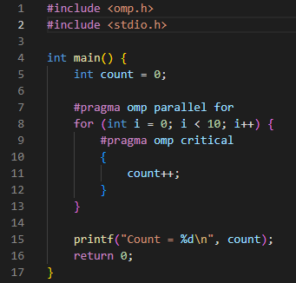
Critical: This directive is used to specify a block of code that should be executed by only one thread at a time, while the other threads wait for it to complete. The purpose of the 'critical' directive is to protect a shared resource (e.g., a variable, a file, or a device) from being accessed by multiple threads simultaneously, which can lead to race conditions and data inconsistencies.
Count = 10

Slide 21
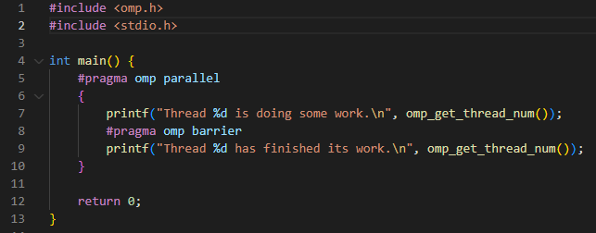
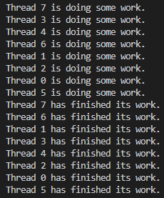
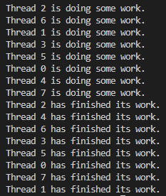
Barrier: This directive is used to synchronize all the threads in a parallel region, so that no thread can proceed until all the other threads have reached the barrier.

