Slide 2
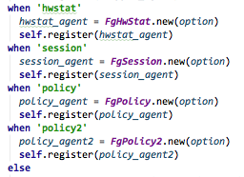
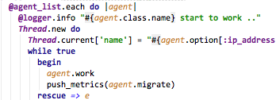
Setup config, log, signal
Main
Flow
Register agents
Trigger agent to work

Slide 3
inherit
interact
Agent Base
.work
.migrate
Get Base
.deal
depend on
data flow
FGT
libs for getting information from devices
.. SshGet
. ScpGet
. SnmpGet
. SnmpWalk
…
fgt agents
switch
ios/nexus
switch agents
Metrics
.new
.merge
marmot
influxdb

