Slide 1
MoneyMate – Personal Finance Tracker overview
Capstone Project Presentation
Nimisha Madavi
SEN:
Guide: Dr. Madhu Bhan
Amity University Bengaluru

Slide 2

The Problem
1}65% of people cannot track their monthly spending
2}Existing apps require subscriptions or share user data
3)Lack of visual insights reduces motivation to save

Slide 3
Motivation & Research Gap

Slide 4

Objectives
Comprehensive tracking of income expenses
Real-time budget monitoring with visual alerts
Goal-based savings tracking with progress visualization
Financial insights via 6-month analytics dashboard

Slide 5
Literature Review Highlights
Digital tools improve financial literacy and spending control
Visualizations increase savings goal completion rates
Budget alerts effectively modify user behavior before overspending
Research gap: lack of affordable privacy-focused personal finance systems

Slide 6
Technology Stack
- Backend: Flask (Python)
- Database: SQLite + SQLAlchemy ORM
- Frontend: HTML5, CSS3, JavaScript
- Methodology: Modular MVC architecture

Slide 7
02
System Architecture

Slide 8
Database Design
Core Entities: User, Income, Expense, Budget, SavingsGoal
- Normalized schema avoiding redundancy
- Foreign key relationships maintaining data integrity

Slide 9
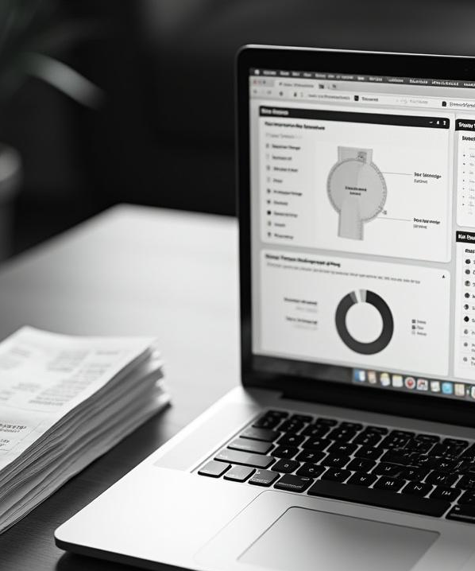
Module Overview
Expense income tracking
Dashboard with live summaries
Category-based budgeting alerts
Savings goal progress indicators
Monthly analytics with graphs

Slide 10
Business Logic & Algorithms
Monthly financial calculations
Category-wise totals aggregation
Budget utilization status
Savings goal progress calculation

Slide 11
03
System Screenshots

Slide 12
Testing & Validation
Unit testing for calculations
Integration testing for modules
Functional testing of user workflows
Performance tested with 10+ records

Slide 13
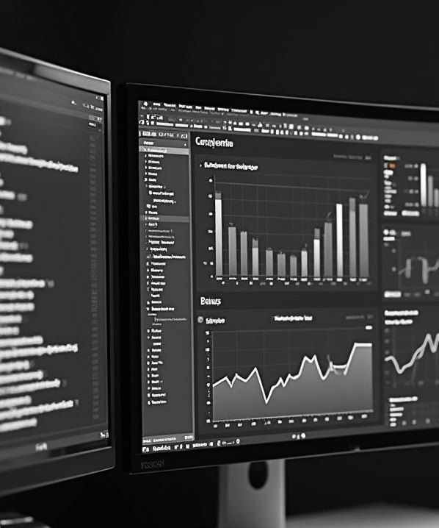
Results & Outcomes
Objectives successfully achieved
Real-time budget tracking and visual goal progress operational
Dashboard and analytics load under 2 seconds
Maintains accurate processing with large transaction sets

Slide 14
Limitations
Single-user mode (no authentication yet)
No mobile responsiveness
No automated recurring expenses
Limited advanced analytics

Slide 15
04
Future Enhancements

Slide 16

Conclusion
MoneyMate empowers individuals to manage finances conveniently
Combines accessibility, analytics, and privacy
Demonstrates strong full-stack engineering with practical relevance

Slide 17
Demonstration
Add expense in real-time
Observe dashboard update
Show color-coded budget indicator change

Slide 18
Thank You / Q&A
MoneyMate: Track smart. Spend wisely. Save confidently.

Slide 19
Conclusions
MoneyMate effectively addresses the critical need for accessible, privacy-focused personal finance management. It empowers users with tools for comprehensive tracking, intelligent budgeting, and goal-oriented savings. The platform’s modular design and clear visualizations promote financial literacy and sustained engagement. Future enhancements will leverage AI and expanded functionality, establishing MoneyMate as a leading solution for personal financial empowerment.

Slide 20

THANKS
Do you have any questions?
youremail@freepik.com
+00 000 000 000
yourwebsite.com
Please keep this slide for attribution

