Slide 1
Crowdfunding Flow
Major / Minor Functionalities
User
User Page
Sign Up
User Profile Edit
Login / Logout
Create project
User Chat
Search project
Pay for the project
Cancel payment
Receive Payment (Project owner)
Owner

Slide 2
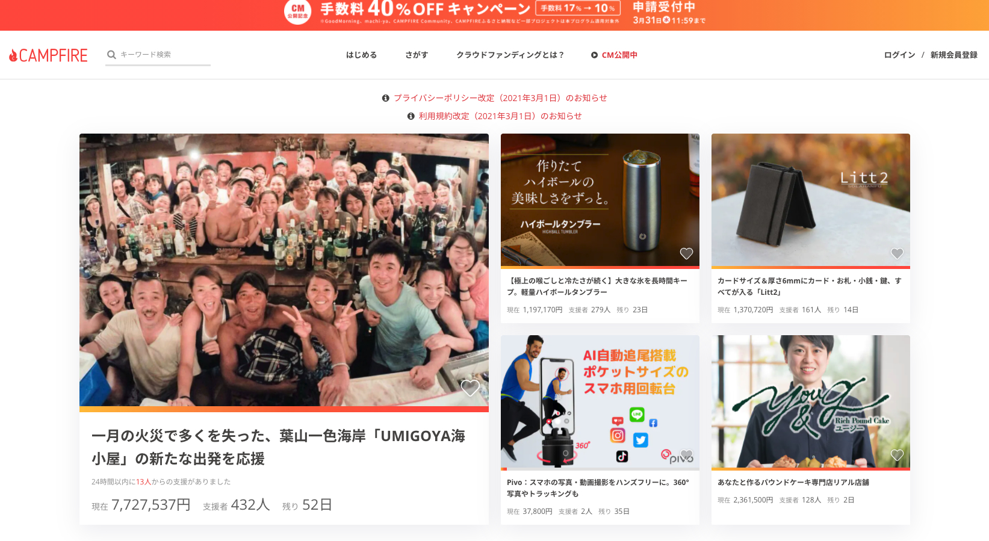

Slide 3
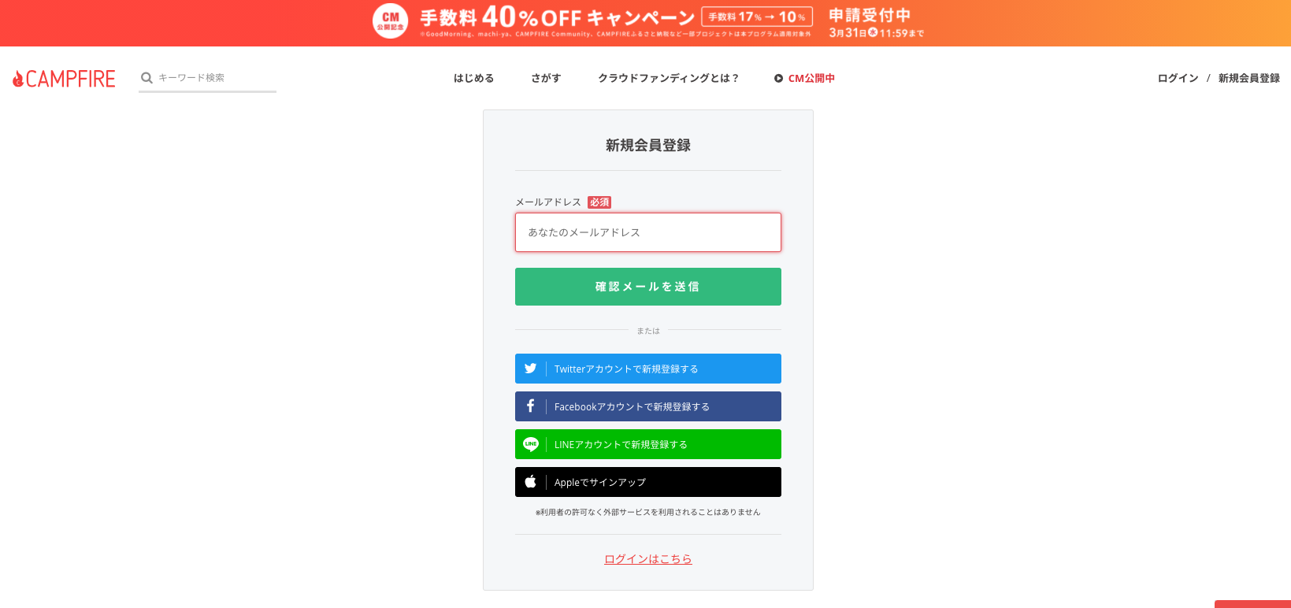
Sign up

Slide 4
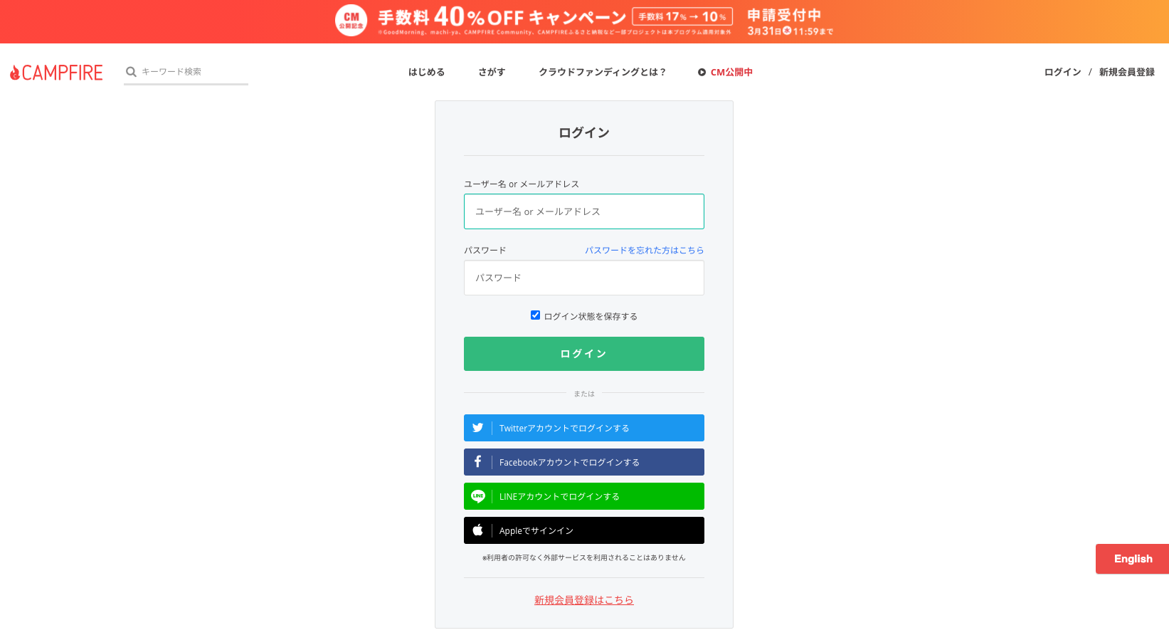
Login / Logout

Slide 5
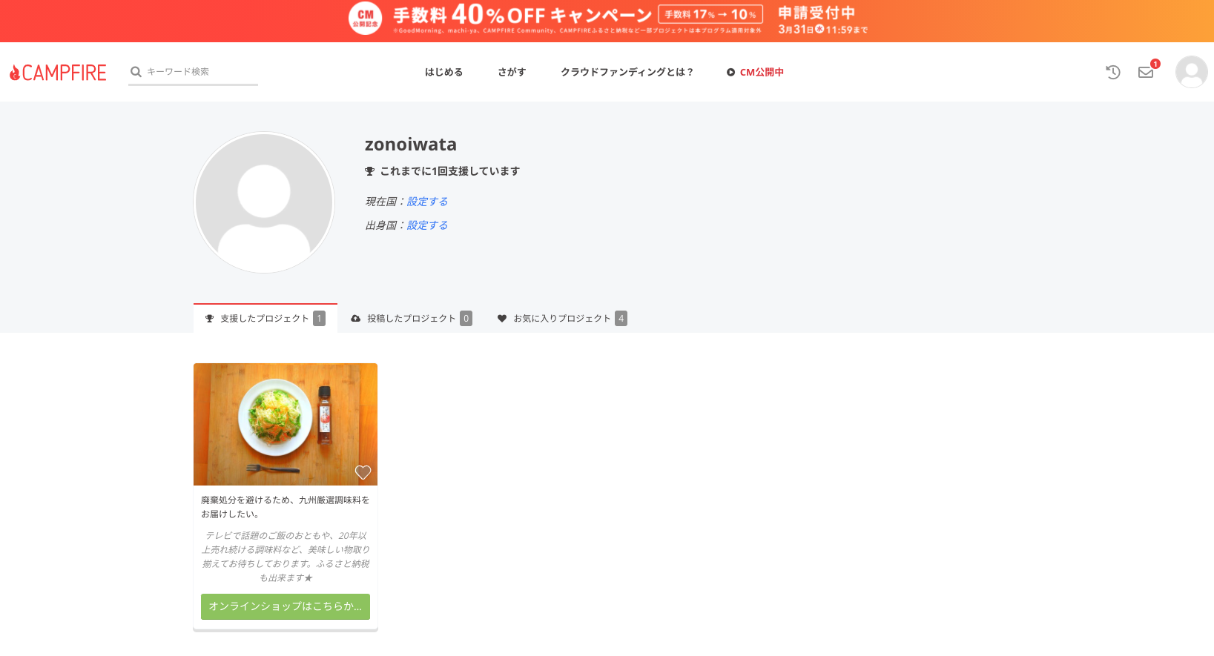

Slide 6
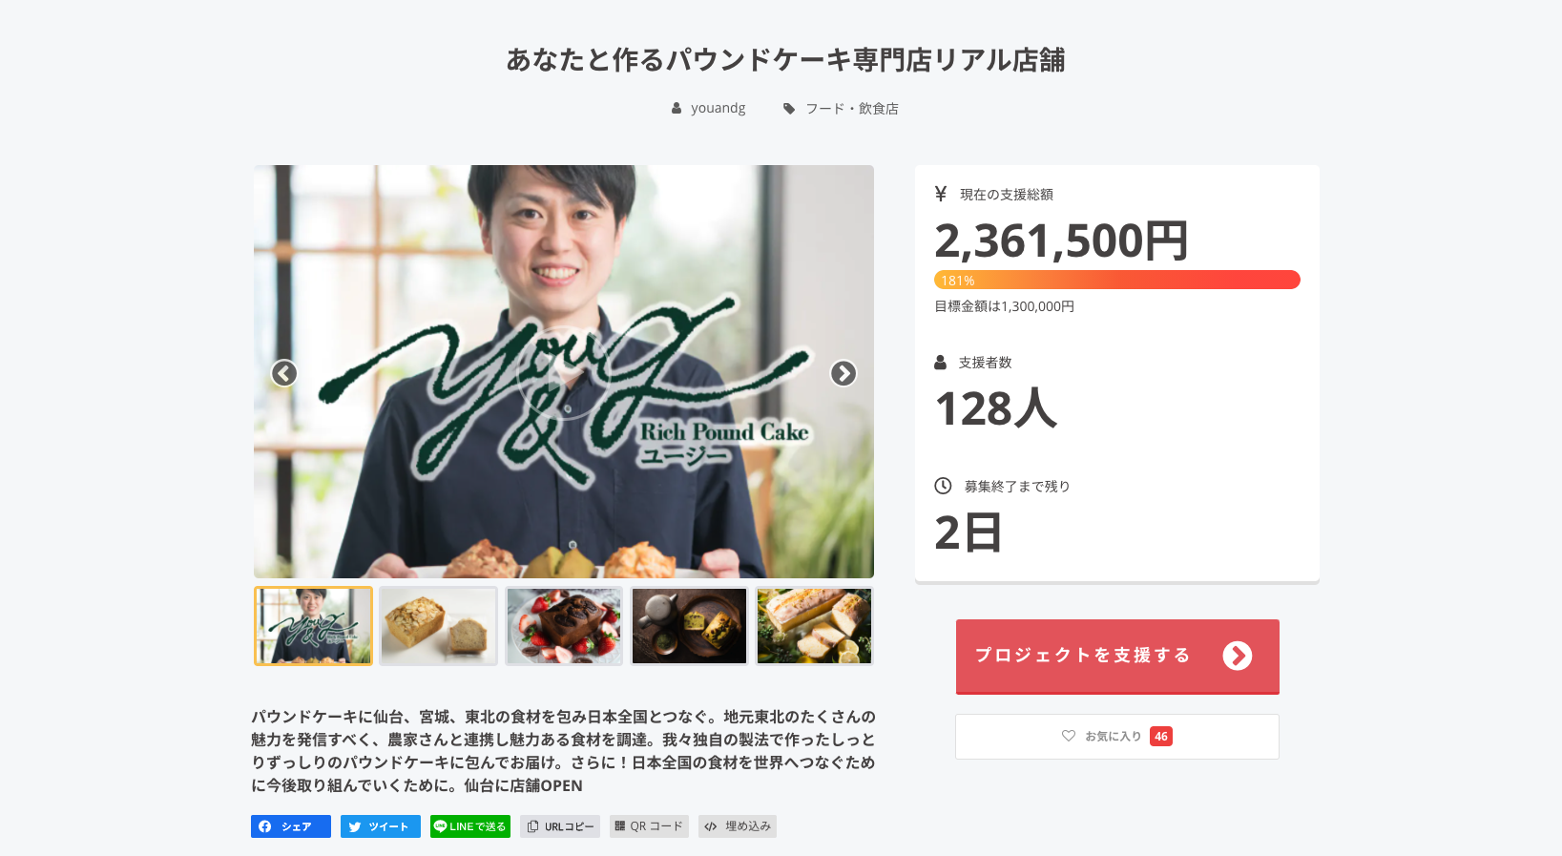

Slide 7
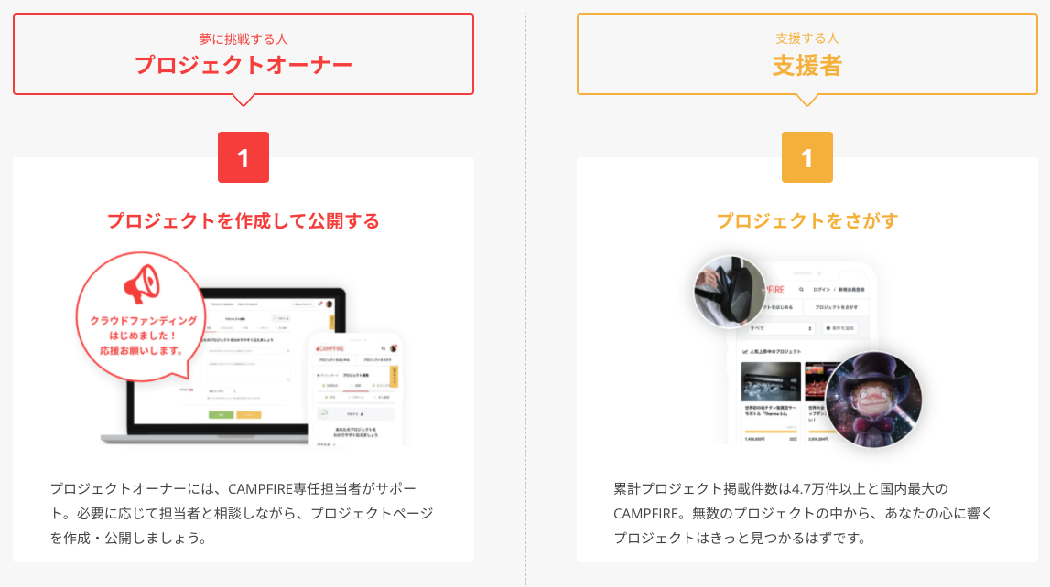

Slide 8
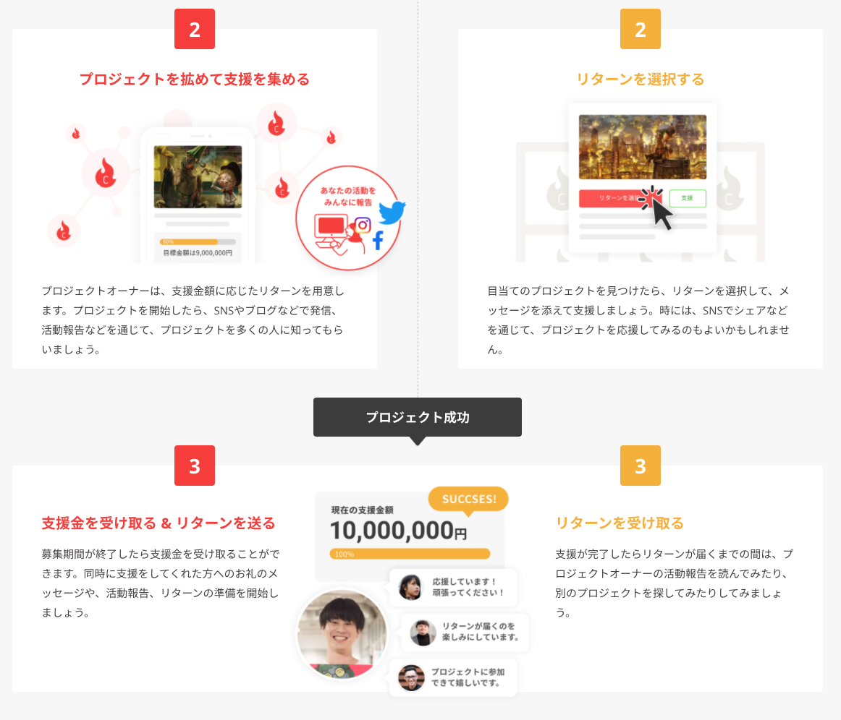

Slide 10


Request Form for Evaluation
Major / Minor Functionalities
Chemical Company
Analysis Company
Sign Up
User Page
Login / Logout
User Profile
Search the list
User Chat
Create the request
Evaluation list
/ Price Table
Payment
Calculate total cost
Edit the request
Request data
Cancel the request
Check the progress
Update the progress
Owner

