Slide 2













$$b$$
$$x_{1}$$
$$w_{1}$$
$$x_{2}$$
$$w_{2}$$
$$w_{3}$$
$$x_{3}$$
$$z$$
$$\hat{y}$$
$$w_{4}$$
$$x_{4}$$
$$w_{5}$$
$$x_{5}$$

Slide 3
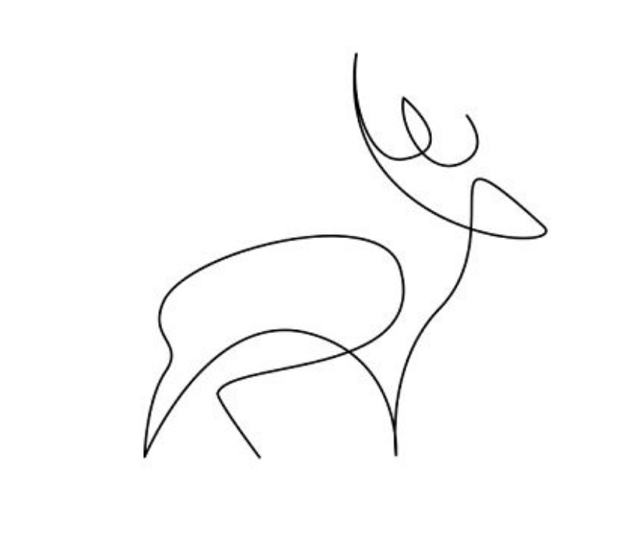
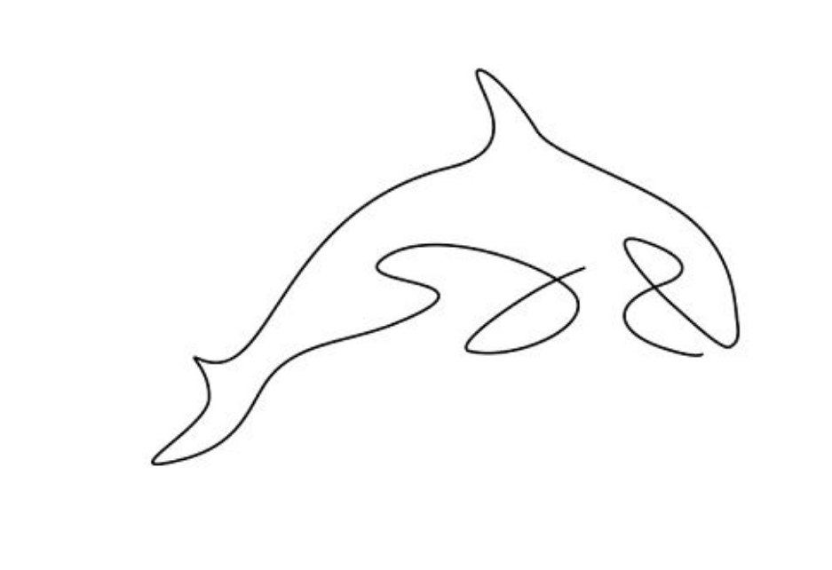
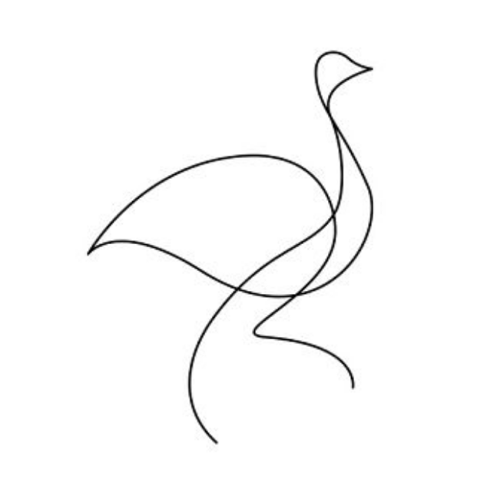




$$x$$
$$\hat{y}$$
$$x$$
$$\hat{y}$$
$$x$$
$$\hat{y}$$

Slide 4



$$\hat{y_{1}}$$
$$x$$
$$\hat{y_{2}}$$
$$\hat{y_{3}}$$

Slide 5
$$\hat{y_{1}}$$
$$x$$
$$\hat{y_{2}}$$
$$\hat{y_{3}}$$

Slide 6
Hidden
Input
Output

Slide 7
With Activation Functions
Without Activation Functions

Slide 8
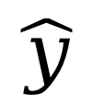
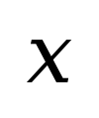
$$x$$
$$\hat{y}$$

Slide 9
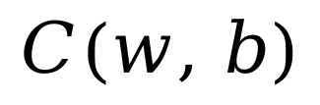
$$C(w, b)$$

Slide 10
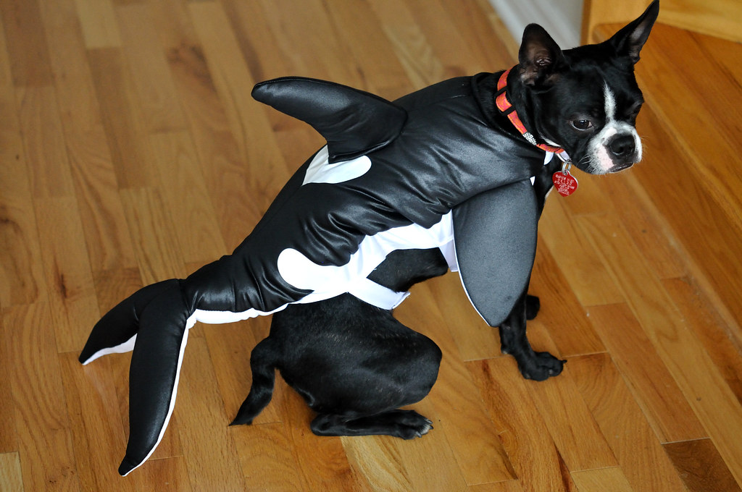




$$\hat{y_{1}} = 0.7$$
$$\hat{y_{2}} = 0.1$$
$$x$$
$$\hat{y_{3}} = 0.4$$

Slide 11

$$\hat{y_{1}} = 0.7$$
$$\hat{y_{2}} = 0.1$$
$$x$$
$$\hat{y_{3}} = 0.2$$

Slide 12

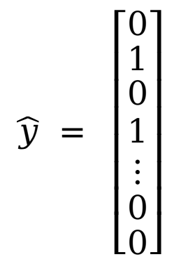
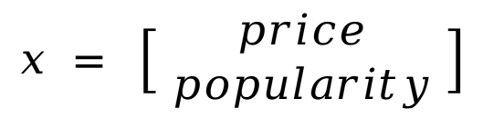
$$\hat{y} = \left[\begin{matrix}0 \\ \begin{matrix}1 \\ \begin{matrix}0 \\ 1 \\ ⋮\end{matrix} \\ 0\end{matrix} \\ 0\end{matrix}\right]$$
$$x = \left[\begin{matrix}price \\ popularity \end{matrix}\right]$$
$$⋮$$

Slide 13
With Random Initialization
Without Random Initialization

Slide 14
Linear
Activation
BN
Linear
Activation
BN
Layer 1
Layer 2
Linear
BN
Activation
Linear
BN
Activation
Layer 1
Layer 2

Slide 17
Learning Rate
L2

Slide 18
Learning Rate
L2

