Slide 1
Spectre
20150814

Slide 2
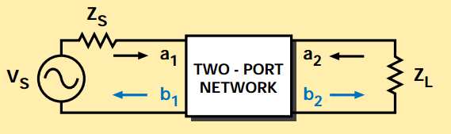
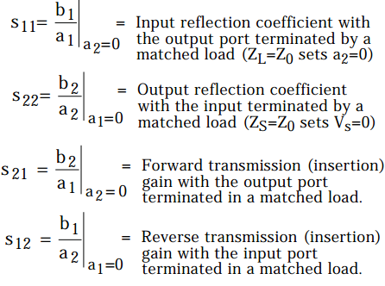
S-parameter

Slide 3
S-parameter
Use instance “port" at input and output node. It can be found in analoglib.
Set port to type dc. Check and save schematic and open ADE.
In sp analysis select input and output port.
Do “Noise" select yes and set output port and input port.
Run Simulation.
You can get S-parameter , Noise figure and power gain in Main Form.

Slide 4
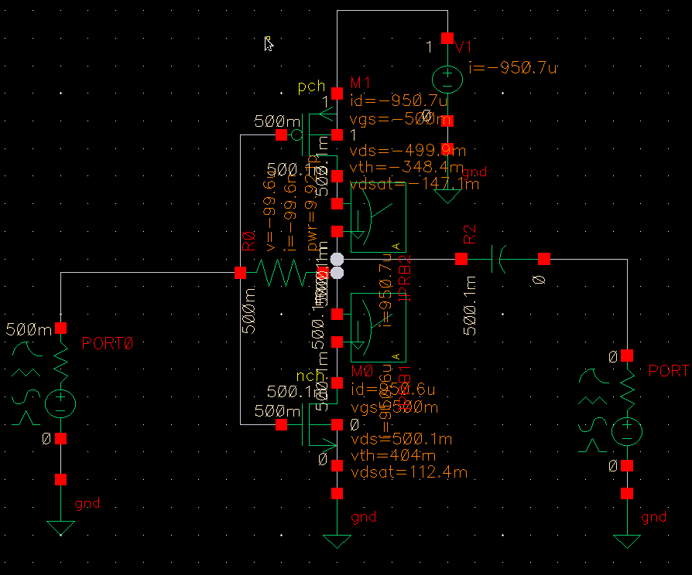
S-parameter
1.

Slide 5
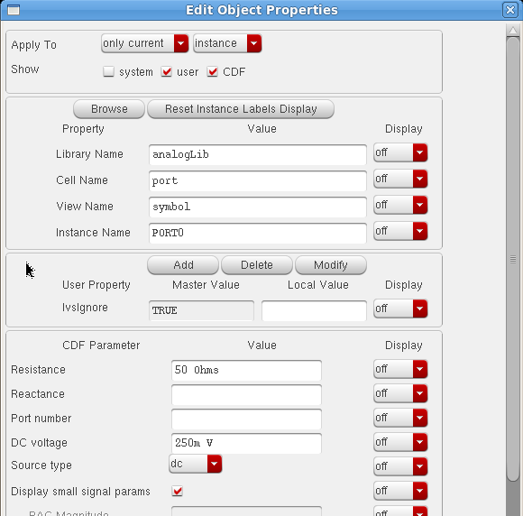
S-parameter
2.

Slide 6
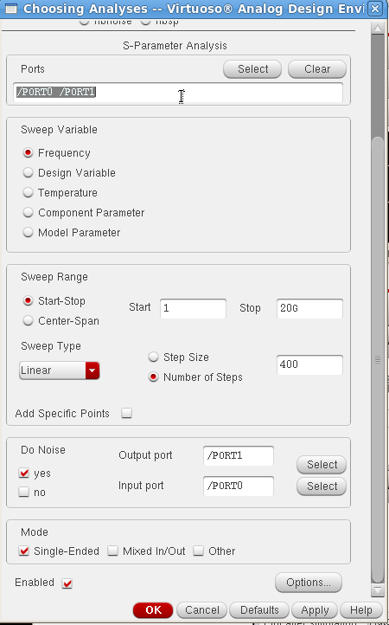
S-parameter
3.4.

Slide 7
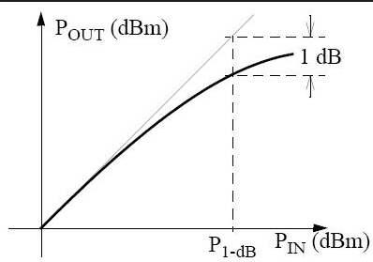
1dB Compression

Slide 8
1dB Compression
Add port to input and output of schematic and do the following settings.
1. In schematic, select input port
Port no. = 1
DC volt = 0.5
source type = sine
frequency name = rf
freq 1 = frf (this is the fundamental frequency)
amplitude 1 (dBm) = prf
2. In ADE, copy variables from schematic and enter values of frf and prf.
frf = 100K
prf = -40
3. Setup PSS analysis.
Auto Calculate Beat Frequency.
Number of Harmonics = 10.
Accuracy = Moderate.
Sweep prf from ay -30 to 30 Number of steps = 30.
4. Run.

Slide 9
1dB Compression
5. Results > Direct Plot > Main Form.
Analysis = PSS.
Function = Compression Point.
Select - Port (Fixed).
Format = Output Power.
Input Power extrapolation point - (blank)

Slide 10
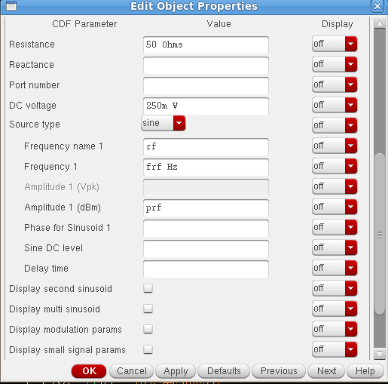
1dB Compression
1.

Slide 11
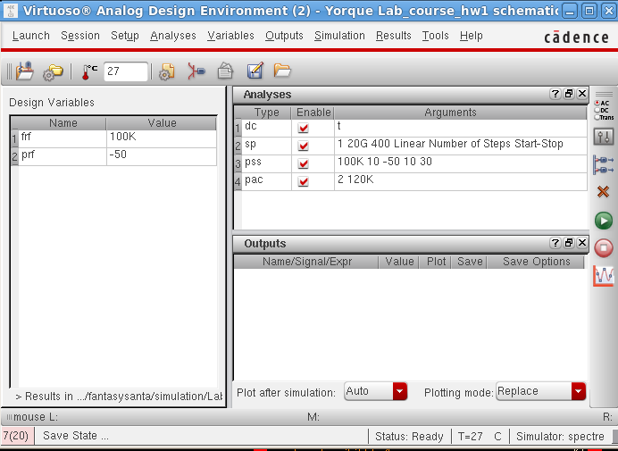
1dB Compression
2.

Slide 12
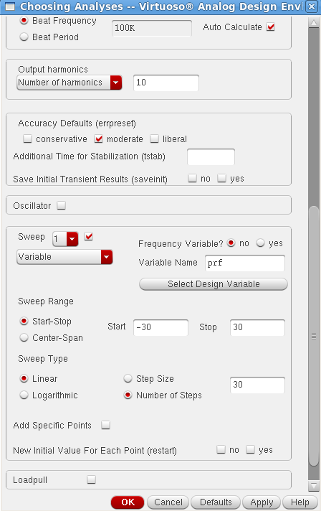
1dB Compression
3.

Slide 13
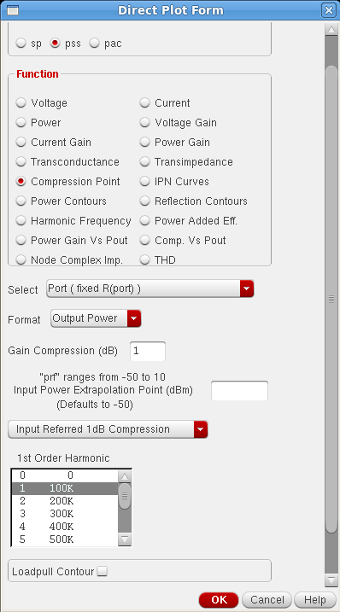
1dB Compression
5.

Slide 14
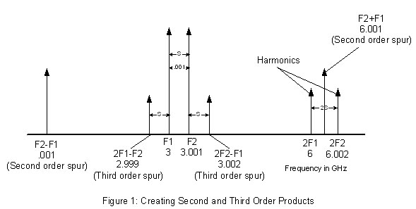
IP3

Slide 15
IP3
Setup PSS and PAC analysis
1. Setup test bench with port as input and output instance. For input port
Resistance = 50 ohms
Port num = 1
DC volt = 0.5
source type = sine
frequency name 1 = rf
freq1 = frf
Amplitude 1 (dBm) = prf
Select Display small signal parameters"
pac magnitude (dBm) = prf
2. Start ADE and copy variables from schematic. Enter value of frf and prf. frf is w1
which is the fundamental frequency. Enter prf in negative range say -50 (typically).

Slide 16
IP3
3. Setup pss analysis as discussed in earlier chapters. Auto calculate beat frequency
(equal to value of frf put in ADE). This is w1.
Set accuracy to moderate.
Activate sweep. Sweep power prf from say -50 to 10 dBm in say 30 steps.
click OK.
4. Setup PAC analysis.
Enter input frequency sweet range. Choose single point and give value of w2(120k).
Maximum sideband = 2 (for 3rd order)
5. Simulate. Results > Direct Plot > Main Form.

Slide 17
IP3
6. Select the following under Direct Plot > Main form.
Analysis = PAC
Function = IPN Curves
Drop down menu Select - Port (Fixed R(port))
Circuit Input Power - Variable Sweep (\prf")
Input power extrapolation point (dBm) = -40
Select \Input referred IP3" in drop down menu
Under 3rd order harmonic, select the frequency which is equal to 2w1-w2(80k). i.e.
Click on output port to plot the input referred IP3 in dBm.

Slide 18
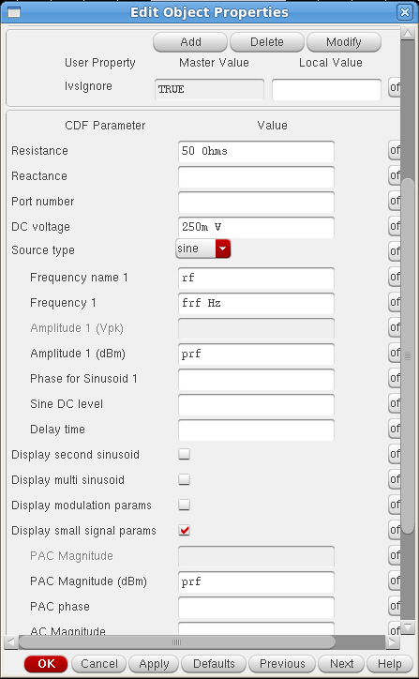
IP3
1.

Slide 19
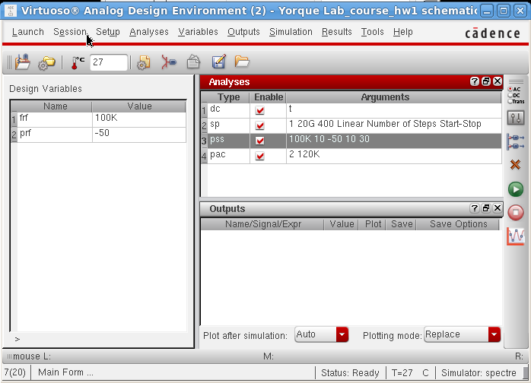
IP3
2.

Slide 20
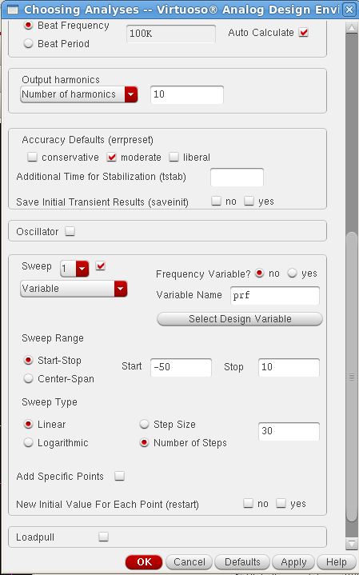
IP3
3.

Slide 21
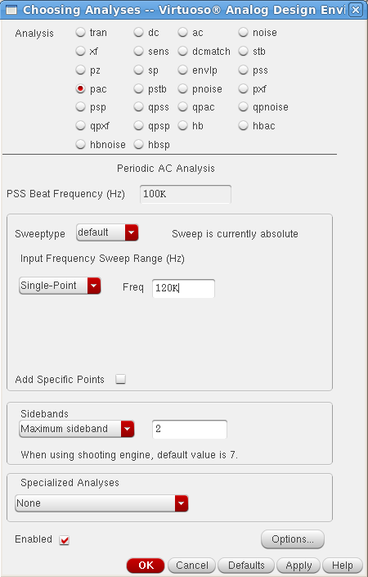
IP3
4.

Slide 22
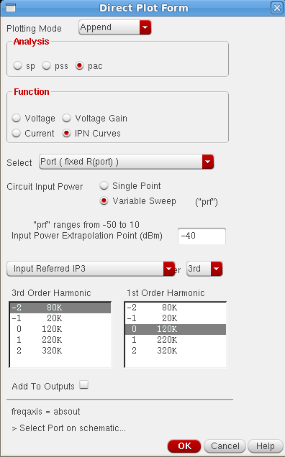
IP3
6.

Slide 23
IP3
6.

