Slide 1
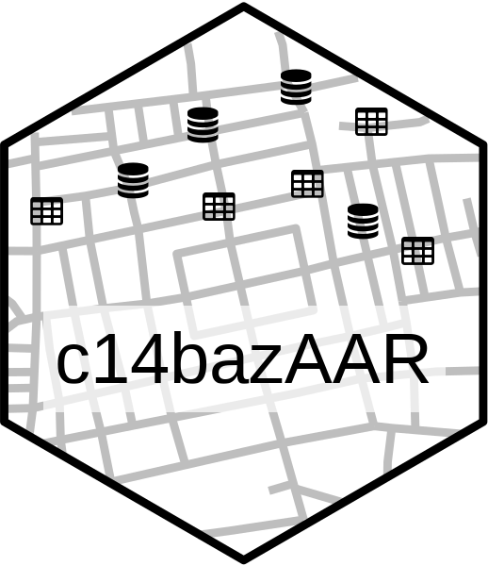

databases
...
3rd part datasets
collect
🕒
is.within selected period
🗺️
is.within selected area
standardisation
filters
has.a NeoNet class
is.not.in Aberrant dates
has.a SD < threshold

Slide 2
date
databases
...
3rd part datasets
collect
🕒
is.within selected period
standarisation
filters
🗺️
is.within selected area
has.a NeoNet class
is.not.in Aberrant dates
has.a SD < threshold
output

Slide 3
date
databases
...
3rd part datasets
collect
🕒
is.within selected period
🗺️
is.within selected area
standardization
filters
has.a NeoNet class
is.not.in Aberrant dates
has.a SD < threshold
output

Slide 4
