Slide 1
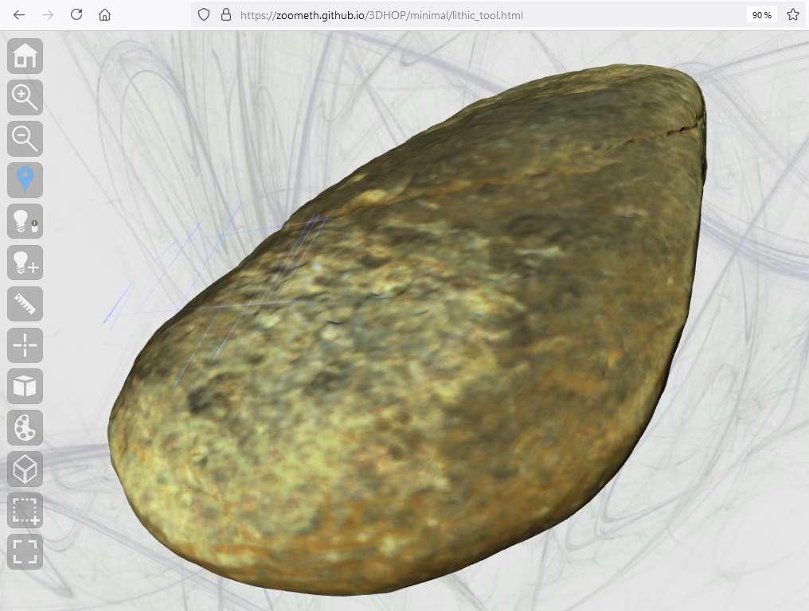


- LiDAR
- Aerial Photogrammetry
- Close-up Photogrammetry
- Lasergrammetry
Microscopy
.ply
NEXUS
or
.nxz
nxsbuild
nxscompress
.obj
GitHub
3DHOP
.html
.nxz
ROCKART
.html
https://zoometh.github.io/3DHOP/minimal/lithic_tool.html

