Slide 1
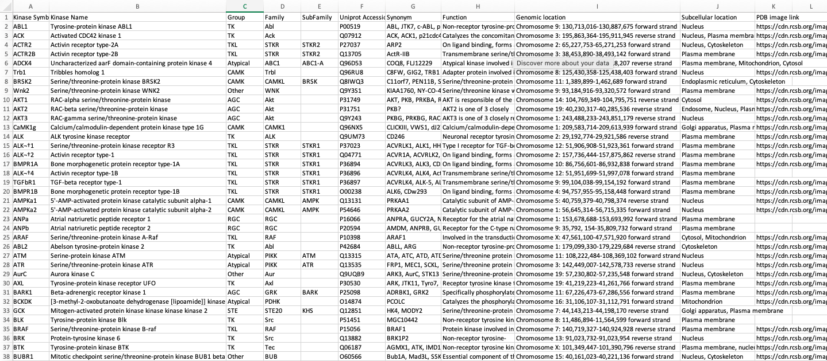
Protein Kinases Data Collection
Kinase Symbol, Name, Group, Family, Subfamily and Uniprot Accession Number obtained from KinHub
Synonym and Genomic Location obtained from Ensembl
Function and Subcellular location obtained from UniProt
Image obtained from Protein Data Bank website
This data was used to browse general information about protein kinases

Slide 2
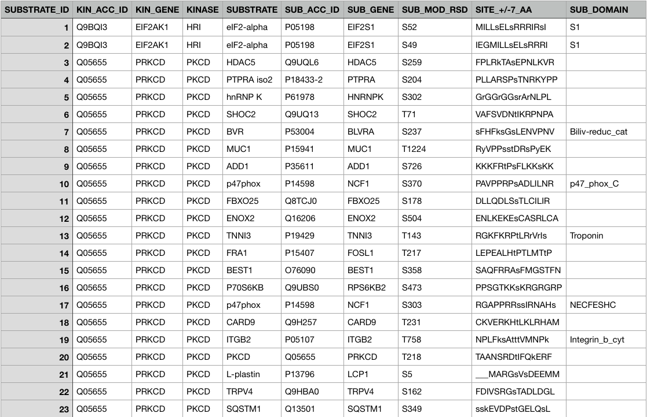
Phosphosites Data Collection
Phosphosites data downloaded from PhosphoSitePlus
Initial raw data was filtered to show only human data
Show information about phosphorylation sites of human protein kinases
This data was used to browse information about substrates phosphorylated by a protein kinase

Slide 3
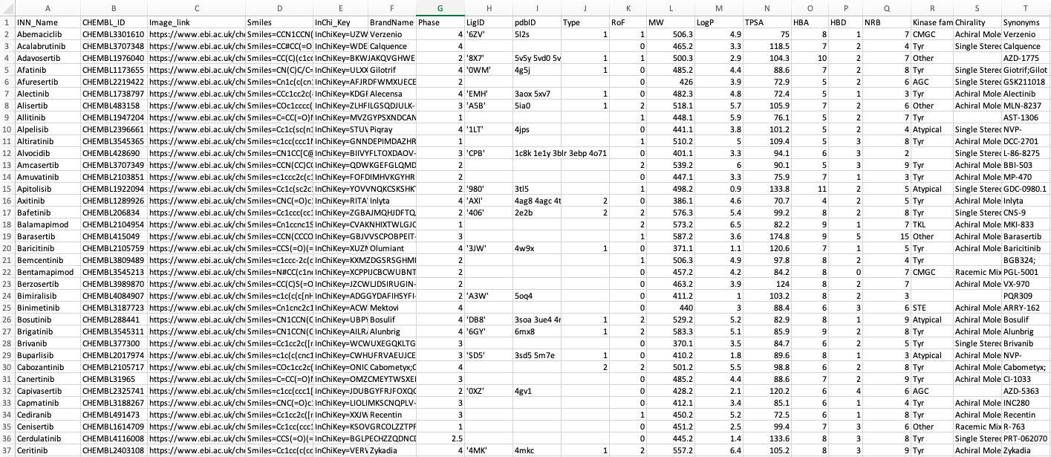
Inhibitors Data Collection
Inhibitors data gathered from PKIDB
This csv file contains general information such as the inhibitor name, Chembl ID, Smiles, Synonyms etc.
Another csv file was generated which contains information about the inhibitors Chembl ID and the protein kinase target
The data was used to browse general information about inhibitors and the protein kinases they inhibit

