Slide 1
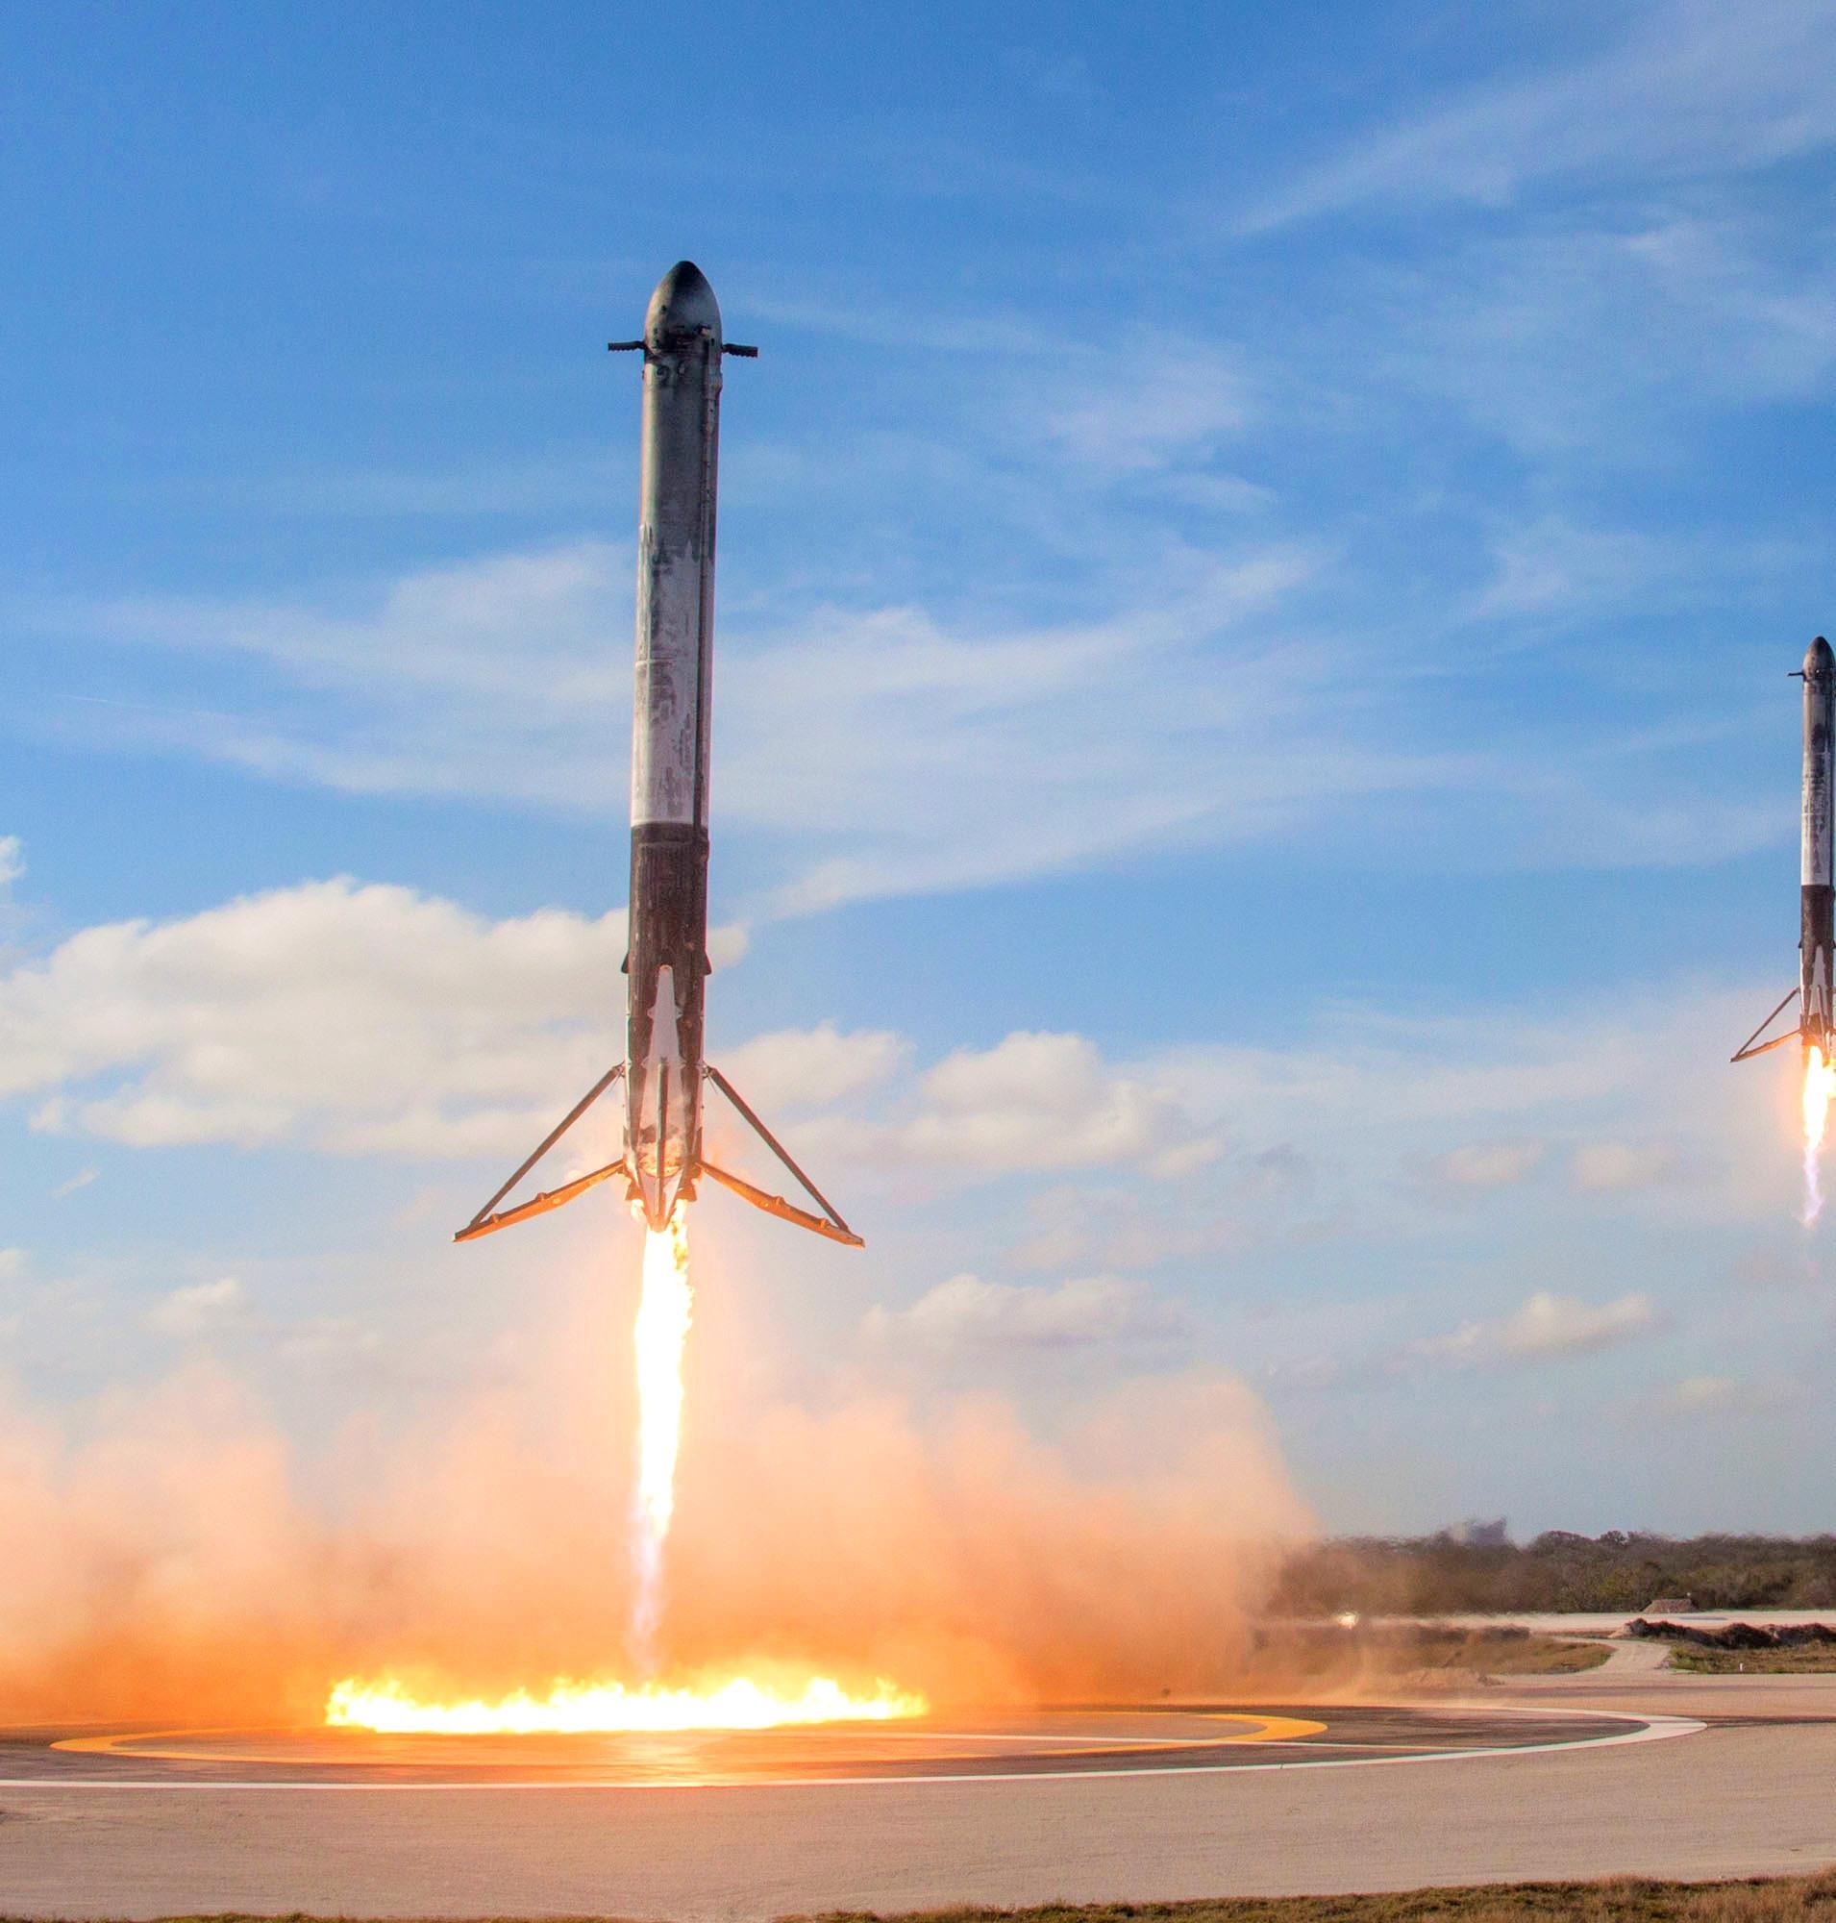
Redefining the Space Access with Data Science
Name: Oluwaseyi Akinsanya
September 10, 2023.
1

Slide 2
Outline
Executive Summary
Introduction
Methodology
Results
Conclusion
Appendix
2

Slide 3
Executive Summary
In this project, we will predict whether the first stage of the Falcon 9 rocket will land successfully.
The reuse of the first stage of the Falcon 9 rocket will reduce costs by
30%.
The methodology followed will include data collection, data wrangling, and data preprocessing.
After conducting the analysis, the outcomes indicate that some features
are correlated with success and failure.
Finally, on the basis of results we can conclude that the decision tree classifier method is the best fit for this analysis.
3

Slide 4
Introduction
Falcon 9 is a partially reusable medium-lift launch vehicle.
By reusing the first stage of the rocket, costs can be reduced by nearly 30%, allowing the company to stay competitive.
The primary goal of this project is to predict the successful landing of the first stage of the rocket.
We aim to answer the question: "Will the first stage of the rocket land successfully for a given set of features?"
4

Slide 5

Section 1: Methodology
5

Slide 6
Summary of Methodology
Data collection methodology:
SpaceX REST API and Web Scraping
Perform data wrangling
Create datasets for analysis, filter, clean data and deal with null values.
Perform exploratory data analysis (EDA) using visualization and SQL
Perform interactive visual analytics using Folium and Plotly Dash
Perform predictive analysis using classification models
Building, tuning, and evaluating different classification models
6

Slide 7
Data Collection: SpaceX Rest API
1. Request and parse the SpaceX launch data using get request.
2. Create a DataFrame that contains normalized JSON response.
3. Remove unwanted columns using auxilary functions.
4. Filter the data to comprise only Falcon 9 launches.
5. Handle missing values.
6. Export to CSV file
GitHub URL: Redefining-The-Space-Access-with-Data-Science/Data Collection with API.ipynb at main · zooviee/Redefining-The-Space-Access-with-Data-Science (github.com)
7

Slide 8
Data Collection: Web-Scraping
1. Request the launch data from Wikipedia.
2.Extract all columns from the HTML table header.
3. Create a DataFrame by parsing the HTML tables.
4.Export to CSV file.
GitHub URL : Redefining-The-Space-Access-with-Data-Science/Data Collection Web Scraping.ipynb at main · zooviee/Redefining-The-Space-Access-with-Data-Science (github.com)
8

Slide 9
Data Wrangling
1. Count the number of launches on each site.
2. Count the number and occurrence of each orbit.
Count the number and occurrence of mission
outcome per orbit type
Creating a landing outcome label from the outcome column
5. Export to CSV.
GitHub URL : Redefining-The-Space-Access-with-Data-Science/Data Wrangling Notebook.ipynb at main · zooviee/Redefining-The-Space-Access-with-Data-Science (github.com)
9

Slide 10
EDA with Data Visualization
Scatterplots represent the relationship between two variables, including:
Flight number vs. payload mass
Flight number vs. launch site
Payload mass vs. launch site
Flight number vs. orbit
Orbit vs. payload mass
Bar Charts: Bar charts are utilized to compare different categorical or discrete variables, specifically using horizontal bar charts to compare success rates with different orbits.
Line charts are employed to display trends, with a focus in this project on
tracing the change in success rates over the years.
GitHub URL: Redefining-The-Space-Access-with-Data-Science/EDA with Visualizations.ipynb at main · zooviee/Redefining-The-Space-Access-with-Data-Science (github.com)
10

Slide 11
EDA with SQL
Display unique launch site names.
Show 5 records with launch sites starting with 'CCA'.
Calculate the total payload mass carried by NASA (CRS) boosters.
Find the average payload mass carried by booster version F9 v1.1.
Identify boosters with successful drone ship landings, payload mass between 4000 and 6000, and launch site names in 2015.
List the total number of successful and failure mission outcomes.
Determine the names of booster versions that carried the maximum payload
mass.
Highlight failed landing outcomes on drone ships, including their booster versions and launch site names in 2015.
Rank the count of landing outcomes between the dates 2010-06-04 and 2017-
03-20 in descending order.
GitHub URL : Redefining-The-Space-Access-with-Data-Science/EDA with SQL.ipynb at main · zooviee/Redefining-The-Space-Access-with-Data-Science (github.com)
11

Slide 12
Build an Interactive Map using Folium
We crafted objects and integrated them into a Folium map. Markers highlighted launch sites and their success/failure records, while Lines measured distances between launch sites and their nearby locations.
By analyzing these maps, we can answer the following questions :
Are launch sites in close proximity to railways? Yes
Are launch sites in close proximity to highways? Yes
Are launch sites in close proximity to the coastline? Yes
Do launch sites keep a certain distance away from cities? Yes
GitHub URL: Redefining-The-Space-Access-with-Data-Science/Interactive VIsualizations.ipynb at main · zooviee/Redefining-The-Space-Access-with-Data-Science (github.com)
12

Slide 13
Dashboard Building using Plotly Dash
Features of the Dashboard :
1. Drop-down Bar: In the dashboard, we can see the dropdown
Bar in which you can put the launch site that you want to analyze.
2. Payload mass slider: A slider has also been provided to change
The range of payload mass for plotting scatter plots for success vs
Payload mass.
Contents of the Dashboard :
Pie Charts: In the dashboard, we can analyze the probability of success and failure for each Launch site using Pie charts.
Scatter charts: Scatter plots are drawn to show the relationship
between success and payload mass.
GitHub URL : Redefining-The-Space-Access-with-Data-Science/dash_interactivity.ipynb at main · zooviee/Redefining-The-Space-Access-with-Data-Science (github.com)
13

Slide 14
Predictive Analysis
1. Create a class column and standardize the data.
2. Make a split of data in test and train set.
3. Find the best hyperparameter for SVM, Decision Trees, KNN, and Logistic Regression.
4. Evaluate the models using test data based on their
accuracy scores and confusion matrix.
GitHub URL : Redefining-The-Space-Access-with-Data-Science/Machine Learning Predictions.ipynb at main · zooviee/Redefining-The-Space-Access-with-Data-Science (github.com)

Slide 15
Results
From the results we get from Exploratory Data Analysis, we can say that success
rate of Falcon 9 rocket landing is 66.66%.
After evaluating the models in predictive analysis, the decision tree model is the best fit with an accuracy of 94%.

Slide 16

Section 2:
Insights Drawn from EDA

Slide 17
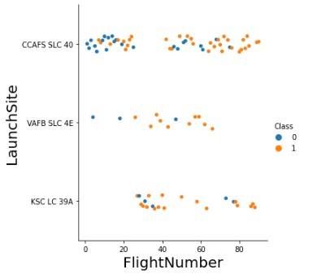
Flight Number vs. Launch Site
In this figure we can see orange and blue dots:
Blue dots represent Failure,
Orange dots represent Success.
In this plot we can see that the probability of success increases as the number of flights increases.

Slide 18
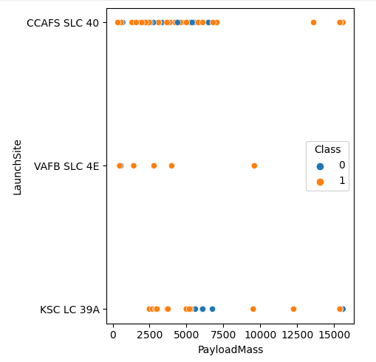
Payload vs. Launch Site
In the given plot we can see that, for the VAFB SLC- 4E launch site, there are no heavy payload masses.
There is a very weak correlation between payload mass and launch site.

Slide 19
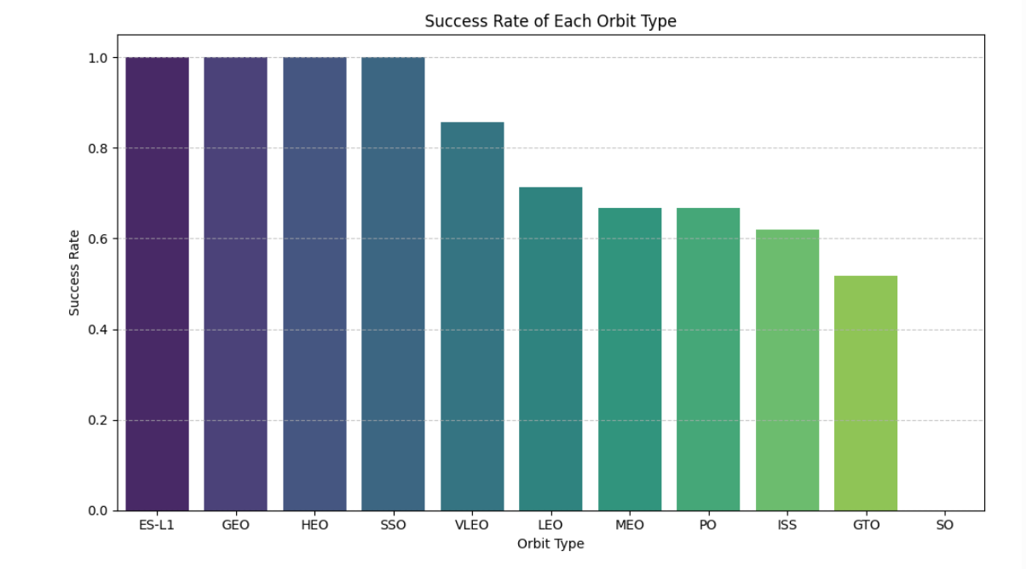
Success Rate vs. Orbit Type
In this chart we can see that there are some orbits with a success rate of 100% which are, ES-L1, GEO, HEO, and SSO.
Also we can see that orbit SO did not have
any successful launch.

Slide 20
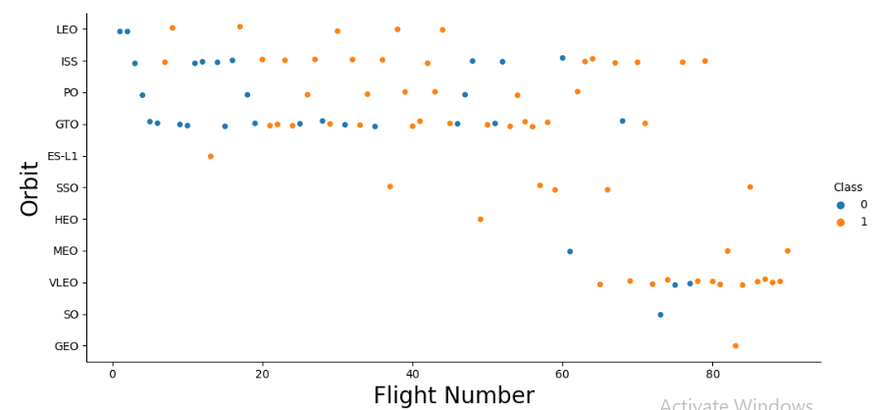
Flight Number vs. Orbit Type
In this chart we can see that the success rate of orbit LEO is positively correlated with Flight No.
There seems to be no relationship between Flight no. And success rate for GTO orbit.
Flight no. More than 40 have high success rate.

Slide 21
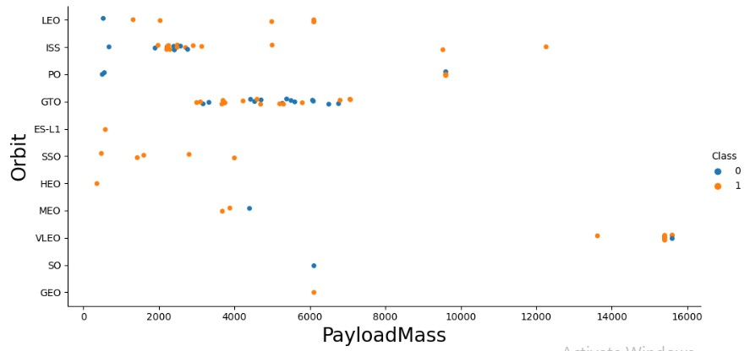
Payload Mass vs. Orbit Type
In this figure we can see, for orbits LEO, ISS, SSO, PO success rate increases with increase in payload mass.
There seems to be no correlation between orbit and payload
mass for orbit GTO.

Slide 22
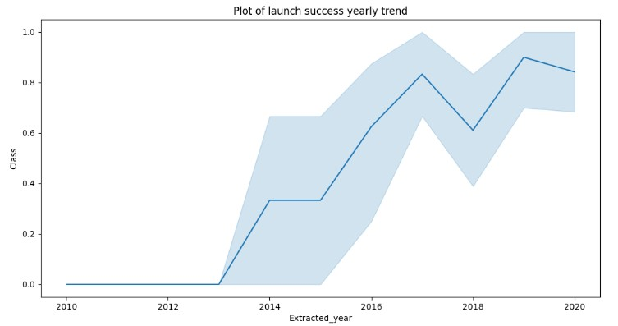
Launch Success Yearly Trend
In this trendline, we can see that the launch success is trending up. There is a short dip in the year 2018.

Slide 23
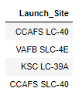
Site Names
Using the DISTINCT command in SQL we can print all unique sites from
column launch_site.
The names of the launch sites are, CCAFS LC-40, CCAFS SLC-40, KSC LC-39A, VAFB SLC-4E.

Slide 24
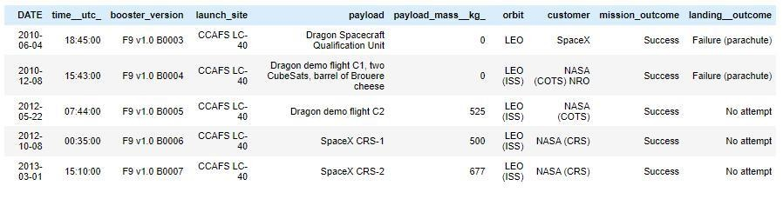
Launch Site Names Starting with 'CCA'
Using the SQL command LIKE we can return the names of the launch sites that start with 'CCA'.
These are the top 5 results

Slide 25

Total Payload Mass
We can calculate the total payload mass of boosters by NASA using the SUM() function.

Slide 26

Average Payload Mass by F9 V1.1
The AVG() function was used to calculate the average and the WHERE clause was used to specify Booster version as V1.1.

Slide 27

First Successful Ground Landing Date
The MIN(Date ) function was used to find the date of successful landing on ground pad.
The WHERE clause was used to specify landing outcome as 'Success (ground pad)'.

Slide 28
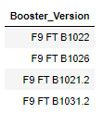
Successful Drone Ship Landing with Payload between 4000 and 6000
The BETWEEN clause was used to retrieve only those results of payload mass greater than 4000 but less than 6000. The WHERE clause filtered the results to include only boosters which successfully landed on drone ship

Slide 29
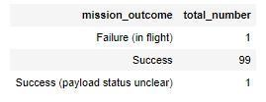
Total Number of Successful and Failure Mission
Outcomes
To calculate total number of occurences of different mission outcomes, the COUNT() function was used with the help of the GROUP BY clause on the mission_outcome column.
There are a total of 101 launches out of which 99 mission outcomes are
successful.

Slide 30
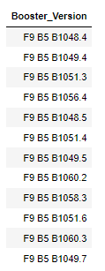
Boosters with Maximum Payload
The MAX() function was used in a subquery to retrieve a list of boosters that have carried the maximum payload mass

Slide 31

Launch Records for the Year 2015
The Year(Date) function was used to retrieve only those rows containing year 2015 as a Launch date.

Slide 32
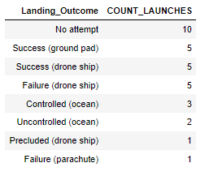
Ranking of the Landing Outcomes between
2010-06-04 and 2017-03-20.
The COUNT() function was used to count the different landing
outcomes. The WHERE and BETWEEN clauses filtered the results to only
include results between 2010-06-04 and 2017-03-20. The GROUPBY clause ensure that the counts were grouped by their outcome. The ORDERBY and DESC clauses were used to sort the results by descending order.

Slide 33
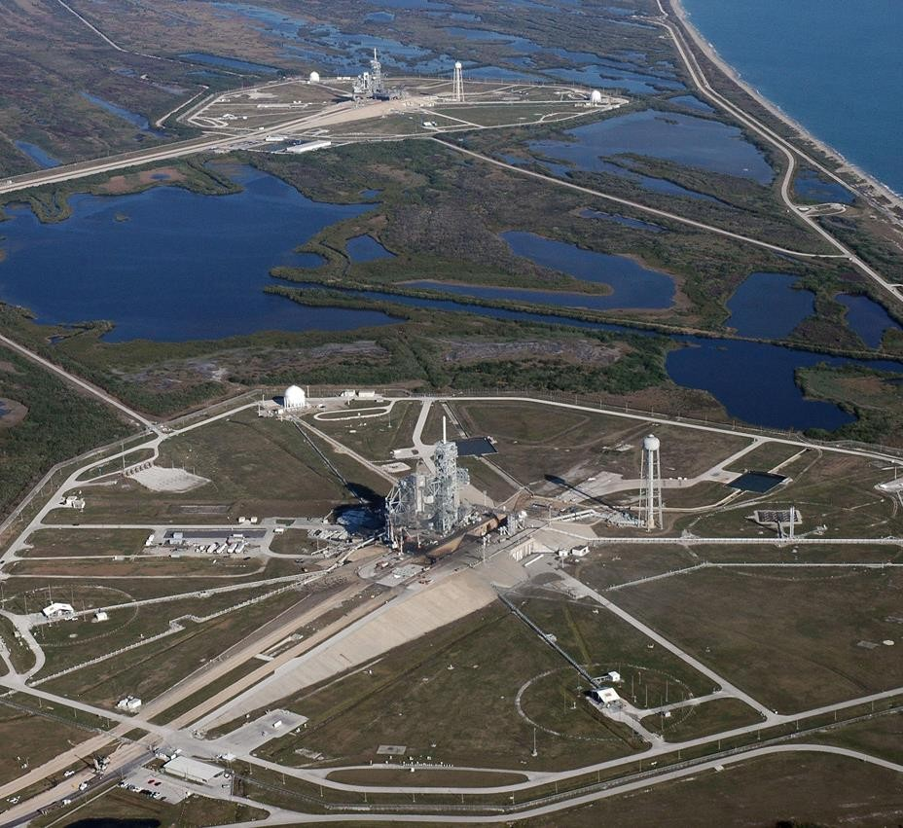
Section 3:
Launch Sites Proximities Analysis

Slide 34
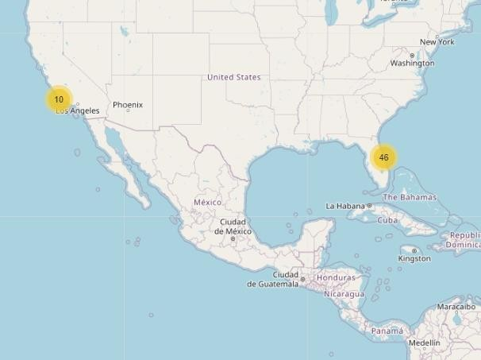
Locations of Launch Sites
The yellow markers on the map shows the Launch sites of the SpaceX in the US.
Both the Launch sites are placed near the coast.
The numbers shown indicates
the number of Launches.

Slide 35
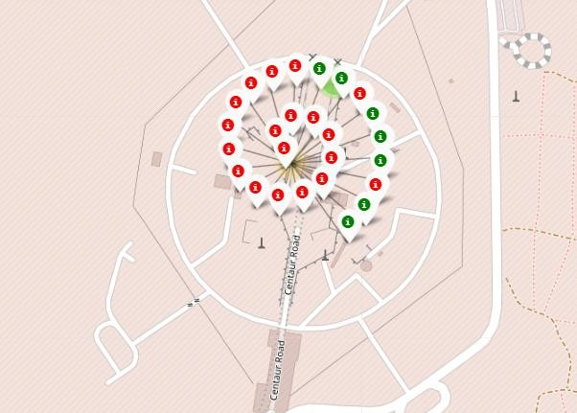
Zooming Out The Map
Zooming out the map and clicking the launch site will show the marker clusters over there.
This figure will indicate the number of successful (green) and unsuccessful landings (Red) on that particular site.

Slide 36
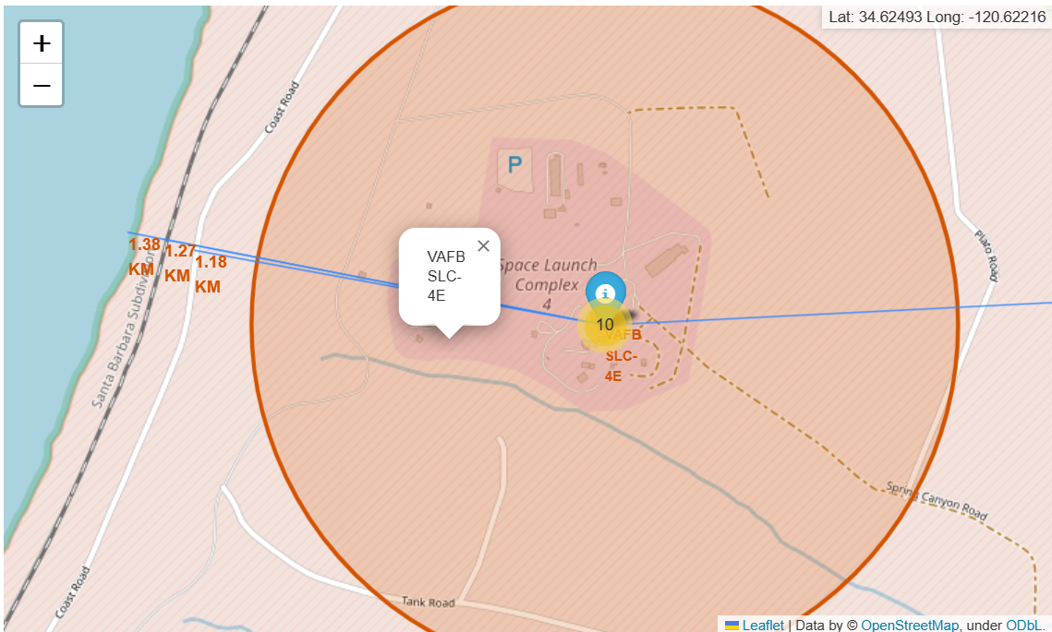
Launch Site Proximities
Based on the calculated distances, the launch site appears to be strategically located in close proximity to railways, highways, and coastlines, while maintaining a safe distance from populated cities for safety reasons. These factors are important considerations for the logistics and safety of rocket launches.

Slide 37

Section 4:
Building Dashboard

Slide 38
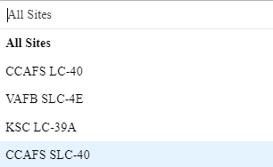
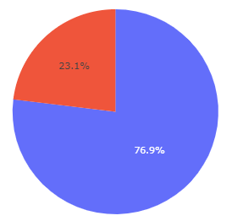
Overview of Dashboard
Drop-down bar: By clicking the drop-down bar, you can select the Launch site that you want to analyze.
Pie chart and Scatter plot: The pie chart represents the success of Launches in % while the Scatter plot represents the correlation between payload and Launch success.

Slide 39
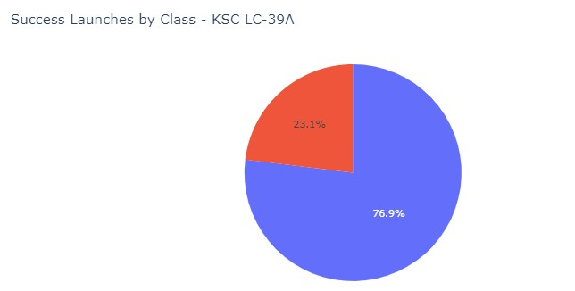
Launch Site with Highest Success Rate
The KSC LC-39A is the Launch Site with the highest success rate of 76.9%.

Slide 40
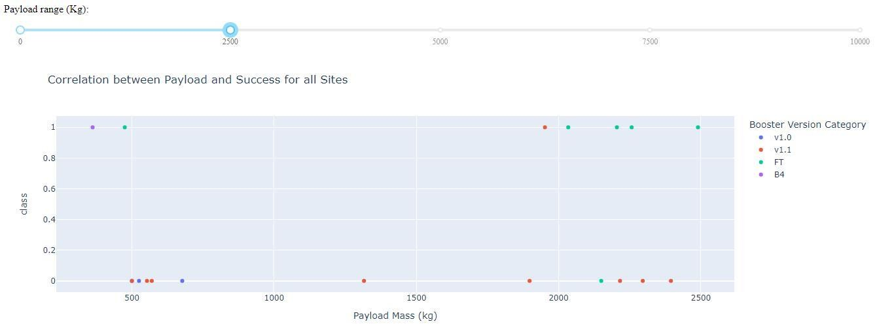
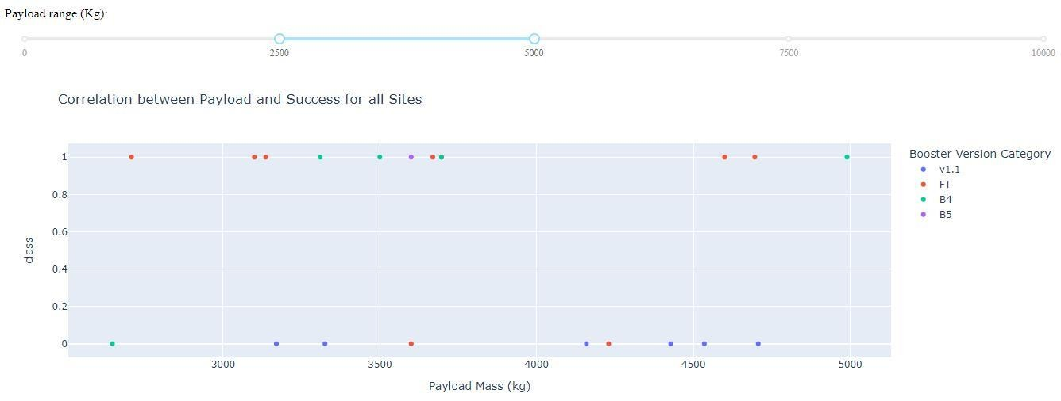
Payload Vs Launch Outcome
The launch success rate for payloads 0 - 2500 kg is slightly lower than that of payloads 2500 - 5000 kg. There is in fact not much difference between the two.
The booster version with the largest success rate in both weight ranges is the v1.1

Slide 41

Section 5:
Predictive Analysis

Slide 42
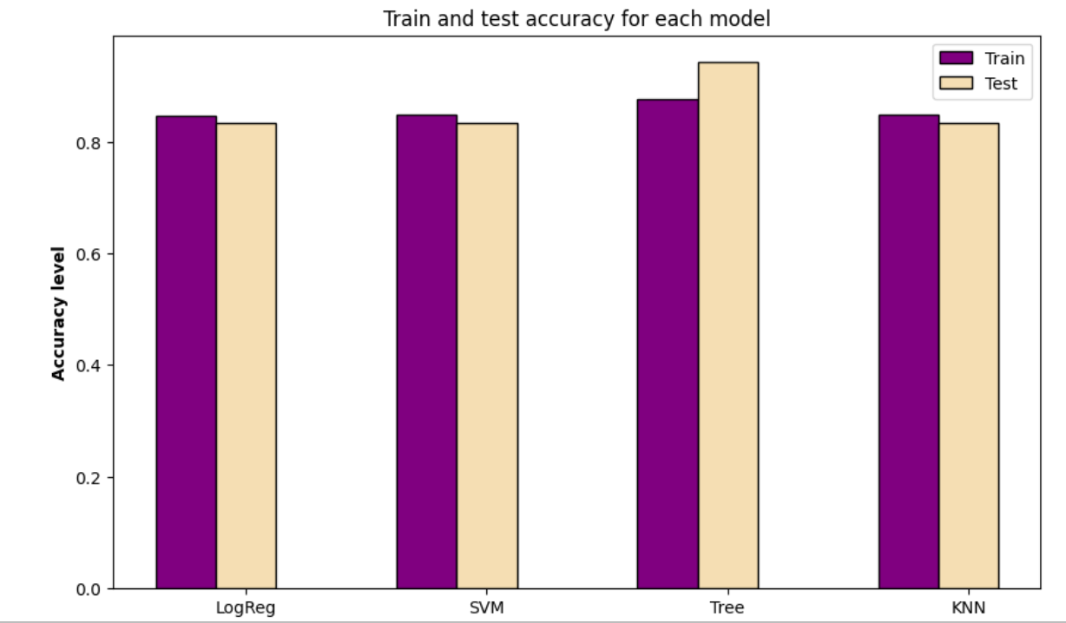
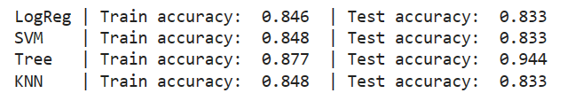
Classification Accuracy
Out of all 4 classifiers, Decision Tree Classifier has the highest accuracy of 94%.

Slide 43
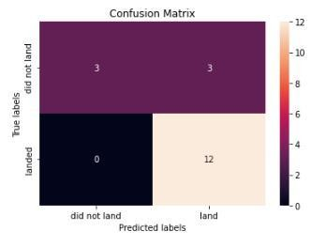
Confusion Matrix
The model predicted 12 successful landings when the True label was successful (True Positive) and 3 unsuccessful landings
when the True label was a failure (True Negative).
The model also predicted 3 successful landings when the True label was unsuccessful landing (False Positive).
The model generally predicted successful
landings.

Slide 44
Conclusions
We can see the uptrend in success rate over the years.
The orbits like SSO, HEO, GEO, and ES-L1 have the most successful launches.
The relationship between success rate and Payload mass shows that the probability of successful landing increases if we reduce the payload.
The maps show that the Launch sites are strategically placed near
the highway, railway, and coastline for transportation purposes, but also away from the cities for safety.
Decision tree classifier has the highest accuracy (94%). Therefore it will be the best predictive model.

Slide 45
Appendix
GitHub Repository : zooviee/Redefining-The-Space-Access-with-Data-Science (github.com)

Slide 46
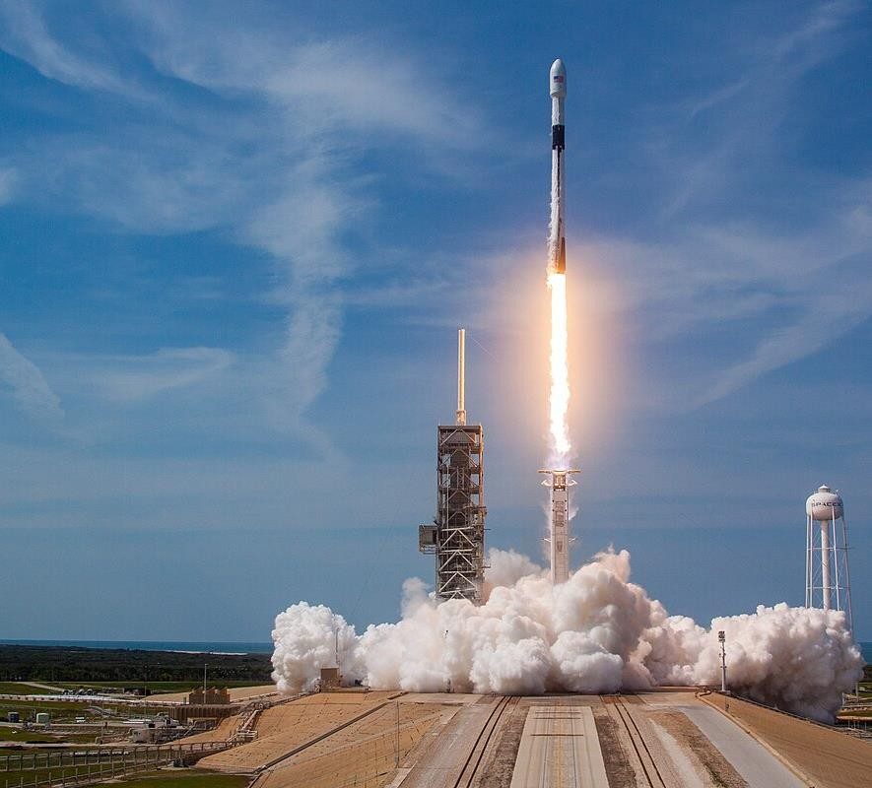
Thank you!

