Slide 1



Housing Price Index vs Household Median Income
By: Wee Kiam, Sophia, Zu and Dawn
Notes:
Hello everyone! Today we will be presenting to you on our findings between Housing Price Index vs Household Median Income. This is brought to you by Wee Kiam, Sophia, Zu and myself, Dawn.

Slide 2
Problem Statement
Does median monthly household income increase proportionally with the housing pricing indexes?
Can we use the housing pricing indexes to predict the median monthly household income?
Anecdotal
Empirical
Notes:
In this presentation, we wanted to find out 2 things. Firstly… Secondly…
Anecdotal approach at first then to Empirical approach

Slide 3
Stakeholder Analysis
Primary Stakeholders:
Government bodies (to help with policymaking e.g. cooling measures, grants)
Secondary Stakeholders:
General public

Slide 4
Source of Data and Data Type
Quantitative Data Type
Multi-structured/ Hybrid Data Type
Acquisition: Public data available from Singstat and Data.gov.sg
Private Property Price Index: https://data.gov.sg/dataset/private-residential-property-price-index-by-type-of-property
HDB Resale Price Index Data of Median Monthly Income: https://data.gov.sg/dataset/hdb-resale-price-index
Data of Median Monthly Income: https://www.tablebuilder.singstat.gov.sg/publicfacing/createDataTable.action?refId=12307
Notes:
HDB Price index - Tracks the overall price movement of the public residential market. The index is based on quarterly average resale price by date of registration. The index till 3Q2014 was computed using stratification method, while that from 4Q2014 onwards is computed using the stratified hedonic regression method.
PPI - The current PPI is computed using the stratification method. Under this method, transacted properties are grouped into different categories based on property type, tenure, completion status, and region. The median prices for each category are then aggregated using 12-quarter moving average weights to derive the PPI.

Slide 5

2019 Covid 19
Notes:
Generally, median monthly income of Singapore had been progressing on a healthy path from yr 2000 to yr 2020.
It had increased from $4398 to $9189, an increase of about 110% for the past 20 years.
However there are certain years when we face a drop. (2001, 2008 and 2019)
https://www.straitstimes.com/singapore/jobs/lower-incomes-in-2020-with-employment-rate-in-singapore-at-6-year-low-due-to-covid-19
https://www.straitstimes.com/singapore/real-household-incomes-decline-for-the-first-time-in-more-than-10-years-but-impact

Slide 6
Notes:
Many factors can affect housing prices to fluctuate.
Both Macro and Micro events can cause the supply and demand for housing to change and thus resulting the prices to fluctuate.

Slide 7
Events affecting the Housing Price Index
2001 Dotcom Bust, 911 terrorist attack, Singapore in recession
2003 SARS
2005 Announcement of 2 Integrated Resort
2005 to 2007 En Bloc Wave
2008 Global financial crisis (Lehman Brothers collapse)
2008 to 2011 Three rounds of Quantitively Easing by US. Flow of Hot money into Singapore. Foreigners drove housing demand
2010 Opening of the two Integrated Resorts
Sep 2009 to July 2018 – Cooling Measures like SSD, ABSD, LTV limit, Loans Period, TDSR etc implemented to control housing prices
2017 to 2018 En Bloc Wave
2020 Covid-19
Notes:
Here are the events causing the housing prices to increase or decease.
Timeline
2001 Dotcom Bust, 911 terrorist attack, Singapore in recession
2003 SARS
2005 Announcement of 2 Intregarted Resort
2005 to 2007 En Bloc Wave
2008 Global financial crisis (Lehman Brothers collapse)
2008 to 2011 Three rounds of Quantitively Easing. Circulating of Hot money. Foreigners drove housing demand
2010 Opening of the two Integated Resorts
Sep 2009 to July 2018 – Cooling Measures like SSD, ABSD, LTV limit, Period of loans, TDSR implemented to control housing prices
2017 to 2018 En Bloc Wave
2020 Covid-19
https://www.finko.com.sg/articles/housing-loan/property-cooling-measures
https://www.srx.com.sg/cooling-measures
https://en.wikipedia.org/wiki/Quantitative_easing
https://en.wikipedia.org/wiki/Hot_money

Slide 8
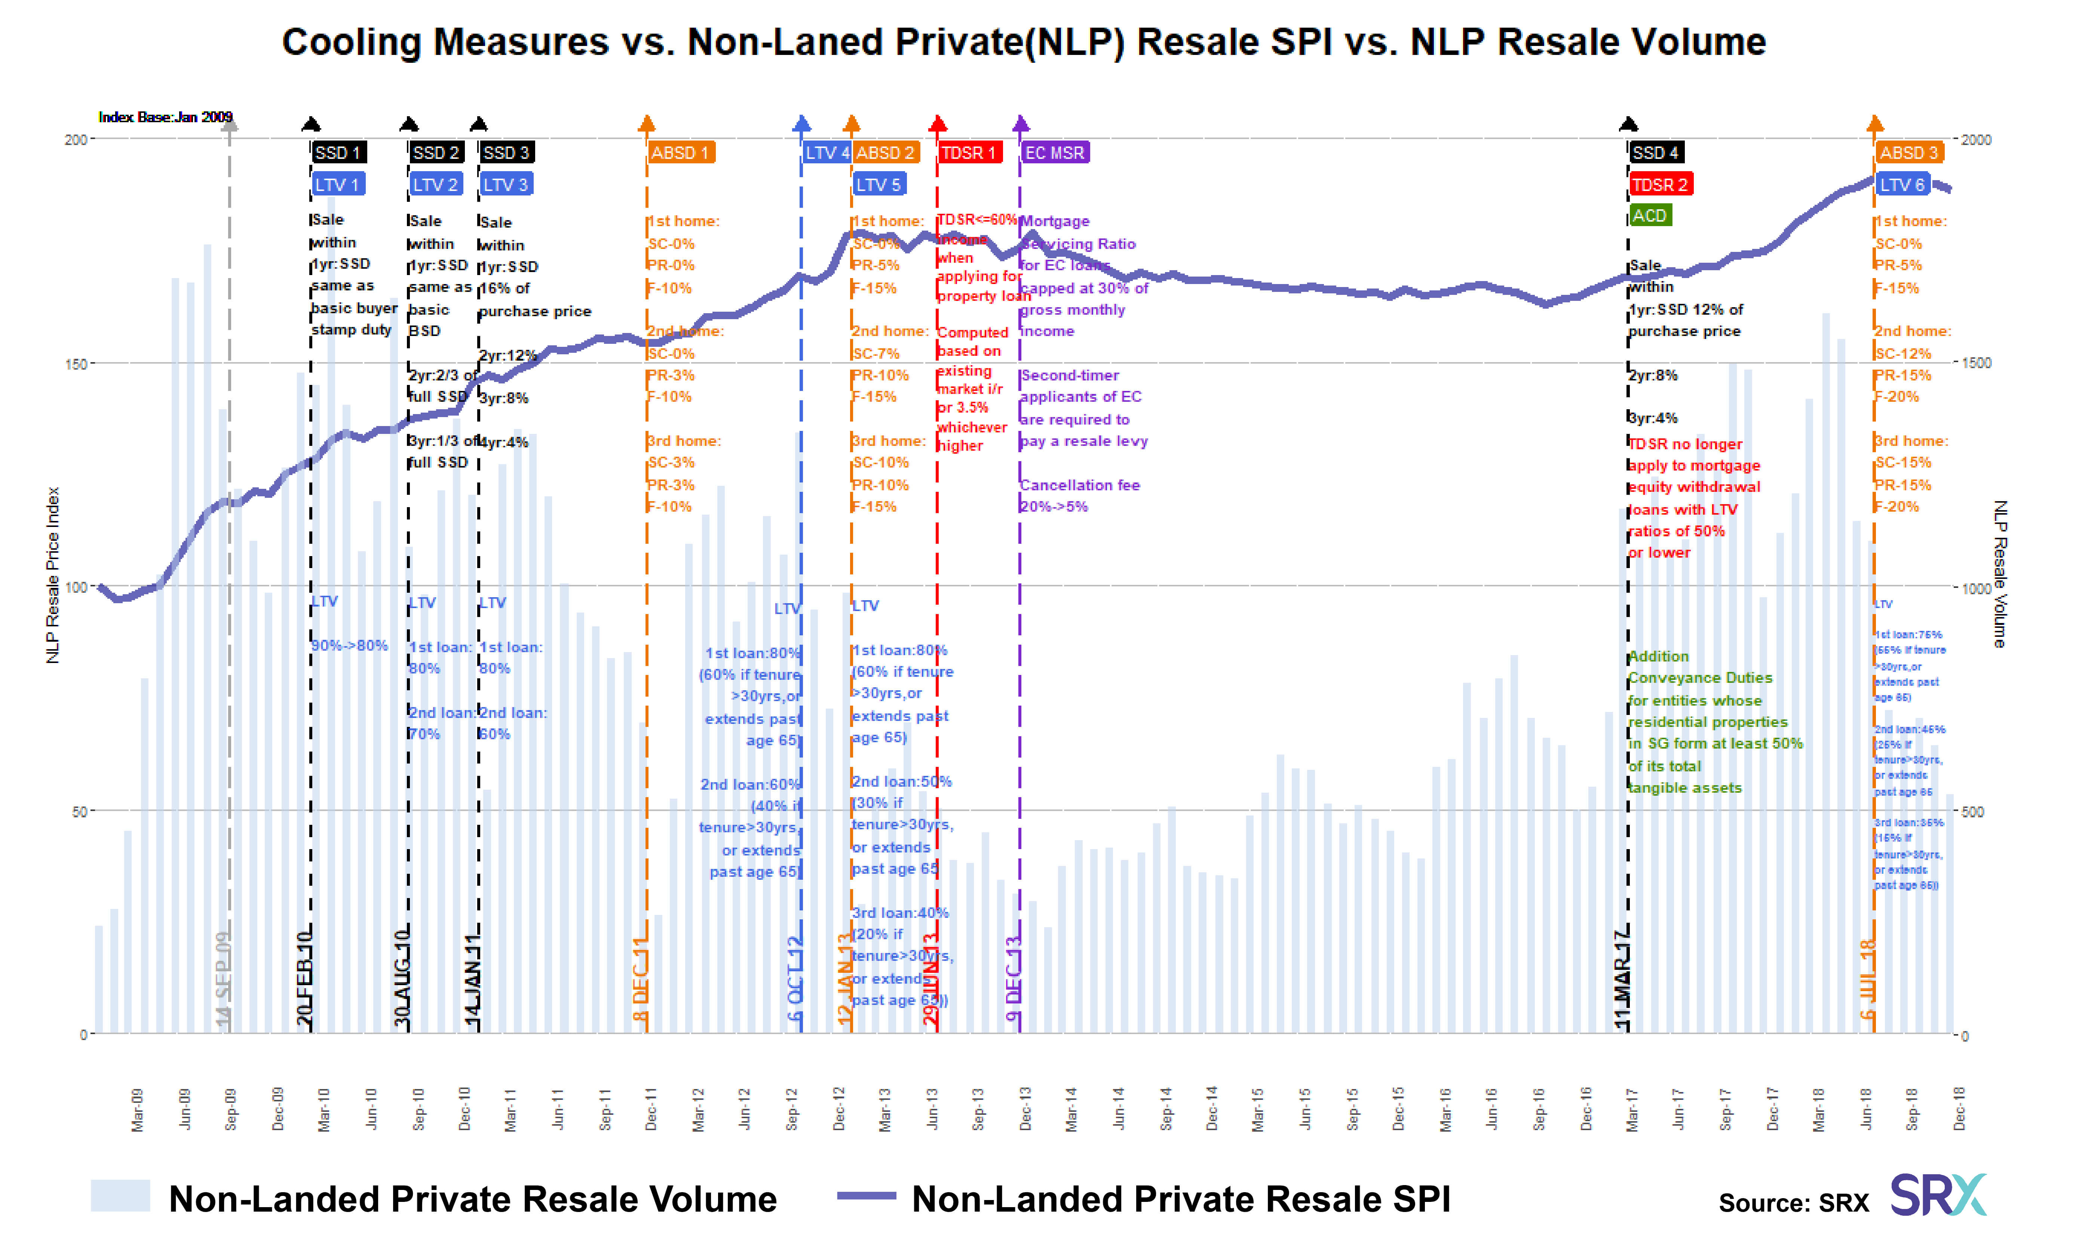
Source: https://www.srx.com.sg/cooling-measures

Slide 9
Notes:
Above chart shows the comparison of the Median Monthly Household income vs the Housing Price indexes.

Slide 10
Notes:
On this chart, it shows the % change of the Median Monthly Household income and both the Housing price indexes on a yearly basis.
The events causing the fluctuation is explained on Events affecting the Housing Price indexes slide.
2001 Dotcom Bust, 911 terrorist attack, Singapore in recession
2003 SARS
2005 Announcement of 2 Intregarted Resort
2005 to 2007 En Bloc Wave
2008 Global financial crisis (Lehman Brothers collapse)
2008 to 2011 Three rounds of Quantitively Easing. Circulating of Hot money. Foreigners drove housing demand
2010 Opening of the two Integated Resorts
Sep 2009 to July 2018 – Cooling Measures like SSD, ABSD, LTV limit, Period of loans, TDSR implemented to control housing prices
2017 to 2018 En Bloc Wave
2020 Covid-19
https://www.edgeprop.sg/market-watch/enbloc-market

Slide 11
Notes:
On this chart, it shows the Cumulative % change of the Median Monthly Household income and both the Housing price indexes to Year 2000.
In general, housing prices in Singapore had increase over the last 20 years.
HDB Price index show an increase of 71%. At its peak, the cumulative % change show 89%.
Private Price Index increased by 62%. At its peak, the cumulative % change show ^5%
Median Monthly Household income had increased by 109%.

Slide 12
Insights
Many factors can affect housing prices and household income to fluctuate.
Both Macro and Micro events can cause the supply and demand for housing to change and thus resulting the prices to fluctuate.
Housing prices in Singapore are largely managed and controlled by the SG government through policies like controlled land sales, cooling measures etc.
Coupled with efforts to increase the household income by attaching investments, upgrading and reskilling the labor force etc
This enable public housing to remain affordable to most Singaporeans.

Slide 13
Descriptive Statistics
HDB Price Index
Mean | 108.553571
Standard Error | 6.44037055
Median | 118.6
Mode | #N/A
Standard Deviation | 29.5134856
Sample Variance | 871.04583
Kurtosis | -1.8691931
Skewness | -0.1787612
Range | 78.45
Minimum | 69.525
Maximum | 147.975
Sum | 2279.625
Count | 21
Private Price Index
Mean | 124.814881
Standard Error | 6.95150012
Median | 136.1625
Mode | #N/A
Standard Deviation | 31.8557755
Sample Variance | 1014.79043
Kurtosis | -1.7903927
Skewness | -0.2227433
Range | 81.2625
Minimum | 81.5625
Maximum | 162.825
Sum | 2621.1125
Count | 21
Median Monthly Household Income
Mean | 6746.190476
Standard Error | 410.887197
Median | 6342
Mode | #N/A
Standard Deviation | 1882.921682
Sample Variance | 3545394.062
Kurtosis | -1.693771277
Skewness | 0.135215268
Range | 5027
Minimum | 4398
Maximum | 9425
Sum | 141670
Count | 21

Slide 14
Multiple Linear Regression
Chosen because:
Quantitative Data
More than one predictor variable

Slide 15
MLR – Predicting Private PI
Regression Analysis
OVERALL FIT
Multiple R | 0.97898151 |  | AIC | 83.57140887
R Square | 0.9584048 |  | AICc | 86.07140887
Adjusted R Square | 0.95378312 |  | SBC | 86.70497618
Standard Error | 6.8483904
Observations | 21
ANOVA |  |  |  | Alpha | 0.05
 | df | SS | MS | F | p-value | sig
Regression | 2 | 19451.6005 | 9725.80026 | 207.3711454 | 3.7272E-13 | yes
Residual | 18 | 844.208119 | 46.9004511
Total | 20 | 20295.8086
 | coeff | std err | t stat | p-value | lower | upper | vif
Intercept | 9.35828887 | 5.88177758 | 1.59106473 | 0.129004228 | -2.9988673 | 21.715445
Median Monthly Household Income | 0.00242221 | 0.00204862 | 1.1823664 | 0.252444281 | -0.0018818 | 0.0067262 | 6.34510092
HDB Price Index | 0.91305952 | 0.130699 | 6.98597154 | 1.59584E-06 | 0.6384711 | 1.18764793 | 6.34510092
Notes:
The P-value of Medium monthly household income is higher than 0.05, reject
However, the P-value of the HDB PI is lower than 0.05
VIF for both is higher than 5

Slide 16
MLR – Predicting HDB PI
Regression Analysis
OVERALL FIT
Multiple R | 0.97853709 |  | AIC | 80.79849805
R Square | 0.95753484 |  | AICc | 83.29849805
Adjusted R Square | 0.95281648 |  | SBC | 83.93206536
Standard Error | 6.41085059
Observations | 21
ANOVA |  |  |  | Alpha | 0.05
 | df | SS | MS | F | p-value | sig
Regression | 2 | 16681.1345 | 8340.56726 | 202.9384212 | 4.4905E-13 | yes
Residual | 18 | 739.782096 | 41.0990053
Total | 20 | 17420.9166
 | coeff | std err | t stat | p-value | lower | upper | vif
Intercept | -4.3887372 | 5.78873885 | -0.7581508 | 0.458172887 | -16.550426 | 7.77295182
Median Monthly Household Income | 0.00193825 | 0.00193768 | 1.000295 | 0.330426065 | -0.0021327 | 0.00600917 | 6.47780967
Private Price Index | 0.80011678 | 0.11453193 | 6.98597154 | 1.59584E-06 | 0.55949413 | 1.04073943 | 6.47780967
Notes:
Similar conclusions can be made for this like previous slide.

Slide 17
MLR – Predicting Income
Regression Analysis
OVERALL FIT
Multiple R | 0.92398933 |  | AIC | 281.307669
R Square | 0.85375628 |  | AICc | 283.807669
Adjusted R Square | 0.83750698 |  | SBC | 284.441236
Standard Error | 759.013706
Observations | 21
ANOVA |  |  |  | Alpha | 0.05
 | df | SS | MS | F | p-value | sig
Regression | 2 | 60538048.7 | 30269024.4 | 52.5411031 | 3.0598E-08 | yes
Residual | 18 | 10369832.5 | 576101.805
Total | 20 | 70907881.2
 | coeff | std err | t stat | p-value | lower | upper | vif
Intercept | 83.2136229 | 695.939117 | 0.11957026 | 0.90614801 | -1378.9002 | 1545.32745
HDB Price Index | 27.1693042 | 27.1612916 | 1.000295 | 0.33042606 | -29.894452 | 84.2330603 | 22.3086147
Private Price Index | 29.753278 | 25.1641775 | 1.1823664 | 0.25244428 | -23.114697 | 82.6212531 | 22.3086147
Notes:
Now, we switch over, we use the price index to predict the income.
As you can see the VIF is super high, with the value of 22 and both p-value is above 0.05

Slide 18
MLR Findings
Since p-values are all > 0.05, we cannot use MLR
We found that HDB PI and Private PI are highly correlated
Hence, switch to simple linear regression
Notes:
We then test for correlation between HDB PI and Private PI to check if they are dependent or independent variables

Slide 19
Simple Linear Regression
SUMMARY OUTPUT
Regression Statistics
Multiple R | 0.97733017
R Square | 0.95517427
Adjusted R Square | 0.95281502
Standard Error | 6.9197448
Observations | 21
ANOVA
 | df | SS | MS | F | Significance F
Regression | 1 | 19386.0341 | 19386.0341 | 404.8636784 | 2.8533E-14
Residual | 19 | 909.774495 | 47.8828682
Total | 20 | 20295.8086
 | Coefficients | Standard Error | t Stat | P-value | a 95% | Upper 95% | Lower 95.0% | Upper 95.0%
Intercept | 10.3023267 | 5.88804936 | 1.74970114 | 0.096304225 | -2.0215023 | 22.6261556 | -2.0215023 | 22.6261556
HDB Price Index (avg) | 1.0548944 | 0.05242695 | 20.1212246 | 0.0000000000000285 | 0.94516353 | 1.16462526 | 0.94516353 | 1.16462526
Notes:
We then test for correlation between HDB PI and Private PI to check if they are dependent or independent variables
As u can see the p-value for the price indexes is below 0.05

Slide 20
Observe the correlation (HDB/Private)
Notes:
Talk about the correlation – hence we only need to use one of the PI to predict for median income

Slide 21
Predicting Income using Private PI
SUMMARY OUTPUT
Regression Statistics
Multiple R | 0.9195797
R Square | 0.84562683
Adjusted R Square | 0.83750193
Standard Error | 12.8413974
Observations | 21
ANOVA
 | df | SS | MS | F | Significance F
Regression | 1 | 17162.68036 | 17162.6804 | 104.0783838 | 3.8106E-09
Residual | 19 | 3133.128272 | 164.901488
Total | 20 | 20295.80863
 | Coefficients | Standard Error | t Stat | P-value | Lower 95% | Upper 95% | Lower 95.0% | Upper 95.0%
Intercept | 19.8596951 | 10.66263693 | 1.86255007 | 0.078062646 | -2.4574605 | 42.1768507 | -2.4574605 | 42.1768507
Median Monthly Household Income | 0.0155577 | 0.001524983 | 10.2018814 | 0.00000000381 | 0.01236587 | 0.01874952 | 0.01236587 | 0.01874952
Notes:
When we use the Private PI to predict median income,
The p-value is also below 0.05
Hence we can conclude that we can use the indexes to predict median income.

Slide 22
SUMMARY OUTPUT
Regression Statistics
Multiple R | 0.91782247
R Square | 0.84239809
Adjusted R Square | 0.83410326
Standard Error | 12.0209678
Observations | 21
ANOVA
 | df | SS | MS | F | Significance F
Regression | 1 | 14675.3469 | 14675.3469 | 101.5569176 | 4.6466E-09
Residual | 19 | 2745.56966 | 144.503666
Total | 20 | 17420.9166
 | Coefficients | Standard Error | t Stat | P-value | Lower 95% | Upper 95% | Lower 95.0% | Upper 95.0%
Intercept | 11.5013381 | 9.98140706 | 1.15227623 | 0.2635001 | -9.38998694 | 32.3926632 | -9.38998694 | 32.3926632
Median Monthly Household Income | 0.01438623 | 0.00142755 | 10.0775452 | 0.00000000465 | 0.01139833 | 0.01737413 | 0.01139833 | 0.01737413
Predicting Income using HDB PI

Slide 23
Recommendations, Limitations and Future Research
Recommendations: Cooling measures are effective in controlling the housing prices to a certain extent.
Limitations: differences in computation and assumptions taken in for both PI, timeframe of analysis
Future Research: Going into more micro perspective - look into other factors such as inflation, floor, floor area, property type, location, GDP, etc.
Notes:
For our stakeholders, which is the government, we can say that the cooling measures are effective to a certain extent.

Slide 24
Conclusions
Increase and decrease of PI are affected by:
Government policies like the Cooling measures
Supply and Demand
Macro and micro Events
* HDB PI and Private PI are highly correlated
* Housing price indexes can predict the median monthly household income.
Notes:
Does median monthly household income increase proportionally with the housing pricing indexes?
Can we use the housing pricing indexes to predict the median monthly household income?

