Slide 1
Sports Analytics Final Project
Created By: Zach Palmer

Slide 2
Season Overview
The 2005-06 NHL season is unique:
Followed the 2004-05 season that was cancelled in its entirety due to the lockout that ensued after a labor dispute between the NHL and NHLPA over the Collective Bargaining Agreement (CBA)
A mid-season break in February occurred to allow participation in the 2006 Winter Olympics
The All-Star Game was cancelled to make room for the Olympics as well
Stanley Cup Finals featured the Hurricanes and Oilers, two teams who would experience considerable hardship in the ensuing years to follow
The league returned with a revamped rulebook that featured rule experimentation based on creating a more exciting game with more scoring opportunities
Highest scoring regular season in NHL history in terms of the sheer number of goals scored: 7,443 goals in 1,230 games (higher goals per game in 1992-93)
As a Buffalo Sabres fan, 2005-06 was a breakout year for many young players who would define the Sabres throughout my childhood

Slide 3
Rule Changes
Introduced shoot-outs at the end of over-time if the score was still tied in regular season games (playoffs still sudden-death)
Decreased the size of the neutral zone by four feet
Not allowed to make a line change after icing the puck
Abolished the “two-line offside pass” rule; required a stoppage in play if a pass originating from inside a team's defending zone was completed on the offensive side of the centerline, unless the puck crossed the line before the player.
The size of goalie equipment was reduced by 11%
Players who start a fight in the last five minutes of a game will be given a game misconduct penalty plus a one-game suspension.
The player's coach will also be fined $10,000
Delay of Game penalty for any player that shoots the puck over the glass (without deflection) from his own defensive zone. After the 2006 Olympic break, the rule was modified to read that the puck must cross the glass before crossing the blue line.

Slide 4
Season Format
Regular season format
The 05-06 NHL regular season was the same as any traditional NHL season of the era
Two conferences that each have three divisions with 5 teams in each division
Each team plays 82 games in total
Playoff format
At that time in the NHL, the top teams in each of the three divisions automatically placed in the top three of their conference, with the remaining five spots being filled by the five remaining teams in the conference with the greatest amount of points
Additionally, none of the 16 teams that make the playoffs receive a bye to the second round
Four rounds, all of which are best-of-seven; reseeding after first round

Slide 5
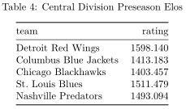
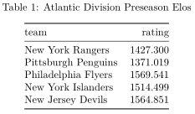
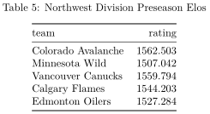
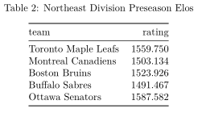
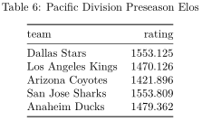
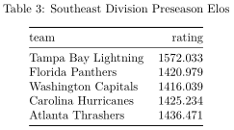
Preseason Elo Ratings
Based on the preseason elo ratings, we would expect the following:
Division Winners:
Detroit Red Wings, Colorado Avalanche, San Jose Sharks, Philadelphia Flyers, Ottawa Senators, and the Tampa Bay Lightning
Western Conference Wild Card:
Vancouver Canucks, Dallas Stars, Calgary Flames, Edmonton Oilers, and the St. Louis Blues
Eastern Conference Wild Card:
New Jersey Devils, Toronto Maple Leafs, Boston Bruins, New York Islanders, and the Montreal Canadiens

Slide 6
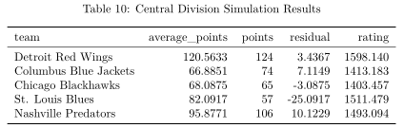
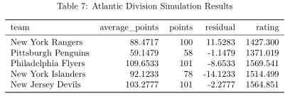
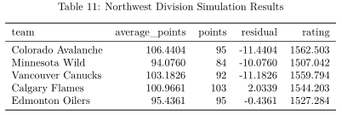
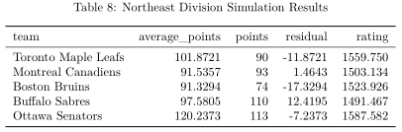
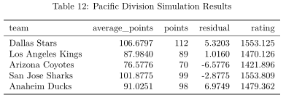
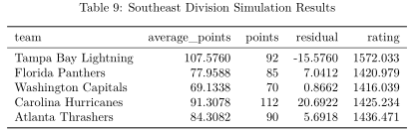
Simulated Regular Season Results
These tables offer a nice look into what happened in the simulation relative to the actual relative season
Examining the residual relative to the rating offers an easy, but simplistic measure of whether a team performed up to the expectation provided by their preseason Elo rating

Slide 7
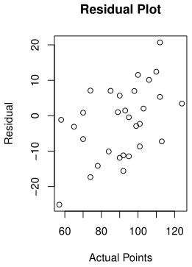
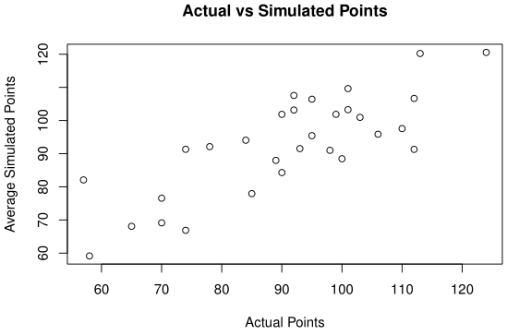
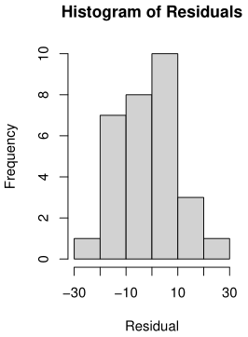
Comparison of Simulated and Actual Regular Seasons
As we would expect, we see a positive, fairly strong relationship between actual and simulated points in the scatterplot
The correlation between the actual and simulated points was: 0.802
The residual plot seems to show that we can expect greater residual values at the two extremes of actual point values
Essentially, as a team’s actual performance gets further from the league average, our predictive power using the simulation decreases
The histogram appears to show that the distribution of residuals is relatively Normal looking, although there may be a slight left-skew

Slide 8
Discussion of Regular Season Results
Some teams that performed very close to expectation (small residual) include:
Detroit Red Wings, Chicago Blackhawks, Calgary Flames, Edmonton Oilers, Los Angeles Kings, San Jose Sharks, Pittsburgh Penguins, New Jersey Devils, Montreal Canadiens, and Washington Capitals
All of these teams had a residual with a magnitude less than four
Note that, while the majority of these teams finished around the league average, the list includes teams in the extremes of the actual point totals as well
The St. Louis Blues are an example of a team that wildly underperformed their simulation based expectation in reality
In the simulation, the Blues did not do amazing, but on average, while they would have typically missed the playoffs, they still performed about as well as a below average NHL team would have been expected to. However, in the actual 2005-06 regular season, the Blues finished with the lowest amount of points of any team in NHL, earning last place and the first pick in the upcoming NHL Draft
Largest negative residual of all at: -25.0917
An example of a team that overperformed their simulation based expectation in reality was the Carolina Hurricanes
In the actual 2005-06 NHL regular season, the Hurricanes won their division and were the second seed in the Eastern Conference, but, based on the average points from the simulation, they are actually expected to just barely miss the Wild Card and thus the playoffs as well
Largest positive residual of all at: 20.6922

Slide 9
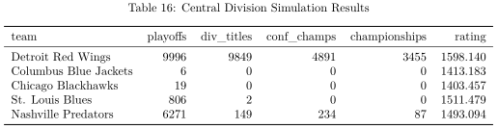
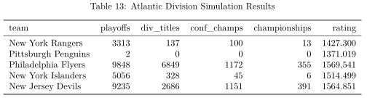
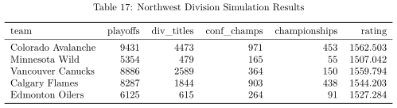
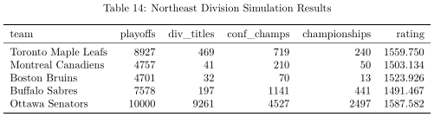
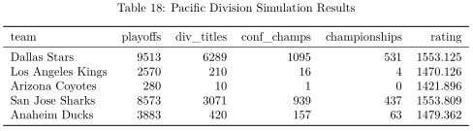
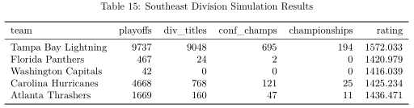
Simulated Playoff Results
Tables of simulated playoff appearances, division titles, championship game appearances, and championships for all six NHL division at the time
Similar to with the simulated regular season results, the preseason Elo ratings are useful here to help put the numbers in context

Slide 10
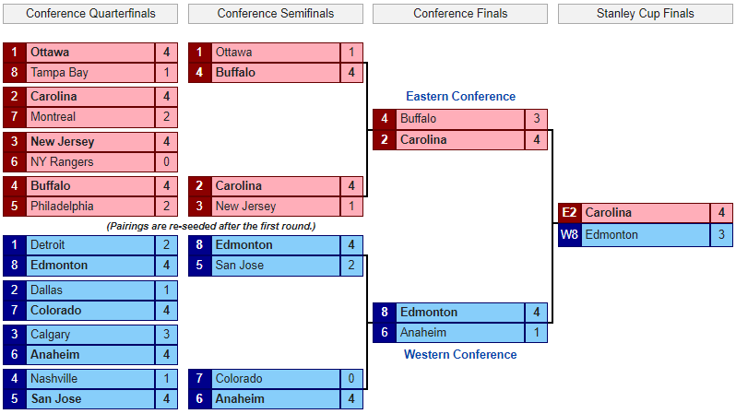
Actual Playoff Bracket

Slide 11
Comparison of Simulated and Actual Playoffs
The most notable underperformers in the actual playoffs relative to in the simulation were arguably the Detroit Red Wings and the Ottawa Senators
Both teams were clear favorites to win their conference at the start of the season and have the two greatest amounts of championship wins in the simulation by far
In reality, the Red Wings would lose 4-2 in the first round to the eventual runners-up the Oilers, and the Senators would lose 4-1 in the second round to the Sabres
Based on the simulation, it is definitely safe to say that, while they had a shot, neither of the eventual Stanley Cup Finalists, the Edmonton Oilers and the Carolina Hurricanes, were favorites to win the Cup at the start of the season
There were a number of unusual outcomes/runs/events that occurred in reality during the actual 2006 Stanley Cup Playoffs that Elo may have had a hard time accounting for:
Perhaps the most surprising was the result of the first round (Conference Quarterfinals) in the Western Conference, as the bottom four seeded teams made NHL history by all winning their games
Somewhat ironically, the top four seeded teams in the Eastern Conference all ended up winning their games (exact opposite result)
The 8th seeded Oilers in the Western Conference would go on a run to win the Conference Finals and ultimately lose to the Hurricanes in the Finals
Four Canadian teams qualified for the playoffs, a total not matched until 2013 and not exceeded until 2015

Slide 12
Three Teams Overview
Close to Expectation - Los Angeles Kings
Based on the simulation results, the Kings were projected to be very average and to miss out on the Wild Card by a little bit
In reality, they were in fact average and missed the Wild Card as they were six points behind the 8th seeded Oilers with a point total of 89, 1.016 points above their average simulated total
Overachieved - Carolina Hurricanes
According to the simulation, the Hurricanes were expected to typically miss the playoffs as their average simulated point total of 91.3078 would not be enough to make the Wild Card; finished 20.6922 points better in reality than on average in the simulation
Their performance in the simulated playoffs is definitely below average
Despite this, in reality the Hurricanes won their division, finished second in the Western Conference, and went on a run to win the 2006 Stanley Cup in the playoffs
Underachieved - Vancouver Canucks
The Canucks had one of the highest preseason Elo ratings in the Western Conference and in the simulation that were expected to finish as the top Wild Card in the West on average and to perform decently well in the playoffs
In reality, the Canucks failed to make the playoffs entirely and finished with a point total of 92, 11.1826 points below their average simulated total

Slide 13
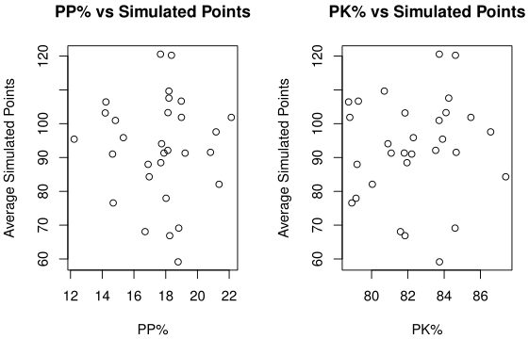
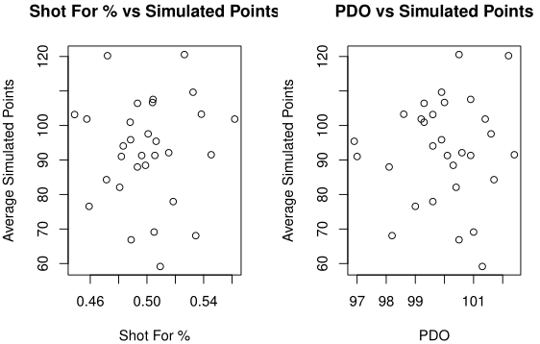

Relevant Statistics
The relevant statistics that I chose to examine were PP%, PK%, PDO, and an approximation of Fenwick For %
I could not find data on missed shots so to calculate the “S.SA” statistic I did: S/(S + SA)
I call this statistic: Shots For %
Unfortunately, upon cursory inspection, these statistics do not appear to do a great job of predicting simulated performance
The scatterplots all appear to be basically just a random assortment of dots with no noticeable patterns
Correlations are all very weak:
PP%: -0.04339668
PK%: 0.08122941
Shots For %: 0.02585755
PDO: 0.05311544

Slide 14
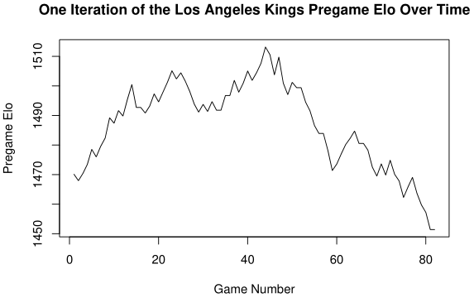

Analysis of Average Team: Los Angeles Kings
As we might expect with our average team, the graph of Elo over time for a single iteration of the Kings 2005-06 season shows them with an Elo that is about average throughout the majority of the season, although they appear to have a pretty rough spell towards the end of season
Although the relevant statistics did not appear to be too indicative of simulated performance, the Kings were very close to the league average in the Shots For % and PDO
Perhaps attributing to their inability to make the Stanley Cup Playoffs, the Kings had very bad PP and PK units that both performed ~3.5% worse than the league average

Slide 15
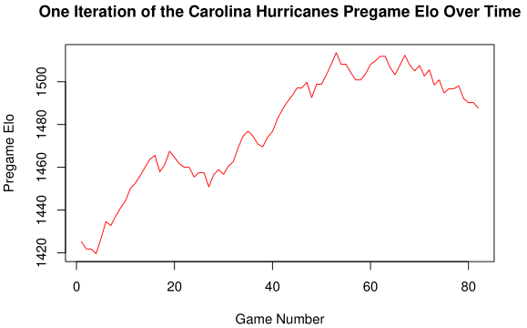

Analysis of Overachieving Team: Carolina Hurricanes
With our overachieving team, the Hurricanes, we see that their Elo rating is on the rise throughout essentially the entire example season as they finally crack 1500 near the end, although they do eventually fall off
Although their PP and PK units were relatively average, the Hurricanes finished 11th in Shots For % and 8th in PDO, which may have contributed to their success/luck

Slide 16
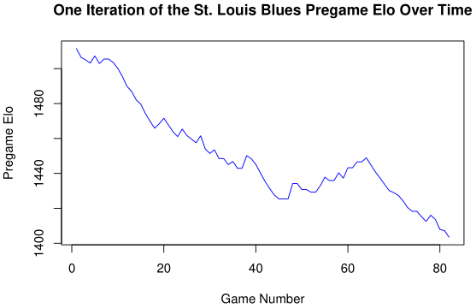

Analysis of Underachieving Team: St. Louis Blues
The Elo rating graph for the underachieving team, the St. Louis Blues, depicts an Elo rating that undergoes a steady decline for the majority of the season, as it starts around the average 1500 and progresses lower and lower all the way to around 1400 by the end of the season
Looking at the relevant statistics we perhaps see some inklings into why the Blues performed so poorly
They performed below average across the board with their PP% and PDO standing out the most as both are ~3% below the league average
Finished 27th in PP%
Finished 29th in PDO

Slide 17
Conclusions/Takeaways
While the simulation does a great job of offering a glimpse into the possibilities of a given sports season, it inevitably cannot account for all of the randomness that lies in store during the actual season
The 2005-06 NHL season offers an excellent example of this, as the 8th seeded Edmonton Oilers made it all the way to the Stanley Cup Finals, and the team that exceeded their expectations the most, the Carolina Hurricanes, ended up winning the Cup themselves
Hockey is a very volatile sport where random chance plays a significant role in the outcome of any game, so I was not super surprised by the results of the simulation/project
It was fascinating to see just how little the individual teams’ season statistics seemed to explain/correlate to the Monte Carlo simulation
The ultimate question remains:
How did the Sabres manage to fail to resign both Chris Drury and Daniel Briere in the same offseason?

