Slide 1

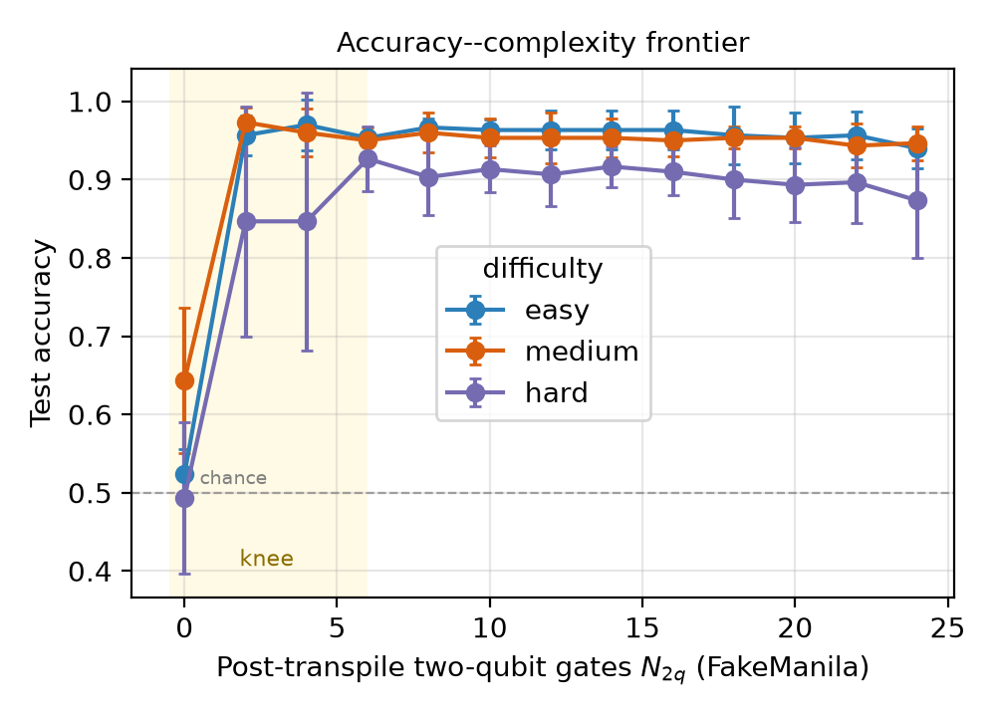
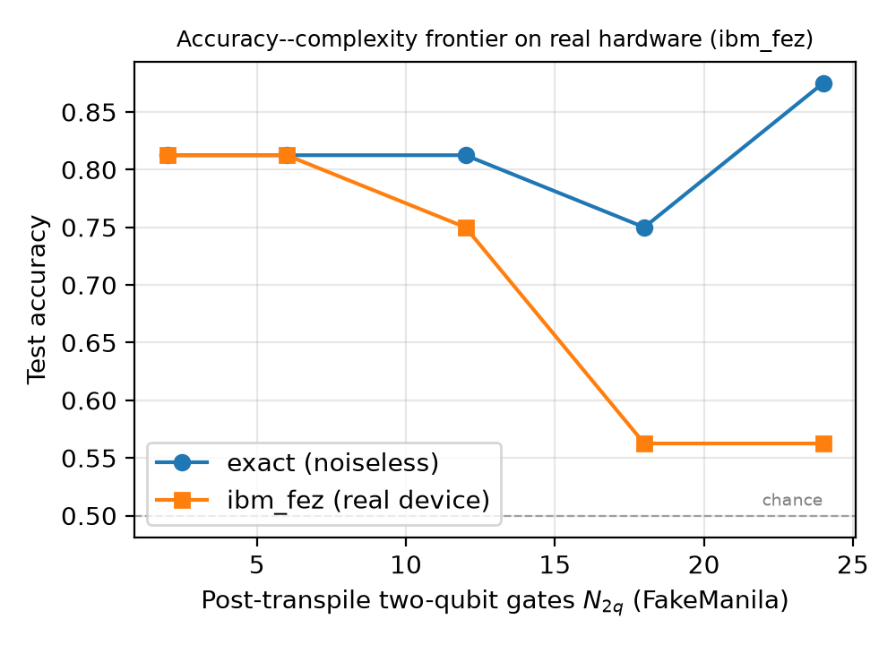
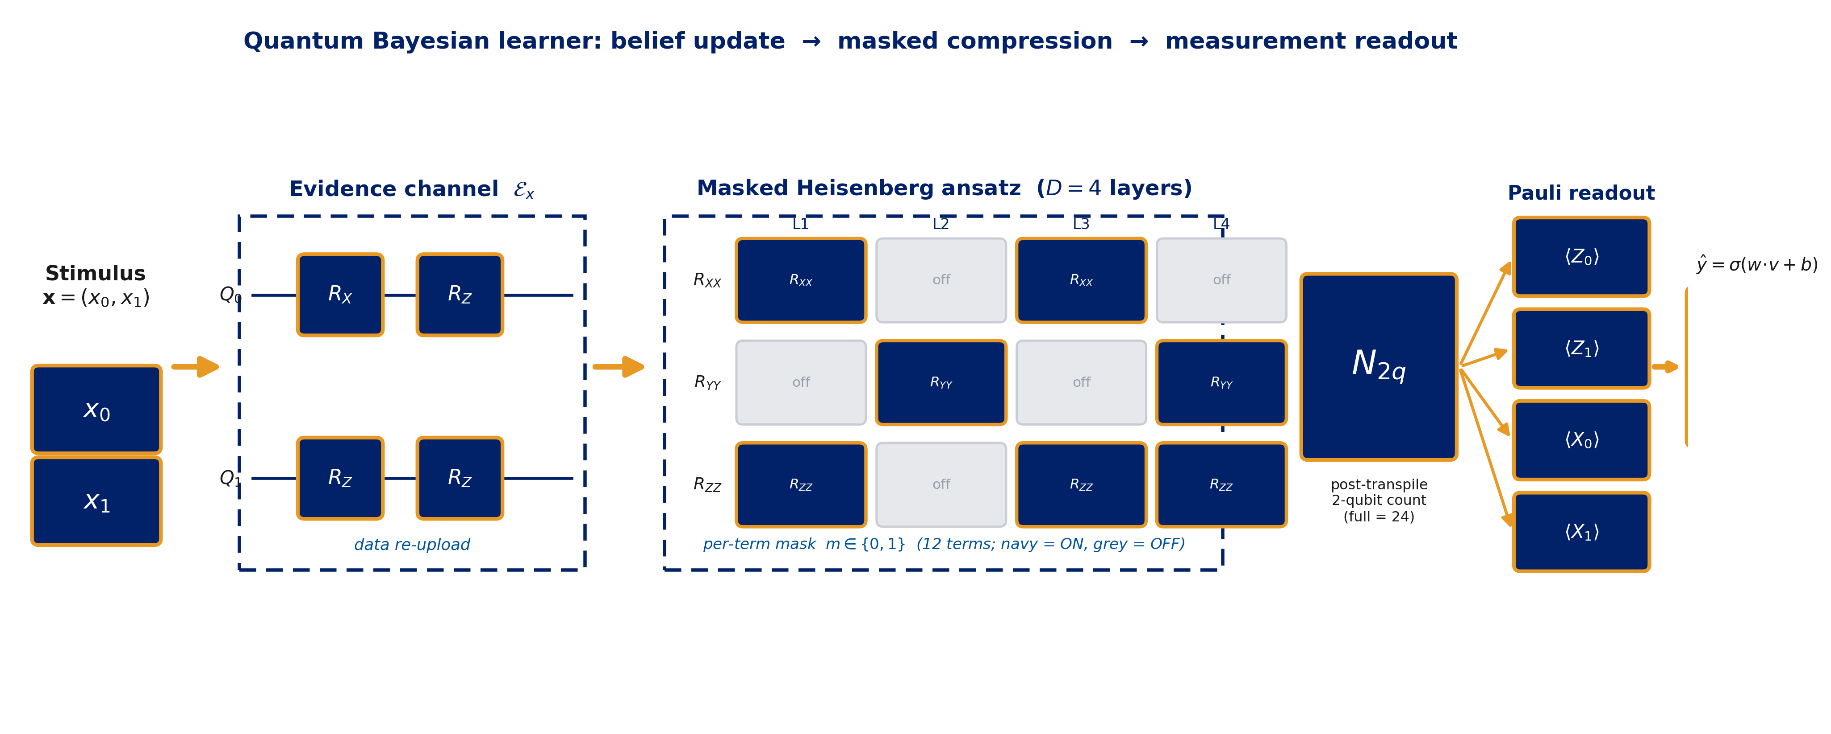
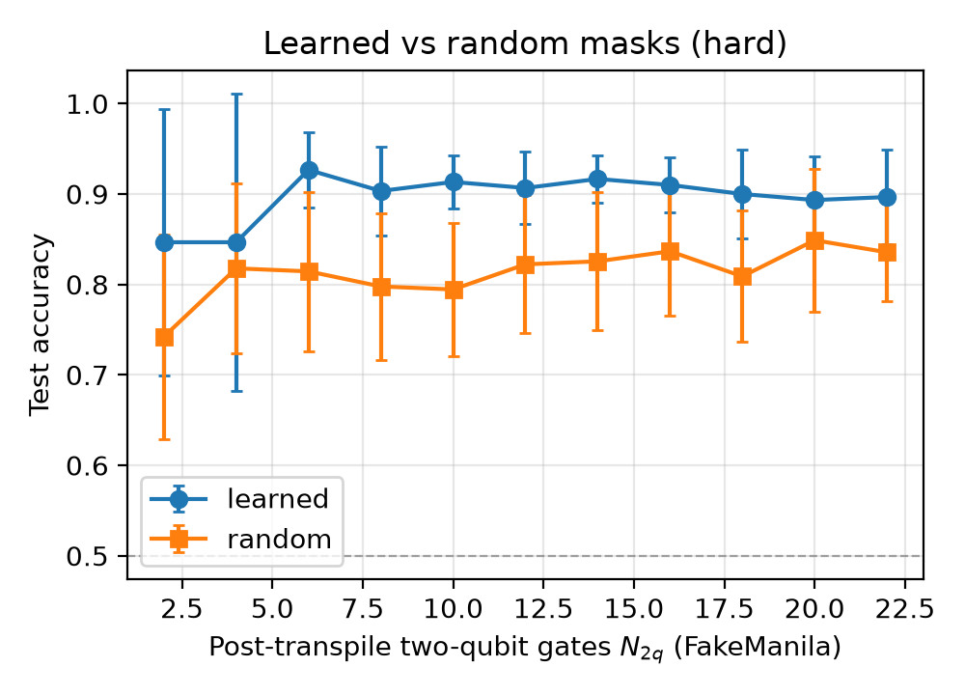
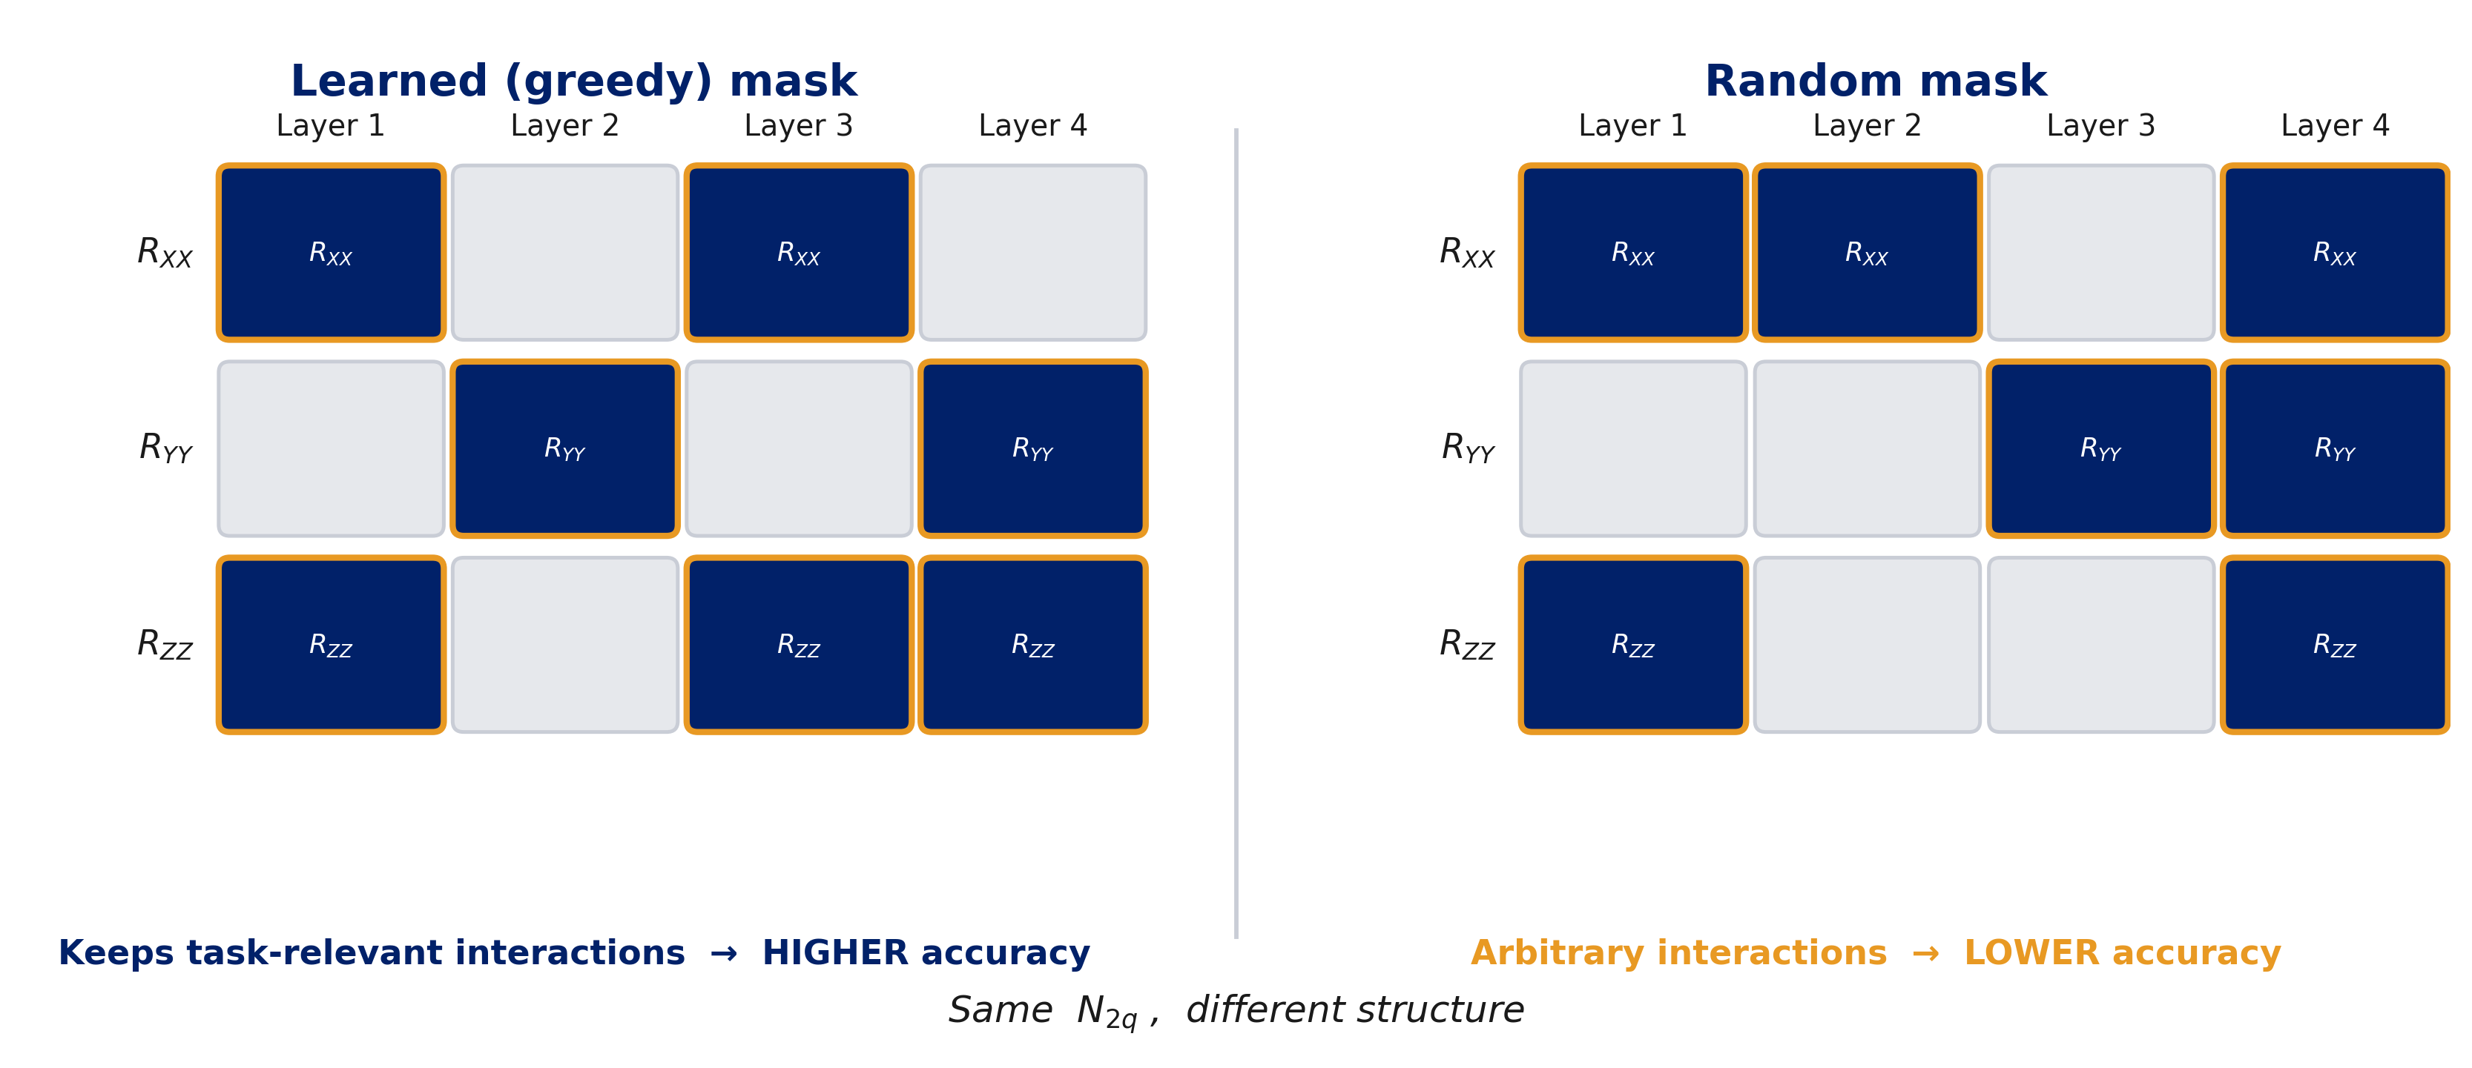

IEEE Quantum Week — QCE26 Poster
Hardware-Aware Quantum Bayesian Learner Compression
Linking Human Belief Updating to NISQ Circuit Complexity
Mohammad Zoraiz ✉ mz248@duke.edu
Duke University · Pratt School of Engineering · Electrical Engineering, Physics & Computer Science · Durham, NC
1
Motivation — Two fields, one question
4
Result 1 — The capacity boundary
6
Result 3 — On REAL hardware, compression becomes NECESSARY
Bayesian models cast human learning as belief updating: a prior over hypotheses, revised by evidence. Quantum cognition represents beliefs as density operators in Hilbert space, with evidence acting through quantum channels.
On NISQ hardware, two-qubit gates dominate the error budget, so removing them without breaking the task is a central engineering goal.
Central question: How much of a quantum Bayesian learner’s entangling structure can we remove before it can no longer represent the task — and what happens on real hardware?
2
The Quantum Bayesian Learner
Above chance at all nonzero budgets (easy/medium ≈ 0.95–0.97, hard ≈ 0.87–0.93); frontier nearly flat → most entangling structure is redundant.
At N₂q = 0 all difficulties collapse toward chance (0.52 easy, 0.64 medium, 0.49 hard) → some entanglement is necessary, but far less than the full circuit.
Hard task peaks at intermediate cost (0.927 @ N₂q=6) and is lower for the full circuit (0.873 @ N₂q=24) → moderate compression acts as a capacity-control regularizer.
Trained circuits run on physical IBM ibm_fez (156-qubit Heron), hard task, 5 device budgets, 16 test stimuli @ 2048 shots (endpoints: 40 stimuli @ 4096 shots).
In simulation the frontier is flat; on hardware it falls monotonically with N₂q: 0.81 @ N₂q=2,6 → 0.75 @ 12 → collapses to 0.56 (near chance) @ N₂q=18,24.
Endpoint confirmation: full circuit 0.60 (sim 0.95) vs compressed 0.83 (sim 0.93).
Belief = state ρ on a 2-qubit register; prior ρ₀ = “no evidence yet.” A stimulus x updates the belief via a CPTP evidence channel 𝓔ₓ(ρ) = Σₖ Eₓₖ ρ Eₓₖ†.
Update circuit = hardware-efficient ansatz: data re-uploading + per-layer Rₓ, R_z + Heisenberg entanglers U_ij = exp[−i(α XᵢXⱼ + β YᵢYⱼ + γ ZᵢZⱼ)] as native R_XX, R_YY, R_ZZ. Depth D = 4, 2 re-uploads.
Readout: single-qubit Pauli expectations v = (⟨Z₀⟩,⟨Z₁⟩,⟨X₀⟩,⟨X₁⟩) → trainable head ŷ = σ(w·v + b). Single-qubit-only readout means entanglement is the ONLY way to carry feature interaction — the two-qubit budget literally bounds the learner’s capacity.
Two realizations, same conclusions: a fast pure-state model and a literal mixed-state density matrix (maximally mixed prior I/2ⁿ, non-unital Lüders/POVM evidence filter + amplitude damping, Bayesian trace renormalization).
TAKEAWAY
On real NISQ hardware, hardware-aware compression is not merely economical but necessary — surplus entangling capacity is actively harmful, and task-aware pruning is what makes the learner usable at all.
5
Result 2 — Structure beats count
7
Robustness — not an artifact
Device noise model (FakeManila, 4096 shots, 5 seeds): noisy accuracy tracks the noiseless frontier within a few % at every budget → savings genuine net of noise.
Density-matrix model (genuine mixed state, non-unital channel): reproduces every finding — flat frontier, collapse at N₂q=0, hard peak 0.88 @ 6 vs 0.87 @ 24, learned > random (mean +0.043).
Classical baselines (identical splits, 5 seeds): logistic regression at chance on every level; RBF-SVM & MLP fall monotonically easy→hard. Best compressed QBL: easy 0.970, medium 0.973, hard 0.927.
3
Method — mask, real cost, greedy pruning
Per-term binary mask mₗ,ₚ ∈ {0,1} over p ∈ {XX,YY,ZZ} in each of D=4 layers ⇒ 12 maskable terms (R_PP(0)=I when off).
Hardware-aware cost N₂q = real post-transpile two-qubit gate count on IBM FakeManila (5-qubit, includes SWAPs), via Qiskit’s transpiler. Full circuit ⇒ N₂q = 24 (each active Heisenberg term = 2 CNOTs).
Objective: L(θ,m) = (1/N) Σ BCE(yₖ, ŷ) + λ·N₂q(m).
Greedy structured pruning: from the full circuit, repeatedly drop the term whose removal least increases training cross-entropy, warm-start retrain → traces the accuracy-vs-N₂q frontier from 24 down to 0.
Exact JAX autodiff (no parameter-shift); statevector verified bit-for-bit vs Qiskit (|1 − fidelity| ≈ 4×10⁻¹⁶).
Learned (greedy) masks vs random masks at matched N₂q.
Learned wins at every budget by ~6–12 points. Per seed: learned beats random in 49 / 55 paired comparisons, mean advantage +0.083, one-sided Wilcoxon p < 10⁻⁷.
⇒ Which entanglers you keep matters, not just how many.
Hard task — learned vs random (mean acc, 5 seeds)
N₂q | Learned | Random | Δ
2 | 0.847 | 0.742 | +0.104
6 | 0.927 | 0.814 | +0.112
10 | 0.913 | 0.794 | +0.119
14 | 0.917 | 0.826 | +0.091
18 | 0.900 | 0.809 | +0.091
22 | 0.897 | 0.836 | +0.061
8
Key takeaways
Most entanglement is redundant — sheds ~2/3 of two-qubit gates for free, >90% at modest cost.
Entanglement is necessary — removing all of it collapses the learner to chance: a concrete capacity boundary.
Structure beats count — learned masks beat random at every matched budget.
On real hardware, compression is what makes the learner work at all.
Task — controllable difficulty knob
Checkerboard categorization: y = (⌊f·x₀⌋ + ⌊f·x₁⌋) mod 2, stimuli in [0,1]².
Difficulty f: f=2 easy / f=3 medium / f=4 hard. 200 stimuli, 70/30 split, balanced ⇒ chance = 0.5.
Local similarity, but the rule depends on the joint features ⇒ needs the interaction only entanglement can supply.
Structure, visualized — learned vs. random
References · Acknowledgments · Links
Future work: Multi-qubit belief registers & higher-dim stimuli; richer non-unital evidence channels; hardware-aware objectives weighting depth, coherence & native fidelity; measured device error rates fed back into the compression objective.
[1] Busemeyer & Bruza, Quantum Models of Cognition and Decision, 2012.
[2] Pothos & Chater, “A simplicity principle in unsupervised human categorization,” Cogn. Psych., 2002.
[3] Kandala et al., “Hardware-efficient VQE,” Nature, 2017.
[4] Preskill, “Quantum computing in the NISQ era and beyond,” Quantum, 2018.
[5] Cerezo et al., “Variational quantum algorithms,” Nat. Rev. Phys., 2021.
[6] Sim et al., “Adaptive pruning-based optimization of PQCs,” Quantum Sci. Technol., 2021.
Acknowledgments: Device runs used IBM Quantum services. The author thanks Duke University’s Pratt School of Engineering.
Scan for code & data
github.com/zoraizmohammad/ qb-learner-compression
Mohammad Zoraiz · mz248@duke.edu
At the same N₂q, greedy pruning keeps task-relevant interactions while random masks discard them — the pattern of retained entanglers, not the count, drives accuracy.

