Slide 1


Keeping Secrets in Azure
Azure, Office and Data Community (Singapore)
for .NET Developers
Zoran Horvat
Principal consultant at Coding Helmet
https://codinghelmet.com
zh@codinghelmet.com
zoranh75

Slide 2
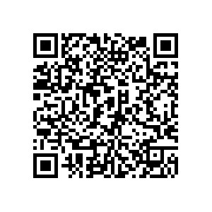
Source Code
https://github.com/zoran-horvat/ conf-azure-singapore-2021

Slide 3


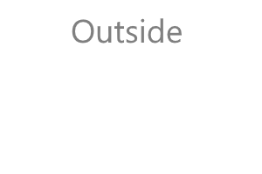



A Word on Safety…
“Keep it secret. Keep it safe." – Gandalf
Pilot Timothy Lancaster, 1990

