Slide 1


Performance vs. Composability
.NET Open Day 2021 - ITKonekt
Surviving Functional Design with C#
Zoran Horvat
Principal consultant at Coding Helmet
http://codinghelmet.com
zh@codinghelmet.com
zoranh75

Slide 2
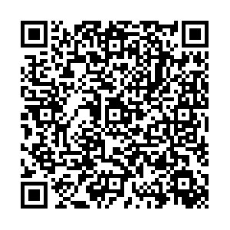
Find me at:
https://codinghelmet.com
Working Software series at YouTube
https://youtube.com/playlist?
list=PLSDYwLgFqaX5A2uDkGzkIDcCxZmPQtmVf
Pluralsight:
https://codinghelmet.com/go/pluralsight
Udemy:
https://codinghelmet.com/go/udemy

Slide 3
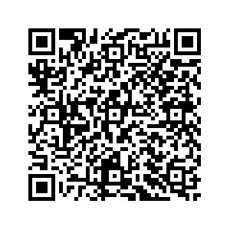
Source code available at GitHub:
https://github.com/zoran-horvat/
conf-itkonekt-net-open-day-2021

