Slide 1
Network/System Co-simulation Platform for Design Space Exploration of IoT Applications
Zhuoran Zhao¹, Vasileios Tsoutsouras², Dimitrios Soudris² and Andreas Gerstlauer¹
¹The University of Texas at Austin
²National Technical University of Athens
SAMOS, 7/17/17

Slide 2
Background
Growing complexity and scale of future IoT applications
  Distributed data collection, aggregation and processing
  Tightly coupled communication and computation workload
  Non-obvious interactions and tradeoffs
Networks-of-Systems (NoS) environment
  System & network architecture configurations
  Application mapping and offloading
  Complex application/network/system interactions
Network and system co-design
  Traditionally designed in isolation
  Joint consideration of design parameters from applications to network configurations and system platform definitions
SAMOS, 7/17/17
© 2017 Z. Zhao, V. Tsoutsouras, D. Soudris, A. Gerstlauer
Notes:
Different parameters and configurations are existing in both system and network sides, and how to choose the optimal set of parameters and partition the application among such a NoS environment are the key questions
During execution, computation and communication can be dynamically parallelized or serialized at intra- or inter-device level.
In order to accurately estimate application performance, the potential overlap among each data processing and communication tasks need to be carefully considered. This is in turn a function of their realistic execution durations, dependencies and concurrency available in the underlying computation platform.
Determining how to optimally partition and ofﬂoad application tasks among an appropriately designed NoS architecture requires a comprehensive consideration of design parameters from all design levels

Slide 3
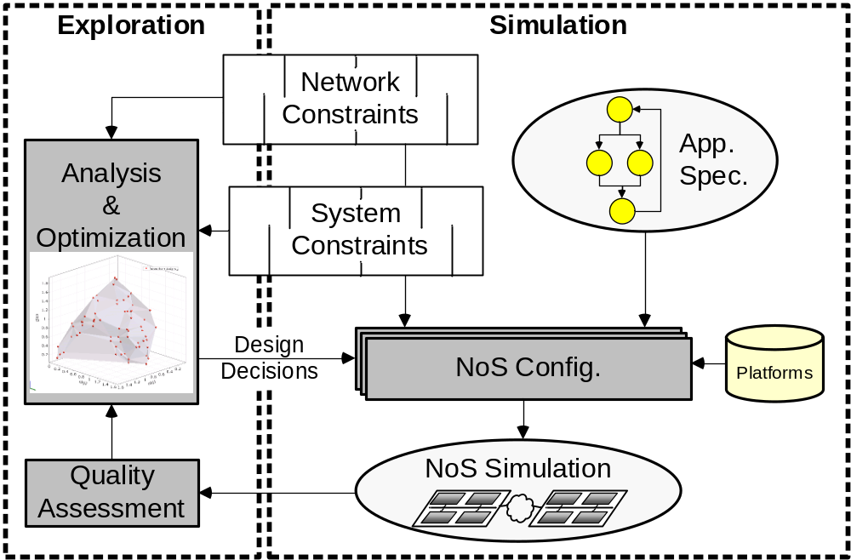
Network/System Co-Design
Flexible NoS simulation platform to instantiate various network/system configurations for exploration
SAMOS, 7/17/17
© 2017 Z. Zhao, V. Tsoutsouras, D. Soudris, A. Gerstlauer
Notes:
Starting from an application speciﬁcation and network and system constraints, the goal is to derive an optimal NoS architecture and application-to-architecture mapping. This is inherently an iterative process that requires fast and accurate methods for NoS validation and prototyping.
A ﬂexible NoS simulation platform can instantiate different NoS conﬁgurations and generate corresponding simulation models, where systems, networks and their interactions can be simultaneously simulated. Simulation results are then feed back for performance analysis, after which corresponding design decisions for speciﬁc optimization targets such as performance, utilization or cost can be explored.

Slide 4
Related Work
IoT design space exploration
  Application-specific with over-simplified models
    Smart camera networks [Devarajan’06, Quaritsch’07]
    Healthcare systems [Doukas’12, Catarinucci’15]
  Limited design space exploration
Network and system simulation
  Existing network simulators
    Traditional network simulators (ns-3, OMNeT++) model system devices without detailed system architectures
    State-based system models and over-simplified network models in WSN-oriented simulators [Sommer’09, Bai’11, Du’11, Damm’10]
  Existing system simulators
    Host-compiled TLM simulation [Bringmann’15]
    Simple network extension [Fummi’08, Banerjee’09]
  Comprehensive NoS simulation platform are lacking
SAMOS, 7/17/17
© 2017 Z. Zhao, V. Tsoutsouras, D. Soudris, A. Gerstlauer

Slide 5
Outline
Introduction
  Motivation, background
  Related work
NoS simulation platform overview
  System simulation model
  Network simulation backplane
Experimental setup
  IoT application case studies
  Exploration results
  Simulation speed and accuracy
SAMOS, 7/17/17
© 2017 Z. Zhao, V. Tsoutsouras, D. Soudris, A. Gerstlauer

Slide 6
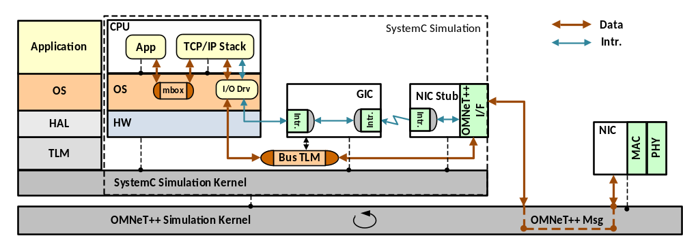
NoS Simulation Platform Overview
System simulation model
  SystemC-based host-compiled device model [Razaghi’14]
  Capture system-wide interactions between application, OS and underlying hardware components
Network simulation backplane
  OMNeT++/INET network simulation framework
Exploration Parameters
Application
Algorithms
Offloading levels
System
HW platforms
OS parameters
Network
Protocols
Network topology
Number of clients
IoT Performance Metrics
QoS levels
Throughput
Device utilization
Battery life
…
SAMOS, 7/17/17
© 2017 Z. Zhao, V. Tsoutsouras, D. Soudris, A. Gerstlauer
Notes:
System-wide interactions between applications tasks, the underlying OS and various hardware components communicating through a hardware abstraction layer and bus TLMs are captured
The SystemC kernel is further integrated into a overall OMNeT++ simulation backplane, which includes channel and communication models that capture the interactions between different system devices in a given network topology
All together, an reconfigurable modeling setup allows instantiating different application, system architecture and network configurations to evaluate both functional/non-functional metrics

Slide 7
System Simulation Model
Host-compiled (HC) system simulator
  Source-level back-annotated application model
  Network stack model [lwIP]
  Abstract multi-core OS and processor model [Razaghi’14]
  Network interface & hardware peripheral models
  Transaction-level modeling (TLM) base [SystemC]
Our work
SAMOS, 7/17/17
© 2017 Z. Zhao, V. Tsoutsouras, D. Soudris, A. Gerstlauer
Notes:
Overview :
NoS DSE require the system simulator to be reconfigurable and scalable. We employ host-compiled simulation methodology and layer-based organization to model the behavior and performance of complete multi-processor and multi-core SoCs.
In such a setup, applications are annotated with target performance metrics and mounted on top of a light weight abstract OS and processor model. Where OS and processor layers replicated a typical multicore OS and hardware architecture to emulate the execution of application tasks on a parallel hardware platform. HW CPU models are futher integrated with other hardware components through a standard TLM co-simulation backplane.
New things:
In this work, we developed a LLVM-based automatically function-level back annotation framework.
In order to enable networked device modeling and simulation, we further extend the host-compiled platform by integrating a widely used open source TCP/IP stack and developed related drivers/HW component models to enable the accurate modeling and precise emulation of the network services on IoT device

Slide 8
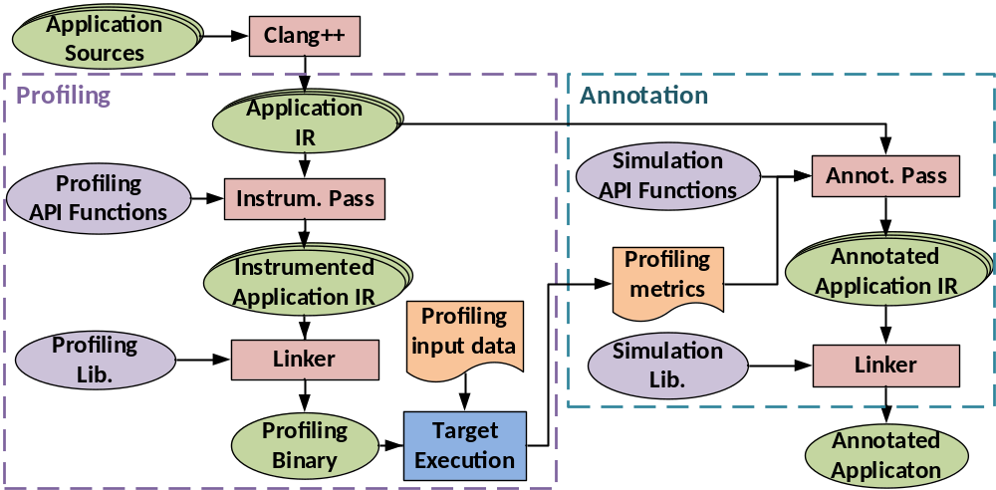
Application Task Model
Function-level performance back-annotation
  Function-level profiling/annotation pass [LLVM]
  Back-annotation with average per-function execution time
SAMOS, 7/17/17
© 2017 Z. Zhao, V. Tsoutsouras, D. Soudris, A. Gerstlauer
Notes:
Source code of IoT application tasks is ﬁrst annotated with estimated execution time metrics and then converted into task models that run on top of the host-compiled OS simulator. The approach in requires this to be done manually. We developed a customized LLVM pass to perform automatic back-annotation and conversion.
Our approach applies a function-level instrumentation by extract proﬁling metrics from running the application code on an existing hardware platform. Application source code is ﬁrst converted into intermediate representation (IR) form. Proﬁling calls are inserted into the entry and exit points of each function to collect function-level performance metrics. The instrumented IR is then converted into an object ﬁle, linked with a proﬁling library, and the resulting binary is executed on the target platform under an input data set to collect cycle counts for all application functions.
This proﬁling data is then used to back-annotate average per-function execution time estimates into the application code. Finally, application tasks are mapped onto a simulated system device by wrapping them into host-compiled task models that run on top of the OS API provided by the simulator.

Slide 9
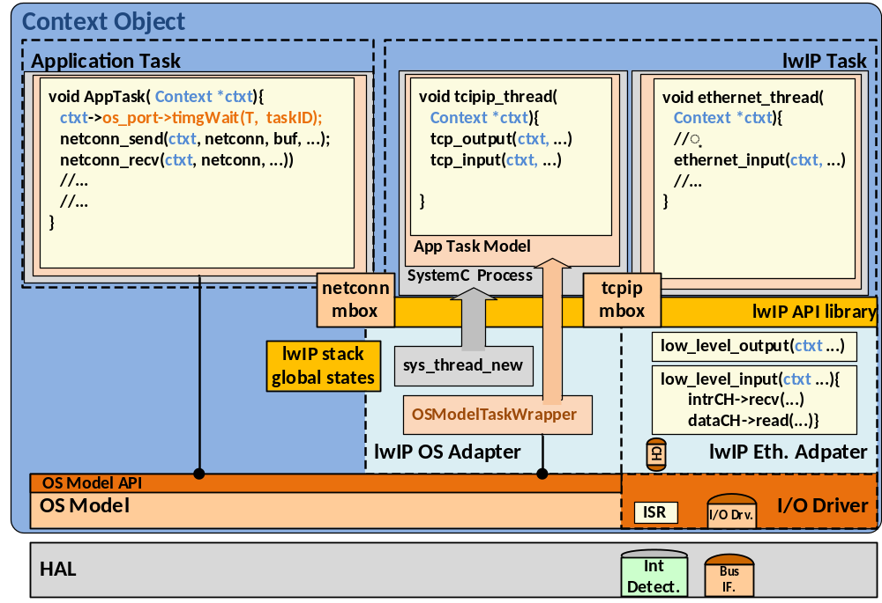
Network Stack Model
Open source lightweight TCP/IP stack [lwIP]
Input pkt.
Output pkt.
Intr.
SAMOS, 7/17/17
© 2017 Z. Zhao, V. Tsoutsouras, D. Soudris, A. Gerstlauer
Notes:
In order to allow integration with network simulation while accurately accounting for associated system impact and overhead, we implemented a realistic model of the network stack and external network interfaces as part of the HC model
lwIP, a widely used embedded and open-source TCP/IP stack is ported
Global states of lwIP stack is encapsulated into a context object, pointers to corresponding OS and I/O driver model, instantiation with multiple device model instances
Multi-thread lwIP configuration on OS model. OS kernel tasks
tcpip_thread: application tasks communication requests, in/out network packet processing
Nic thread: interruption-driven task to receive incoming network packets
OS adapter and Ethernet adapter to be implemented on top of existing OS and NIC driver APIs
Make use of bus TLM API, interruption detection API
Rely on OS model API and SystemC API for dynamic task creation and synchronization
Lwip provides a set of Netconn APIs for application
Flow of in/out data packets

Slide 10
Network Interface Model
SystemC network interface card (NIC) stub model
  Interfacing with detailed NIC model in OMNET++
Generic interruption controller (GIC) model
  Distribute interruption signals from NIC upon packet arrival
NIC driver
  Interrupt service routine (ISR) triggered by GIC
  Notify lwIP to read network packet data from NIC through bus TLM
SAMOS, 7/17/17
© 2017 Z. Zhao, V. Tsoutsouras, D. Soudris, A. Gerstlauer
Notes:
In order to make use of such network stack model within the overall NoS simulation, necessary network interface models are also implemented, including network interface card model and all related HW components and drivers to enable such packets exchanging.
The network interface card (NIC) hardware model is in the simulated device is, however, an internally an empty stub that interfaces with a detailed model of the detailed NIC realization in the OMNeT++ backplane. On the system side, the NIC model communicates with the protocol stack through interrupts and bus transactions using accurate models of generic interrupt controllers (GICs) and OS-level NIC drivers.
Upon arrival of a new network data packet, the NIC stub will buffer the data packet and generate an interrupt signal that is further distributed by the GIC model.
The incoming interruption signal will trigger the OS model’s interrupt handling service routines, which will notify protocol stack process. Then the corresponding lwIP thread will read the data packet through the TLM bus model from the NIC stub. For outgoing network data packets, the protocol stack can directly write into the NIC stub through the TLM bus, from where the packet will be forwarded to the OMNeT++.
In such a way, a SystemC device model can communicate with other device instances in an overall OMNeT++ network topology.

Slide 11
Network Simulation Backplane
Detailed NIC model in OMNeT++
  Media access (MAC) and physical (PHY) layer simulation
  Interfacing with NIC stub through OMNeT++ message
SystemC/OMNeT++ integration
  Scheduled and synchronized globally by OMNeT++
  Multiple device instances in given network topology
SAMOS, 7/17/17
© 2017 Z. Zhao, V. Tsoutsouras, D. Soudris, A. Gerstlauer
Notes:
We employ OMNeT++ together with the INET package as our network simulation backplane. The OMNeT++/INET combination provides a ﬂexible network simulation platform supporting rich choices of network protocols and topologies through an easy conﬁguration process.
In our setup, only the lower media access and physical layers are provided by OMNeT++ as part of the NIC models, which communicate with other OMNeT++ modules through wired or wireless channel models on the one side and forward network packets into/out of the simulated NIC stub on the other system side.
OMNeT++ natively provides a co-simulation with SystemC that integrates the two simulation kernels at the basic discrete event level in a master-slave arrangement (with the OMNeT++ kernel serving as the master). During co-simulation, SystemC models are scheduled and synchronized globally by the OMNeT++ event scheduler.

Slide 12
Experimental Setup
IoT application case studies
  Vision graph discovery
  ECG diagnosis
Target platform
  Raspberry Pi 3 with 1.2 GHz ARM Cortex A-53
  Raspberry Pi 0 with 1.0 GHz ARM11
WLAN client-server topology
Design space exploration parameters
  Application task offloading levels
  System configurations
    Single core client (C:1×)
    Single/dual core server (S:1×, S:2×)
    Device type: Pi0, Pi3, Pi4 (Pi3 with twice the frequency)
  802.11 WLAN (b@11Mbps, g@9Mbps, g@54Mbps)
SAMOS, 7/17/17
© 2017 Z. Zhao, V. Tsoutsouras, D. Soudris, A. Gerstlauer

Slide 13
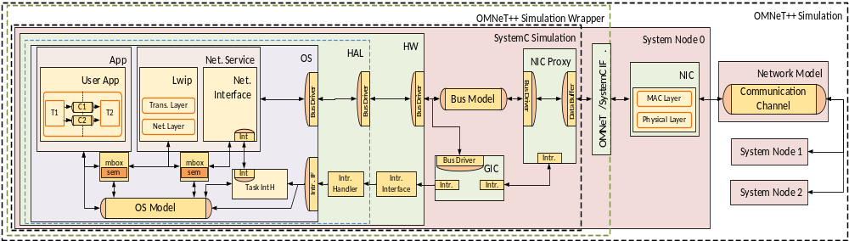
NoS Simulation Setup
SystemC system instances
  Profiling using HW counters [PAPI]
  FIFO scheduler in OS model
INET/OMNeT++
  Network-related timing information
  Star-like client-server topology
SAMOS, 7/17/17
© 2017 Z. Zhao, V. Tsoutsouras, D. Soudris, A. Gerstlauer

Slide 14
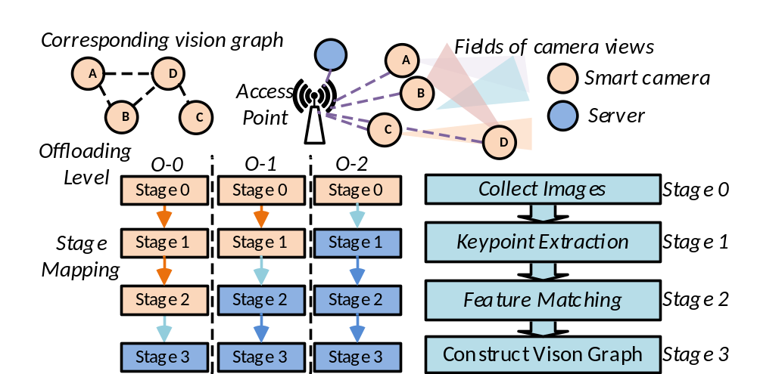
Vision Graph Discovery
Vision graph discovery in smart camera networks
  Discover view overlaps among a set of cameras
  4 execution stages, 3 offloading levels, 2-6 clients
  Implemented in C++ with OpenCV
  Performance metrics: throughput, client core utilization
SAMOS, 7/17/17
© 2017 Z. Zhao, V. Tsoutsouras, D. Soudris, A. Gerstlauer
Notes:
In a network of smart cameras, estimating their position and orientation relative to each other and to their environment is an essential operation and key challenge. This type of relationship is deﬁned as vision graph. In a vision graph, each camera is represented by a node, and an edge appears between two nodes if the two cameras share a sufﬁciently large part of a view. Computation is divided into four stages, along which we deﬁne three ofﬂoading levels:

Slide 15
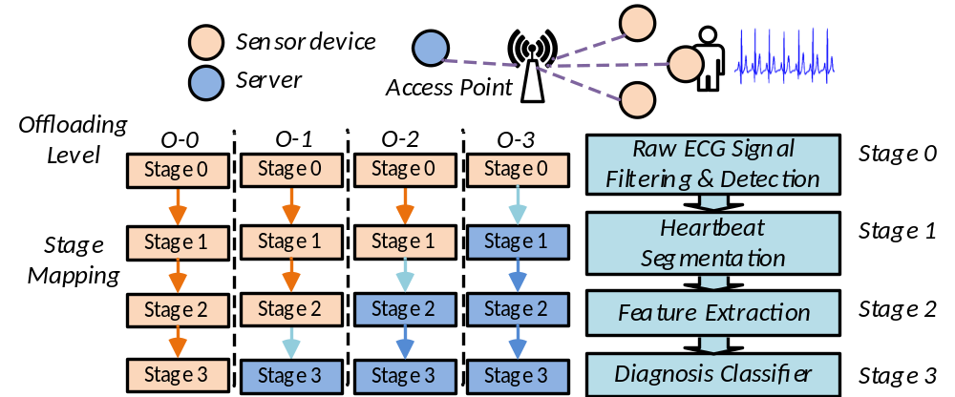
ECG Diagnosis
ECG monitoring
  Recognize abnormal heartbeat from raw ECG signals
  4 execution stages, 4 offloading levels, 2-6 clients
  Implemented in C
  Performance metrics: throughput, client core utilization
SAMOS, 7/17/17
© 2017 Z. Zhao, V. Tsoutsouras, D. Soudris, A. Gerstlauer
Notes:
In the healthcare domain, networked wearable devices providing continuous personal monitoring services are increasingly used to support early disease detection and improve the quality of healthcare. We formulate a case study in this domain using recent work on IoT-based ECG diagnosis optimization. ECG signals are used to detect heart arrhythmia, i.e. irregularly fast or slow heart beats, which may lead to strokes or heart failure.
The detection ﬂow is divided into four stages with four possible ofﬂoading level

Slide 16
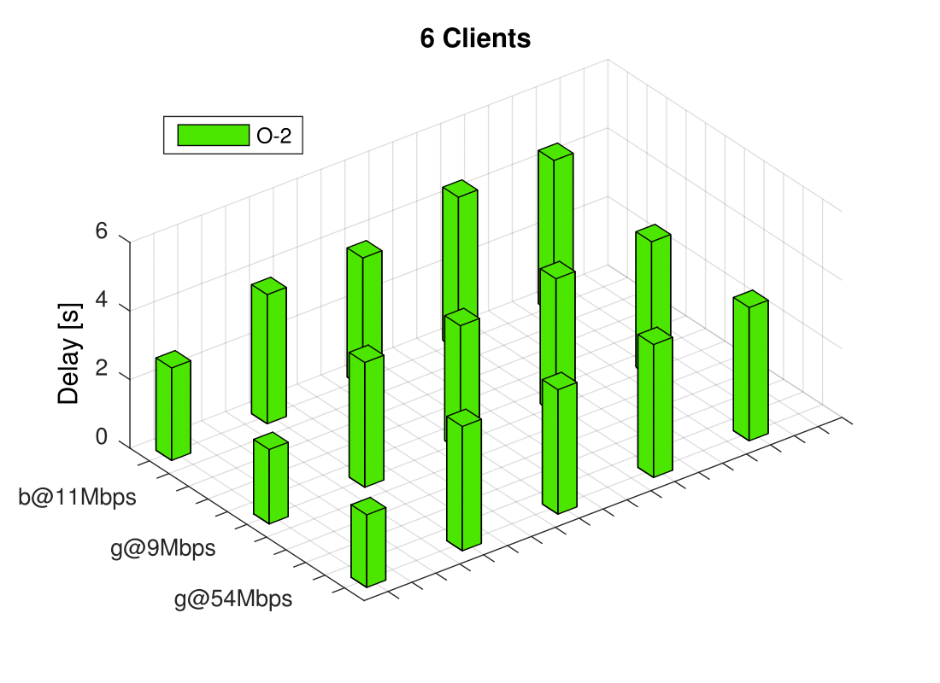
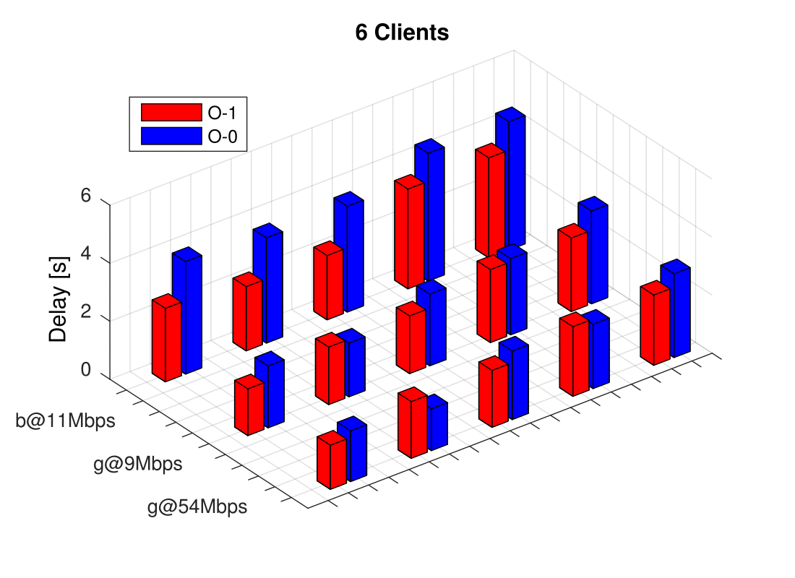
Vision Graph Discovery Throughput
Output-to-output delay with 6 clients
  Server- and computation-bound at O-2
  Balanced at O-0 and O-1
S:1×Pi3
C:1×Pi0
S:1×Pi3
C:1×Pi0
S:1×Pi3
C:1×Pi3
S:1×Pi3
C:1×Pi3
S:2×Pi3
C:1×Pi0
S:2×Pi3
C:1×Pi0
S:2×Pi3
C:1×Pi3
S:2×Pi3
C:1×Pi3
S:1×Pi4
C:1×Pi3
S:1×Pi4
C:1×Pi3
SAMOS, 7/17/17
© 2017 Z. Zhao, V. Tsoutsouras, D. Soudris, A. Gerstlauer
Notes:
We explore IoT applications metrics under different implementation conﬁgurations. First metric is the delay between consecutive output, which is the inverse of throughput. Different application conﬁgurations show various sensitivities to system and network parameters.
6 client case:
Generally computation-dominated, and network bandwidth has an overall smaller impact on performance than client/server conﬁgurations.
At 6 clients and ofﬂoading level O-2, neither network nor client conﬁgurations will signiﬁcantly affect overall performance. With the dominance of computation, available server-side parallelism is also limited, which results in a relatively small beneﬁt when going from a single-core (SxS3) to a double-core (SxD3) server. By contrast, a twice as powerful single-core server (S3S4) shows a more than 40% output delay reduction.
With lower ofﬂoading levels, network and client conﬁgurations start to have a higher impact. Due to the need for centralized server coordination, both client computation and total communication demands increase with lower ofﬂoading in the vision graph example. At level O-0 with 6 clients, the server is mostly performing communication and coordination between clients, and throughput is noticeably affected by both client and network parameters.

Slide 17
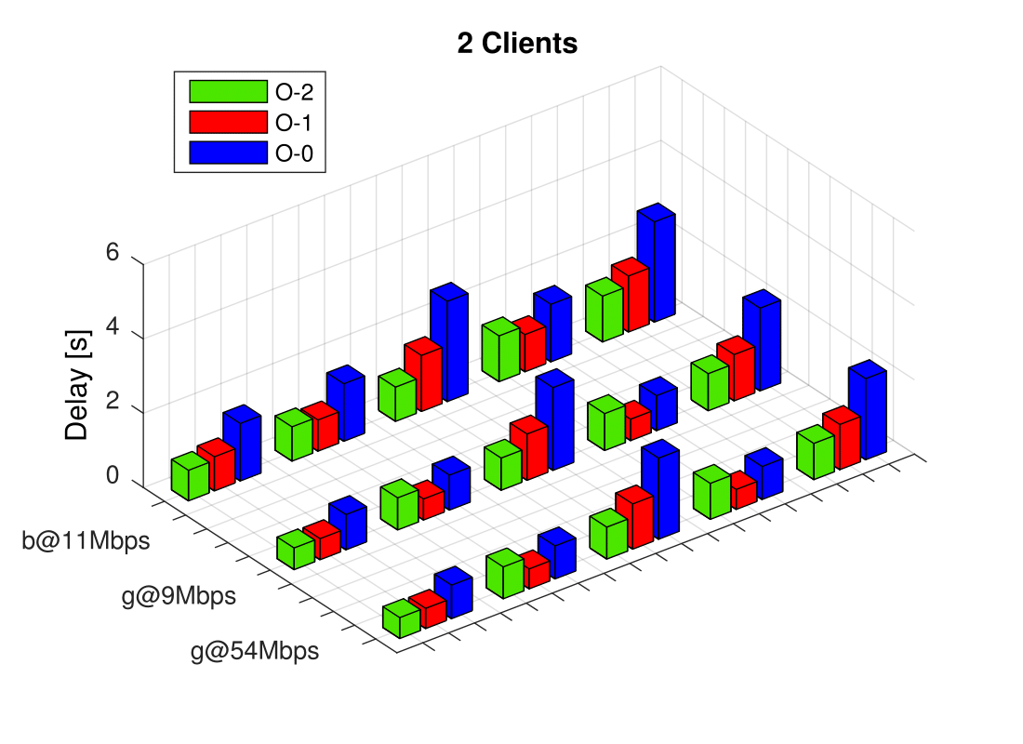
Vision Graph Discovery Throughput
Output-to-output delay with 2 clients
  Computation and communication balanced
  Client-bound at O-0 and O-1
S:1×Pi3
C:1×Pi0
S:1×Pi3
C:1×Pi3
S:2×Pi3
C:1×Pi0
S:2×Pi3
C:1×Pi3
S:1×Pi4
C:1×Pi3
SAMOS, 7/17/17
© 2017 Z. Zhao, V. Tsoutsouras, D. Soudris, A. Gerstlauer
Notes:
Computation scales faster (quadratically) with client counts than communication and per-client demands (which grow linearly or are constant, respectively).
As a result, when the number of clients decreases, server and communication demands shrink, and the application becomes client-bound, especially at low ofﬂoading levels

Slide 18
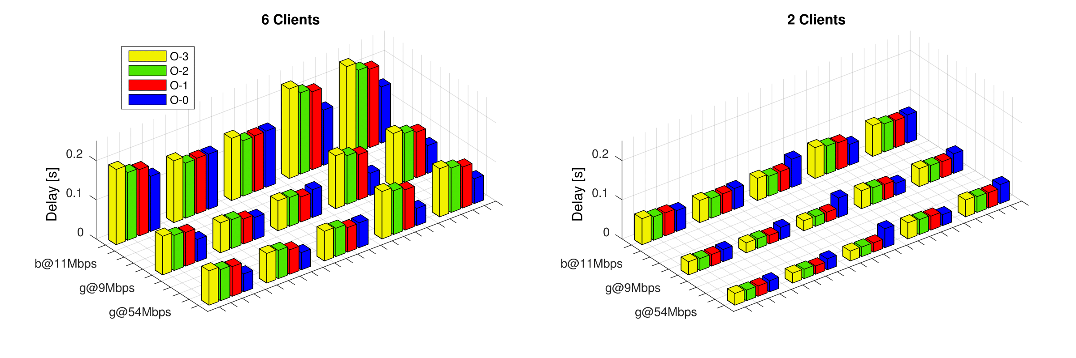
ECG Diagnosis Throughput
Output-to-output delay with 2 and 6 clients
  Always computation and communication balanced
  Server-bound at O-1,2,3
  Client-bound at O-0
S:1×Pi3
C:1×Pi0
S:1×Pi3
C:1×Pi0
S:1×Pi3
C:1×Pi3
S:1×Pi3
C:1×Pi3
S:2×Pi3
C:1×Pi0
S:2×Pi3
C:1×Pi0
S:2×Pi3
C:1×Pi3
S:2×Pi3
C:1×Pi3
S:1×Pi4
C:1×Pi3
S:1×Pi4
C:1×Pi3
SAMOS, 7/17/17
© 2017 Z. Zhao, V. Tsoutsouras, D. Soudris, A. Gerstlauer
Notes:
In the ECG example, both computation and communication demands scale linearly with the number of clients, where communication overhead is more dominant and roughly constant, independent of the ofﬂoading level. As such, throughput generally varies with both network and system parameters at all ofﬂoading and client levels.
In the case of O-3, O-2 and O-1 ofﬂoading, throughput is bounded by communication and server-side computation resources. As a result, network protocols can signiﬁcantly affect overall output delay, and, in contrast to the vision graph case, a double-core server (SxD3) can reduce output delay by hiding server computation behind the communication overhead.
In the O-0 case, throughput mainly depends on the client device conﬁgurations. However, as more clients are introduced, per-client computation remains constant, but communication overhead can dominate especially with slower communication protocols (b@11Mbps), where the effects of system device conﬁgurations become negligible

Slide 19
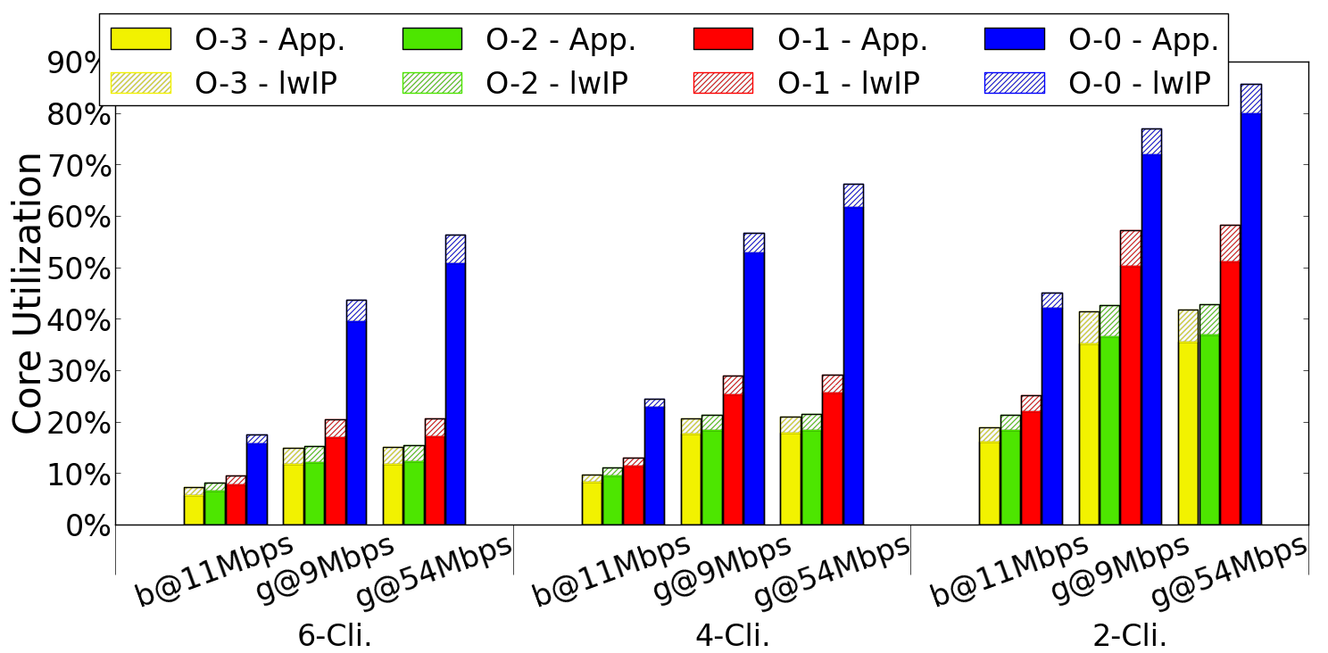
Client Core Utilization
Mainly affected by offloading level and client count
  Lower offloading increases client load
  Lower client count increases throughput
Network configuration impact
  ECG diagnosis: 13.7% - 31.6%
  Vision graph discovery: 11.5% - 19.5%
ECG diagnosis
SAMOS, 7/17/17
© 2017 Z. Zhao, V. Tsoutsouras, D. Soudris, A. Gerstlauer

Slide 20
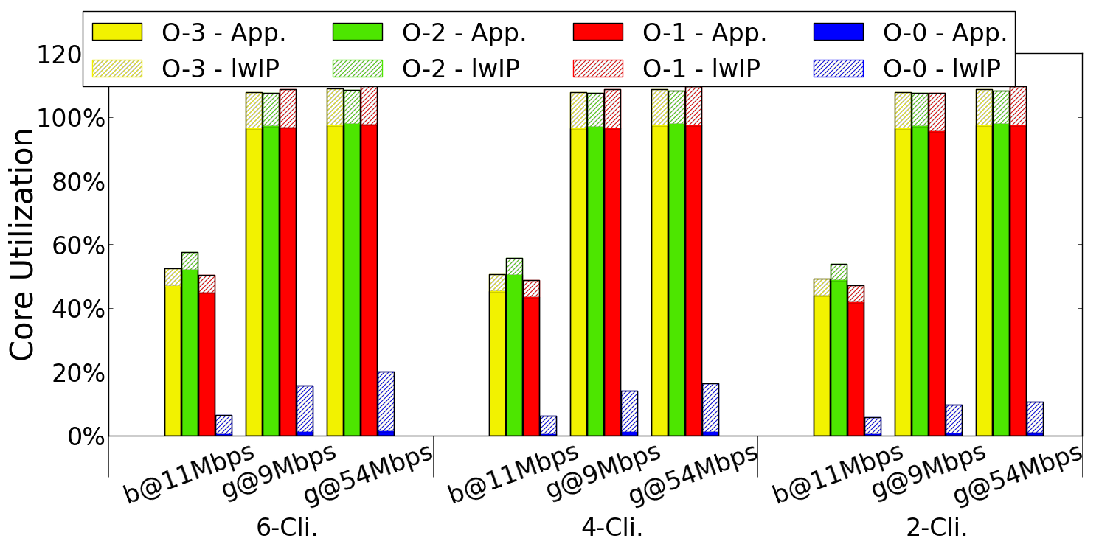
Server Core Utilization
Mainly affected by offloading level
  Higher offloading increases server load
  Client count affects throughput and server load
Up to 20% core utilization for lwIP stack
ECG diagnosis
SAMOS, 7/17/17
© 2017 Z. Zhao, V. Tsoutsouras, D. Soudris, A. Gerstlauer

Slide 21
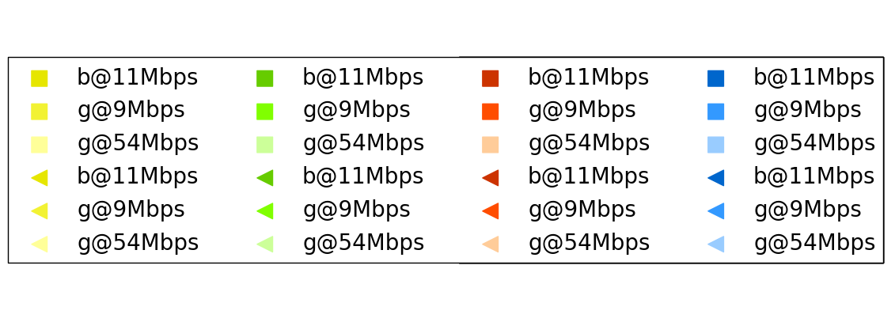
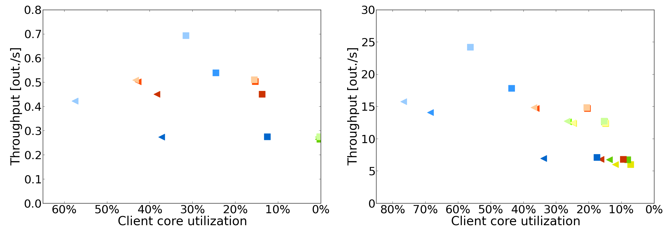
NoS Design Space
IoT design space exploration
  6-client setup with different app., system and net. config.
  Non-obvious parameter interactions
O-3
O-2
O-1
O-0
S:2×Pi3
C:1×Pi0
S:2×Pi3
C:1×Pi3
Vison graph discovery
ECG diagnosis
SAMOS, 7/17/17
© 2017 Z. Zhao, V. Tsoutsouras, D. Soudris, A. Gerstlauer
Notes:
As shown before, ofﬂoading inﬂuences client core utilization, with lower ofﬂoading levels (lighter shades) on the left. However, ofﬂoading also affects throughput, and other parameters affect both throughput and utilization in non-uniform ways, where design spaces can not be easily predicted without detailed exploration.
As these case studies show, IoT design space exploration involves multi-dimensional parameters at application, mapping and architecture levels with non-obvious interactions between each other. Fast NoS co-simulation for rapid prototyping at early design stages enables joint exploration across such application, network and system design spaces.

Slide 22
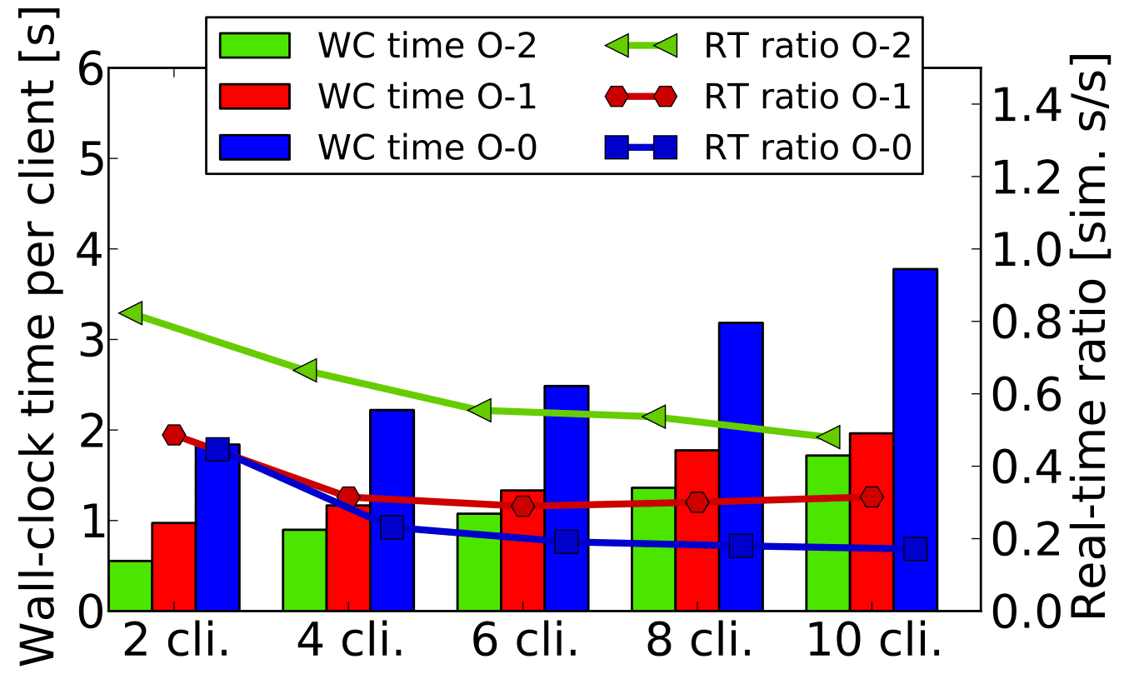
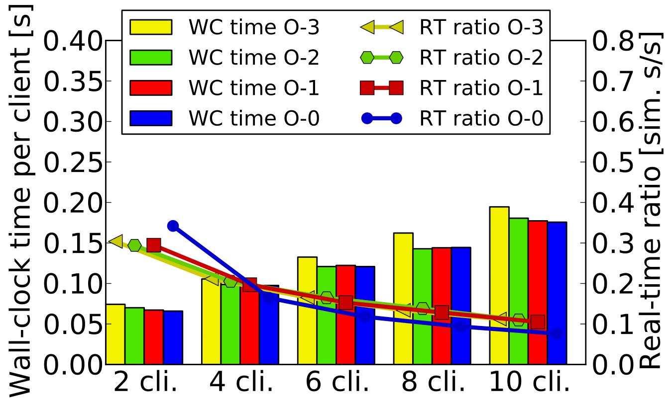
Simulation Speed and Accuracy
Simulation speed
  Vision graph discovery: 0.39 sim. seconds/s
  ECG: 0.18 sim. seconds/s
  Larger communication requires more simulation events
Simulation accuracy
  >95% for system simulator
Vison graph discovery
ECG diagnosis
SAMOS, 7/17/17
© 2017 Z. Zhao, V. Tsoutsouras, D. Soudris, A. Gerstlauer
Notes:
Vision graph discovery is about twice as fast since it is more computation-dominated, which requires relatively fewer OMNeT++ and SystemC communication and synchronization events to be simulated.
For both examples, per-client wall clock time is increased and speed is dropped with more clients, which is caused by extra synchronization and context switch overhead. In the vision graph example, server-side computation increases quadratically with more clients. This negatively affects per-client wall-clock time but not speed. On the contrary, due to the application becoming even more computation-dominated, speed can increase.
Ofﬂoading may inﬂuence the amount of communication to be simulated. In the vision graph example, higher ofﬂoading levels require less communication, which results in faster simulation speed and lower wall-clock time.
The system simulator is reported to be more than 95% accurate. Accuracy of the OMNeT++ network simulator depends on a wide range of factors, such as propagation and channel models, which are out of the scope of this paper. Nevertheless, for the purposes of exploration, relative accuracy is most important, where OMNeT++ has been widely used in academia and industry to perform corresponding studies.

Slide 23
Summary & Conclusions
Networks-of-Systems (NoS) simulator
  SystemC based host-compiled system model
  INET/OMNeT++ integration
  Fast, comprehensive and flexible NoS simulator
NoS design space exploration
  IoT application case studies
  Significant network/system interactions
Future work
  Accuracy validation against more real world setups
  Various metrics such as quality and reliability
  Network/system co-optimization
SAMOS, 7/17/17
© 2017 Z. Zhao, V. Tsoutsouras, D. Soudris, A. Gerstlauer

