Slide 1
Automated, Retargetable Back-Annotation for Host Compiled Performance and Power Modeling
Suhas Chakravarty, Zhuoran Zhao, Andreas Gerstlauer
Electrical and Computer Engineering
The University of Texas at Austin
http://www.ece.utexas.edu/~gerstl
CODES+ISSS, 9/30/13

Slide 2
Outline
Introduction
Related Work
Retargetable Back-Annotation Flow
Experimental Results
Summary and Conclusion
CODES+ISSS, 9/30/13
© S. Chakravarty, Z. Zhao, A. Gerstlauer

Slide 3
Motivation
Increasing design complexities
  Rapid design space exploration desired
  Fast and accurate performance and power validation
Traditional simulation models
  Instruction Set Simulator (ISS)
  RTL/Gate level
  Too slow or too inaccurate
Modeling at higher abstraction levels
  Higher simulation speed
  Host-compiled simulation
CODES+ISSS, 9/30/13
© S. Chakravarty, Z. Zhao, A. Gerstlauer
Notes:
Brief introduction, why simulation, why introduce HC

Slide 4
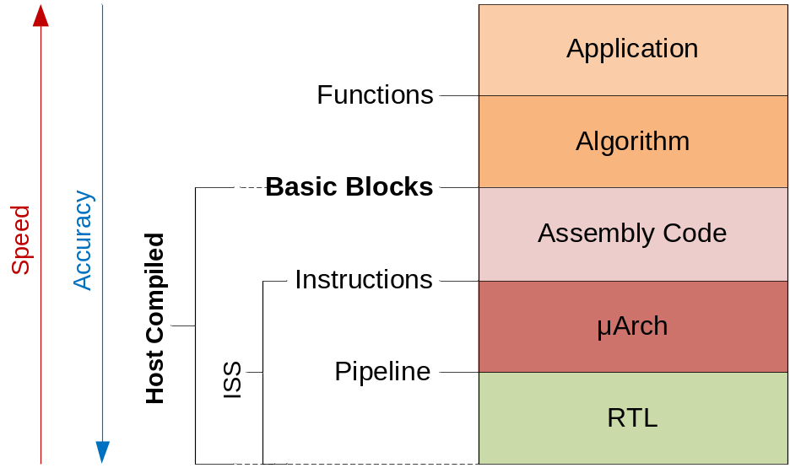
Host-Compiled Modeling
Modeling above the ISS level
  Compile and execute
  application natively
  Annotate application with
  target timing and power
  Wrap with SystemC code
  for platform integration
Fast and accurate simulation to complement ISS
CODES+ISSS, 9/30/13
© S. Chakravarty, Z. Zhao, A. Gerstlauer
Notes:
Key points of HC

Slide 5
Related Work
Source level timing modeling
  Binary-to-source mapping
    Obtain estimation at source IR level [Hwang08, Brandolese01]
    Disable optimization and rely on debug information [Wang09]
    Mapping ambiguity
  Reference model
    Static binary code analysis [Stattelmann11, Wang09, Schnerr08]
    Apply ISS or abstract pipeline model [Plyaskin11, Lin10]
Source level power modeling
  Coarse-grain reference model
    Complete instructions and source-level operations
    [Brandolese00, Brandolese11, Calvo11]
    Fast, but not accurate
CODES+ISSS, 9/30/13
© S. Chakravarty, Z. Zhao, A. Gerstlauer
Notes:
B to SCR mapping/ where the information comes from

Slide 6
Back-Annotation Concerns
Annotation granularity?
  Speed vs. accuracy tradeoff
  Dynamic execution effects
  Basic Block (BB) granularity
Compiler optimizations?
  Mapping between source and binary
  Work with intermediate representation (IR)
Dynamic architecture effects?
  Pipelining, caching, branch prediction
  Pairwise characterization
  BB granularity + hybrid simulation (future)
CODES+ISSS, 9/30/13
© S. Chakravarty, Z. Zhao, A. Gerstlauer
Notes:
Path dependency…
IR BB highlight difference
Two issue: what path, how long of the path
Static vs dynamic WCET
Annotation granularity?
Speed vs. accuracy tradeoff
Dynamic execution effects
Basic Block (BB) granularity
Data dependent execution behavior captured
Simulation speed still close to native execution
Compiler optimizations?
Mapping between source and binary
Work with intermediate representation (IR)
Front-end optimizations accounted for

Slide 7
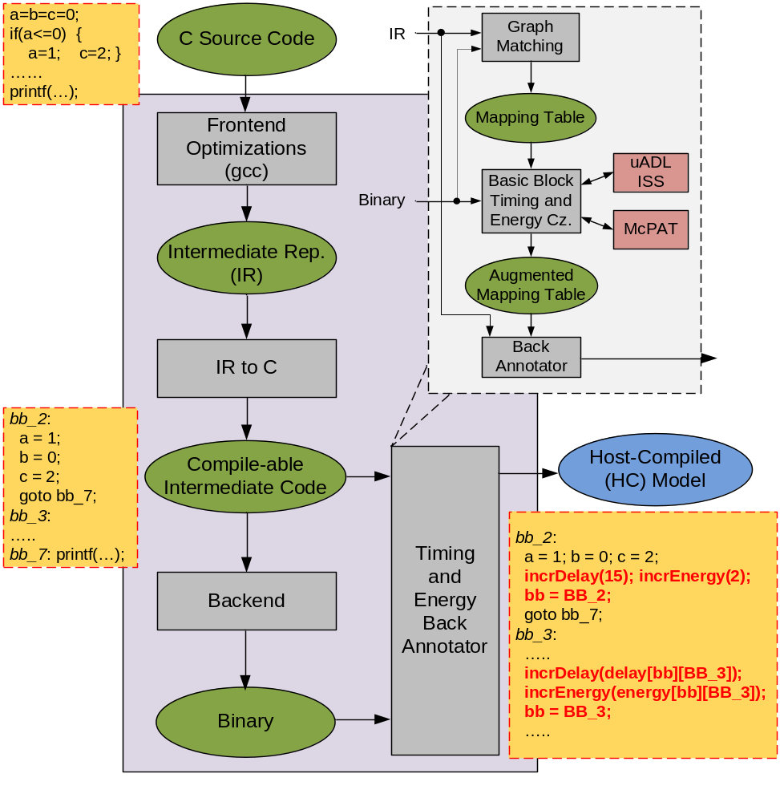
Retargetable Back-Annotator (RBA)
  Intermediate
  representation (IR)
  Frontend
  optimizations [gcc]
  IR to C conversion
  Timing and energy
  Back-Annotator
  Binary-to-IR mapping
  Timing and power
  estimation
  Back-annotation
CODES+ISSS, 9/30/13
© S. Chakravarty, Z. Zhao, A. Gerstlauer
Notes:
Sum of the annotator,

Slide 8
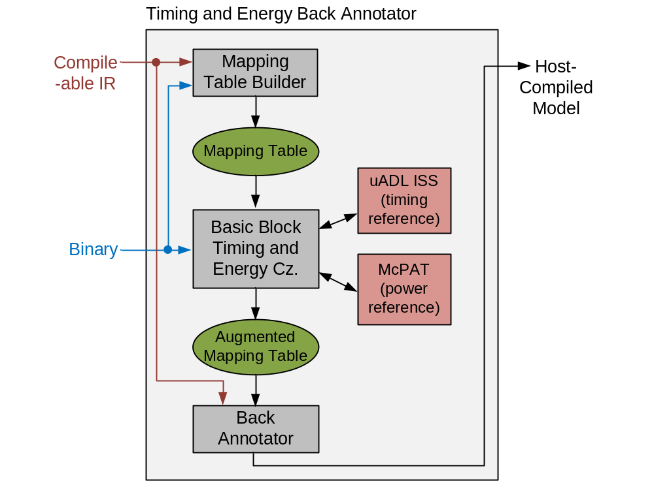
Timing and Energy Back Annotator
  Binary-to-IR mapping
  Cross-compiler backend [gcc]
  Control-flow graph
  matching
  Timing and power estimation
  Micro-architecture
  description language
  (uADL) or RTL
  Cycle-accurate timing
  Reference power model
  [McPAT]
  Back-annotation
  IR basic block level
CODES+ISSS, 9/30/13
© S. Chakravarty, Z. Zhao, A. Gerstlauer

Slide 9
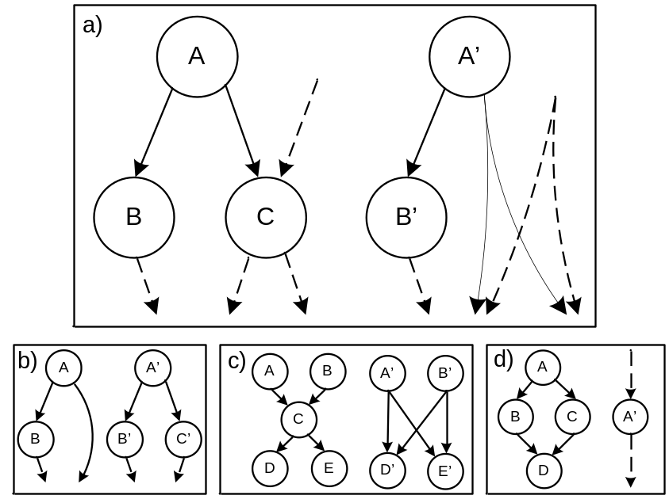
Binary-to-IR mapping
IR
Binary
Backend optimizations
  Instruction scheduling
    Blocks added/removed
    Predicated execution
  Control flow mismatches
    Establish binary-IR mapping
    for back-annotation
Graph matching heuristic
  Recursive traversal
  Identify all legal mappings
Resolve ambiguities using
debug information
CODES+ISSS, 9/30/13
© S. Chakravarty, Z. Zhao, A. Gerstlauer
Notes:
Traversal both graph… ani on the algo
Predicated instruction

Slide 10
Graph Matching Heuristic
Loop and branch level computation
  Loop: nesting level
  Branch: flow value
Synchronized, recursive depth-first traversal
  Enumerate all compatible successor pairings
    Compatibility: loop and branch nesting levels
    Including successor skips (hoist successors of successors)
  Return least-cost mapping
    Cost: sum of unmatched nodes in subgraphs rooted at node
CODES+ISSS, 9/30/13
© S. Chakravarty, Z. Zhao, A. Gerstlauer
Notes:
Traversal both graph… ani on the algo
Predicated instruction

Slide 11
Graph Matching Example
A (1)
Cost =5
Cost =5
A (1)
A (1)
A (1)
A
A’ (1)
A’ (1)
A’ (1)
A’ (1)
A’
0.5
0.5
0.5
B (0.5)
0.5
B (0.5)
B
C (0.5)
C (0.5)
C (0.5)
C (0.5)
C
Cost =2
C’ (0.5)
C’ (0.5)
C’ (0.5)
C’ (0.5)
C’ (0.5)
C’ (0.5)
B (0.5)
C’
Cost =2
Cost =2
0.5
0.5
0.5
D (1)
D (1)
D (1)
D (1)
D
D (1)
Cost =2
D’ (1)
D’ (1)
D’ (1)
D’ (1)
D’ (1)
D’ (1)
D’
D’ (1)
Cost =2
0.5
0.5
0.5
0.5
E (0.5)
E (0.5)
E (0.5)
E
E (0.5)
F (0.5)
F (0.5)
F (0.5)
F (0.5)
F
F’ (0.5)
F’ (0.5)
F’ (0.5)
F’ (0.5)
E’ (0.5)
F’
E’ (0.5)
E’ (0.5)
E’
Cost =1
E’ (0.5)
Cost =1
Cost =1
Cost =1
0.5
0.25
0.25
0.25
0.25
G (0.75)
G
G (0.75)
G (0.75)
H (0.25)
H (0.25)
H (0.25)
H (0.25)
H
H’ (0.25)
H’ (0.25)
H’ (0.25)
H’ (0.25)
H’
Cost = 0
0.5
H’ (0.25)
Cost = inf
Cost = 0
0.75
0.25
0.25
I (1)
I (1)
I (1)
I
I (1)
I (1)
I’ (1)
I’ (1)
I’ (1)
I’ (1)
I’ (1)
I’ (1)
I’
I’ (1)
Cost = 0
I’ (1)
Cost = 0
IR CFG
Binary CFG
CODES+ISSS, 9/30/13
© S. Chakravarty, Z. Zhao, A. Gerstlauer
Notes:
Traversal both graph… ani on the algo
Predicated instruction

Slide 12
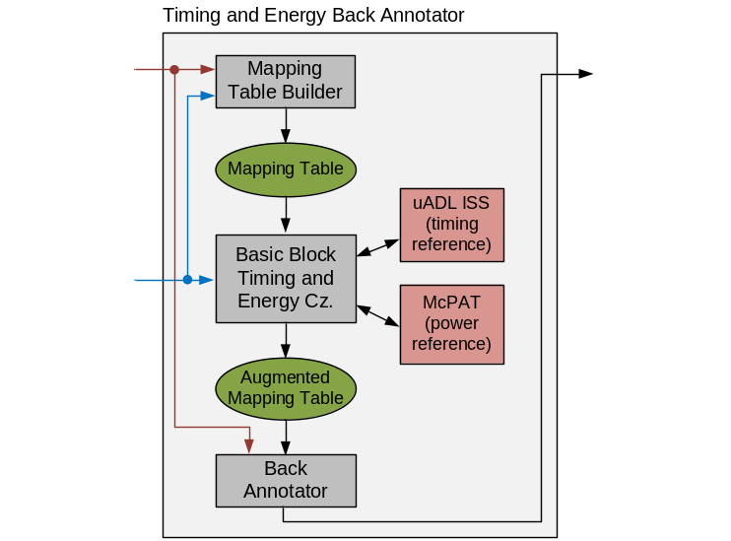
Basic Block Characterization
BB1
BB2
Exec flow 1
  Path-dependent metrics
    Execution history
    Architecture state
  Execution path estimation
    Capture the effects of previously
    executed code
    Trade off between accuracy
    and complexity
    Pairwise characterization
Exec flow 2
SS – Sys State (registers, mem,
pipeline)
SS =A
BB3
SS = B
CODES+ISSS, 9/30/13
© S. Chakravarty, Z. Zhao, A. Gerstlauer
Notes:
What is the issue? 2 How to solve the problem, highlight the principles energy

Slide 13
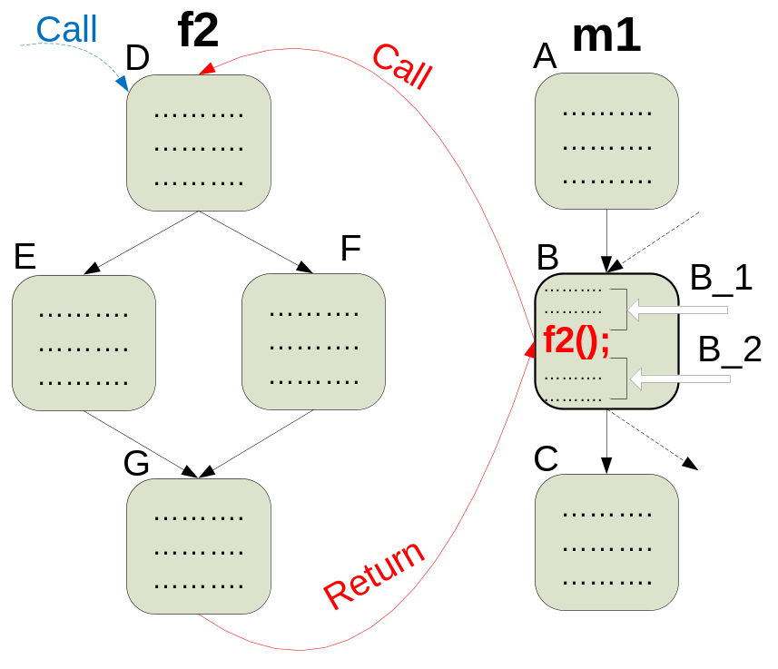
Pairwise Characterization
  Pairwise characterization
    Characterize each block with all immediate predecessors
    Initialize system state from earlier execution
    Scoreboarding to resolve dependency between pairs
  Function call characterization
    Divide caller block
    into sub-blocks
    Characterize caller and
    callee in conjunction
    with each other
    On call and return
CODES+ISSS, 9/30/13
© S. Chakravarty, Z. Zhao, A. Gerstlauer
Notes:
What is the issue? 2 How to solve the problem, highlight the principles energy

Slide 14
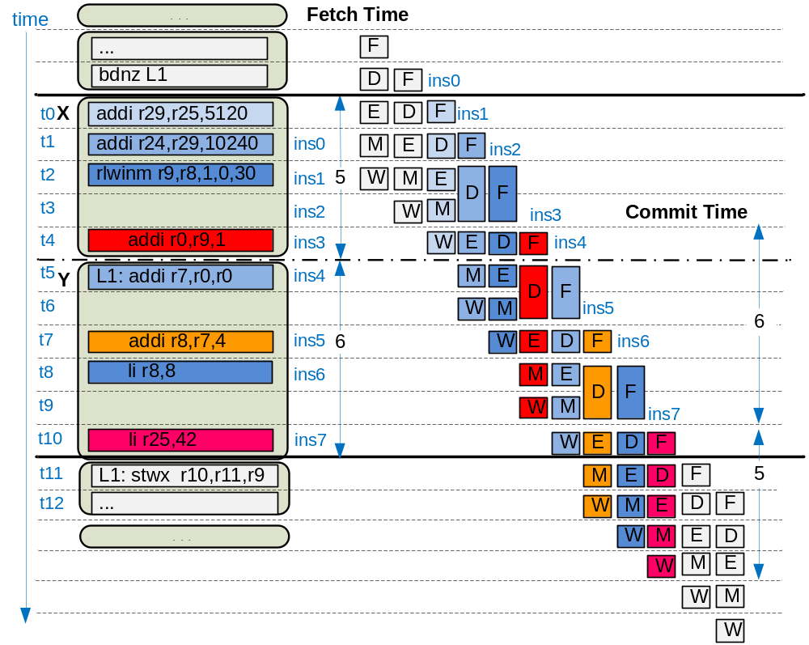
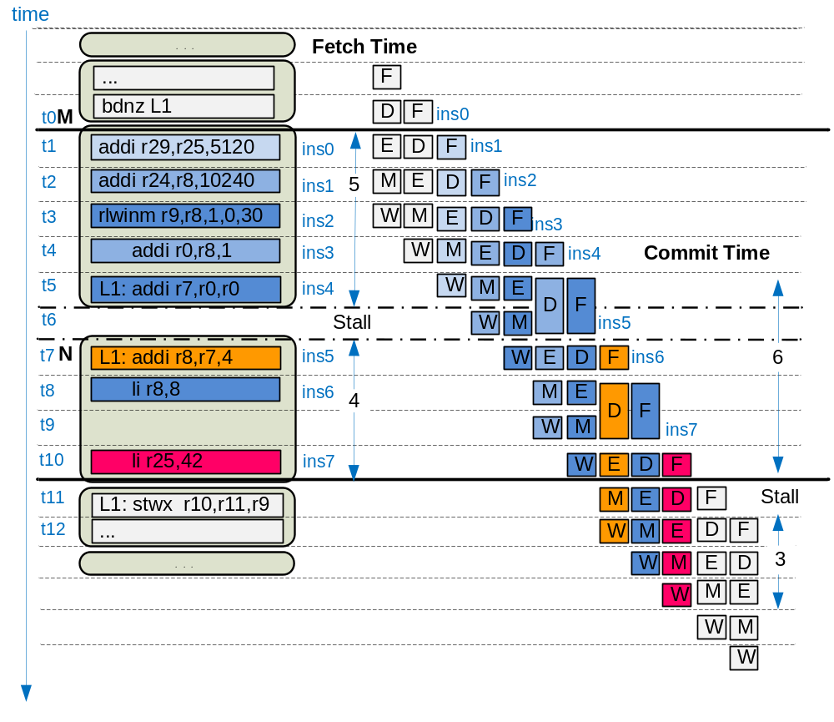
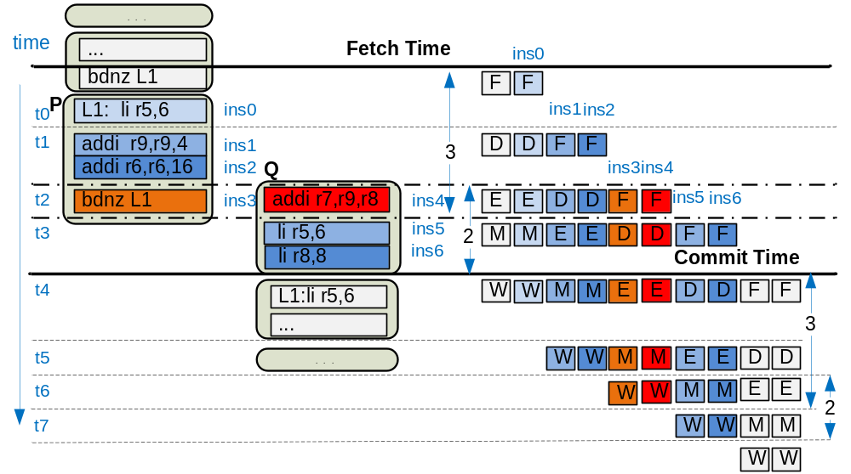
Pairwise Execution
  Difference in fetch times
    Intra block stall will propagate and manifest
    Adjust for: inter block stall
  Difference in fetch times
    Intra block stall will propagate and manifest
    Adjust for: inter block stall or overlap
CODES+ISSS, 9/30/13
© S. Chakravarty, Z. Zhao, A. Gerstlauer
Notes:
What is the issue? 2 How to solve the problem, highlight the principles energy

Slide 15
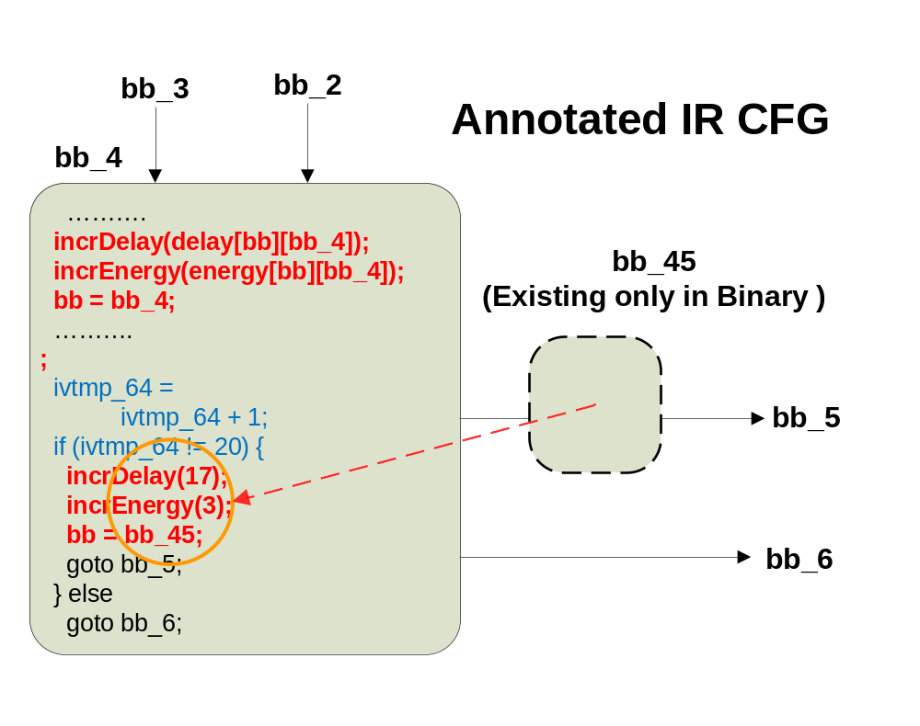

IR Back Annotation
Path dependent metrics
  Encoded as global array: delay[pred_bb][cur_bb]
Captures static branch prediction
CODES+ISSS, 9/30/13
© S. Chakravarty, Z. Zhao, A. Gerstlauer
Notes:
What is the issue? 2 How to solve the problem, highlight the principles energy

Slide 16
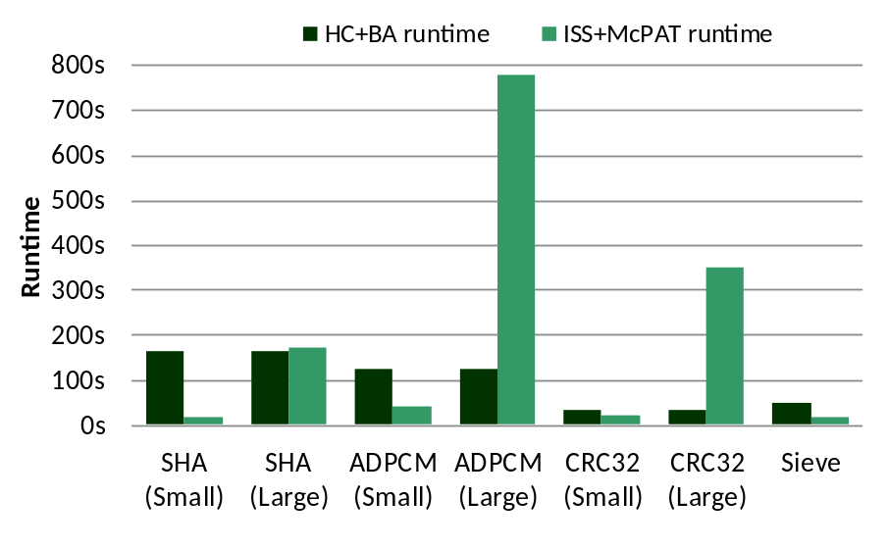
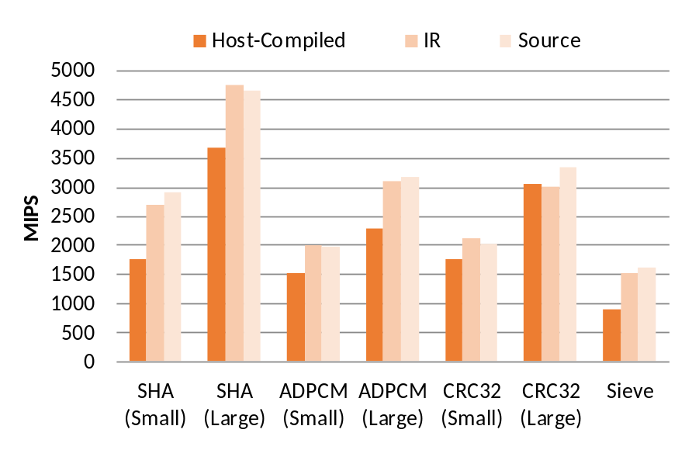
Experimental Results
Automatic timing and energy back-annotation
  Telecom & security applications [MiBench]
    SHA, ADPCM, CRC32 & custom Eratosthenes’ Sieve
    Small and large data sets,
    10 to 700 million instr.
  One-time back-annotation
    3min. to 3s BA runtime
  Host-compiled simulation vs. traditional ISS
    2000 MIPS vs. 0.8-1 MIPS
    Close to source-level speeds
CODES+ISSS, 9/30/13
© S. Chakravarty, Z. Zhao, A. Gerstlauer
Notes:
Key points why these benchmarks, no floating point no library…

Slide 17
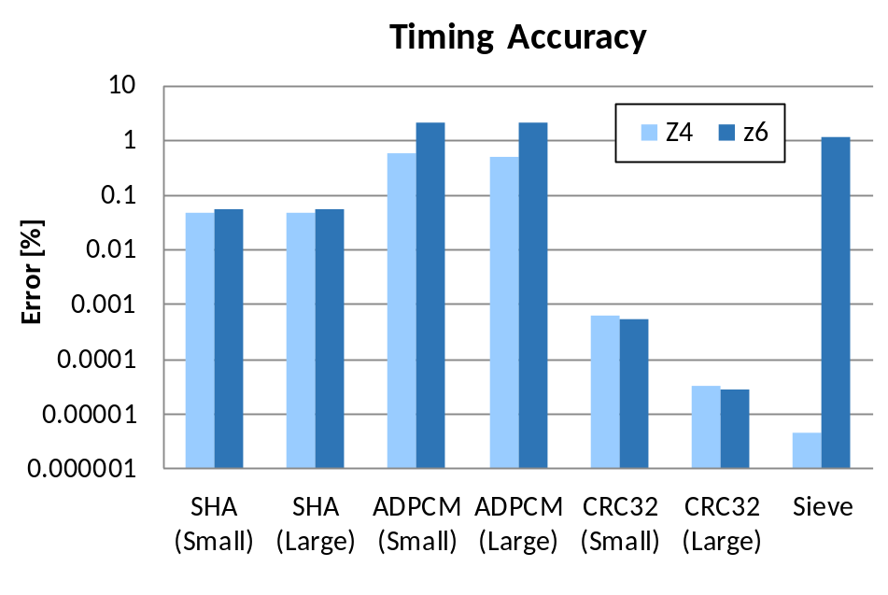
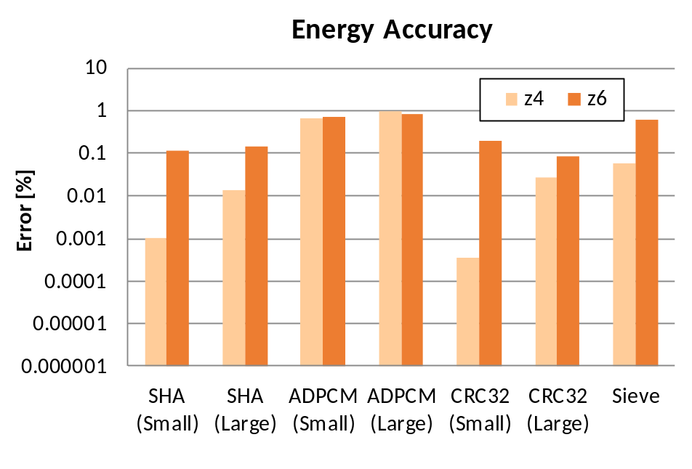
Accuracy Results
Host-compiled power and performance simulation
  Single- (z4-like) and dual-issue (z6-like) e200 PowerPC
    No cache, static branch prediction
  Compare against cycle-accurate reference ISS+McPAT
    >98% average timing and energy accuracy @ 2000 MIPS
CODES+ISSS, 9/30/13
© S. Chakravarty, Z. Zhao, A. Gerstlauer

Slide 18
Summary & Conclusions
Retargetable power/performance back-annotation
  Automated ISS-driven estimation and BB characterization
    Binary-to-IR control flow matching algorithm
    ADL/ISS/McPAT-based pairwise block-level characterization
  Back-annotation of timing & energy estimates into IR
    Scripting to insert source level timing and energy annotations
Host-compiled simulation performance
  Running at 2000MIPS with >98% accuracy
Future work
  Integrated other metrics into host-compiled simulation (thermal, reliability)
Fully automated host-compiled modeling flow
CODES+ISSS, 9/30/13
© S. Chakravarty, Z. Zhao, A. Gerstlauer

