Slide 1


Silent Patient Pool Finder
Finding the patients your claims data can’t see. County → ZIP → prescriber intelligence for undiagnosed chronic disease — built entirely on public, PHI-free data, with campaign measurement built in.
Zorawar Singh Nandwal
Live now — silent-patient-pool-finder.streamlit.app
·
IQVIA Ideathon · MVP demo
·
July 2026
Notes:
Every chronic-disease brand in this room is fighting over the same already-diagnosed patients, using the same data about doctor visits and prescriptions. But the biggest patient pool in metabolic disease never shows up in that data — because these people have not been diagnosed yet. SPPF finds them — by place, not by name. It touches no personal health data, costs nothing in data licensing, and needs no legal sign-offs. And it is not just a slide — it is running live right now: scan the QR code, it is the same app I am about to demo.

Slide 2
The biggest patient pool generates zero claims
8.7M
34.9M
2.1M
US adults with undiagnosed Type 2 Diabetes
with undiagnosed or uncontrolled hypertension
with undiagnosed hypothyroidism
No diagnosis code, no prescription, no claim — invisible to claims analytics by definition. Every traditional targeting tool starts after a patient enters the system. The commercial question sits upstream of all of it:
“Where are the patients who should be diagnosed but aren’t — and who will find them?”
A population-level planning tool, not a clinical diagnostic instrument — every diagnosis it enables happens through a licensed clinician.
Notes:
Let the title sit for a beat — then walk the numbers. 8.7 million US adults have Type 2 diabetes and do not know it. 34.9 million have high blood pressure that is undiagnosed or not under control. 2.1 million have an undiagnosed thyroid condition. None of them appear in any dataset sold today — no diagnosis on file, no prescription, no insurance claim, so there is literally nothing to buy. Every traditional targeting tool starts after a patient enters the system. Our question comes before all of that: where are the people who should be diagnosed but aren’t — and who will find them?

Slide 3
Invisible individually — loud in aggregate
11 public datasets
7-dimension scoring engine
Actionable outputs
CDC PLACES, Census ACS, CMS Medicare, HRSA, USDA, County Health Rankings — zero PHI, zero licensing cost.
Burden, diagnosis gap, access, SDoH, payer mix, readiness, trajectory — every US geography scored 0–100.
Ranked geographies → prescriber call lists → pre-registered campaign measurement.
The compliance story is the moat: no patient-level data at any stage — no HIPAA exposure, no data-use agreements, no procurement friction, and a marginal data cost of zero.
Notes:
One undiagnosed patient is invisible. A county full of them leaves clear statistical footprints. The engine has three parts. First: eleven free public datasets — from the CDC, the Census, and Medicare — with no personal health information in any of them. Second: a scoring engine that grades every US geography from 0 to 100 on seven factors. Third: practical outputs — a ranked list of places, a call list of doctors, and a built-in way to measure whether a campaign worked. The compliance story is the moat: because no individual patient data is ever touched, there is no privacy risk, no legal agreements to negotiate, and the data itself costs nothing.

Slide 4
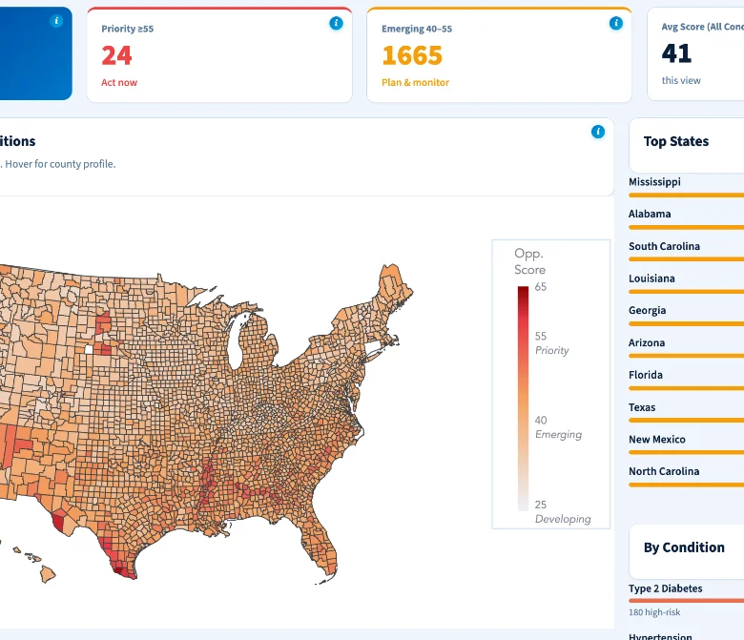
Market → territory → prescriber
3,144
US counties scored — 7 dimensions, percentile, A/B/C confidence grade
33,791
ZIP codes — ZCTA-level CDC + Census data via crosswalk downscaling
411,115
prescribers ranked from CMS panel data — 20,612 Priority-tier NPIs
Notes:
The map is on screen from the start — let it do the talking. The tool scores 3,144 counties, breaks those down into 33,791 ZIP codes, then ranks 411,115 individual prescribers — about 20,600 in the top priority tier — all from one automated pipeline that runs in an afternoon. Point at the map: south Texas, the Bronx, the Mississippi Delta light up — exactly the places public-health research says undiagnosed metabolic disease concentrates. You can see with your own eyes it is finding the right places.

Slide 5
Seven questions, answered per geography
DIMENSION
WEIGHT
THE QUESTION IT ANSWERS
Diagnosis Gap
25%
How much of the problem is still invisible?
Disease Burden
20%
How big is the problem here?
Access to Care
15%
Can a found patient actually get treated?
Social Determinants
15%
What’s causing the gap?
Payer Landscape
10%
Who pays — and what are their incentives?
Commercial Readiness
10%
How easy is it to run a program here?
Trajectory
5%
Growing or shrinking? (real 3-yr CDC trend)
Skeptical of the weights? Good — live sliders re-weight any need-side dimension and the ranking holds (Spearman 0.97–0.99; 93% weight stability under Monte Carlo perturbation). Trajectory runs on the real +0.9pp national diabetes-prevalence trend (2020→2023 BRFSS) — measured data, not a proxy.
Notes:
Seven questions, answered for every place — walk the table top to bottom. Each factor has a weight: the bigger the weight, the more it influences the score. Then the pre-emptive strike: skeptical of the weights? Good — the dashboard has live sliders that let anyone change them and try to break the ranking. It barely moves: however you reasonably re-weight, ranking agreement stays at 97 to 99 percent and the same places stay on top. Starr County does not move. And the Trajectory factor uses the real three-year CDC trend — measured data, not a guess.

Slide 6
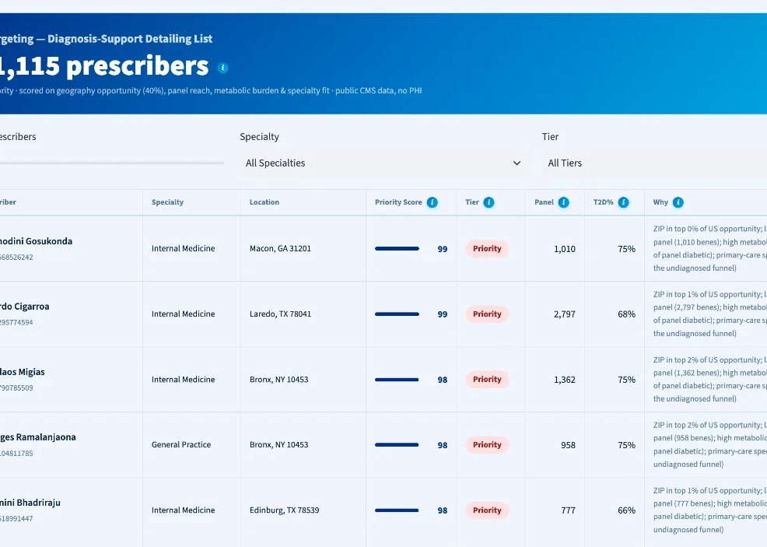
From hot ZIPs to a rep’s Monday call list
40% Geography — ZIP opportunity percentile at the practice address
25% Reach — Medicare panel size percentile
20% Burden — share of panel already diabetic
15% Fit — primary care owns the undiagnosed funnel
One real row: “ZIP in top 6% of US opportunity; 1,840-bene panel, 68% diabetic; primary care.”
Every row exports CRM-ready with a plain-language why. Public CMS aggregate data only — scores rank conversation value, never prescribing quality.
Notes:
From hot ZIP codes to a rep’s Monday call list — walk the blend. A doctor’s score mixes four things: 40 percent where they practice, 25 percent how many patients they see, 20 percent how much diabetes is already in their patient panel, and 15 percent whether they are in primary care — the specialty that finds undiagnosed patients. Every row exports ready for the CRM with a plain-English reason: ZIP in the top 6 percent of US opportunity; 1,840-patient panel, 68 percent diabetic; primary care. Only public, aggregated Medicare data — it ranks where a conversation about diagnosis is most valuable, never how good a doctor is.

Slide 7
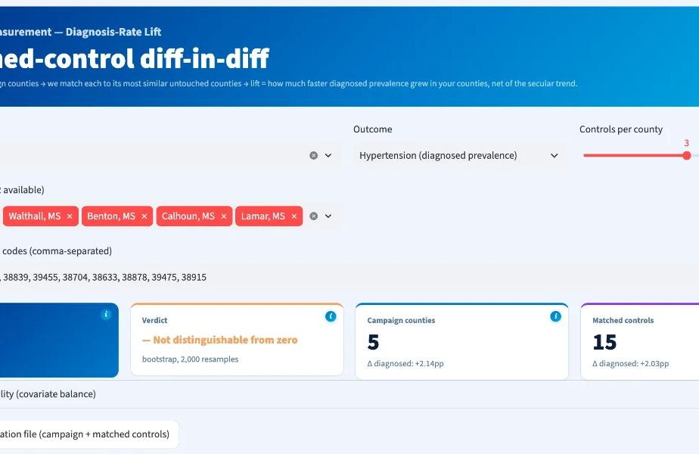
Campaign ROI, measured like a clinical trial
1 Pick campaign counties — select or paste FIPS
2 Auto-match controls — k-nearest statistical twin counties
3 Pre-register both lists — locked before launch
4 Diff-in-diff lift — vs controls, bootstrap 95% CI
Validated: recovers a known +1.5pp synthetic lift within ±0.3pp; a real-data placebo reads not significant — it refuses to hallucinate lift.
Notes:
The part nobody else does: proving the campaign worked — walk the four steps. One: pick the counties where the campaign runs. Two: the tool automatically finds twin counties that look statistically identical but get no campaign. Three: both lists are locked in before launch, so nobody can cherry-pick afterwards. Four: after the campaign, compare how diagnosis rates moved in the campaign counties versus their twins, with an honest margin of error. And we tested the tester: when we planted a known fake effect it found it almost exactly, and when there was no effect it correctly said nothing here. It refuses to invent good news.

Slide 8
Designed to survive your analysts
60+ automated QA gates
Confidence grades A/B/C
Fail-loudly data contracts on every pipeline — corrupt or degraded data cannot ship. Re-run live on the dashboard’s provenance page.
Every county graded on true pre-imputation source coverage: 3,123 A, 21 B. Low-coverage geographies can’t masquerade as corroborated.
Full provenance page
No black box anywhere
Source, vintage, real coverage and refresh date for all 11 datasets — computed from the exact files behind the current session.
Percentile ranks, weight sensitivity exposed — and the seams disclosed: modeled payer mix and the hypothyroid proxy are labeled as such in the app.
Notes:
Built to survive scrutiny — walk the four defenses. More than sixty automatic quality checks re-run live inside the app. Every data point carries an A, B or C confidence grade based on how complete the underlying data really is. A full record of where every number came from, for all eleven datasets, computed from the exact files behind the session. And no black box — we volunteer where the data is weakest: part of the insurance-mix factor is modeled and the thyroid numbers are an approximation, and both are labeled as such in the app. We would rather show you the seams than have you find them.

Slide 9
Does the score beat a spreadsheet?
Lift over a naive baseline
Temporal out-of-time test
Every number is reported against the 5-minute Excel version — rank by population × prevalence. Ranking is judged on Spearman ρ; the model earns its keep only if it beats that. Δρ = +0.55 over the naive pool ranking (0.47 vs −0.08).
Score frozen on the old PLACES vintage predicts the diagnosis-gap move in the new one — coherence, not curve-fitting. Runs today on repo data. ρ = 0.93 · top-50 overlap 84% vs 1.6% by chance.
Predicts a source it never saw
More than a poverty map
Held out premature-death severity (CHR YPLL) — never ingested — and the composite still tracks it. A model, not a restatement of its own inputs. ρ = 0.47 vs −0.08 for the naive ranking.
Diagnosis Gap adds independent signal over an SDoH-only model: ΔR² = +0.20, partial r = 0.51 . If it added nothing, the honest read is “a well-built access map.” The test is built to be able to fail.
Notes:
Four tests, each designed so it could fail. First, the benchmark is deliberately dumb: the ranking anyone could build in Excel in five minutes — population times disease rate. Against premature-death rates — a severity measure the score never ingests — our score reaches 0.47 while the Excel ranking scores minus 0.08: a lift of 0.55 over that naive pool ranking. Second, the time test: freeze the score on the older data vintage and it still matches today’s ranking — agreement 0.93, and 84 percent of the top-50 counties stay the same versus under 2 percent by chance. Third, the held-out test: that 0.47 comes from data the score never touched — it is a model, not a restatement of its own inputs. Fourth, the poverty question: the diagnosis-gap factor explains 20 percent more of the variation than a poverty-and-access model alone, partial correlation 0.51. If a judge asks about prevalence alone: prevalence tracks severity better — by construction — but it cannot tell you which high-burden county has a payer to fund the program or the infrastructure to run one; the 0.51 incremental-value number shows the composite adds signal beyond any single input. Every number comes from a script — if the score ever fails to beat the baseline, we say so.

Slide 10
Three plays, one platform
Market expansion
MA Stars partnership
Territory design + proof
Starr County, TX scores #1 of 3,144: 26% diabetes prevalence, a huge detection deficit. SPPF hands a GLP-1 brand 24 Priority counties, ZIP heatmaps, and the internists with 60–75% diabetic panels — before a claims dollar is spent.
Counties with 40%+ MA penetration and high diagnosis gaps are co-funding opportunities: plans earn Stars and HEDIS credit for the screening pharma wants run. The payer view ranks them and sizes the dual-eligible upside.
Territory Builder assembles rep geographies ZIP-by-ZIP; the measurement engine then proves last cycle’s diagnosis-rate lift to justify next cycle’s budget — a renewable engagement, not a one-off report.
Notes:
Three plays, one platform — walk each play. Market expansion: a diabetes-drug brand team gets Starr County, Texas — ranked number one of 3,144 counties, 26 percent diabetes prevalence — plus its ZIP-level heat maps and the exact internists whose panels are 60 to 75 percent diabetic, before spending a dollar on claims data. Market access: the counties where Medicare Advantage insurers would co-fund screening, because plans earn quality-rating credit for the same screening pharma wants run. Field teams: territory design plus proof of last cycle’s impact — a renewable engagement, not a one-off report. If asked whether this is just creating demand: undiagnosed diabetes and high blood pressure cause strokes, amputations and dialysis. SPPF targets screening programs, not prescriptions, and the measurement engine holds campaigns accountable for diagnosis rates, not sales — the rare case where the commercial incentive and the public-health good point the same direction.

Slide 11
Upstream of claims — and better together
Claims & Rx analytics see…
SPPF sees…
Diagnosed, treated patients
Rich longitudinal detail, patient-level
Post-diagnosis market-share battles
Licensing cost, DUAs, PHI governance
The pre-diagnosis whitespace claims can’t
Every US geography, no sampling gaps
Zero PHI, zero licensing, procurement-light
Where the next diagnosed patient comes from
Every IQVIA asset — claims, LRx, OCE — starts after diagnosis: the product boundary, not a criticism. SPPF is the demand-generation layer upstream — it creates the diagnosed patients every downstream product then tracks, and claims verify the new diagnoses quarterly. A new SKU for an existing sales force.
Notes:
Set the boundary in two halves. Claims and prescription analytics see patients who are already diagnosed and treated — rich, detailed, person-level data. SPPF sees the space before diagnosis, which claims data cannot see by definition — every US geography, no personal data. Every existing IQVIA product starts after diagnosis: that is the product boundary, not a criticism. SPPF sits upstream — it helps create the diagnosed patients every downstream product then tracks. A new product for an existing sales force.

Slide 12
The MVP is live. Here’s the roadmap.
NOW
NEXT
THEN
Working MVP
Condition modules
Claims-sharpened measurement
11-view dashboard, 3,144 counties, 33,791 ZIPs, 411k HCPs, measurement engine, 45-test CI suite — all public data, open for audit.
Every condition with a silent pool: CKD (~90% of early stages undiagnosed), MASH, COPD, AFib, GLP-1-adjacent metabolic expansion — each a config file on the same engine.
Quarterly lift windows via claims integration, Veeva CRM push, and a formal validation study against NHANES measured-vs-reported ground truth.
Notes:
The roadmap in three beats. NOW: the MVP is live — 11 dashboard views, 3,144 counties, 33,791 ZIPs, 411 thousand prescribers, the measurement engine, and 45 automated tests that re-run on every code change — all public data, open for audit. NEXT: new disease modules — chronic kidney disease, where roughly 90 percent of early cases go undiagnosed, then fatty liver disease, COPD, and AFib — each just a settings file on the same engine. THEN: sharpen the measurement with claims data and validate against the CDC’s gold-standard national health survey.

Slide 13
Pure Python, open data, CI-gated
LAYER
STACK
Language & runtime
Python 3.9+ (CI on 3.11) · single requirements.txt · YAML-driven config
Ingestion
requests + certifi TLS fetch · pandas / NumPy / PyArrow → Parquet cache — 7 public sources, zero PHI
Scoring & ML
7-dimension composite · 3,144 counties · 33,791 ZCTAs · 411k HCPs · scikit-learn · SciPy · XGBoost + SHAP
Validation harness
Spatial CV (GroupKFold) · out-of-time lift · held-out-source · bootstrap · weight stability — scripted
Storage
Parquet committed outputs · Neon serverless PostgreSQL (SQLAlchemy + psycopg2, optional sync)
Dashboard
Streamlit 1.49+ — 11 modular views · Plotly choropleth, scatter-geo, radar, funnel
Quality & CI/CD
pytest — 45-test suite · ruff · GitHub Actions on every push · fail-loud QA gates + live provenance page
Deployment
Streamlit Cloud (zero-setup from a fresh clone) · Docker Compose for local Postgres
Notes:
For the technical judges — and in plain English for everyone else. Everything is built in Python, the standard language of data science, on free public data only. The pipeline downloads seven public sources over secure connections; the raw Medicare file lists about 530 thousand prescribers, which we filter down to the 411 thousand worth targeting. The score itself is a weighted average, and standard statistics libraries then stress-test it — including checking it still works on states it was never tuned on. Every number in this deck comes from a script anyone can re-run — nothing is typed in by hand. The dashboard is a standard web app with interactive maps and charts, backed by a cloud database. And the quality bar: 45 automated tests plus code checks run on every single change, and the pipeline is built to stop loudly rather than publish a bad number.

Slide 14
One pilot brand. One condition. 90 days.
One market opportunity assessment — 90 days to a measurable diagnosis-rate story.
Land — $25–75k market opportunity assessment, brand-director budget
Expand — $150–400k/yr multi-brand platform license with quarterly measurement
Renew — the measurement loop turns a report into a subscription
Zorawar Singh Nandwal
Live demo
·
zorawarnandwal@gmail.com
·
github.com/zorawar91/silent-patient-pool-finder
Notes:
The ask: one pilot brand, one condition, one market opportunity assessment — 90 days to a measurable diagnosis-rate story. Then the commercial mechanics, one beat at a time. Land: a 25 to 75 thousand dollar assessment — small enough for a brand director’s own budget. Expand: a 150 to 400 thousand a year multi-brand platform license with quarterly measurement. Renew: because the measurement keeps proving value, a one-off report becomes a subscription. Thank you.

Slide 15
Backup — the two hardest questions
“Isn’t this just demand creation?”
“Is this diagnosing patients?”
Undiagnosed T2D and hypertension cause strokes, amputations and dialysis — every year of delayed diagnosis costs the patient and the health system more. SPPF targets screening programs, not prescriptions: payer partnerships, community health centers, pharmacy screening. And the measurement engine holds campaigns accountable for diagnosis-rate lift — not scripts. The commercial incentive and the public-health good point the same direction.
No — and it can’t, by design. SPPF is a population-level planning tool, not a clinical diagnostic instrument. It never sees an individual patient: all eleven datasets are aggregate, county- or ZIP-level public data. It answers where screening effort will find the most undiagnosed people; every actual diagnosis happens through a licensed clinician, in the normal standard of care.
Notes:
Hold this slide for Q&A — do not present it. Deliver both answers without defensiveness: the ethics answer ends on the incentive alignment, the diagnostic answer ends on the licensed-clinician line.

Slide 16
Backup — if the analysts push harder
“Aren’t you just rediscovering poverty?”
“Can we trust the undiagnosed number?”
No. Fit an SDoH-only baseline, then add the Diagnosis Gap dimension: it carries independent predictive value — ΔR² = +0.20, partial r = 0.51 (p < 0.001) controlling for social determinants. High-opportunity is not the same as high-deprivation; the gap dimension moves the ranking on its own. And every number is reported as lift over a population × prevalence baseline, so the composite must beat the naive map to survive at all. If it doesn’t on your data, that is a finding we report — not one we bury.
Treat it as an interval, never a point: population × prevalence × (1 − diagnosis-rate proxy) × published undiagnosis rate, shown as a low–central–high band (e.g. 38k–52k, central 45k). The absolute count is labeled directional; the ranking is the robust deliverable. A backdated IQVIA claims cut then calibrates the count to real local diagnosis rates and runs one falsifiable test: does the public-data prioritization predict where diagnoses actually landed? If Δρ ≤ 0, the undiagnosed-targeting thesis is not supported — and we say so.
Notes:
Hold for Q&A — the second line of defense if the analysts push past slide 15. Poverty question: lead with the result — the diagnosis-gap factor explains 20 percent more of the variation than poverty alone, partial correlation 0.51 — and end on: if it does not beat the baseline on your data, that is a finding we report. If prevalence-alone comes up (it scores 0.63 against the severity measure, above the composite’s 0.47): expected, not damning — prevalence is practically severity’s sibling, while the composite deliberately trades pure severity correlation for actionability: payer, readiness and access signal. Prevalence alone cannot tell you which high-burden county has a payer to fund the program or the infrastructure to run one; the partial r of 0.51 is the number that shows the composite adds signal beyond any single input. Undiagnosed-count question: always give a range, never a single number — the ranking is the reliable deliverable, and a claims-data check would run one clear pass-or-fail test we state in advance.

