Slide 1

Silent Patient Pool Finder
Finding the patients your claims data can’t see. County → ZIP → prescriber intelligence for undiagnosed chronic disease — built entirely on public, PHI-free data, with campaign measurement built in.
Zorawar Singh Nandwal
Live now — silent-patient-pool-finder.streamlit.app
·
IQVIA Ideathon · MVP demo
·
July 2026
Notes:
Every chronic-disease brand in this room is fighting over the same diagnosed patients — claims data, Rx data, decile lists. But the biggest patient pool in metabolic disease generates zero claims. SPPF finds them — geographically, not individually. Zero patient-level data, zero licensing cost, zero procurement friction. And it is not a slide — it is running live right now: scan the QR code, it is the same app I am about to demo.

Slide 2
The biggest patient pool generates zero claims
8.7M
34.9M
2.1M
US adults with undiagnosed Type 2 Diabetes
with undiagnosed or uncontrolled hypertension
with undiagnosed hypothyroidism
No diagnosis code, no prescription, no claim — invisible to claims analytics by definition. Every traditional targeting tool starts after a patient enters the system. The commercial question sits upstream of all of it:
“Where are the patients who should be diagnosed but aren’t — and who will find them?”
A population-level planning tool, not a clinical diagnostic instrument — every diagnosis it enables happens through a licensed clinician.
Notes:
8.7 million undiagnosed Type 2 diabetics. 34.9 million with undiagnosed or uncontrolled hypertension. They are invisible to every dataset sold today — by definition: no diagnosis code, no prescription, no claim. Traditional targeting starts after a patient enters the system. The commercial question is upstream of all of it.

Slide 3
Invisible individually — loud in aggregate
11 public datasets
7-dimension scoring engine
Actionable outputs
CDC PLACES, Census ACS, CMS Medicare, HRSA, USDA, County Health Rankings — zero PHI, zero licensing cost.
Burden, diagnosis gap, access, SDoH, payer mix, readiness, trajectory — every US geography scored 0–100.
Ranked geographies → prescriber call lists → pre-registered campaign measurement.
The compliance story is the moat: no patient-level data at any stage — no HIPAA exposure, no data-use agreements, no procurement friction, and a marginal data cost of zero.
Notes:
Undiagnosed patients are invisible individually — and loud in aggregate. Eleven public datasets, seven scoring dimensions, every US geography. The compliance story is the moat: no patient-level data at any stage means no HIPAA exposure, no data-use agreements, no procurement friction — and a marginal data cost of zero.

Slide 4
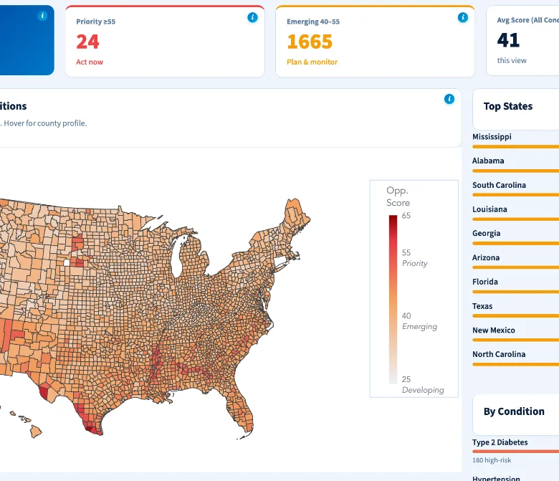
Market → territory → prescriber
3,144
US counties scored — 7 dimensions, percentile, A/B/C confidence grade
33,791
ZIP codes — ZCTA-level CDC + Census data via crosswalk downscaling
411,115
prescribers ranked from CMS panel data — 20,612 Priority-tier NPIs
Notes:
Three resolutions: 3,144 counties, 33,791 ZIP codes, 411,115 prescribers — one pipeline, one afternoon of compute, every US geography. Point at the map: the Rio Grande Valley, the Bronx, the Mississippi Delta light up — exactly where epidemiology says undiagnosed metabolic disease concentrates. Face validity you can see.

Slide 5
Seven questions, answered per geography
DIMENSION
WEIGHT
THE QUESTION IT ANSWERS
Diagnosis Gap
25%
How much of the problem is still invisible?
Disease Burden
20%
How big is the problem here?
Access to Care
15%
Can a found patient actually get treated?
Social Determinants
15%
What’s causing the gap?
Payer Landscape
10%
Who pays — and what are their incentives?
Commercial Readiness
10%
How easy is it to run a program here?
Trajectory
5%
Growing or shrinking? (real 3-yr CDC trend)
Skeptical of the weights? Good — live sliders re-weight any need-side dimension and the ranking holds (Spearman 0.97–0.99). Trajectory runs on the real +0.9pp national diabetes-prevalence trend (2020→2023 BRFSS) — measured data, not a proxy.
Notes:
Seven questions, answered per geography. Skeptical of the weights? Good — open the sensitivity sliders in the dashboard and try to break the ranking. Re-weight any need-side dimension: Spearman 0.97 to 0.99, top-50 overlap 82 to 88 percent. Starr County does not move. The map is driven by where the patients are — not by our weight vector.

Slide 6
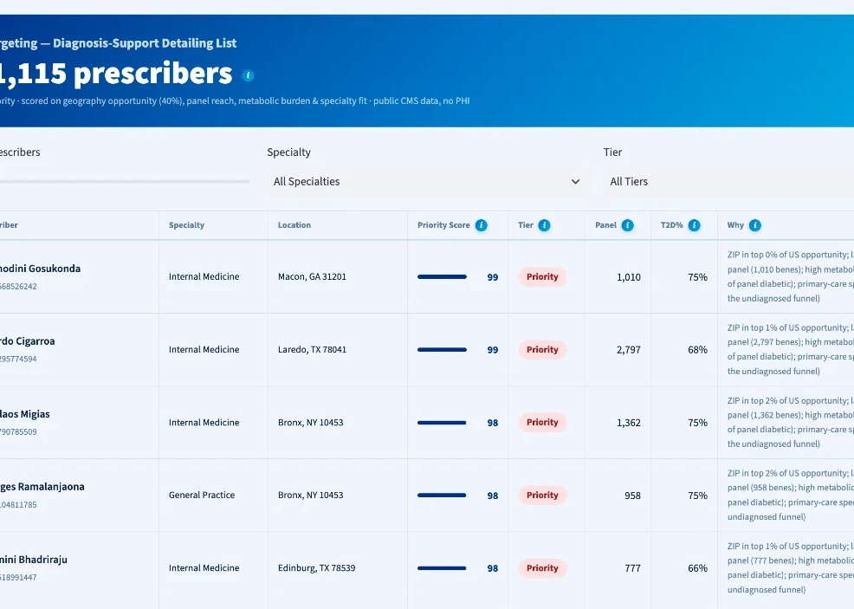
From hot ZIPs to a rep’s Monday call list
40% Geography — ZIP opportunity percentile at the practice address
25% Reach — Medicare panel size percentile
20% Burden — share of panel already diabetic
15% Fit — primary care owns the undiagnosed funnel
One real row: “ZIP in top 6% of US opportunity; 1,840-bene panel, 68% diabetic; primary care.”
Every row exports CRM-ready with a plain-language why. Public CMS aggregate data only — scores rank conversation value, never prescribing quality.
Notes:
From hot ZIP codes to a rep’s Monday call list. The HCP priority score blends 40 percent geography, 25 reach, 20 panel burden, 15 specialty fit. Every row exports CRM-ready with a plain-English why: ZIP in top 6 percent of US opportunity; 1,840-beneficiary panel, 68 percent diabetic; primary care. Public CMS aggregate data only — it ranks where a diagnosis-support conversation is most valuable, never individual prescribing quality.

Slide 7
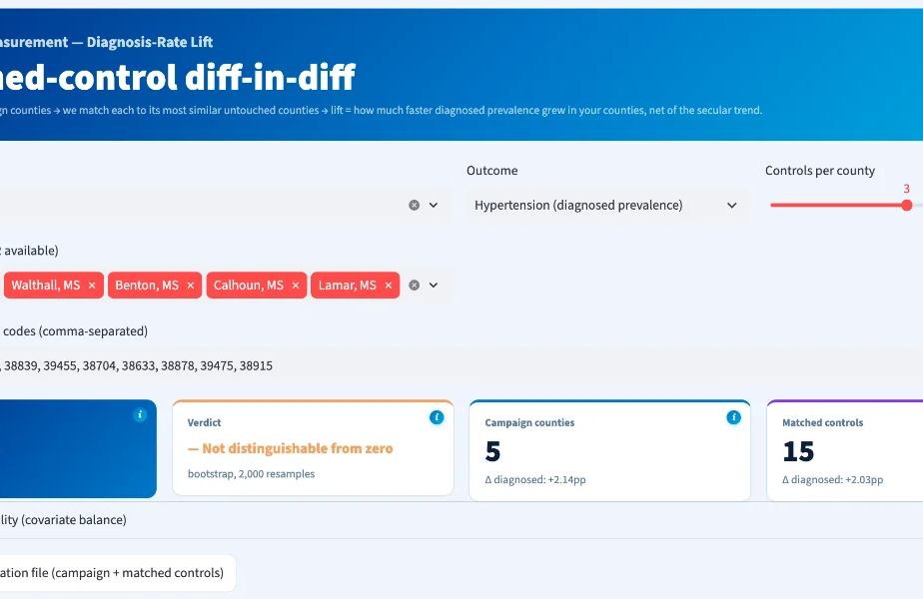
Campaign ROI, measured like a clinical trial
1 Pick campaign counties — select or paste FIPS
2 Auto-match controls — k-nearest statistical twin counties
3 Pre-register both lists — locked before launch
4 Diff-in-diff lift — vs controls, bootstrap 95% CI
Validated: recovers a known +1.5pp synthetic lift within ±0.3pp; a real-data placebo reads not significant — it refuses to hallucinate lift.
Notes:
The part nobody else does: measurement. Pick campaign counties, we auto-match statistical twins on baseline prevalence, SDoH, income and rurality, pre-register both lists before launch, then read diagnosis-rate lift versus controls with a bootstrap 95 percent confidence interval. Validated: it recovers a known synthetic lift within plus or minus 0.3 points, and a real-data placebo correctly reads not significant. It refuses to hallucinate lift.

Slide 8
Designed to survive your analysts
60+ automated QA gates
Confidence grades A/B/C
Fail-loudly data contracts on every pipeline — corrupt or degraded data cannot ship. Re-run live on the dashboard’s provenance page.
Every county graded on true pre-imputation source coverage: 3,123 A, 21 B. Low-coverage geographies can’t masquerade as corroborated.
Full provenance page
No black box anywhere
Source, vintage, real coverage and refresh date for all 11 datasets — computed from the exact files behind the current session.
Percentile ranks, weight sensitivity exposed — and the seams disclosed: modeled payer mix and the hypothyroid proxy are labeled as such in the app.
Notes:
Built for due diligence — designed to survive your analysts. Sixty-plus QA gates re-run live on the provenance page. A/B/C confidence grades on true pre-imputation coverage. And the honest answer on the weakest data, delivered proudly: payer mix beyond MA penetration is modeled and hypothyroidism is a proxy — both labeled as such in the app. We would rather show you the seams than have you find them.

Slide 9
Does the score beat a spreadsheet?
Lift over a naive baseline
Temporal out-of-time test
Every number is reported against the 5-minute Excel version — rank by population × prevalence. Ranking is judged on Spearman ρ; the model earns its keep only if it beats that. Δρ = [ __ ].
Score frozen on the old PLACES vintage predicts the diagnosis-gap move in the new one — coherence, not curve-fitting. Runs today on repo data. ρ = [ __ ] vs baseline [ __ ].
Predicts a source it never saw
More than a poverty map
Held out USRDS CKD prevalence — never ingested — and the composite still tracks it. A model, not a restatement of its own inputs. ρ = [ __ ] vs baseline [ __ ].
Diagnosis Gap adds independent signal over an SDoH-only model: ΔR² = [ __ ]. If it added nothing, the honest read is “a well-built access map.” The test is built to be able to fail.

Slide 10
Three plays, one platform
Market expansion
MA Stars partnership
Territory design + proof
Starr County, TX scores #1 of 3,144: 26% diabetes prevalence, a huge detection deficit. SPPF hands a GLP-1 brand 24 Priority counties, ZIP heatmaps, and the internists with 60–75% diabetic panels — before a claims dollar is spent.
Counties with 40%+ MA penetration and high diagnosis gaps are co-funding opportunities: plans earn Stars and HEDIS credit for the screening pharma wants run. The payer view ranks them and sizes the dual-eligible upside.
Territory Builder assembles rep geographies ZIP-by-ZIP; the measurement engine then proves last cycle’s diagnosis-rate lift to justify next cycle’s budget — a renewable engagement, not a one-off report.
Notes:
Three plays, one platform. A GLP-1-era brand team gets Starr County, Texas — number one of 3,144, 26 percent diabetes prevalence — its ZIP heatmaps and the exact internists with 60 to 75 percent diabetic panels, before a single claims dollar is spent. Market access gets the MA Stars co-funding counties. Field forces get territory design plus proof of last cycle’s lift — a renewable engagement, not a one-off report. If asked whether this is demand creation: undiagnosed T2D and hypertension cause strokes, amputations and dialysis — every year of delayed diagnosis costs the patient and the system more. SPPF targets screening programs, not prescriptions, and the measurement engine holds campaigns accountable for diagnosis-rate lift, not scripts. The rare case where the commercial incentive and the public-health good point the same direction.

Slide 11
Upstream of claims — and better together
Claims & Rx analytics see…
SPPF sees…
Diagnosed, treated patients
Rich longitudinal detail, patient-level
Post-diagnosis market-share battles
Licensing cost, DUAs, PHI governance
The pre-diagnosis whitespace claims can’t
Every US geography, no sampling gaps
Zero PHI, zero licensing, procurement-light
Where the next diagnosed patient comes from
Every IQVIA asset — claims, LRx, OCE — starts after diagnosis: the product boundary, not a criticism. SPPF is the demand-generation layer upstream — it creates the diagnosed patients every downstream product then tracks, and claims verify the new diagnoses quarterly. A new SKU for an existing sales force.
Notes:
SPPF does not compete with a single claims product — every claims asset starts after diagnosis; that is the product boundary, not a criticism. SPPF is the demand-generation layer upstream of that boundary: it creates the diagnosed patients every downstream asset then tracks. The integration play: targeting from public data, measurement sharpened by claims — each layer makes the other more valuable.

Slide 12
The MVP is live. Here’s the roadmap.
NOW
NEXT
THEN
Working MVP
Condition modules
Claims-sharpened measurement
11-view dashboard, 3,144 counties, 33,791 ZIPs, 411k HCPs, measurement engine, 35-test CI suite — all public data, open for audit.
Every condition with a silent pool: CKD (~90% of early stages undiagnosed), MASH, COPD, AFib, GLP-1-adjacent metabolic expansion — each a config file on the same engine.
Quarterly lift windows via claims integration, Veeva CRM push, and a formal validation study against NHANES measured-vs-reported ground truth.
Notes:
The MVP is live today — 11 dashboard views, 3,144 counties, 33,791 ZIPs, 411 thousand HCPs, the measurement engine, a 41-test CI suite, all public data, open for audit. Next: condition modules — CKD, where roughly 90 percent of early stages go undiagnosed, MASH, COPD, AFib — any condition with a silent pool, each a config file on the same engine. Then claims-sharpened quarterly measurement and validation against NHANES ground truth.

Slide 13
One pilot brand. One condition. 90 days.
One market opportunity assessment — 90 days to a measurable diagnosis-rate story.
Land — $25–75k market opportunity assessment, brand-director budget
Expand — $150–400k/yr multi-brand platform license with quarterly measurement
Renew — the measurement loop turns a report into a subscription
Zorawar Singh Nandwal
Live demo
·
zorawarnandwal@gmail.com
·
github.com/zorawar91/silent-patient-pool-finder
Notes:
The ask: one pilot brand, one condition, one market opportunity assessment — 90 days to a measurable diagnosis-rate story. The commercial mechanics: land at $25–75k on brand-director budget, expand to a $150–400k platform license, and the measurement loop is the renewal engine — it turns a report into a subscription. Thank you.

Slide 14
Backup — the two hardest questions
“Isn’t this just demand creation?”
“Is this diagnosing patients?”
Undiagnosed T2D and hypertension cause strokes, amputations and dialysis — every year of delayed diagnosis costs the patient and the health system more. SPPF targets screening programs, not prescriptions: payer partnerships, community health centers, pharmacy screening. And the measurement engine holds campaigns accountable for diagnosis-rate lift — not scripts. The commercial incentive and the public-health good point the same direction.
No — and it can’t, by design. SPPF is a population-level planning tool, not a clinical diagnostic instrument. It never sees an individual patient: all eleven datasets are aggregate, county- or ZIP-level public data. It answers where screening effort will find the most undiagnosed people; every actual diagnosis happens through a licensed clinician, in the normal standard of care.
Notes:
Hold this slide for Q&A — do not present it. Deliver both answers without defensiveness: the ethics answer ends on the incentive alignment, the diagnostic answer ends on the licensed-clinician line.

Slide 15
Backup — if the analysts push harder
“Aren’t you just rediscovering poverty?”
“Can we trust the undiagnosed number?”
No. Fit an SDoH-only baseline, then add the Diagnosis Gap dimension: it carries independent predictive value — ΔR² = [ __ ], partial r = [ __ ] controlling for social determinants. High-opportunity is not the same as high-deprivation; the gap dimension moves the ranking on its own. And every number is reported as lift over a population × prevalence baseline, so the composite must beat the naive map to survive at all. If it doesn’t on your data, that is a finding we report — not one we bury.
Treat it as an interval, never a point: population × prevalence × (1 − diagnosis-rate proxy) × published undiagnosis rate, shown as a low–central–high band (e.g. 38k–52k, central 45k). The absolute count is labeled directional; the ranking is the robust deliverable. A backdated IQVIA claims cut then calibrates the count to real local diagnosis rates and runs one falsifiable test: does the public-data prioritization predict where diagnoses actually landed? If Δρ ≤ 0, the undiagnosed-targeting thesis is not supported — and we say so.

