Slide 1

Development of Secure Framework for Prevention of Crypto-Currency Crimes and Prevention of Money Laundering Using Blockchain
Under
Dr. Santosh Kumar
Chief Investigator, Assistant Professor
Department of Computer Science and Engineering
IIIT Naya Raipur, Chhattisgarh.

Slide 2
Outline
Basic Terminologies
Introduction
Motivation
Problem Statement and Proposed Solution
Types of Cryptocurrency Crimes
Proposed Methodology
Models to Detect Fraud Transactions
CBDC
CBDC v Cryptocurrency - Issues
Payment Gateway
Crypto Wallet - Metamask

Slide 3
Basic Terminology
Cryptocurrency : Cryptocurrency, sometimes also called crypto-currency or crypto, is any form of currency that exists digitally or virtually and uses cryptography to secure transactions.It does not have a central issuing or regulating authority, instead using a decentralized system to record transactions and issue new units.
Blockchain : Blockchain technology is a decentralized, distributed ledger that stores the record of ownership of digital assets.
Bitcoin : Bitcoin is a type of cryptocurrency,a virtual currency designed to act as money and a form of payment outside the control of any one person, group, or entity, and thus removing the need for third-party involvement in financial transactions.

Slide 4
Cryptocurrency crimes: Crimes which take place in the transactions having Cryptocurrency as the currency or the spending unit.There has been an increase in the percentage of these crimes in recent years.Cryptojacking is another term for it which is the unauthorized use of someone else's compute resources to mine cryptocurrency.
Money Laundering: Money laundering is the illegal process of making large amounts of money generated by criminal activity, such as drug trafficking or terrorist funding, appear to have come from a legitimate source. The money from the criminal activity is considered dirty, and the process “launders” it to make it look clean.

Slide 5
Introduction
Bitcoin was the first decentralised virtual money to emerge in 2009. While prior virtual currencies used centralised companies as intermediaries, this new currency gained popularity due to the lack of a third party involved in the transactions.
The revolutionary nature of this type of currency did not allow an immediate legislative and enforcement response. AML (Anti-Money Laundering) and KYC(Know-Your-Customer) processes were not originally designed to cater for cryptocurrencies.
Criminals, in particular cybercriminals, took advantage of the favourable environment and started using cryptocurrencies for trading on the dark web and as part of fraud and extortion schemes. Bitcoins have always been traceable and are not completely anonymous.
Another well known issue is that it opens the possibility for exploits on Bitcoin is the transaction malleability problem.

Slide 6
Motivation of the Project
The Future of Cryptocurrency
To fix the problems of traditional currencies by putting the power and responsibility to the users.
Financial Institutions(Cryptocurrency Exchange Platform)
Boosting the World Economy and Development
Useful and safe for people using Digital Payments

Slide 7
Problem Statement and Proposed Solution
To develop a secure framework for the prevention of cryptocurrency crimes and money laundering using blockchain.
Proposed Solution:
Developing a blockchain based website for transaction process and implementing various algorithms to detect and prevent cryptocurrency crime during online transactions using chain analysis, elliptic curve, limiting transactions in a day, video kyc verification and various anti-money laundering solutions.

Slide 8
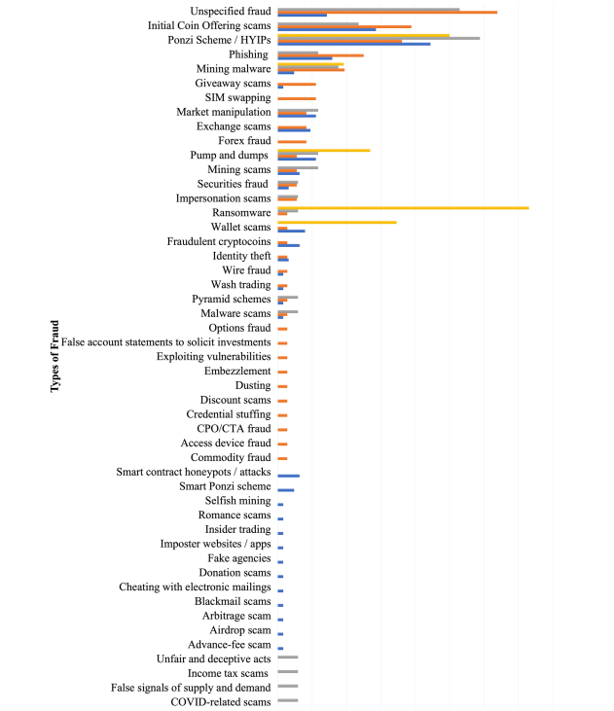
Types of Cryptocurrency Crimes

Slide 9
Proposed Methodology
The first stage of the proposed framework recommends all potentially suspicious activity, such as tracking money laundering accounts and cryptocurrency activity for systematic long-term monitoring of transactions.
The second stage, on the other hand, manually detects highly suspicious accounts and evaluates multiple transaction flows for small accounts at various time intervals.
CBDC v Cryptocurrency - Comparative Analysis
Payment Gateway for secure transactions

Slide 10
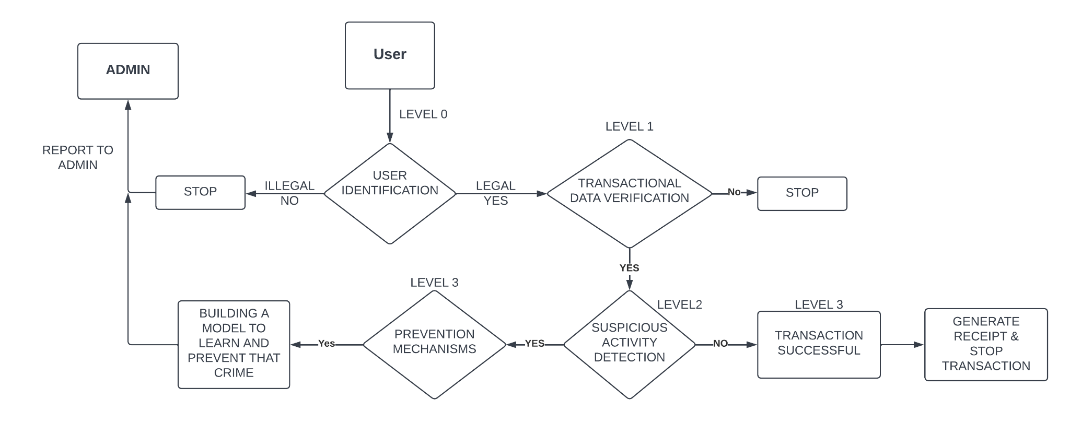
Work Flow of Proposed Methodology

Slide 11
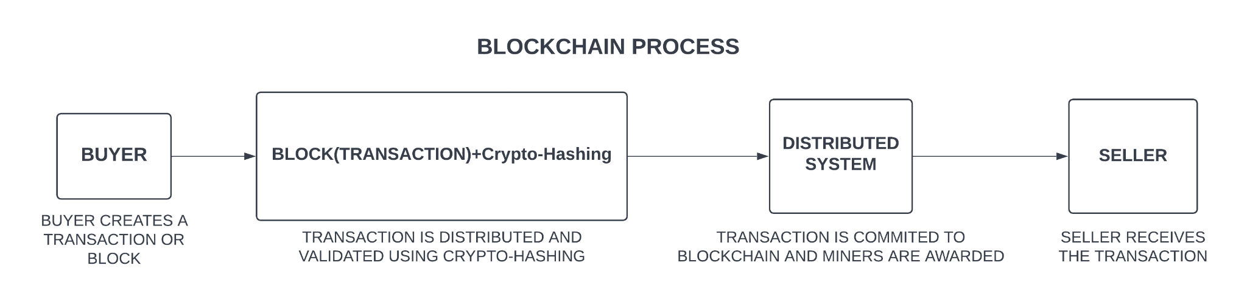
Blockchain

Slide 12
Model To Detect Fraud Transaction
PROCEDURE:
Using Apache Spark Mlib
Anomaly(Fraud)
Detection
Comparing Diff. Algorithms
Choosing the best Algorithm

Slide 13

Apache Spark
Data processing framework
general-purpose distributed processing system used for big data workloads
For large data sets
Used in different languages(Java,Python,Scala,R,etc.)
Supports code reuse across multiple workloads—batch processing, interactive queries, real-time analytics, machine learning, and graph processing.

Slide 14
Spark Framework:
Spark Core - foundation for the platform
Spark SQL - for interactive queries
Spark Streaming - for real-time analytics
Spark MLlib - for machine learning
Spark GraphX - for graph processing

Slide 15
Different Types of Algorithms Applied
Decision Tree classifier
Random Forest classifier
Logistic regression

Slide 16
Decision Tree Classifier Algorithm
Supervised Learning technique
Classification and Regression problems
Tree structured classifier
Two types of Nodes
Decision Node
Lead Node

Slide 17
FLOWCHART
genratedCoins(gc) & TxCount
if gc >5 or TxCount >10
if TxCount > 1
Anomaly
(Fraud)
Normal Tx
if gc >5
if gc < 7
Anomaly
(Fraud)
Normal Tx
if gc <=5
Normal Tx
if TxCount <=10
**From the dataset we used TxCount and generatedCoins as features
Normal Tx

Slide 18
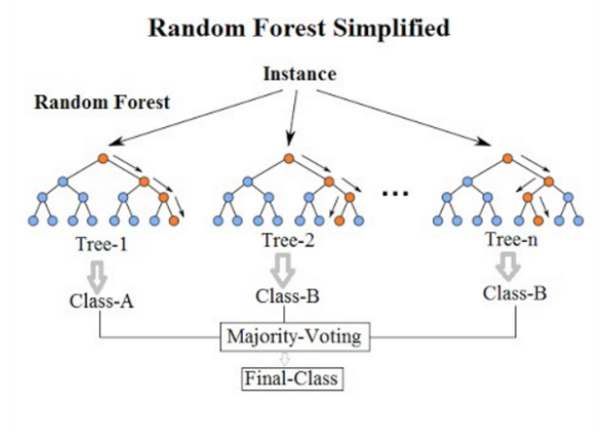
Random Forest Classifier Algorithm
Supervised Learning technique
Classification and Regression problems
contains various decision trees classifier
based on ensemble learning
more number of trees,better accuracy

Slide 19
Logistic Regression
Supervised Learning technique
used for Classification problems
S-Shaped Logistic Function
predicts the categorical dependent variable
probabilistic value between 0 to 1

Slide 20
Logistic Regression
Data Preprocessing step
Fitting Logistic Regression to the Training set
Predicting the test result
Test accuracy of the result(Creation of Confusion matrix)
Visualizing the test set result.

Slide 21
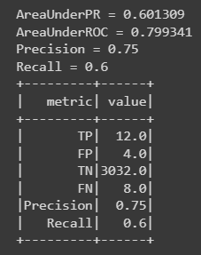
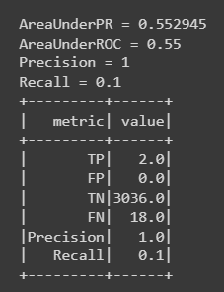
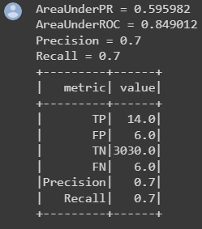
Comparing The Algorithms
Random Forest Classifier Logistic Regression Decision Tree Classifier

Slide 22
Choosing the Best Algorithm
Performance is analysed based on two parameters:
Total running time (time taken to predict the results)
Accuracy(based on F1 Score)
Algorithm Total Running Time(in sec) Accuracy(%)
LOGISTIC REGRESSION | 9 | 84.86
DECISION TREE CLASSIFIER | 5 | 89.32
RANDOM FOREST CLASSIFIER | 6 | 98.18
On the basis of Performance of the applied algorithms:
Random Forest Classifier - best algorithm suited

Slide 23
2. Model To Detect Fraud Transaction
PROCEDURE:
Using Bitcoin Transaction Dataset
Anomaly(Fraud)
Detection
One SVM and K-Cluster
Detecting the Outliers

Slide 24
Anomaly(Fraud) Detection Model Over
Blockchain Electronic Transactions
Electronic transactions with crypto becoming popular
But with good reputation comes the serious anomalies and risks
To detect the anomalies(outliers) - One Class SVM
To group the similar outliers having same type of anomalies -
K-Clustering

Slide 25
Model Framework
Raw Data
Feature Selection
Normalised
Data
Specify the type of attack based on similarity indices
(Clustering)
K-Means
DDOS Attack
Training Data
Testing Data
Double Spending Attack
One Class
SVM
Other Attacks
Outliers Detection

Slide 26
Anomaly(Fraud) Detection
Data Collection and Parsing
Feature Selection
Evaluation methods

Slide 27
Feature Selection
In the dataset mentioned above, we can any select any two of the following features:
• Blockchain size
• TxCount: the number of transactions completed per day
• TxVolume: the total output volume with the addition of an algorithm which attempts to remove change from the total value.
• generatedCoins:Total number of unique Bitcoin transactions per day.
• Avg block size
*In our model,we chose Txcount and generatedCoins as the features.

Slide 28
Evaluation Methods
Procedure:
applying a behavioral analysis by using the One-Class SVM algorithm to detect outliers.
applying the K-means clustering algorithm to gather similar attacks in order to specify their types.

Slide 29
One Class SVM
Unsupervised learning technique
differentiates the test samples of a particular class from other classes
minimizing the hypersphere of the single class of examples in training data
considers all the other samples outside the hypersphere to be outliers or out of training data distribution.

Slide 30
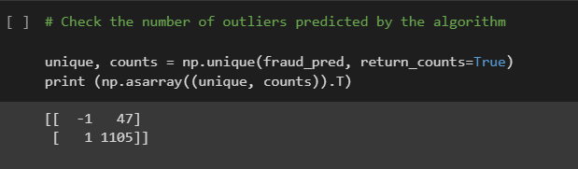
Results
A score will be given to the One Class SVM anomaly detection model for each type of outputting a decision, (1) if normal transaction or (−1) if fraud transaction

Slide 31
CBDC
It stands for Central Bank Digital Currency
Legal tender issued by a central bank in digital form
same as a sovereign currency and is exchangeable (1:1)at par with the fiat currency
Different from existing digital payment modes.

Slide 32
Forms of CBDC
CBDC can be classified into two forms based on structure:
Token-based
Account based
Token based | Account based
bearer-instrument like banknotes, meaning whosoever holds the tokens at a given point in time would be presumed to own them | require maintenance of record of balances and transactions of all holders of the CBDC and indicate the ownership of the monetary balances
In token-based CBDC, the person receiving a token will verify that his ownership of the token is genuine | In an account-based CBDC, an intermediary verifies the identity of an account holder
preferred mode for CBDC-R | preferred mode for CBDC-W

Slide 33
Types of CBDC
CBDC can be classified into two broad types based on usage:
Retail CBDC (CBDC-R)
Wholesale CBDC(CBDC-W)
RETAIL CBDC | WHOLESALE CBDC
potentially available for use by all viz. private sector, non-financial consumers and businesses | designed for restricted access to select financial institutions
electronic version of cash primarily meant for retail transactions. | for the settlement of interbank transfers and related wholesale transactions
can provide access to safe money for payment and settlement as it is a direct liability of the Central Bank | basic merit of this type is the ease, convenience, and safety of financial transactions.

Slide 34
Benefits of CBDC
A CBDC could result in transactions that are much faster, less expensive, and more secure, benefiting everyone involved.
Consumers would not have to take the risk of storing their money with a commercial bank that could fail. Their funds are safe as long as their country's central bank is stable.
Money is considerably easier to trace in this manner since all CBDC transactions are recorded on a digital ledger.
In countries that create retail CBDCs, consumers can get direct access to central bank funds. Many countries have large unbanked populations, and CBDCs could help solve this problem.
CBDC also helps in implementing anti-money laundering (AML) and combating financial terrorism (CFT) measures by acting as a highly secure way for cross-border transactions

Slide 35
Cryptocurrency vs CBDC
CBDCs is not a cryptocurrency however they are inspired by cryptocurrencies because of the blockchain mechanism which is used in both.
The primary distinction between CBDCs and cryptocurrencies is centralization. A cryptocurrency is a decentralised digital money, which means it is not controlled by a single entity where as CBDCs are controlled by Central Bank
Cryptocurrency also provides much greater privacy than CBDCs. Transactions are sent and received using wallet addresses, thus some degree of anonymity is feasible. With a CBDC, the central bank will have a record of users and their transactions.

Slide 36
Challenges of CBDC
Many technological issues might occur, such as internet access, particularly in remote regions, compatibility with current systems, or cyber threats.
It may make it even more difficult for some parts of the population to access and use new technology and related digital services, which, if not handled effectively, may result in financial exclusion of certain segments.
If not properly constructed, the issuing of a CBDC may have substantial ramifications for financial stability, since it may result in bank disintermediation and negative implications for banks' primary business.
Threat to privacy

Slide 37
THANK YOU!!

