Slide 1
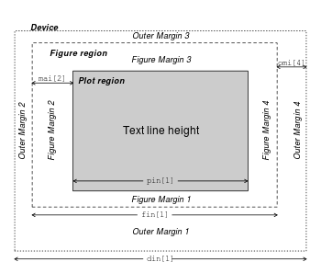

Slide 2
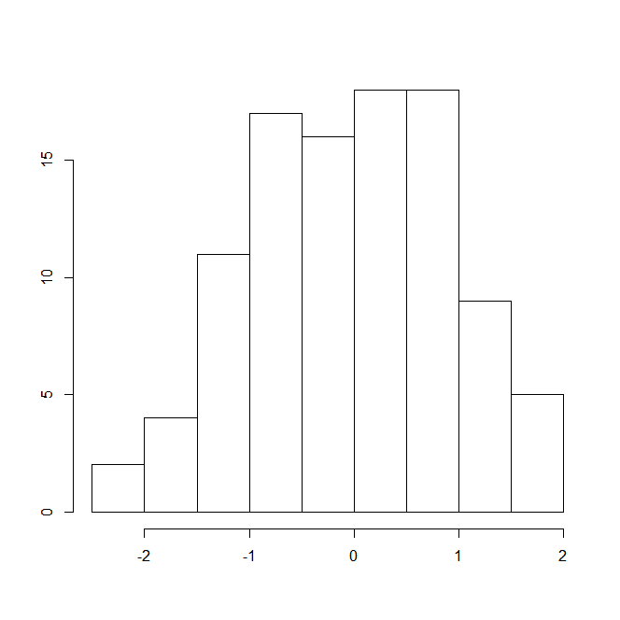
Outer margin3
Figure region
Figure margin3
Plot region
Outer margin4
Figure margin2
Figure margin4
Outer margin2
Figure margin1
Outer margin1

