Slide 1
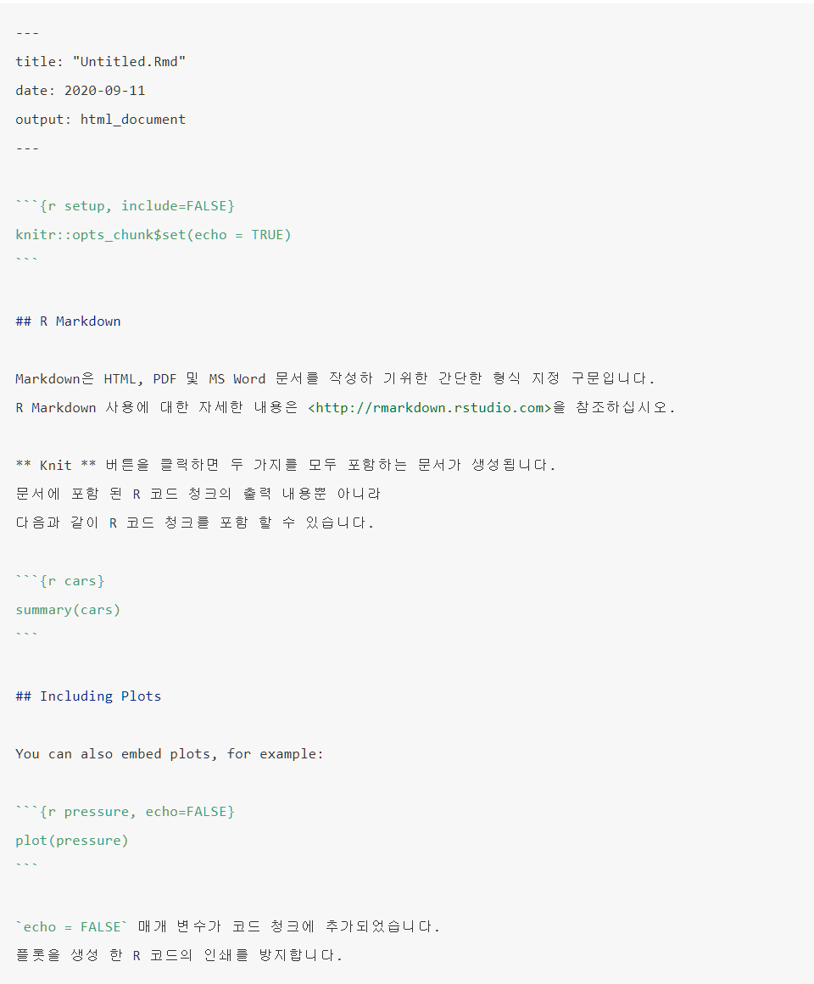
YAML
Code
Text

