Slide 1
Multilingual Neural Machine Translation and Knowledge Distillation vs Code-Mixing
Exploring model robustness for noise when using Knowledge Distillation for handling Code-Switched and Code-Mixed data (WIP)

Slide 2
Overview
Motivation – Why?
Research Questions – What?
Knowledge Distillation
OpusDistillery
Data
Models
Results
To-Do – When (will I be done?)

Slide 3
Motivation
Language Normalization
[L1][L2][L1] → [L1][L1][L1]
Translation models struggle with noisy data
Code-mixing and code-switching are becoming more common due to globalization
Based on increase in research shown by Zhong et al. (2023)
Naturally occurring noise is becoming more common for translation tasks
Knowledge Distillation can improve performance and dealing with noise
Can Knowledge Distillation improve robustness of dealing with naturally occurring code-mixing and code-switching?
BONUS: smaller models → faster, more energy efficient, can run locally

Slide 4

Motivation
Language Normalization
[L1][L2][L1] → [L1][L1][L1]
Translation models struggle with noisy data
Code-mixing and code-switching are becoming more common due to globalization
Naturally occurring noise is becoming more common for translation tasks
Knowledge Distillation can improve performance and dealing with noise
Can Knowledge Distillation improve robustness of dealing with naturally occurring code-mixing and code-switching?
BONUS: smaller models → faster, more energy efficient, can run locally
Energy efficiency/
Low energy requirement
Fast performance
Meet demand for robust models
Picture source: https://imgflip.com/memegenerator/206999279/Epic-Handshake-3-arms

Slide 5
Research Questions
How robust are multilingual Machine Translation models for Language Normalizing tasks when using (sequence-level) Knowledge Distillation
Can further compression of models improve robustness in Language normalization tasks?
Why? Reduction of multimodality
Described by Gu et al. (2017)
The variety in which languages can be expressed -> streamlining the process of creating a consistent output vs a variable input

Slide 6
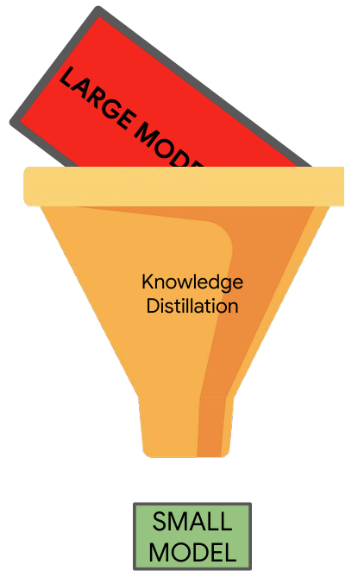
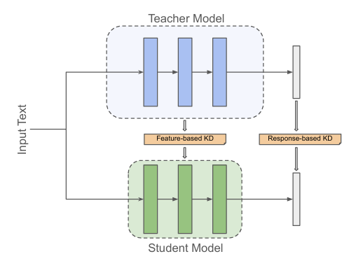
Knowledge Distillation
Picture source: Knowledge Distillation for Machine Translation – Presentation by Ona de Gibert and Joseph Attieh

Slide 7
Knowledge Distillation
Response-based
Sequence-level
Word-level
Feature-based
Layer distillation
Relation-based
Take relation of samples
into account
Picture source: Knowledge Distillation for Machine Translation – Presentation by Ona de Gibert and Joseph Attieh

Slide 8
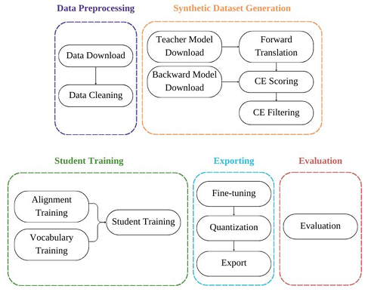
OpusDistillery
Pipeline for Knowledge Distillation
Based on Bergamot project tools
Firefox Translations Training pipeline
Uses MarianNMT as framework
Utilizes OpusFilter
Specialized for Opus-MT models
Also supports Huggingface teachers
Sequence-level KD
Takes care of everything
Picture source: Knowledge Distillation for Machine Translation – Presentation by Ona de Gibert and Joseph Attieh

Slide 9
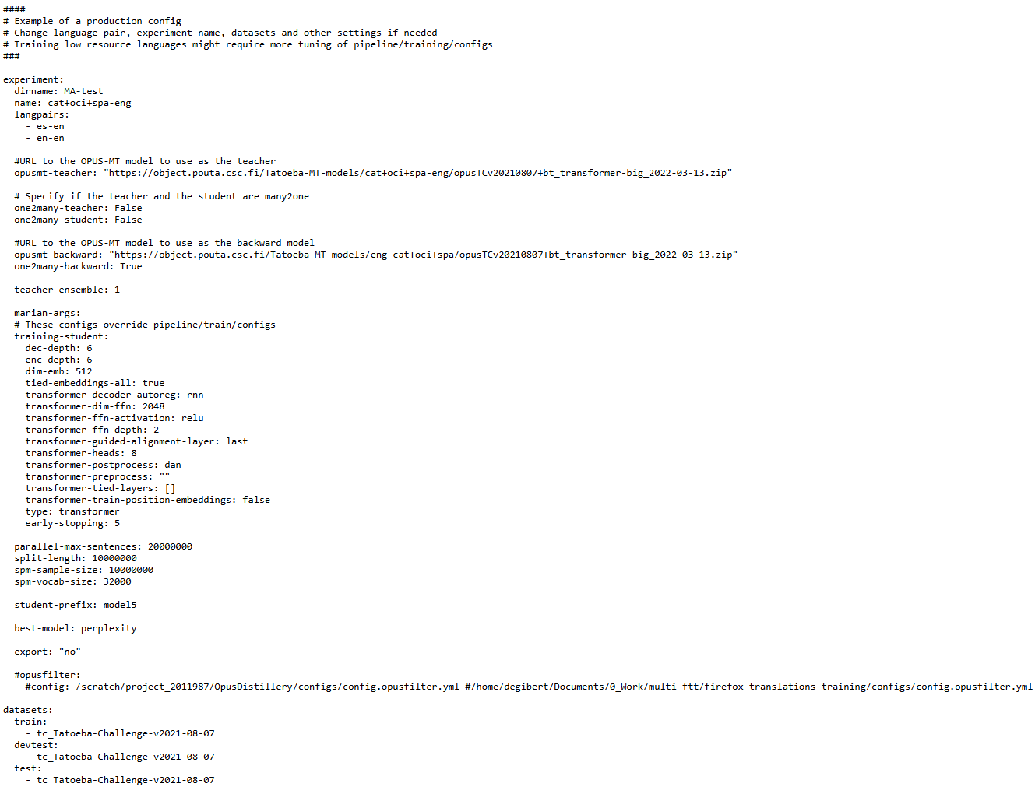
OpusDistillery
Picture source: Knowledge Distillation for Machine Translation – Presentation by Ona de Gibert and Joseph Attieh

Slide 10
Models
Teacher models:
Model 1:
Tatoeba-MT-models/mul-mul/opusTCv20230926+bt+jhubc_transformer-big_2024-08-17
Model 2:
Tatoeba-MT-models/cat+oci+spa-eng/opusTCv20210807+bt_transformer-big_2022-03-13
Model 3:
Tatoeba-MT-models/deu+eng+fra+por+spa-mul/opusTCv20230926max50+bt+jhubc_transformer-big_2024-05-30

Slide 11
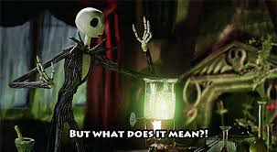
Models
Teacher models:
Model 1:
Tatoeba-MT-models/mul-mul/opusTCv20230926+bt+jhubc_transformer-big_2024-08-17
Model 2:
Tatoeba-MT-models/cat+oci+spa-eng/opusTCv20210807+bt_transformer-big_2022-03-13
Model 3:
Tatoeba-MT-models/deu+eng+fra+por+spa-mul/opusTCv20230926max50+bt+jhubc_transformer-big_2024-05-30
Picture source: https://i.imgflip.com/3o2bfu.jpg?a481440

Slide 12
Models
Teacher models:
Model 1:
Tatoeba-MT-models/mul-mul/opusTCv20230926+bt+jhubc_transformer-big_2024-08-17
Model 2:
Tatoeba-MT-models/cat+oci+spa-eng/opusTCv20210807+bt_transformer-big_2022-03-13
Model 3:
Tatoeba-MT-models/deu+eng+fra+por+spa-mul/opusTCv20230926max50+bt+jhubc_transformer-big_2024-05-30

Slide 13
Models
Tatoeba-MT-models/cat+oci+spa-eng/opusTCv20210807+bt_transformer-big_2022-03-13
Model group

Slide 14
Models
Tatoeba-MT-models/cat+oci+spa-eng/opusTCv20210807+bt_transformer-big_2022-03-13
Model group
Supported languages
Catalan
Occitan
Spanish (Castilian)
English

Slide 15
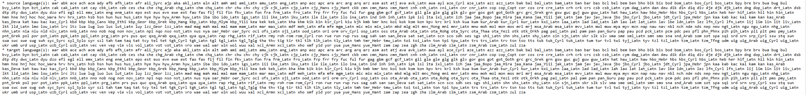
Models
Tatoeba-MT-models/cat+oci+spa-eng/opusTCv20210807+bt_transformer-big_2022-03-13
Model group
Supported languages
Catalan
Occitan
Spanish (Castilian)
English

Slide 16
Models
Tatoeba-MT-models/cat+oci+spa-eng/opusTCv20210807+bt_transformer-big_2022-03-13
Model group
Supported languages
Training set
Tatoeba Corpus version 07.08.2021

Slide 17
Models
Tatoeba-MT-models/cat+oci+spa-eng/opusTCv20210807+bt_transformer-big_2022-03-13
Model group
Supported languages
Training set
Backtranslations
Obtained from Wikipedia dumps

Slide 18
Models
Tatoeba-MT-models/cat+oci+spa-eng/opusTCv20210807+bt_transformer-big_2022-03-13
Model group
Supported languages
Training set
Backtranslations
Architecture
Transformer_big, introduced in Vaswani et al. (2017)

Slide 19
Models
Tatoeba-MT-models/cat+oci+spa-eng/opusTCv20210807+bt_transformer-big_2022-03-13
Model group
Supported languages
Training set
Backtranslations
Architecture
Date

Slide 20
Models
Model Type | Model Architecture | Number of layers (encoder & decoder | Word vector dimension | Feed-forward dimension | Number of heads
Teacher | Transformer-big | 6 | 1024 | 4096 | 16
Student 1st Iteration | Transformer | 6 | 512 | 2048 | 8
Student 2nd Iteration | Transformer-tiny | 6 & 2 | 256 | 1536 | 8
Numbers source: Vaswani et al. (2017), students/train-student/models/student.tiny11/student.tiny11.yml

Slide 21
Data
Training Data
Same as teacher
Tatoeba corpus 07.08.2021 (only used by cat+oci+spa-eng)
Tatoeba Corpus 26.09.2023
Limited to 20M samples
Es-En, En-En
Example pair:
Source Es: Sé que tienes un millón de otras cosas en tu plato.
Target Es: I know you have a million things on your plate.
Source En: We're only talking about a small amount that's missing...
Target En: We're only talking about a small amount that's missing...

Slide 22
Data
Independent test data
Difficult to find
Code-mixing/Code-Switching
Naturally occurring
Manually translated
Aguilar, G., Kar, S., & Solorio, T. (2020) introduced LinCE Benchmark
Collection of web-crawled data from Twitter
Language ID, POS-Tagging, NER, Sentiment Analysis, Machine Translation
Code-switching, Code-mixing included
Naturally occurring
Manually translated

Slide 23
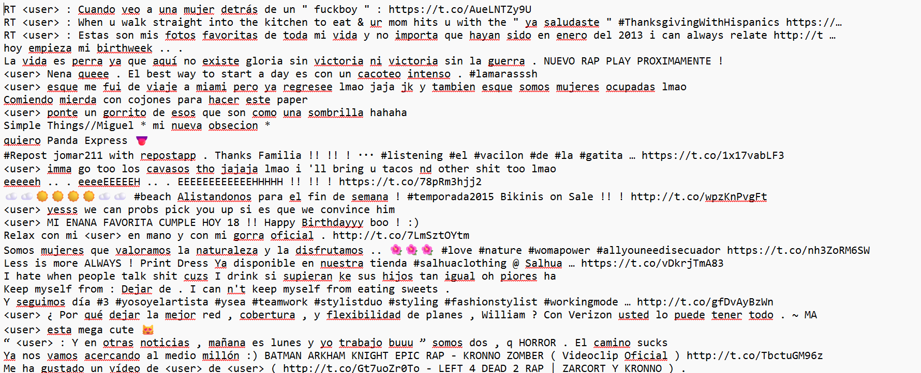
Data
Independent test data
Difficult to find
Code-mixing/Code-Switching
Naturally occurring
Manually translated
Aguilar, G., Kar, S., & Solorio, T. (2020) introduced LinCE Benchmark
Collection of webcrawled data
Code-switching, Code-mixing included
Naturally occurring
Manually translated

Slide 24
Data
Independent test data
Difficult to find
Aguilar, G., Kar, S., & Solorio, T. (2020) introduced LinCE Benchmark
Spanglish-English: 15,000 training samples, 6,500 test sentences
Issues:
Noisy
Code-mixing and code-switching sometimes limited to 1 word
Gold label sentences not available
Evaluation on Lince website
Metrics: BLEU
Similarity score for automatic evaluation of Machine Translation
Introduced by Papineni et al. (2002)
Quick and widely used

Slide 25
Results
What has happened so far
Trained and evaluated 5 students
Teacher: cat+oci+spa-eng
Transformer size
Trained and evaluated 5 baseline models
Transformer size
Training for other students is in progress
Training for second baseline set is finished
Training for transformer-tiny sizes will start once all transformer size models are trained

Slide 26
Results
Not gold label sentences for detailed analysis?
Cosine Similarity
Good measure to check multimodality
Low cosine similarity can also indicate that models have trouble producing a good translation or any translation
Calculate average cosine similarity between all models in a set
Rank average cosine similarities
Find common sentences that models seem to have issues with

Slide 27
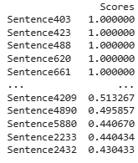
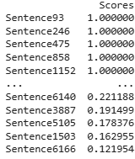
Results
Student models
131 sentences with 1 average cosine score
Baseline models
78 sentences with 1 average cosine score

Slide 28
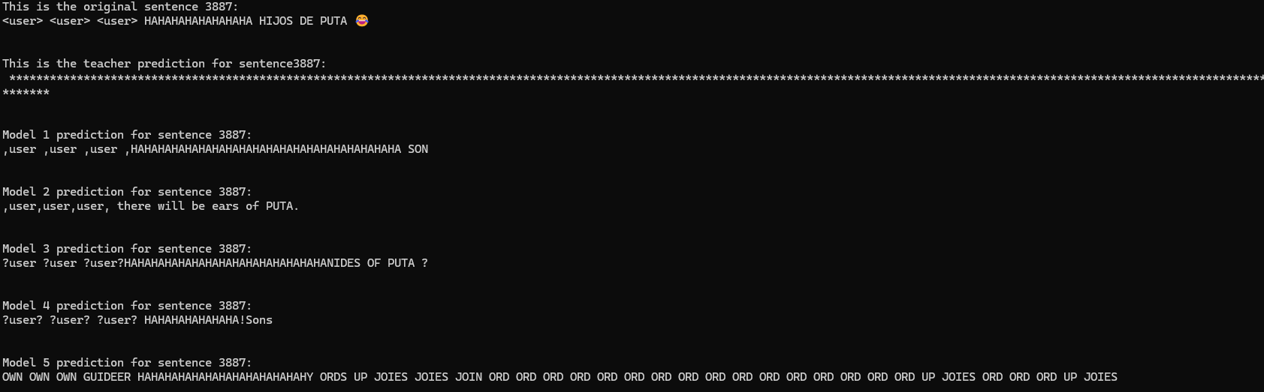
Results
Not gold label sentences for detailed analysis?
Cosine Similarity
Good measure to check multimodality
Low cosine similarity can also indicate that models have trouble coming up with a good translation or any translation
Calculate average cosine similarity between all models in a set
Rank average cosine similarities
Find common sentences that models seem to have issues with

Slide 29
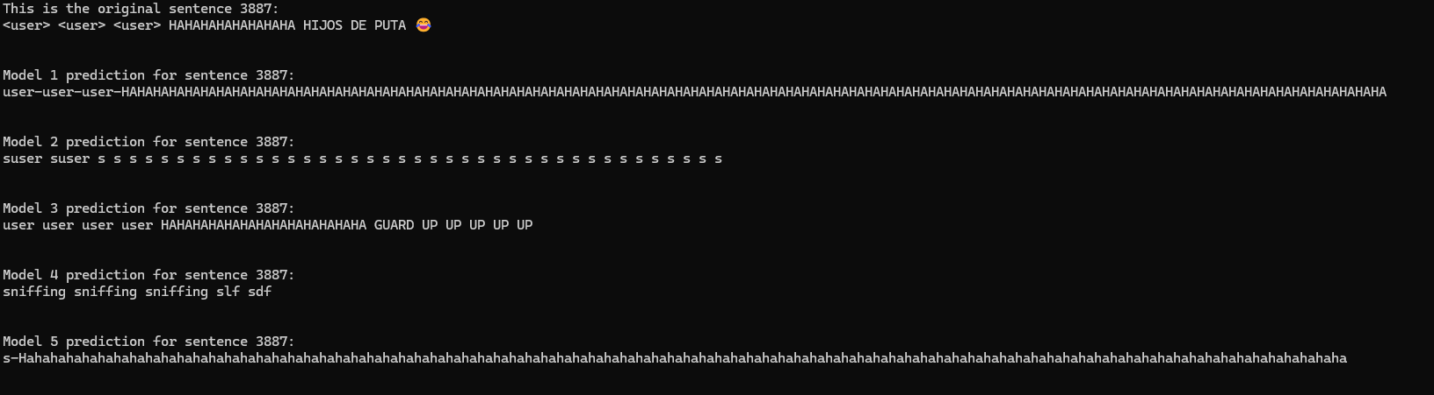
Results
Not gold label sentences for detailed analysis?
Cosine Similarity
Good measure to check multimodality
Low cosine similarity can also indicate that models have trouble coming up with a good translation or any translation
Calculate average cosine similarity between all models in a set
Rank average cosine similarities
Find common sentences that models seem to have issues with

Slide 30
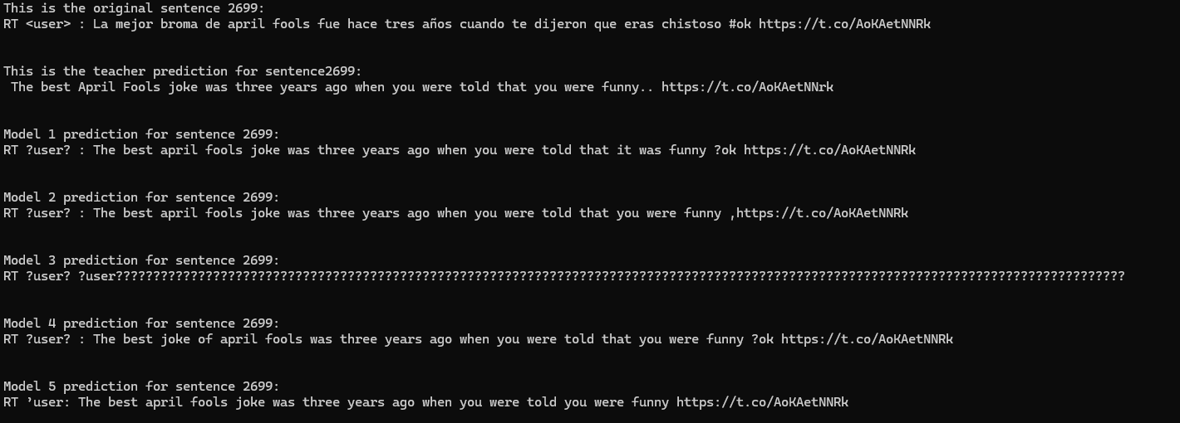
Results
Not gold label sentences for detailed analysis?
Cosine Similarity
Good measure to check multimodality
Low cosine similarity can also indicate that models have trouble coming up with a good translation or any translation
Calculate average cosine similarity between all models in a set
Rank average cosine similarities
Find common sentences that models seem to have issues with

Slide 31
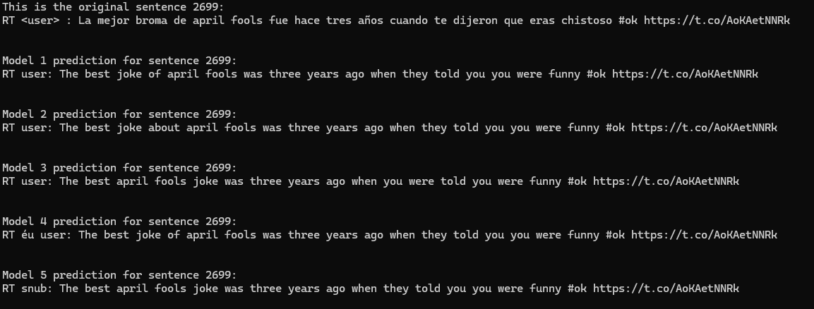
Results
Not gold label sentences for detailed analysis?
Cosine Similarity
Good measure to check multimodality
Low cosine similarity can also indicate that models have trouble coming up with a good translation or any translation
Calculate average cosine similarity between all models in a set
Rank average cosine similarities
Find common sentences that models seem to have issues with

Slide 32
Results
Model | BLEU for test set | BLEU for independent test set
Teacher | Es-En: 62.3 ; En-En: 65.0 | 40.18
Student 1 | Es-En: 68.6 ; En-En: 56.7 | 42.15
Student 2 | Es-En: 68.8 ; En-En: 57.2 | 41.98
Student 3 | Es-En: 68.9 ; En-En: 57.6 | 41.99
Student 4 | Es-En: 68.0 ; En-En: 57.5 | 42.34
Student 5 | Es-En: 68.6 ; En-En: 57.1 | 41.37
Baseline 1 | Es-En: 65.8 ; En-En: 55.3 | 43.12
Baseline 2 | Es-En: 66.7 ; En-En: 55.2 | 42.62
Baseline 3 | Es-En: 64.3 ; En-En: 55.2 | 40.94
Baseline 4 | Es-En: 66.3 ; En-En: 56.7 | 42.05
Baseline 5 | Es-En: 62.3 ; En-En: 57.6 | 40.69

Slide 33
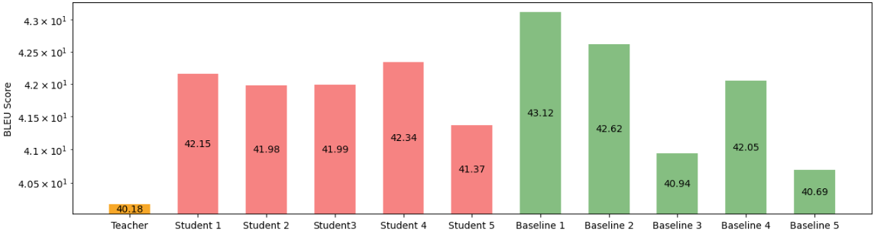
Results
P-value between Student and baseline: 0.87552
Student Mean: 41.966
Baseline Mean: 41.884

Slide 34
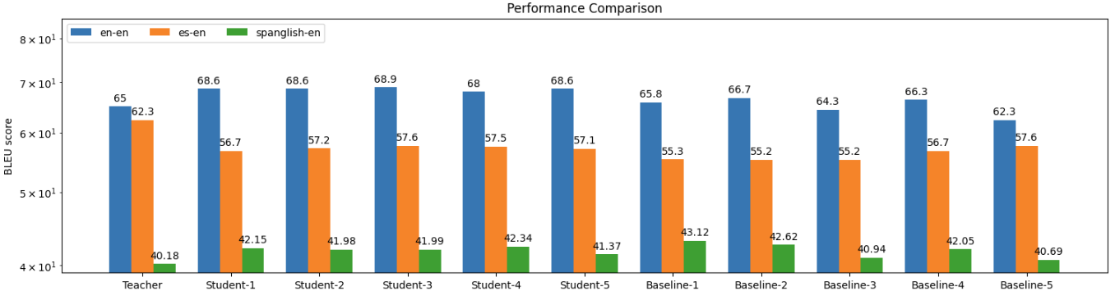
Results
Teacher: 37% reduction in BLEU
Student: 33% reduction of BLEU
Baseline: 30% reduction of BLEU

Slide 35
To-Do
Train the rest of the models
Get performance scores
Compare scores properly
(possibly) use Marian scorer to score independent test set translations to facilitate detailed analysis

Slide 36
Identified limitations
Student and baseline models are trained on far less languages than their teachers
Test data is very noisy, even though it is naturally occurring
Makes analysis of the effect of code-mixing difficult
→identify sentences which are less noisy and simply include code-mixing and code-switching in order to assess translation quality and differences

Slide 37
Conclusion
Student models and baseline models show better noise handling
More information and data is needed to confirm this
First results are interesting
Much more work needs to be done

Slide 38

Thank you for your attention!
You were great!
Any questions?

Slide 39
Any questions?

