Slide 1
SE-315 Cloud Computing · Semester Project
Lakehouse Architecture with Apache Iceberg, Spark and Trino using CDC Ingestion
Group 04: Aliyan Zulfiqar (leader) and Sehrosh Riaz
NUST Balochistan Campus (NBC), Department of Computer Science
PostgreSQL
Debezium
Kafka
Spark
Iceberg
Trino
Notes:
Introduce the team and the topic: a lakehouse that keeps an analytical copy of a live PostgreSQL database up to date through change data capture. Our assigned Apache projects were Iceberg and Spark. The strip at the bottom is the whole pipeline, which we will unpack over the next slides.

Slide 2
Problem statement
1
2
3
Analytics on live data
Batch ETL is stale
What we need
Analysts need current OLTP data, but heavy queries must not load the operational database.
Nightly ETL leaves reports out of date and copies whole tables on every run.
Fresh, correct and cheap-to-query history: stream only the changes, keep every version.
Our answer: capture every committed change with CDC and merge it into open Iceberg tables that any SQL engine can read.
Notes:
Running analytics directly on the production database competes with the application for resources. Classic batch ETL avoids that but is always behind and wastes work by re-copying unchanged rows. We want a copy that is fresh within seconds, provably identical to the source, and still fast to query, including its history.

Slide 3
Goals and evaluation metrics
Goal | How we measure it
CDC freshness | Commit → visible in Trino (p50 / p95)
Ingestion throughput | Rows/s initial load, records/s per batch
Query latency | 8 queries, median of 5 runs, before/after
Small files and storage | File counts, avg file size, MinIO bytes
Correctness | Row counts + checksum() vs PostgreSQL
Datasets
TPC-H sf1
1,650,030 rows: orders 1.5M, customer 150k, nation, region
Synthetic OLTP workload
Continuous inserts, updates and deletes against live tables
Source: README.md (evaluation metrics), results/ingest_load.json
Notes:
These five goals map one-to-one onto the measurements in our benchmark, so every number later in the deck answers one of them. TPC-H at scale factor 1 gives a realistic 1.65 million row starting point, and the generator then keeps inserting, updating and deleting rows so the pipeline is always under live load.

Slide 4
Solution architecture
PostgreSQL 16
logical WAL
Debezium
Kafka Connect
Kafka (KRaft)
topic per table
Spark Streaming
foreachBatch MERGE
Iceberg v2
merge-on-read
REST catalog
JDBC store in PostgreSQL
Airflow
maintenance DAGs
Spark jobs
compact · expire · purge
MinIO (S3)
data + metadata files
Monitoring
Exporter
freshness · lag · files
Prometheus
metrics + alerts
Grafana
pipeline dashboard
Trino 476
SQL + time travel
Notes:
A workload generator writes to PostgreSQL; Debezium reads the write-ahead log through a logical replication slot and publishes one Kafka topic per table. Spark Structured Streaming merges each micro-batch into Iceberg tables whose metadata sits in a REST catalog and whose files live in MinIO, and Trino queries them. Airflow schedules the Spark maintenance jobs, and a custom exporter feeds Prometheus and Grafana. Locally everything runs in Docker; in the cloud each box maps to a managed service such as Event Hubs, Databricks and ADLS Gen2.

Slide 5
CDC and ingestion design
Logical replication with the pgoutput plugin (wal_level=logical)
Debezium snapshots existing rows, then streams every change to one topic per table: pg.shop.<table>
Iceberg format v2, merge-on-read: updates write small delete files instead of rewriting data files
Kafka checkpoint + idempotent MERGE = effectively-once results
Each micro-batch (foreachBatch), per table
Schema discovery: read the schema in the event, create or evolve the table
1
Dedupe by key: keep only the latest change per primary key
2
One MERGE INTO: deletes, updates and inserts in a single commit
3
Commit snapshot: retried with backoff if compaction commits first
4
Source: docs/architecture.md, src/topologies/spark/cdc_to_iceberg.py
Notes:
Debezium reads committed changes from the WAL, so the source database does no extra query work. On the Spark side each micro-batch is handled in foreachBatch: discover and evolve the schema, keep only the newest change per key, and apply everything with one MERGE. Because the MERGE is idempotent and the Kafka offsets are checkpointed, replaying a batch after a crash gives the same table state.

Slide 6
Schema evolution and time travel
Schema evolution (automatic)
Time travel (every batch is a snapshot)
ALTER TABLE … ADD COLUMN in PostgreSQL becomes a new Iceberg column
int → bigint widening is applied in place
No restart and no data rewrite
Old rows read NULL for the new column (schema-on-read)
SELECT * FROM orders
FOR VERSION AS OF <id>;
SELECT * FROM orders
FOR TIMESTAMP AS OF <ts>;
$snapshots lists every commit
Change audit: current version EXCEPT an older one
Source: scripts/demos/schema_evolution.sh, scripts/demos/time_travel.sh
Notes:
In the demo we run ALTER TABLE in PostgreSQL and the new column appears in Iceberg without restarting the stream. Iceberg keeps every committed snapshot, so Trino can query the table as of a snapshot id or a timestamp. Comparing two versions with EXCEPT gives a simple audit of exactly what changed.

Slide 7
Optimisation with Airflow + Spark
orders: partition evolution to months(o_orderdate), sorted by o_orderdate, o_custkey
customer: sorted by c_nationkey, c_custkey
Layout + compact
Rewrite deletes
Expire snapshots
Remove orphans
43.9 s
22.8 s
23.1 s
67.7 s
Apply partition spec and sort order, sorted rewrite of data files
Rewrite position-delete files and manifests
Drop old snapshots and the files only they used
Delete unreferenced files (24 h minimum age)
DAG iceberg_layout_optimization wall time: 169.8 s · an hourly iceberg_maintenance DAG does routine compaction
Source: results/benchmark-20261007-181123/summary.md (compaction overhead), docs/architecture.md
Notes:
Streaming leaves tables unpartitioned with many small data and delete files, so Airflow runs Spark Iceberg procedures to fix the layout. Partition evolution means the new monthly spec applies without rewriting history by hand, and the sorted compaction clusters related rows together. The full optimisation run took 169.8 seconds, which is the compaction overhead we pay for the faster queries on the results slides.

Slide 8
GDPR erasure (extra credit)
1
2
3
DELETE in PostgreSQL
Still reachable
Purge DAG
CDC writes a position-delete file. The row disappears from the current snapshot.
Older snapshots still point at the original data file, so time travel returns the row.
iceberg_gdpr_purge rewrites the data files and expires history. The data is physically gone.
A merge-on-read delete hides a row; only rewriting the files and expiring the snapshots erases it.
Source: scripts/demos/gdpr_delete.sh, DAG iceberg_gdpr_purge
Notes:
A right-to-erasure request is the case where Iceberg's history works against us. The delete reaches Iceberg as a delete file, so current queries no longer see the row, but a FOR VERSION AS OF query on an older snapshot still does. The purge DAG rewrites the affected files without the row and expires the old snapshots, and after that the data cannot be recovered through time travel.

Slide 9
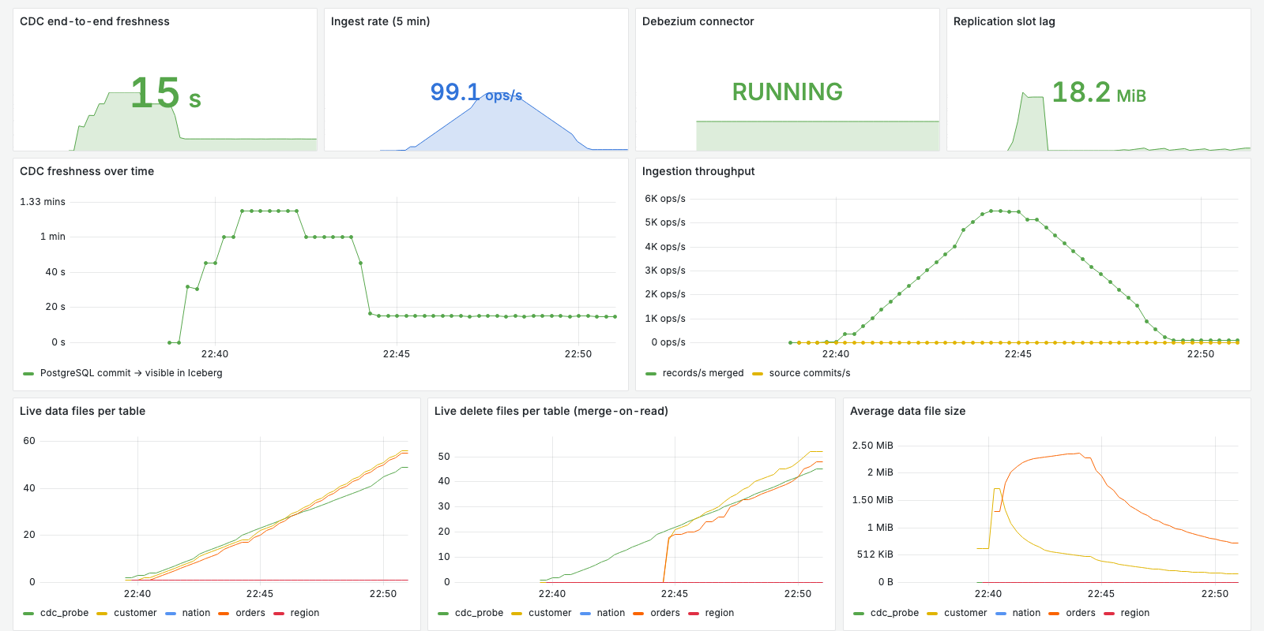
Monitoring and alerting
Prometheus alert rules
CdcFreshnessHigh
freshness > 120 s for 2 min
DebeziumConnectorDown
connector not RUNNING
ReplicationSlotLagHigh
retained WAL > 512 MB
SmallFilesAccumulating
> 500 data files, avg < 8 MB
Grafana "Lakehouse CDC pipeline" dashboard (16 panels) fed by a custom exporter
StreamingStalled
no batch for 10 min, changes pending
Source: docs/report/grafana_dashboard.png, config/monitoring/alerts.yml
Notes:
The exporter measures what matters for a lakehouse: end-to-end freshness with a heartbeat row, replication-slot lag, ingest rate, and file health per table. The screenshot is from a load run, where you can see freshness rise during the bulk load and settle once it finishes. The alert rules turn those signals into actions, for example the small-files alert tells us to run compaction.

Slide 10
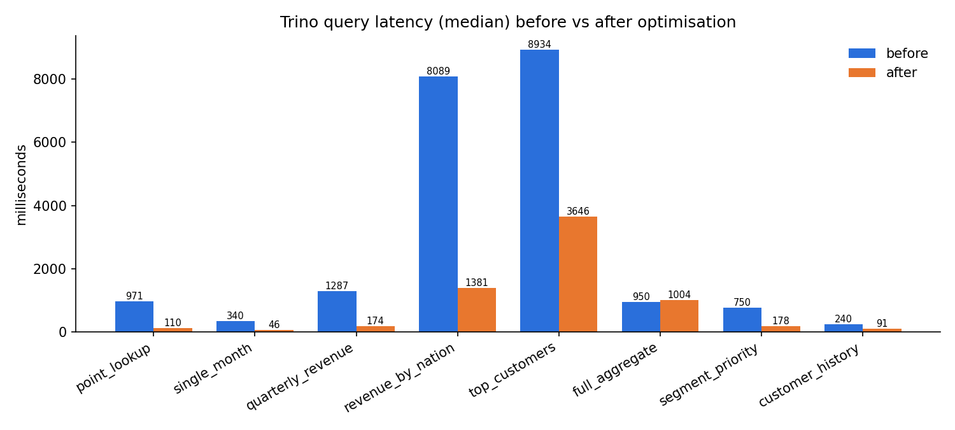
Results: query latency
3.25×
faster overall: 21.6 s → 6.6 s for the 8 queries
8.81×
point lookup: 971 → 110 ms
19,488
rows scanned for one month, down from 1,513,192
Full-table aggregate (q06) is flat at 0.95×: it reads every row either way, so there is nothing to prune.
Source: results/benchmark-20261007-181123/summary.md (Trino, median of 5 runs)
Notes:
Eight Trino queries were run five times each before and after optimisation and we report the median. The whole suite went from 21.6 to 6.6 seconds, a 3.25 times speed-up, with the largest gains on selective queries where monthly partitions and sorting let Trino skip files. The full aggregate did not improve, which is expected because it has to read every row anyway.

Slide 11
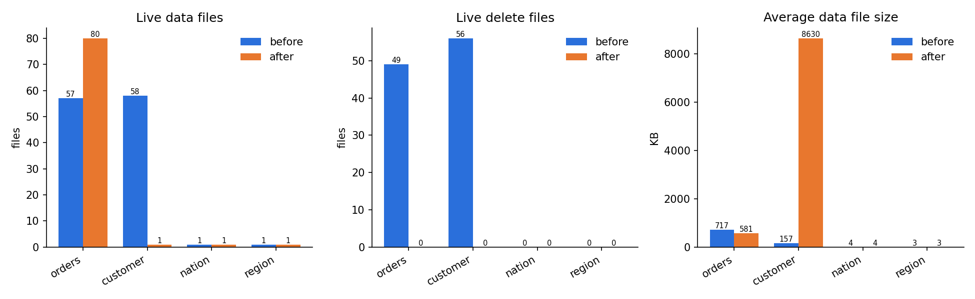
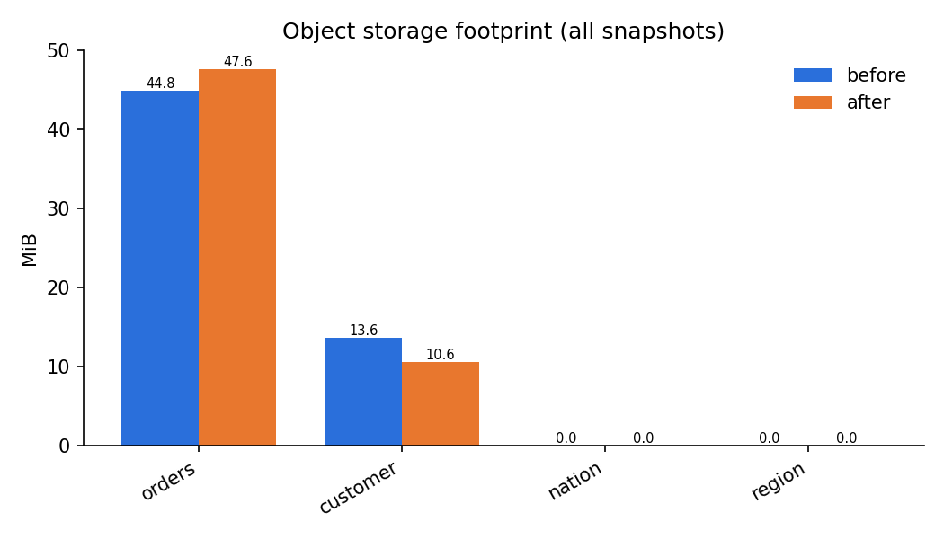
Results: small files and storage
105 → 0
live delete files (orders 49, customer 56)
57 → 1
orders snapshots after expiry (customer 58 → 1)
Trade-off: orders went from 57 to 80 files and +6.2% storage (44.8 → 47.6 MB), because monthly partitions split it into smaller files.
−22.4%
customer storage: 58 small files → 1
Source: results/benchmark-20261007-181123/summary.md
Notes:
Compaction applied all 105 delete files and expiry cut each table's history to a single snapshot. The customer table shows the classic small-file fix: 58 files of about 157 KB became one file of 8.6 MB and storage dropped 22.4 percent. Orders is the honest exception: partitioning by month produced 80 files and 6.2 percent more storage, which is the partition-granularity trade-off we discuss in the report.

Slide 12
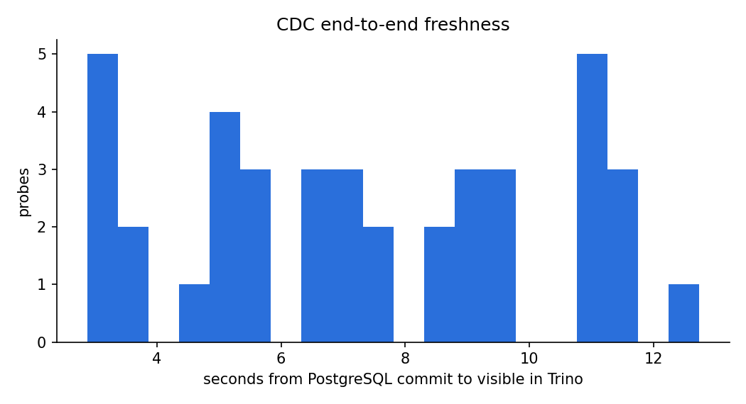
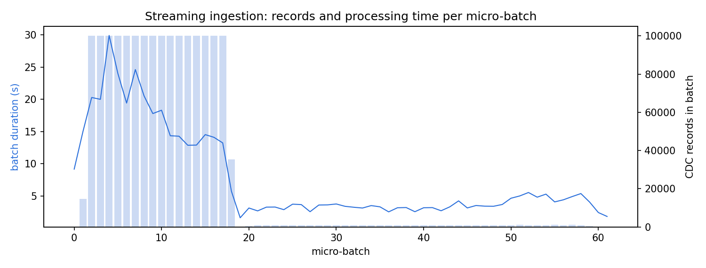
Results: ingestion, freshness, correctness
4,843.5
3,574.9
7.3 s
4 / 4
rows/s initial load (1,650,030 rows in 340.7 s)
records/s streaming MERGE (peak batch 7,751.9)
freshness p50 (p95 11.73 s, 40/40 probes)
tables: row counts and checksums match
Source: results/benchmark-20261007-181123/summary.md, results/ingest_load.json, results/freshness.json
Notes:
The initial TPC-H load of 1.65 million rows was fully queryable in Iceberg after 340.7 seconds, and the streaming job sustained 3,574.9 records per second while processing. Under live load a committed row became visible in Trino after 7.3 seconds at the median and 11.73 seconds at p95, with no probe timing out. Row counts and checksums matched PostgreSQL for all four tables both before and after optimisation, so the copy is exact, not approximate.

Slide 13
Technical challenges
Challenge | Fix
SQLite REST catalog: SQLITE_BUSY under concurrent commits | Catalog moved to PostgreSQL (JDBC)
Spark MERGE fails with identifier fields (Iceberg 1.9) | Primary key kept as a table property
remove_orphan_files needs a Hadoop S3 filesystem | S3 listing via file_list_view (boto3)
Trino's 432 MB per-node memory too small for joins | Raised memory limits + spill-to-disk
Sorted rewrite of 1.5M rows: heap OOM in 1 GB driver | Resized job and container memory
Debezium JSON carries its schema (~3 KB/message) | zstd in Kafka; schema read by prefix
MinIO official Docker images withdrawn (2025) | Maintained community build
Whole stack must fit in Docker's 8 GB | Per-service limits; local-mode Spark
Source: docs/slides/SLIDES_BRIEF.md (technical challenges), docs/architecture.md
Notes:
These are the problems we actually hit, mostly from running concurrent commits and big rewrites on a single laptop. The catalog fix mattered most: SQLite returned HTTP 500 errors as soon as streaming and compaction committed at the same time, and PostgreSQL's transactional store solved it. Most of the rest came down to memory, since the whole stack had to fit inside 8 GB.

Slide 14
Conclusion and future work
What we showed
Future work
A complete CDC lakehouse running in Docker on one laptop
Fresh: 7.3 s median from commit to query
Correct: checksums match on all 4 tables
Optimised: 3.25× faster query suite, 105 delete files → 0
1
Hudi vs Iceberg: same workload, compare table formats
2
Apache Atlas: data lineage across the pipeline
3
Kubernetes / AKS: cloud deployment of the stack
4
Avro + Schema Registry: smaller events than JSON
5
Apache Flink: streaming engine alternative to Spark
Thank you. Questions?
Notes:
To sum up, the pipeline keeps an exact, queryable copy of the operational database a few seconds behind the source, and the Airflow maintenance jobs make it much faster to query. Next we would compare Hudi against Iceberg on the same workload, add lineage with Apache Atlas, and deploy on AKS with Avro and a schema registry. Then we invite questions.

