Slide 1
Droutine – Your Daily Skin Routine
Presenter: Zorka shindova, 61895

Slide 2
Contents
Project summary
Technologies used
APIs
Pages
What’s next?

Slide 3


Project Summary
The idea of the project is to provide a platform for users who need to set up their daily skin care routine but somehow struggle to do this by themselves
You can pick your fav products
You can then request a skin routine to be created specially for you
You can find answers to your skin related questions directly from experts in the area
You can browse for new products worth trying out

Slide 4
Project Summary – the tech way
The platofom is developed as two separate projects:
Client side project
Server side project
And of course .. A NO-SQL Database for the server

Slide 5
Technologies used
Client side
React
React Router
Material-UI
Axios
Server side
Node.js
Express
Mongoose
bcrypt
Jsonwebtoken
Database
Monogo DB

Slide 6
APIs
CRUD operations on Users
CRUD operations on Products
CRUD operations on Routines
Filter criteria on Products(Text search)

Slide 7

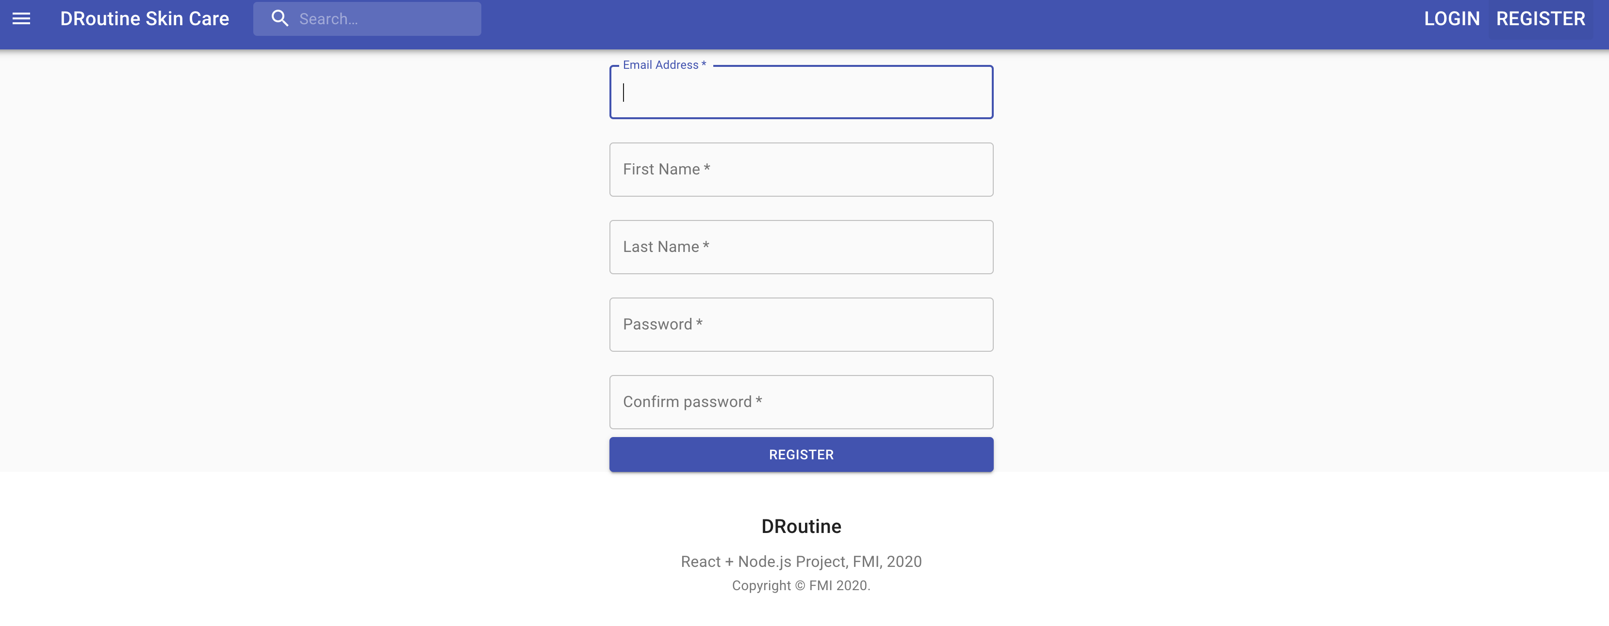


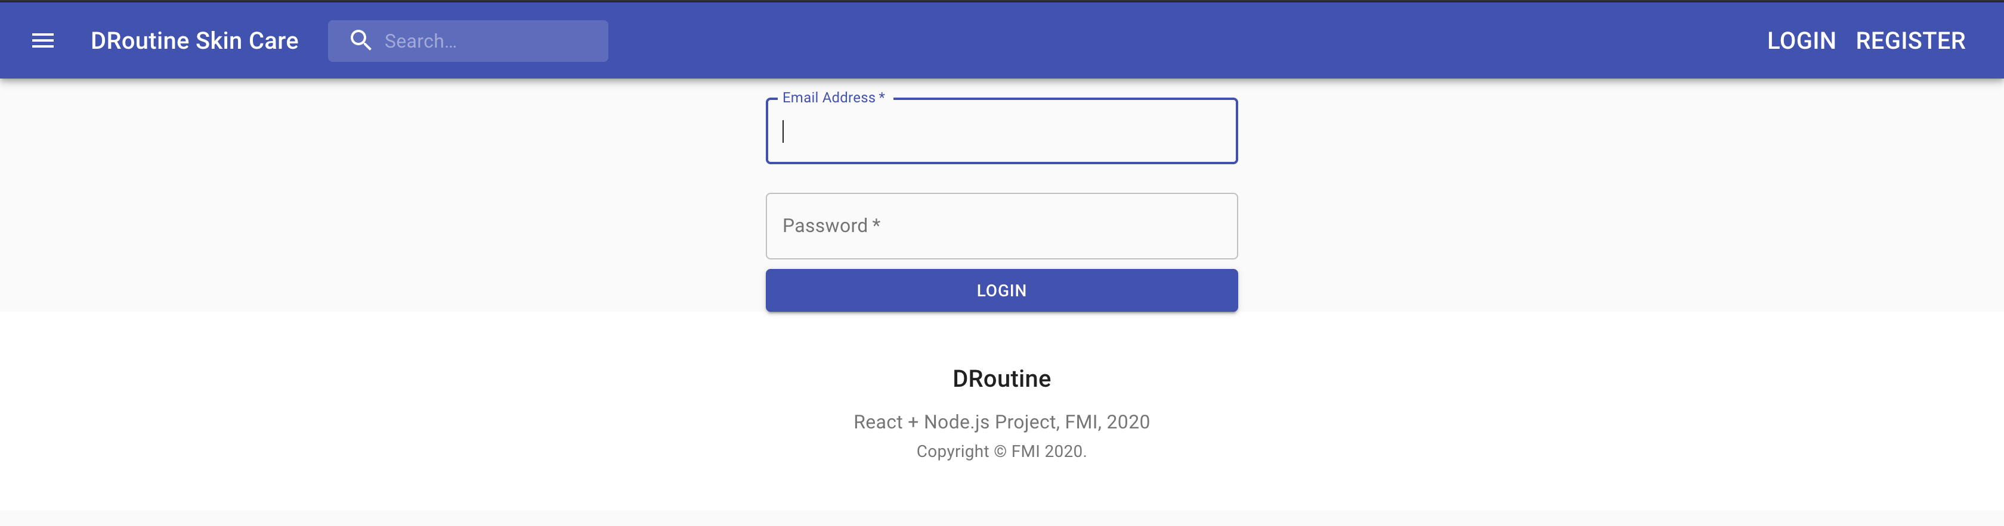
Pages – Login & Register

Slide 8
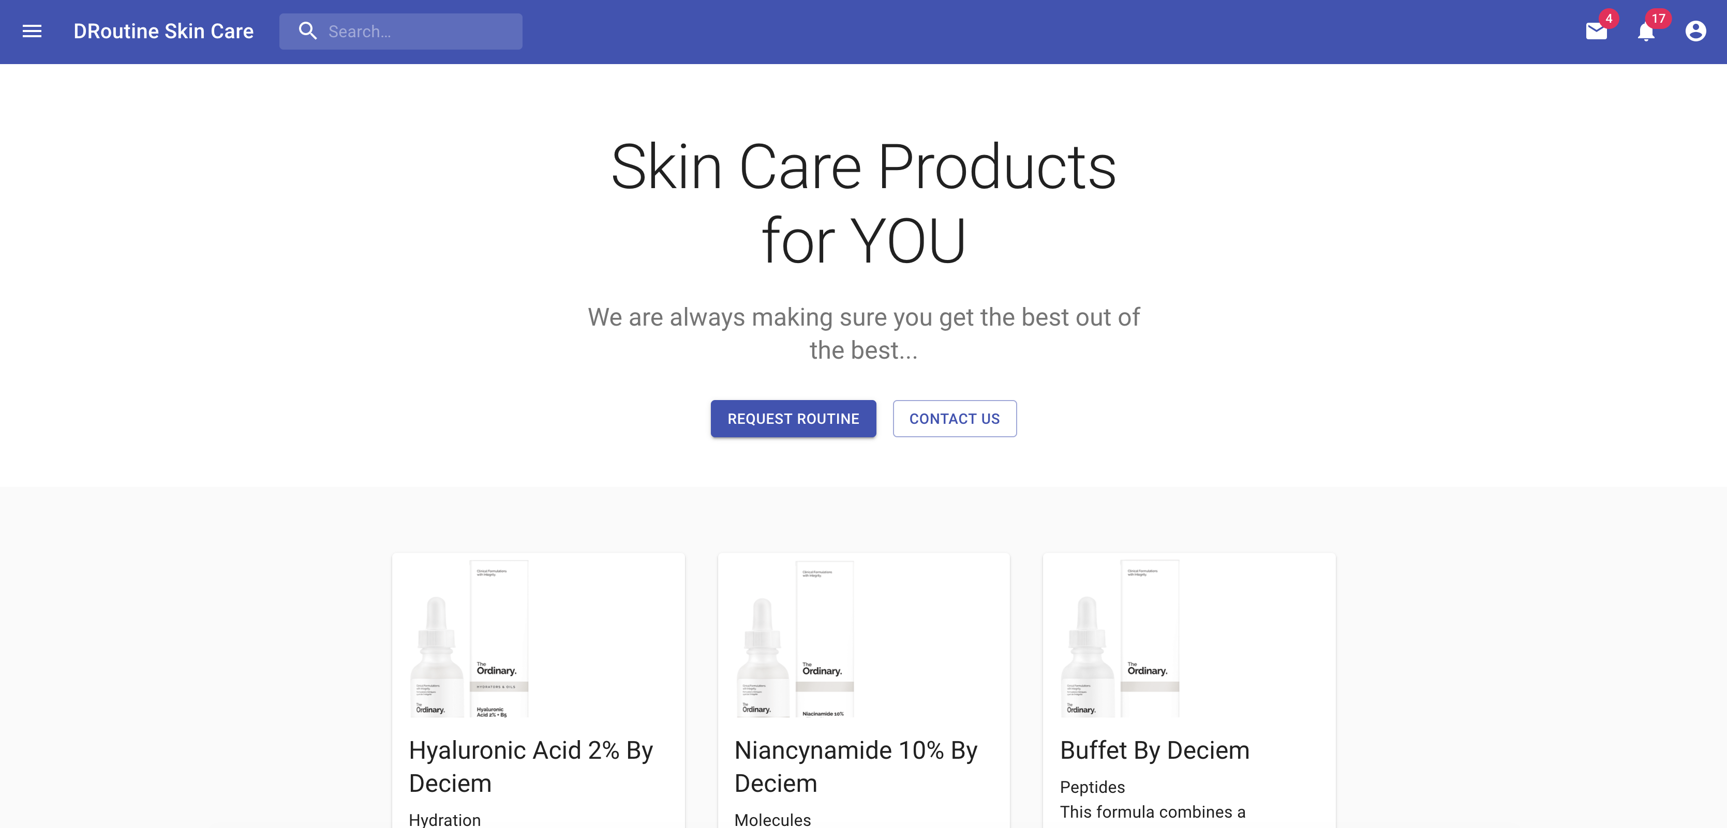
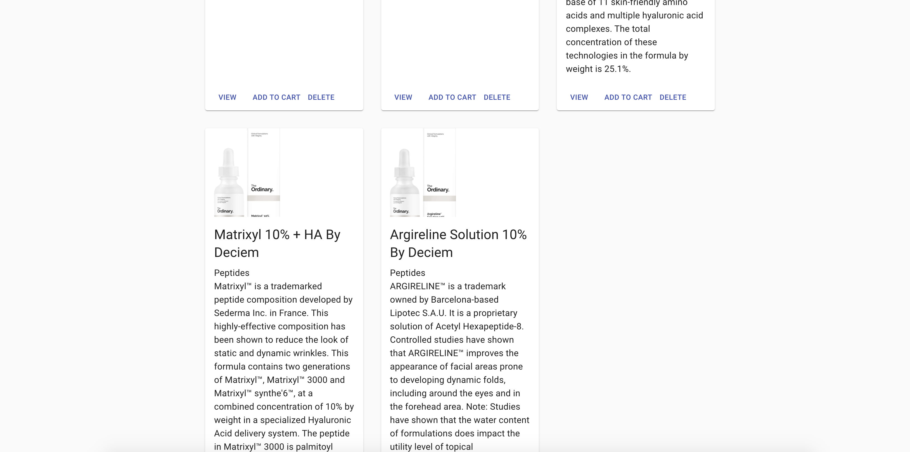
Products List

Slide 9
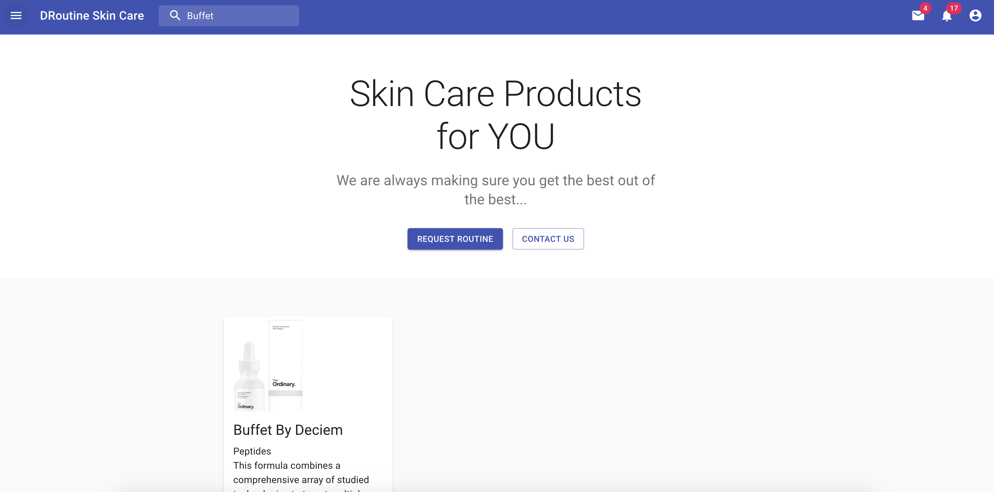
Product Search

Slide 10
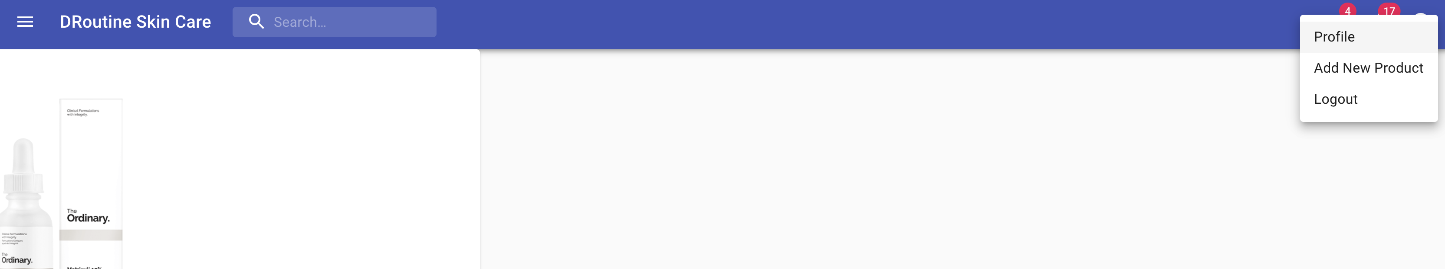
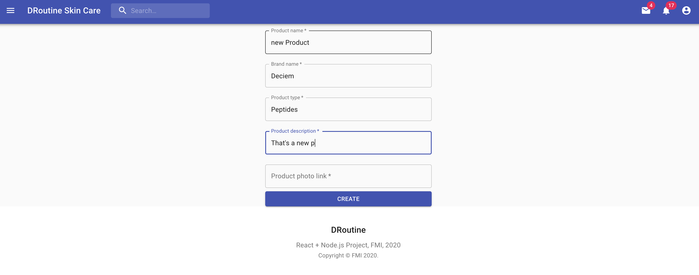
Product Add

Slide 11
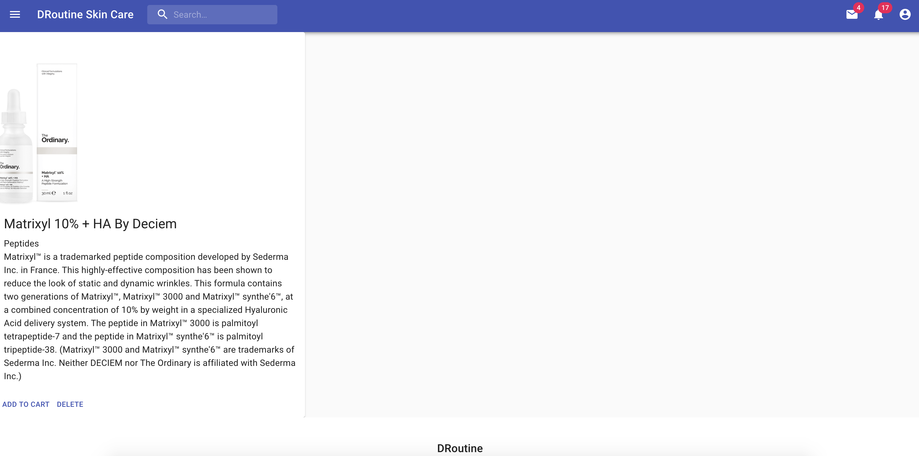
Product Info

Slide 12
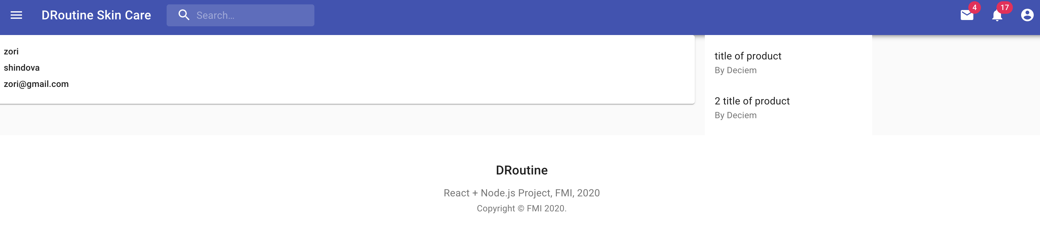
User info and used products

Slide 13
What’s next
Roles
Support chat
Routine details and tracktion

Slide 14
Thank you

