Slide 1



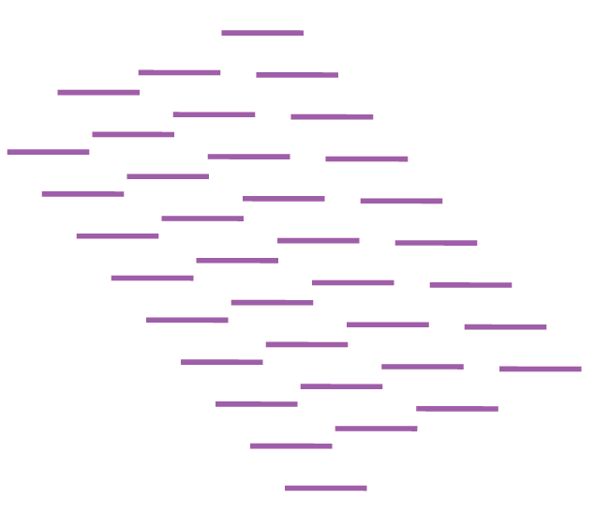
Physical Colors
Virtual Colors
All Kmers
Genome A
[1,0,0]
[1,1,0]
A+B
[0,1,0]
Genome B
[0,1,1]
B+C
Genome C
[0,0,1]
[1,1,1]
A+B+C

Slide 2

Physical Colors
Virtual Colors
All Kmers
Filtering-IN
Dataset (A)
[1,0,0]
[1,1,0]
A+B
[0,1,0]
Genome B
[0,1,1]
B+C
Genome C
[0,0,1]
[1,1,1]
A+B+C

Slide 3
Physical Colors
Virtual Colors
All Kmers
Filtering-OUT
Dataset (A)
[1,0,0]
[1,1,0]
A+B
[0,1,0]
Genome B
[0,1,1]
B+C
Genome C
[0,0,1]
[1,1,1]
A+B+C

