Slide 1
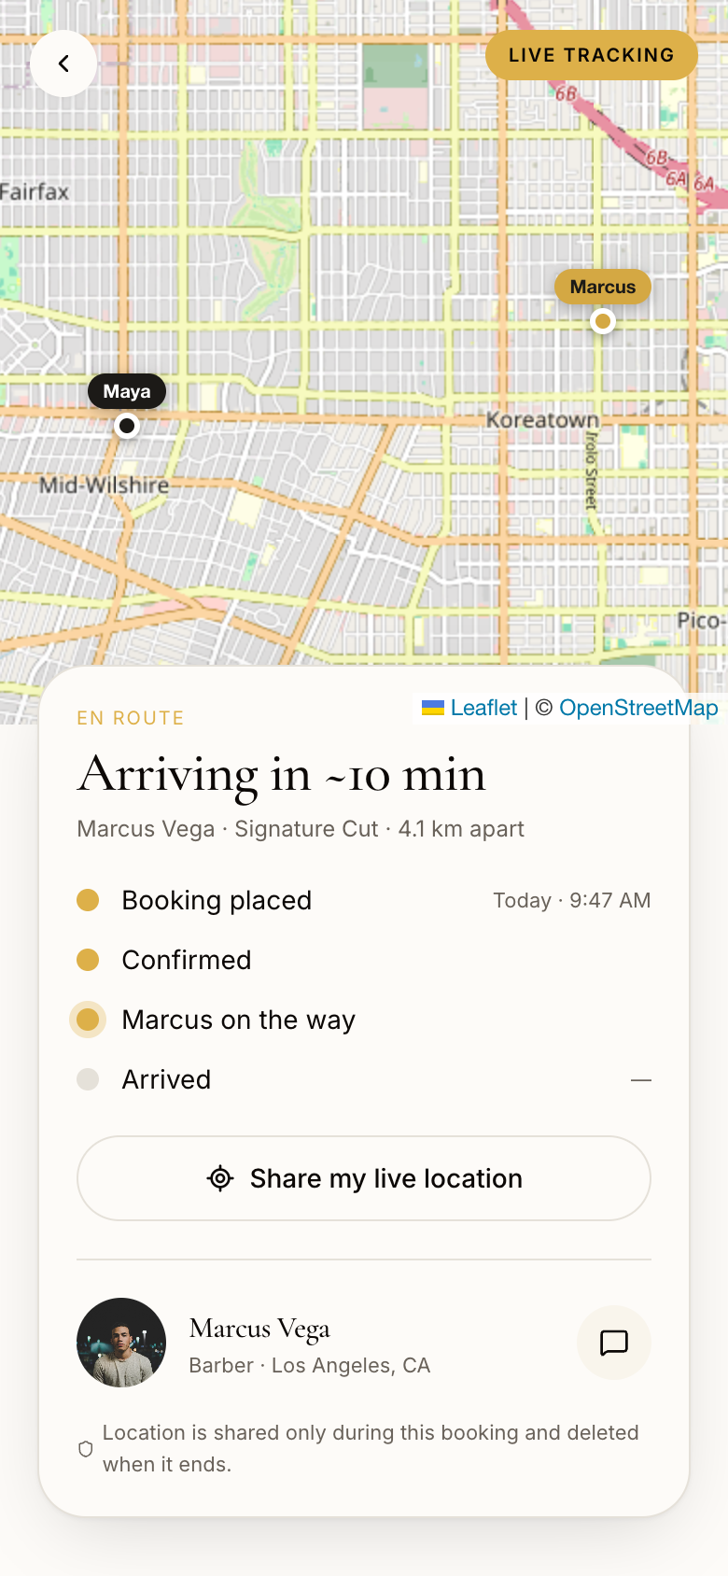
TRACK THEM · BOOK THEM · LOVE THEM™
BOUJEE BOOK™
The Operating System for Personal Care.
Book licensed beauty professionals. Watch them arrive like a ride-share.
Zero commission — pros keep 100%.
Pre-Seed · July 2026 · help@boujeebook.app
Notes:
Opening: Boujee Book brings the Uber playbook to the $95B personal-care economy. This is a real screenshot of the working product — live GPS tracking of your barber on the way to you.

Slide 2
Personal care still runs on DMs and no-shows.
1
Discovery is fragmented
Finding a great barber or lash tech means Instagram archaeology, screenshots, and word of mouth. There is no trusted, licensed marketplace.
2
Booking is phone tag
DMs, missed calls, double-booked slots. Independent pros spend hours a week coordinating instead of working.
3
No-shows and blind waits
Clients don't know if the pro is coming; pros eat the cost when clients ghost. Neither side has visibility after booking.
4
Platforms tax the pro
Existing booking apps charge commissions and fees, squeezing solo professionals who already run on thin margins.
BOUJEE BOOK™ · CONFIDENTIAL
2
Notes:
Frame the pain from both sides: customers can't find/trust/track; professionals lose income to coordination overhead, no-shows, and platform take-rates.

Slide 3
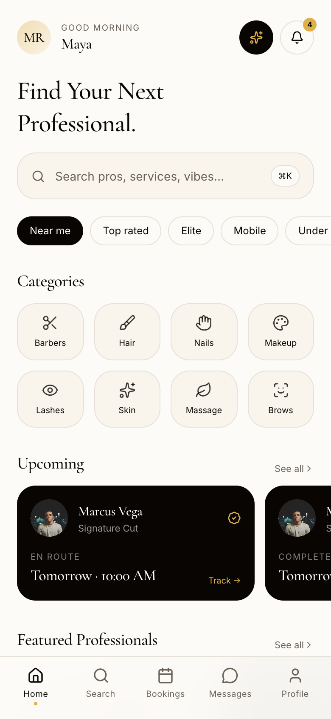
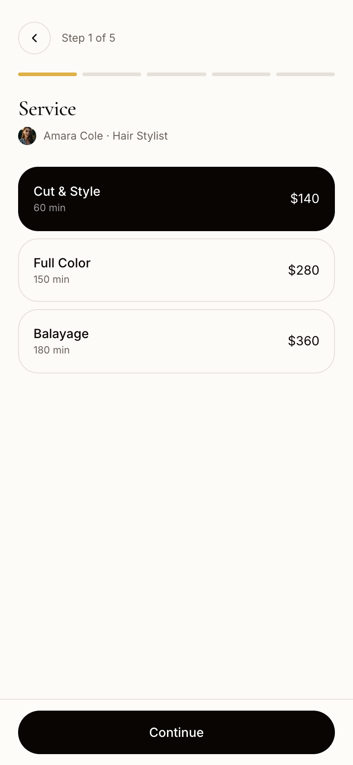
One app. Both sides. Ride-share polish.
Book like a ride
Real-time availability with server-enforced conflict prevention. Double-booking is impossible.
Track like a delivery
Two-way live GPS during active bookings: on my way, arrived, done — with ETA.
Priced like a friend
Zero commission. Pros keep 100% of service revenue; the platform runs on memberships.
Discover licensed pros
Book real openings in five taps
Watch them arrive — live
BOUJEE BOOK™ · CONFIDENTIAL
3
Notes:
These are live product screenshots, not mockups. The three pillars: booking without phone tag, tracking without blind waits, pricing without commissions.

Slide 4
No one else lets you watch your stylist arrive.
Two-way live GPS
Client sees the pro approaching; the pro sees exactly where the house call is. Both opt in per booking.
Journey statuses
Confirmed → on my way → arrived → done. Every step notifies the other side instantly.
Live ETA & distance
Real map, real position, honest arrival estimate — like every delivery app your users already trust.
Privacy-first by design
Location shares only during an active booking and is permanently deleted the moment it ends.
BOUJEE BOOK™ · CONFIDENTIAL
4
Notes:
This is the wedge feature. Booksy and StyleSeat are calendars; Glamsquad is an agency. None offer consumer-grade live tracking. It converts anxiety (is my pro coming?) into delight, and it's already built.

Slide 5
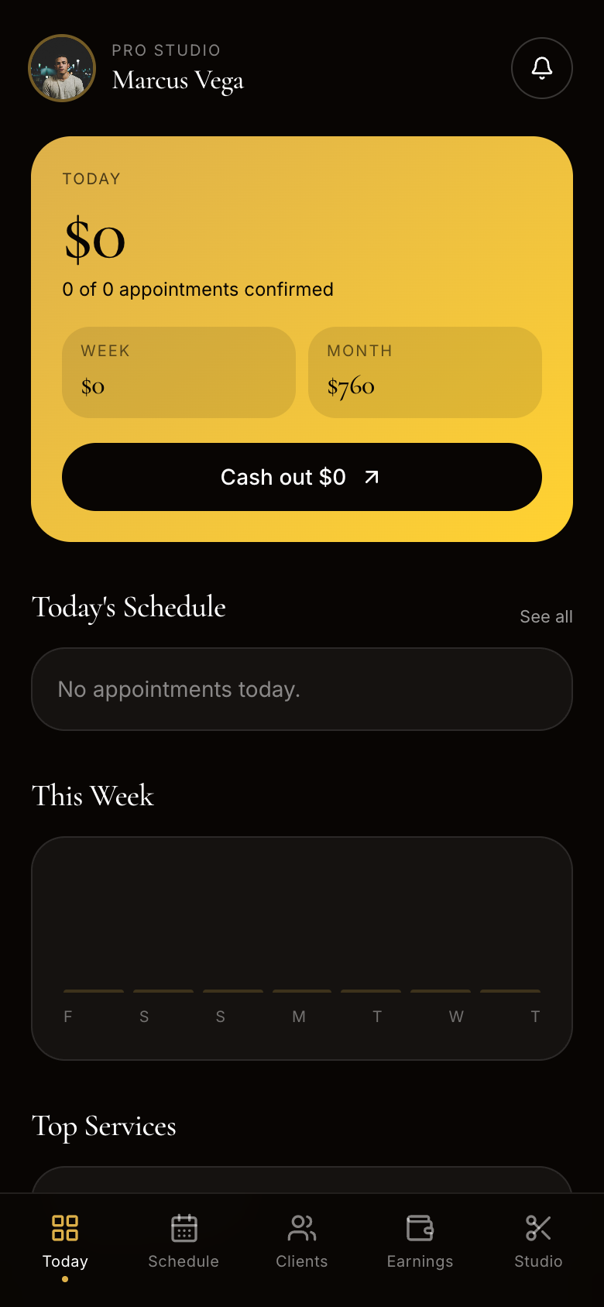
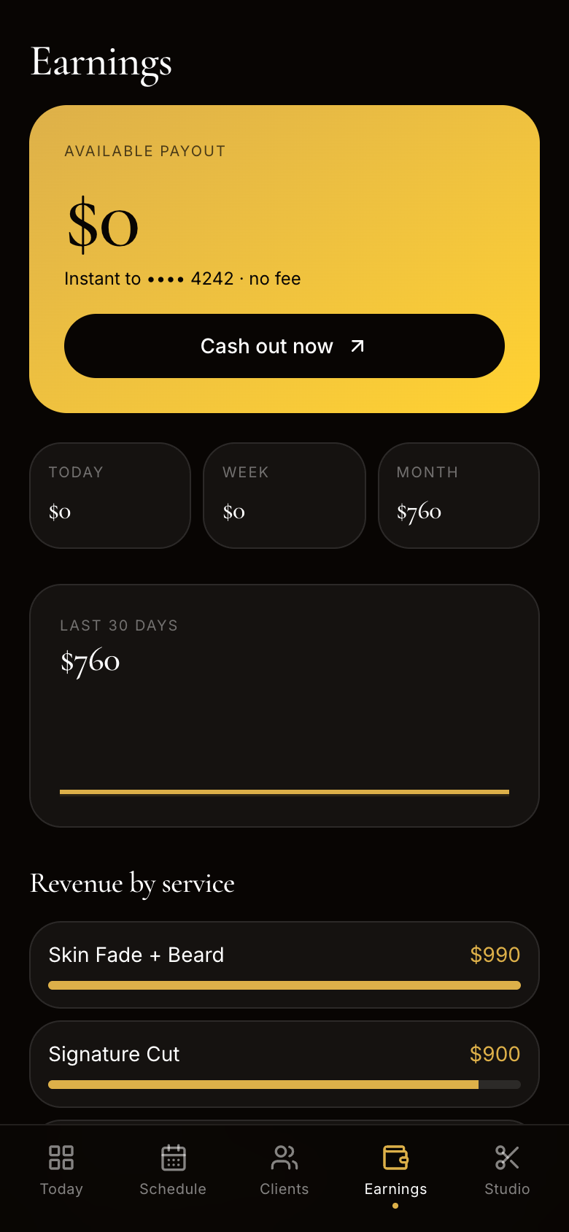
Pros get a business-in-a-box. Free to run.
1
Self-serve onboarding
License capture, service menu, working hours — live and bookable the same day.
2
Anti-chaos calendar
Availability rules enforced server-side; requests expire; one-tap confirm.
3
A real client CRM
Visit history, favorite services, and lifetime value for every client, built automatically.
4
Earnings that make sense
Daily / weekly / monthly revenue, top services, CSV statements for tax time.
5
100% of their money
Zero commission — the platform monetizes memberships, not the pro's labor.
BOUJEE BOOK™ · CONFIDENTIAL
5
Notes:
Supply side is the constraint in every services marketplace. Our pitch to pros is unbeatable: a full booking + CRM + earnings stack, zero take-rate. Screenshots are the live pro dashboard and earnings screens.

Slide 6
Trust is engineered in, not promised.
1
2
3
License verification
Moderation built-in
Dispute resolution
Pros submit state licenses; an admin trust queue reviews before the verified badge appears.
Report any profile or conversation; block users; admin queues with audit-logged actions.
In-app dispute center; human review; resolution recorded and messaged to the customer.
4
5
6
Hardened platform
Data rights, instant
Location privacy
Rate-limited auth, hashed credentials, session controls, security headers, full audit log.
One-tap data export and account deletion — GDPR / CCPA / App Store compliant.
GPS shared only during active bookings, deleted at completion. No ad trackers anywhere.
BOUJEE BOOK™ · CONFIDENTIAL
6
Notes:
Trust features are usually a seed-stage promise; here they're shipped: license queue, moderation, disputes, audit logs, data rights. This also clears App Store review requirements (UGC moderation, account deletion).

Slide 7
A massive market still booked over DMs.
~$95B
~1.4M
~$18B
US personal-care services spend (est.)
US beauty & wellness professionals (est.)
Serviceable: urban mobile-first bookings (est.)
Hair, barbering, nails, skin, lashes, massage — recession-resilient and habitual.
A majority independent or booth-renting — exactly who a 0% platform serves.
Metro clients who already live in Uber, DoorDash, and Instagram.
Wedge: launch city-by-city with mobile-capable pros (house calls), where live tracking matters most and word of mouth is strongest.
Market figures are directional estimates from public industry data; detailed sourcing available in diligence.
BOUJEE BOOK™ · CONFIDENTIAL
7
Notes:
Keep TAM honest: ~$95B US services spend is a widely-cited ballpark; the wedge is urban mobile-first bookings. City-by-city density beats national thinness.

Slide 8
Memberships, not commissions.
Customer Basic
$9.99/mo
Unlimited booking, reviews, reminders
Customer Elite
$29.99/mo
Priority windows, cancellation protection, rewards
Pro Basic
$9.99/mo
Calendar, messaging, standard payouts
Pro Elite
$29.99/mo
Instant payouts, featured placement, higher daily volume
0% take-rate is the supply-acquisition weapon: pros bring their books — and their clients — with them.
Illustrative model, not a forecast — assumes city-by-city rollout with blended ~$14/mo ARPU across the four tiers.
BOUJEE BOOK™ · CONFIDENTIAL
8
Notes:
Subscription economics: predictable revenue, no take-rate fights, and the 0% commission story recruits supply. The chart is explicitly illustrative — swap with your live numbers post-launch.

Slide 9
Calendars, agencies, and DMs — nobody owns the full loop.
Boujee Book
Booksy / StyleSeat
Glamsquad
Instagram DMs
Two-way live GPS tracking
YES
—
—
—
Commission on pro revenue
0%
Fees + charges
Agency margin
0%
License verification
YES
Partial
In-house staff
—
Real-time availability
YES
YES
YES
—
Both-sides consumer app
YES
Pro-first
Client-first
—
Disputes & moderation
YES
Basic
Internal
—
BOUJEE BOOK™ · CONFIDENTIAL
9
Notes:
Booksy/StyleSeat are pro-side calendars with fees; Glamsquad is a managed agency (thin margins, limited supply); DMs are free but chaotic. The full loop — discovery, booking, tracking, trust, zero commission — is unclaimed.

Slide 10
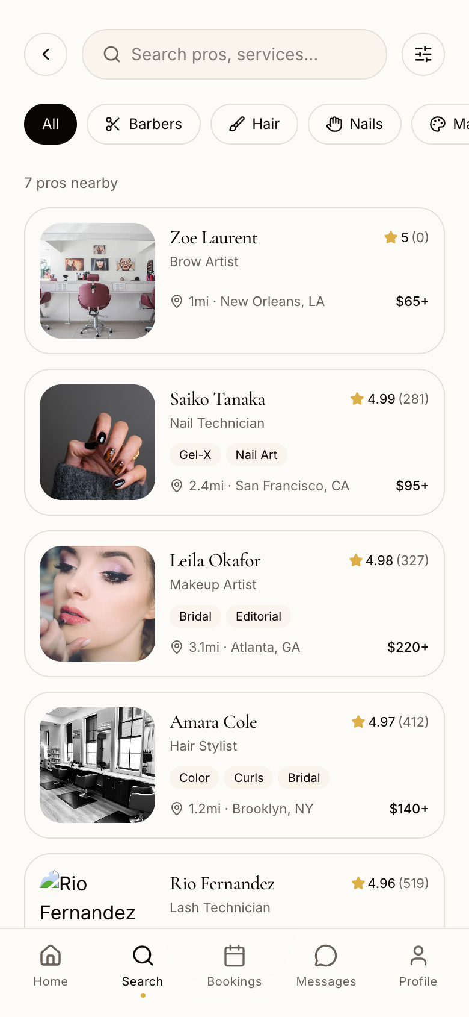
The product isn't a promise. It's built.
✓
Three shipped surfaces: customer app, pro studio, admin console
✓
Live two-way GPS tracking with journey statuses and ETA
✓
Availability engine — double-booking is impossible
✓
Self-serve pro onboarding with license verification queue
✓
Messaging, reviews, favorites, notifications — all live
✓
Disputes, reporting, blocking, audit-logged moderation
✓
Security hardening: rate limits, session controls, headers
✓
Data export & account deletion (App Store / GDPR ready)
Next 60 days: Stripe payments + payouts, media uploads, production deploy, first-city pro recruitment.
BOUJEE BOOK™ · CONFIDENTIAL
10
Notes:
Traction slide for a pre-launch company = execution velocity. The entire platform in this deck is functional today; remaining launch work is integrations (Stripe, storage, email), not product invention.

Slide 11
Roadmap to a category brand.
NOW
Q4 2026
H1 2027
H2 2027
Launch
Mobile
Density
Moat
Web launch city #1 · Stripe payments & Connect payouts · pro recruitment engine
iOS + Android apps (App Store / Play) · push notifications · memberships live
Cities 2–5 · background checks & insurance partners · referral loops
AI concierge booking · dynamic pricing tools for pros · B2B (salon suites, hotels)
Every phase compounds the same flywheel: more verified pros → better selection → more clients → fuller books → more pros.
BOUJEE BOOK™ · CONFIDENTIAL
11
Notes:
Sequence: prove one city, go mobile for retention, then density and moat features. The Capacitor path reuses the shipped codebase for the app stores.

Slide 12
The Ask
Raising $1.5M pre-seed.
18 months of runway to launch, reach paid-membership revenue, and make city #1 undeniable.
40%
25%
20%
15%
Product & mobile
Supply
Growth
Trust & ops
Stripe rails, iOS/Android apps, uploads, realtime
Recruit and verify the first 500 professionals
City-level launch marketing and referral loops
Verification, background checks, support
BOUJEE BOOK™ · Track Them · Book Them · Love Them™ · help@boujeebook.app
Notes:
Adjust the raise amount and allocation to your actual plan before sending — the structure is what matters: integrations + supply + one-city proof. Close on the demo: the product works today.

