Slide 1


(a)
(b)
293T
HL-60

Slide 2
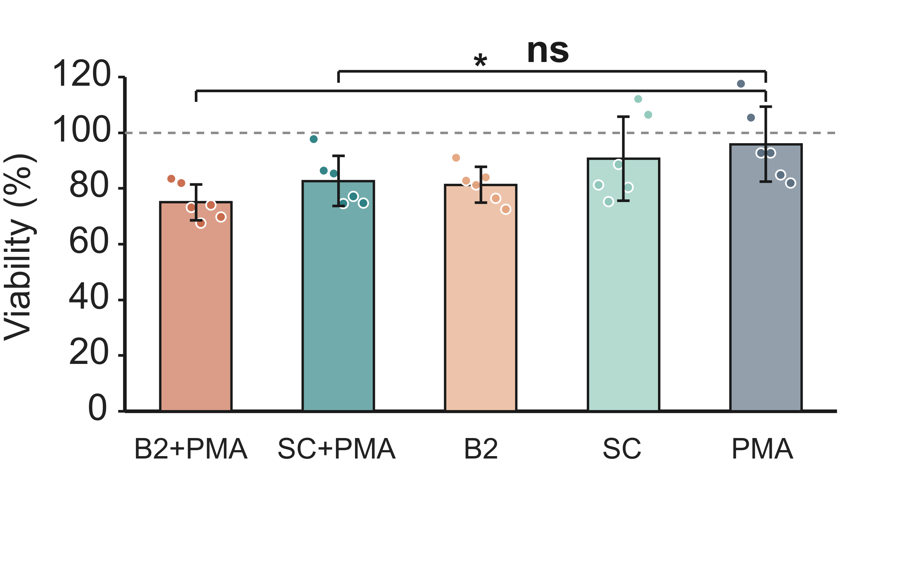
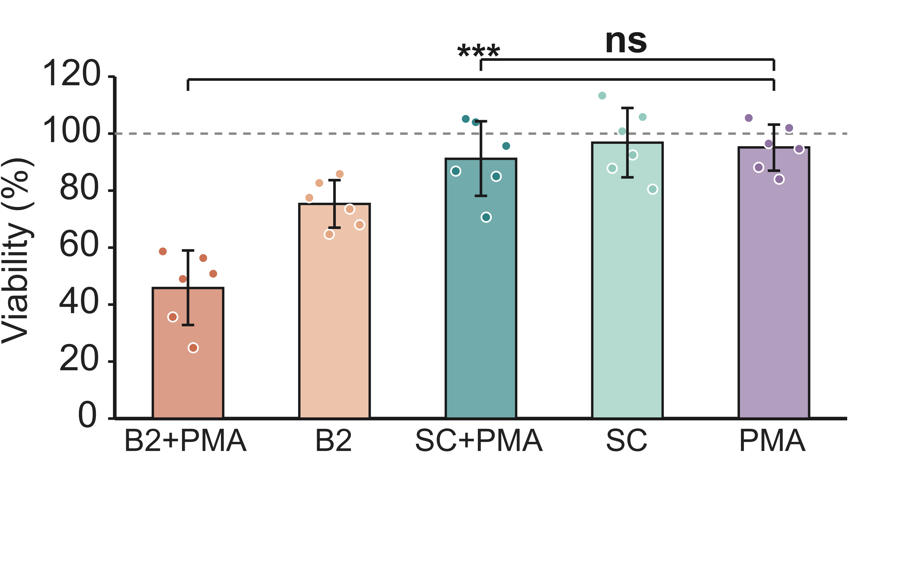
(a)
(b)
293T
HL-60

