Slide 1

“Php team Project”
Team “ROSE LAVANDA”

Slide 2
Team Members
Gabriela Burlakova
Username: G.Burlakova
Boni Mislyashki
Username: BoniMislyashki
Konstantin Gerov
Username: kgerov
Alexandar Ivanov
Username: alexxokey
Zornitza Gencheva
Username: zornitza_gencheva

Slide 3
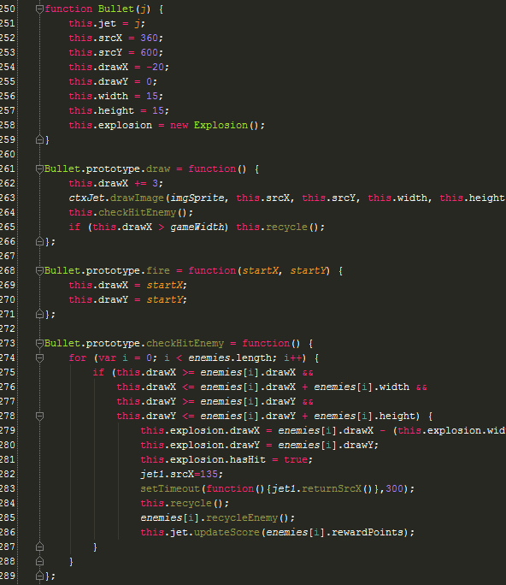
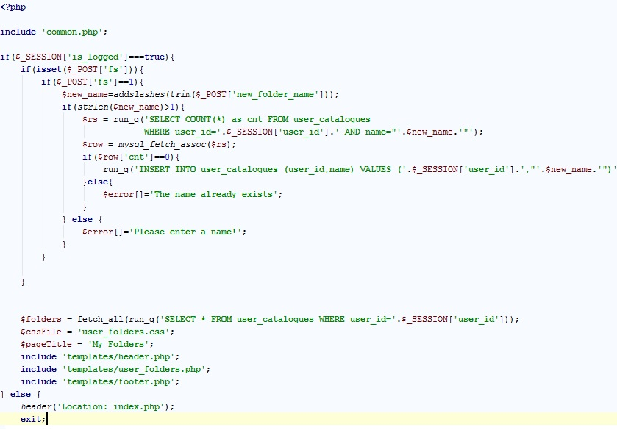
Brief code description

Slide 4


