Slide 1


SMART INDIA HACKATHON 2026
AEGIS
• Problem Statement ID: SIH26106
• Problem Statement Title: AI-Powered Email Threat Detection, GeoLocation and Forensic Intelligence Platform
• Theme: Blockchain & Cybersecurity PS
• Category: Software
• Team ID: 172296
• Team Name: Shinigami Sentinel

Slide 2
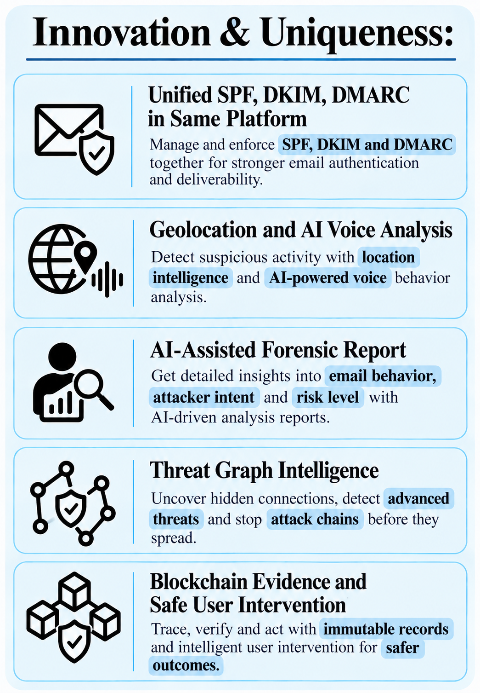
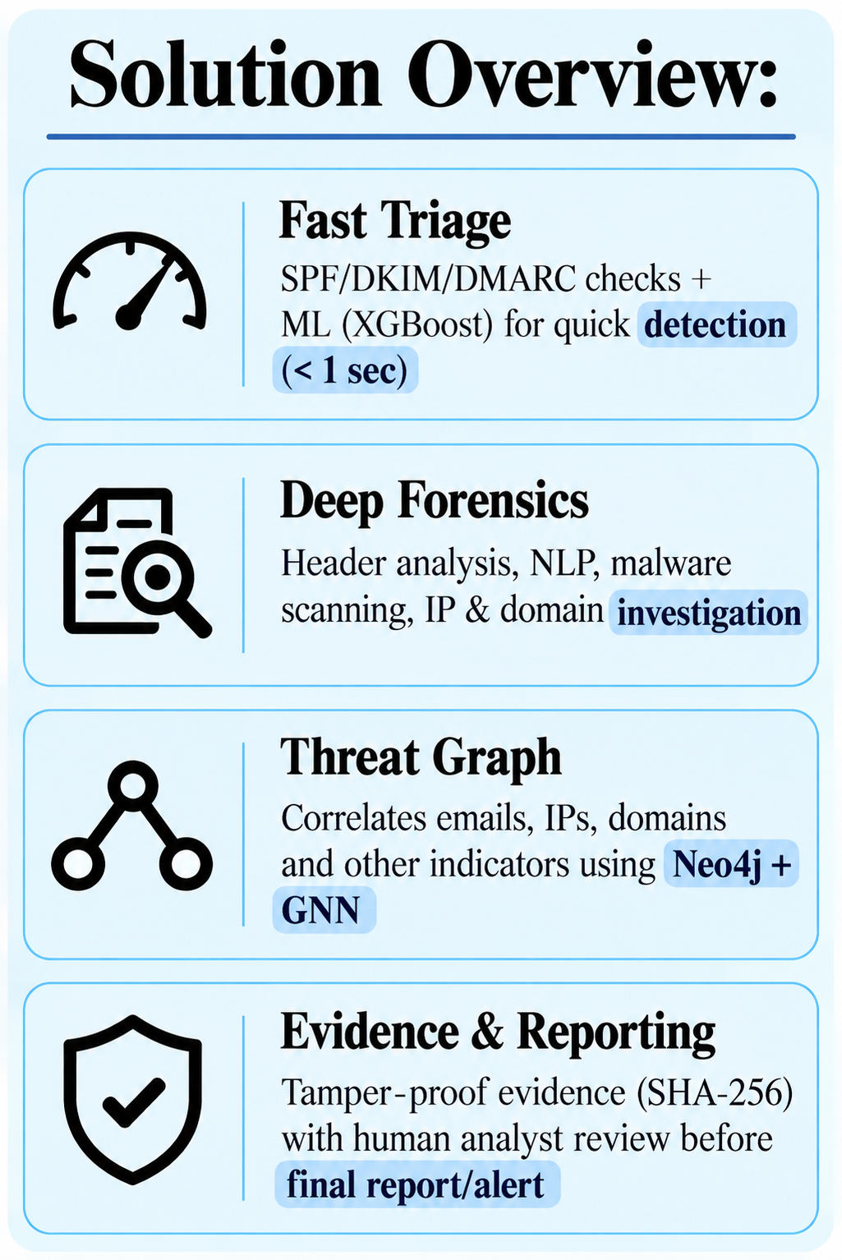
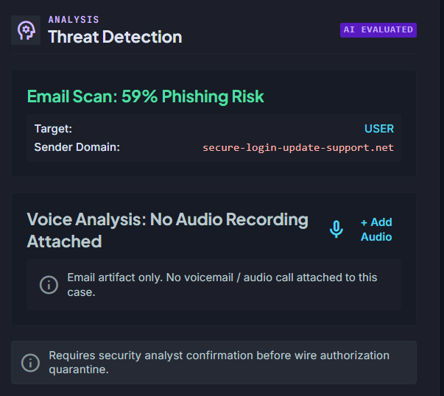
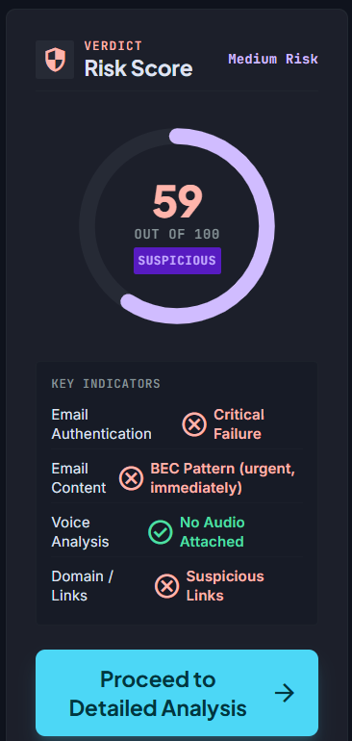
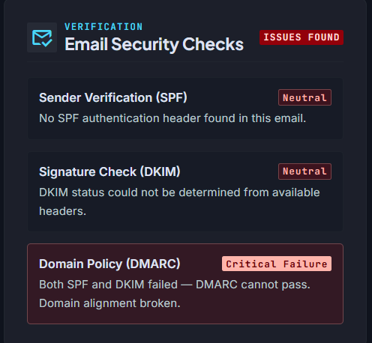
AI-Powered Email Threat & Forensics Platform
Shinigami Sentinel
IDEA TITLE

Slide 3
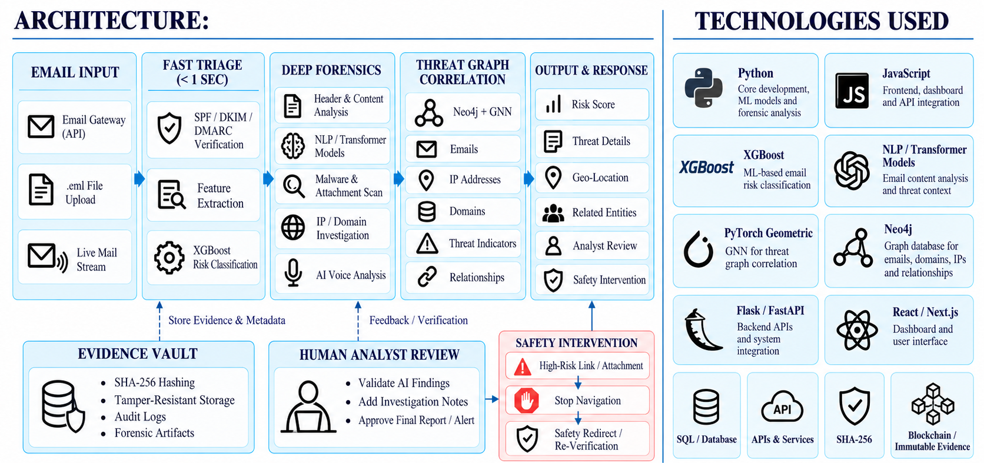
TECHNICAL APPROACH
Shinigami Sentinel

Slide 4
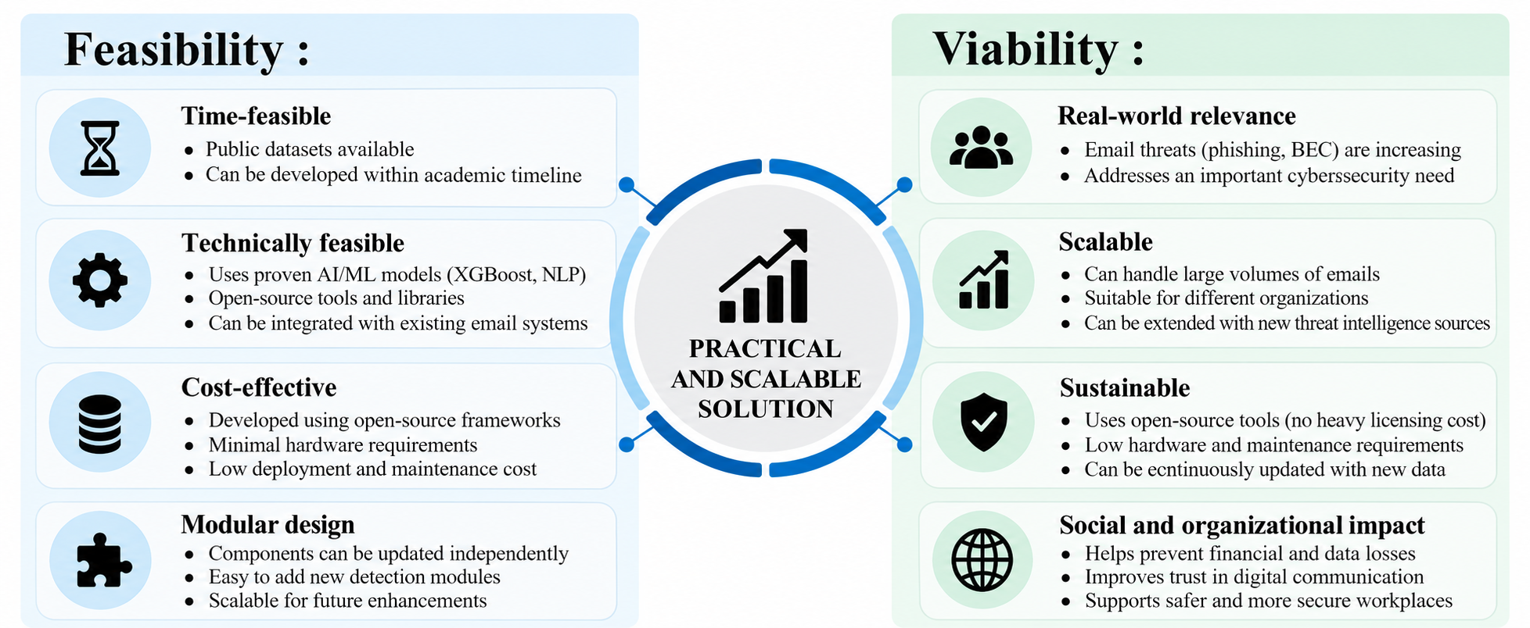
FEASIBILITY AND VIABILITY
Shinigami Sentinel

Slide 5
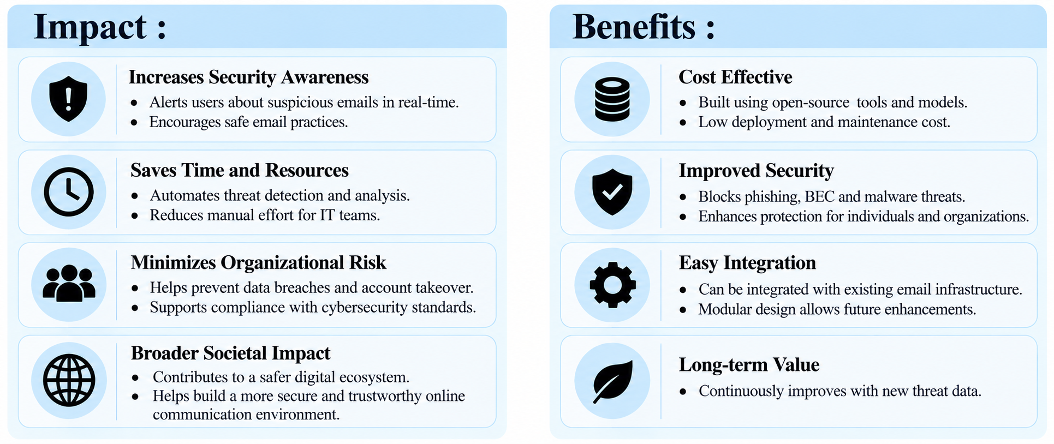
IMPACT AND BENEFITS
Shinigami Sentinel

Slide 6
RESEARCH AND REFERENCES
Shinigami Sentinel
RESEARCH:
Our research focuses on email threat detection, email authentication, digital forensics, and threat
intelligence, with emphasis on SPF, DKIM, DMARC, XGBoost, NLP, Neo4j, and Graph
Neural Networks for detecting and investigating phishing, BEC, and impersonation attacks.
RFC
RFC
Links:
Our Github Repository:
https://github.com/zoro-uchiha-007/aegis-trace.git
RFC
https://aegis-trace.vercel.app
Our Domain Link:
SPF:
https://www.rfc-editor.org/info/rfc7208/
XGB
DMARC:
https://www.rfc-editor.org/info/rfc7489/
REFERENCES:
The proposed solution is supported by RFC 7208 (SPF), RFC 6376 (DKIM), RFC 7489 (DMARC)
,XGBoost research by Chen & Guestrin, Neo4j Documentation, and Graph Attention Networks
by Veličković et al.
GAT

