Slide 1
Database Management System (DBMS)
Unit-1

Slide 2
Basic Concepts
Data- Data is a collection of facts and figures that can be processed so produce information
e.g: 25, “ajit” etc.
Information- When the data is processed and converted into meaningful and useful form.
Eg: “The age of Ravi is 25”
Knowledge-Knowledge refers to the relevant and objective information gained through experience.

Slide 3
Database Management System (DBMS)
Definition:
A database-management system (DBMS) is a collection of interrelated data and a set of programs to access those data.
The collection of data can be information relevant to an enterprise.
DBMS provide a way to store and retrieve database information that is both convenient and efficient.
Manage large bodies of information.
Management of data involves both defining structures for storage of information and providing mechanisms for the manipulation of information.
It must ensure the safety of the information stored, despite system crashes or attempts at unauthorized access.
Data must be shared among several users.

Slide 4
Database Applications:
Banking: transactions
Airlines: reservations, schedules
Universities: registration, grades
Sales: customers, products, purchases
Online retailers: order tracking, customized recommendations
Manufacturing: production, inventory, orders, supply chain
Human resources: employee records, salaries, tax deductions
Databases can be very large.
Databases touch all aspects of our lives

Slide 5
Enterprise Information
Sales: For customer, product, and purchase information.
Accounting: For payments, receipts, account balances, assets and other accounting information.
Human resources: For information about employees, salaries, payroll taxes, and benefits, and for generation of paychecks.
Manufacturing: For management of the supply chain and for tracking production of items in factories, inventories of items in warehouses and stores, and orders for items.
Online retailers: For sales data noted above plus online order tracking, generation of recommendation lists, and maintenance of online product evaluations.

Slide 6
• Banking and Finance
Banking: For customer information, accounts, loans, and banking transactions.
Credit card transactions: For purchases on credit cards and generation of monthly statements.
Finance: For storing information about holdings, sales, and purchases of financial instruments such as stocks and bonds; also for storing real-time market data to enable online trading by customers and automated trading by the firm.
Universities: For student information, course registrations, and grades (in addition to standard enterprise information such as human resources and accounting).
Airlines: For reservations and schedule information. Airlines were among the first to use databases in a geographically distributed manner.
Telecommunication: For keeping records of calls made, generating monthly bills, maintaining balances on prepaid calling cards, and storing information about the communication networks.

Slide 7
Purpose of the Database
University Database Example
Application program examples
Add new students, instructors, and courses
Register students for courses, and generate class rosters
Assign grades to students, compute grade point averages (GPA) and generate transcripts
In the early days, database applications were built directly on top of file systems
Typical file-processing system is supported by a conventional operating
system. The system stores permanent records in various files, and it needs
different application programs to extract records from, and add records to, the appropriate files. Before database management systems (DBMSs) were introduced, organizations usually stored information in such systems.

Slide 8
Drawbacks of using file systems to store data
Data redundancy and inconsistency
Multiple file formats, duplication of information in different files
Difficulty in accessing data
Need to write a new program to carry out each new task
Data isolation
Multiple files and formats
Integrity problems
Integrity constraints (e.g., account balance > 0) become “buried” in program code rather than being stated explicitly
Hard to add new constraints or change existing ones

Slide 9
Drawbacks of using file systems to store data
Atomicity of updates
Failures may leave database in an inconsistent state with partial updates carried out
Example: Transfer of funds from one account to another should either complete or not happen at all
Concurrent access by multiple users
Concurrent access needed for performance
Uncontrolled concurrent accesses can lead to inconsistencies
Example: Two people reading a balance (say 100) and updating it by withdrawing money (say 50 each) at the same time
Security problems
Hard to provide user access to some, but not all, data

Slide 10
VIEW of Data
A major purpose of a database system is to provide users with an abstract view of the data. That is, the system hides certain details of how the data are stored and maintained.
Data Abstraction
Complex data structures to represent data in the database.
Database-system users are not computer trained
Developers hide the complexity from users through several levels of abstraction, to simplify users’ interactions with the system:

Slide 11
Levels of Abstraction
Physical level:
describes how a record (e.g., instructor) is stored.
complex low-level data structures in detail.
Logical level:
describes what data are stored in the database, and what relationships exist among those data.
type instructor = record
ID : string; name : string; dept_name : string; salary : integer;
end;
View level:
describes only part of the entire database.
because of the variety of information stored in a large database.
application programs hide details of data types. Views can also hide information (such as an employee’s salary) for security purposes.

Slide 12
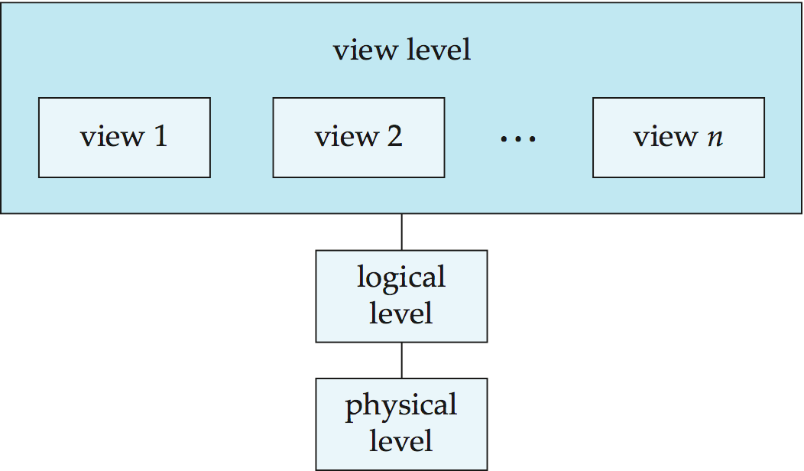
View of Data

Slide 13
Instances and Schemas
Logical Schema – the overall logical structure of the database
Example: The database consists of information about a set of customers and accounts in a bank and the relationship between them
Analogous to type information of a variable in a program
Physical schema– the overall physical structure of the database
Instance – the actual content of the database at a particular point in time
Analogous to the value of a variable
Physical Data Independence – the ability to modify the physical schema without changing the logical schema
Applications depend on the logical schema
In general, the interfaces between the various levels and components should be well defined so that changes in some parts do not seriously influence others.

Slide 14
Data Models
A collection of tools for describing
Data
Data relationships
Data semantics
Data constraints
Relational model
Entity-Relationship data model (mainly for database design)
Object-based data models (Object-oriented and Object-relational)
Semistructured data model (XML)
Other older models:
Network model
Hierarchical model
Notes:
14

Slide 15
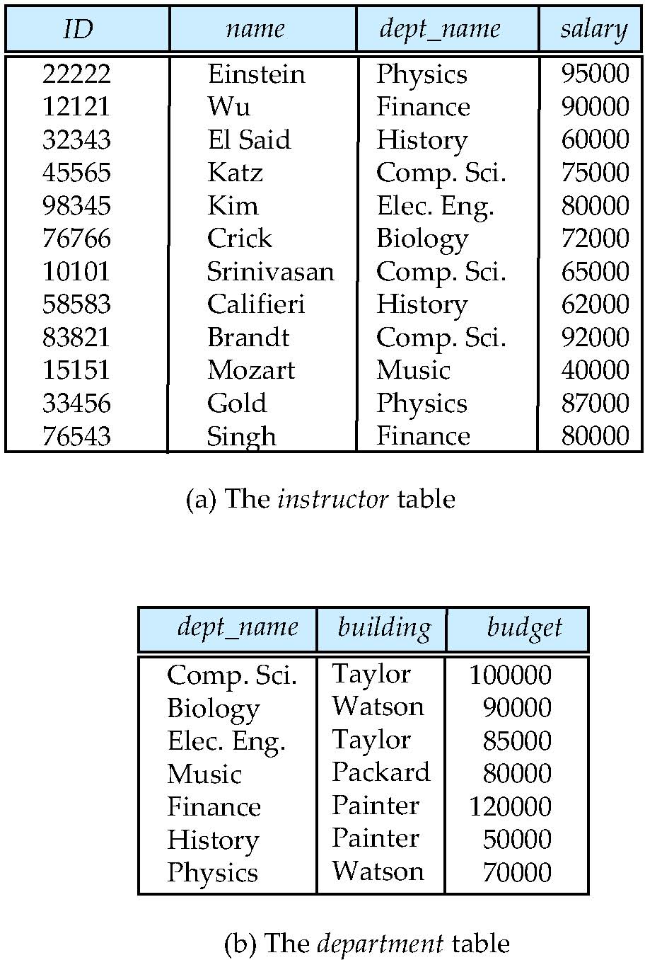
Relational Model
All the data is stored in various tables.
Example of tabular data in the relational model
Columns
Rows
Notes:
15

Slide 16
A Sample Relational Database
Notes:
16

Slide 17
Database System Structure

Slide 18
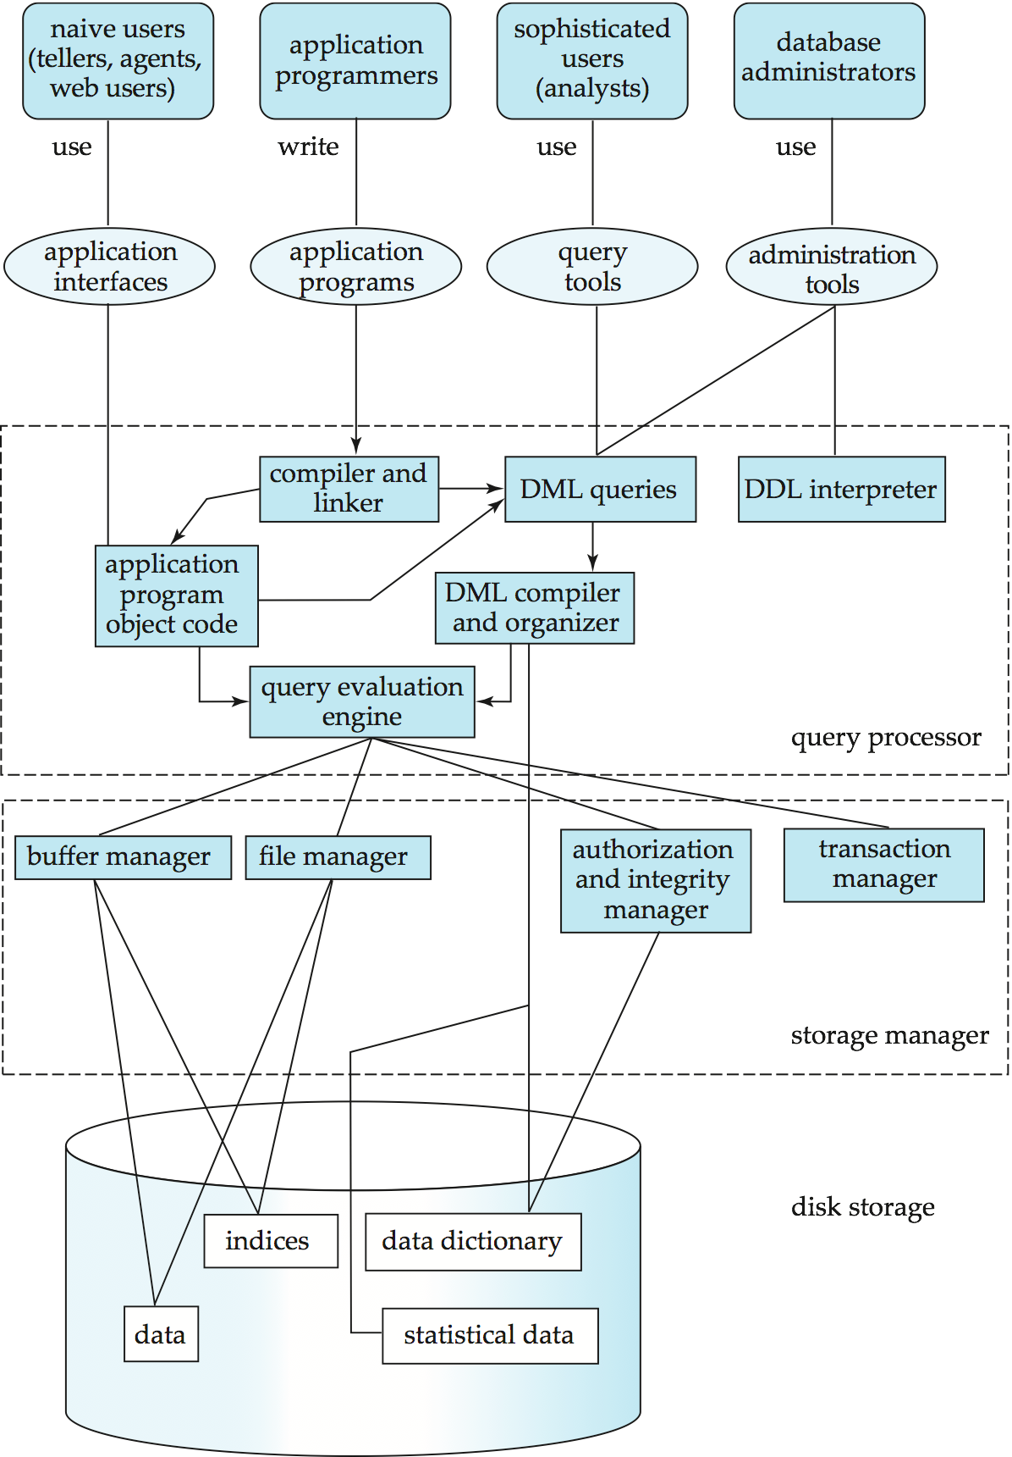

Slide 19
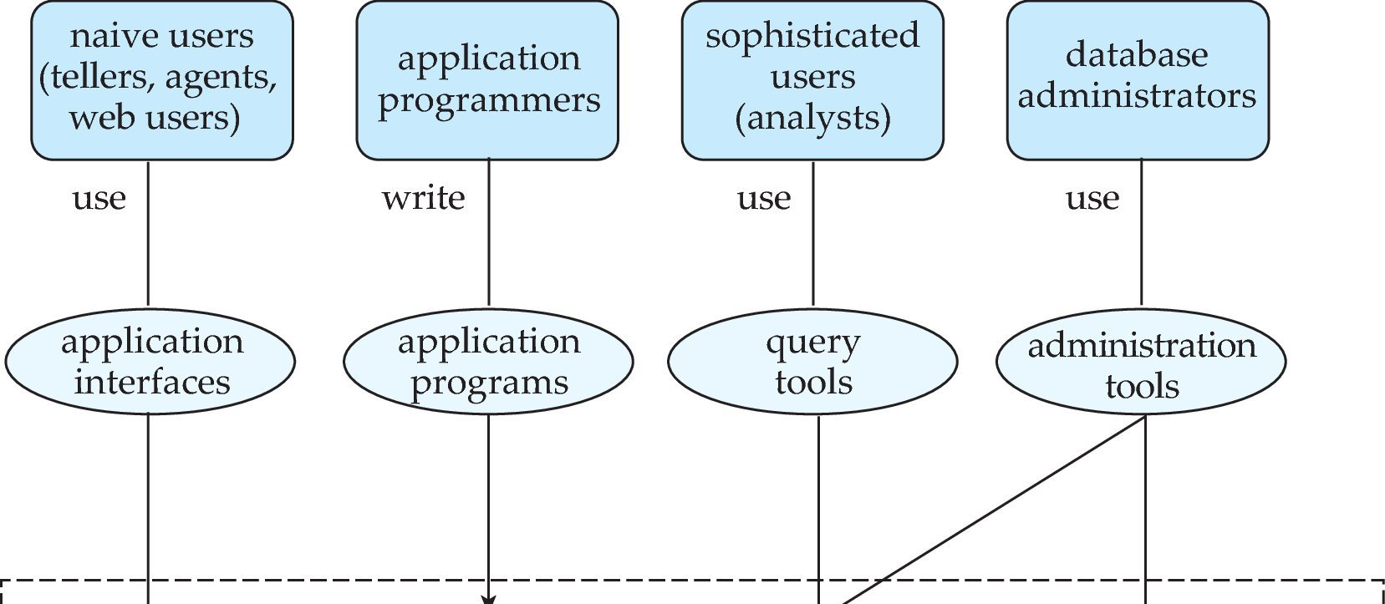
Database Users and Administrators
Database

Slide 20
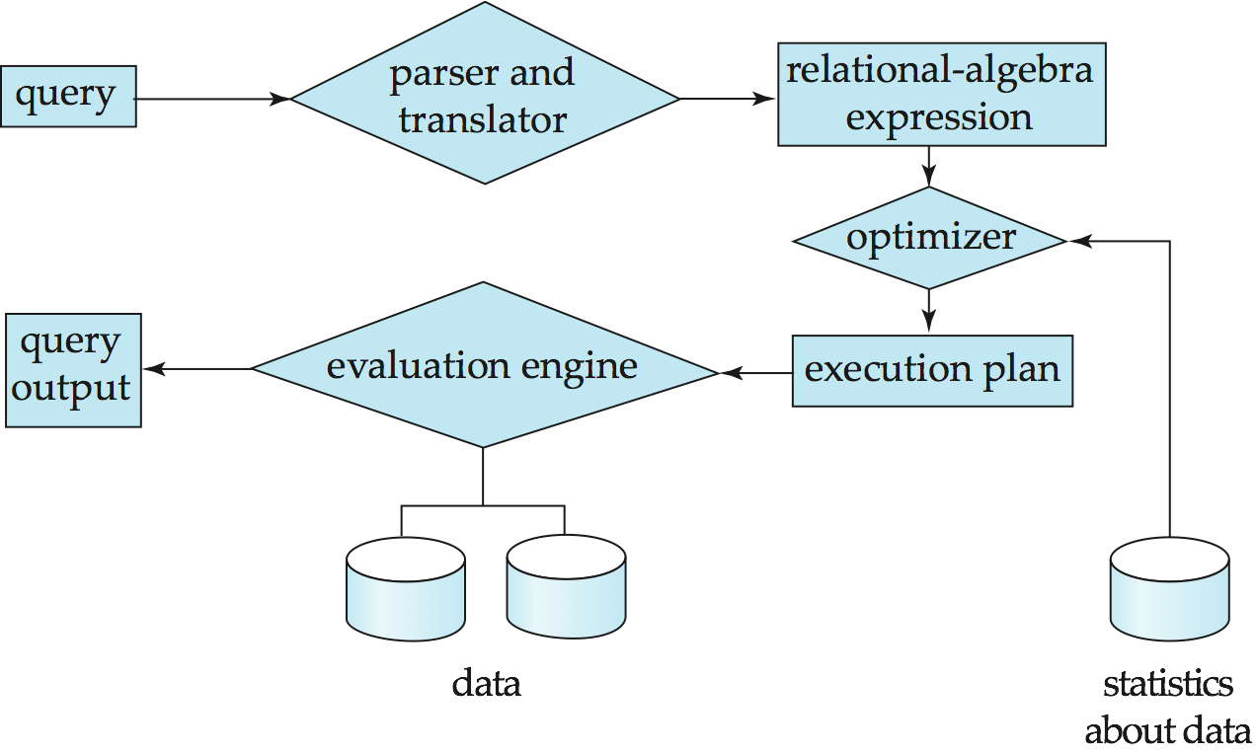
Query Processing
1. Parsing and translation
2. Optimization
3. Evaluation

Slide 21
Query Processing (Cont.)
Alternative ways of evaluating a given query
Equivalent expressions
Different algorithms for each operation
Cost difference between a good and a bad way of evaluating a query can be enormous
Need to estimate the cost of operations
Depends critically on statistical information about relations which the database must maintain
Need to estimate statistics for intermediate results to compute cost of complex expressions

Slide 22
Storage Management
Storage manager is a program module that provides the interface between the low-level data stored in the database and the application programs and queries submitted to the system.
The storage manager is responsible to the following tasks:
Interaction with the OS file manager
Efficient storing, retrieving and updating of data
Issues:
Storage access
File organization
Indexing and hashing

Slide 23
Transaction Management
What if the system fails?
What if more than one user is concurrently updating the same data?
A transaction is a collection of operations that performs a single logical function in a database application
Transaction-management component ensures that the database remains in a consistent (correct) state despite system failures (e.g., power failures and operating system crashes) and transaction failures.
Concurrency-control manager controls the interaction among the concurrent transactions, to ensure the consistency of the database.

Slide 24
Database Architecture
The architecture of a database systems is greatly influenced by
the underlying computer system on which the database is running:
Centralized
Client-server
Parallel (multi-processor)
Distributed

Slide 25
EER Diagram
The E-R model that is supported with the additional semantic concepts called the Enhanced Entity- relationship model (EER) model. they were:
Generalization
Specialization
Aggregation

Slide 26
Specialization
Top-down design process; we designate sub-groupings within an entity set that are distinctive from other entities in the set.
These sub-groupings become lower-level entity sets that have attributes or participate in relationships that do not apply to the higher-level entity set.
Depicted by a triangle component labeled ISA (e.g., instructor “is a” person).
Attribute inheritance – a lower-level entity set inherits all the attributes and relationship participation of the higher-level entity set to which it is linked.

Slide 27
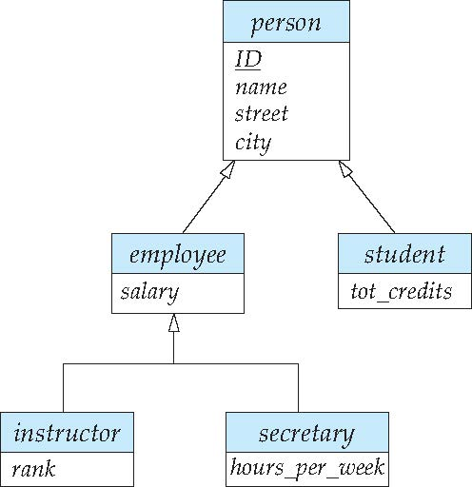
Specialization Example
Overlapping – employee and student
Disjoint – instructor and secretary
Total and partial

Slide 28
Generalization
A bottom-up design process – combine a number of entity sets that share the same features into a higher-level entity set.
Specialization and generalization are simple inversions of each other; they are represented in an E-R diagram in the same way.
The terms specialization and generalization are used interchangeably.

Slide 29
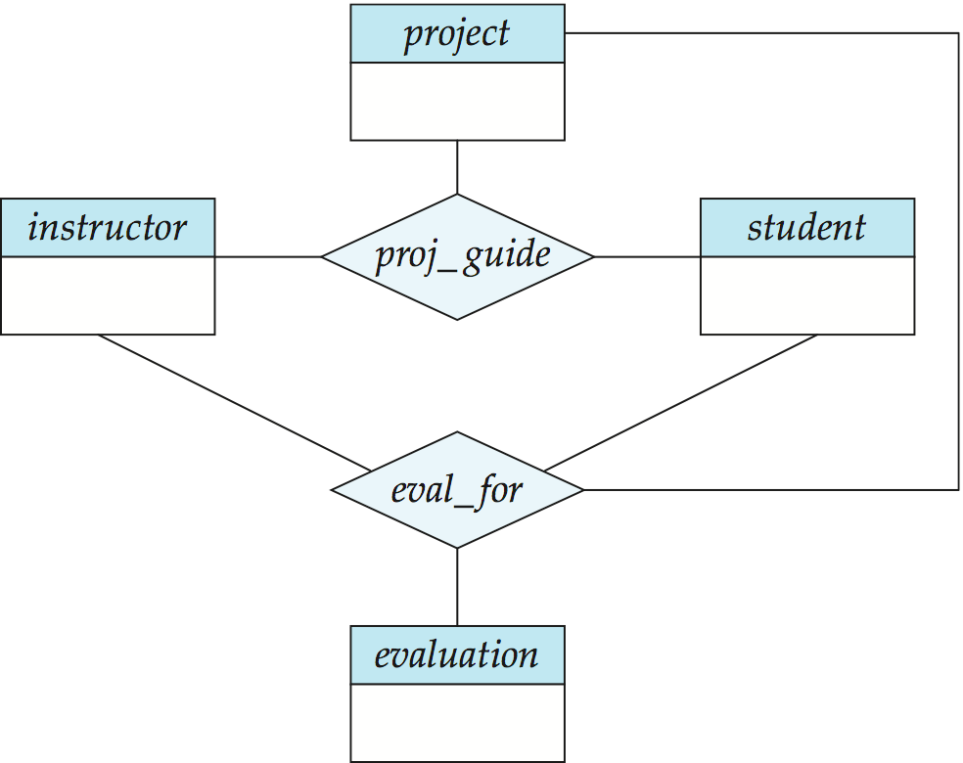
Aggregation
Consider the ternary relationship proj_guide, which we saw earlier
Suppose we want to record evaluations of a student by a guide on a project

Slide 30
Aggregation (Cont.)
Relationship sets eval_for and proj_guide represent overlapping information
Every eval_for relationship corresponds to a proj_guide relationship
However, some proj_guide relationships may not correspond to any eval_for relationships
So we can’t discard the proj_guide relationship
Eliminate this redundancy via aggregation
Treat relationship as an abstract entity
Allows relationships between relationships
Abstraction of relationship into new entity

Slide 31
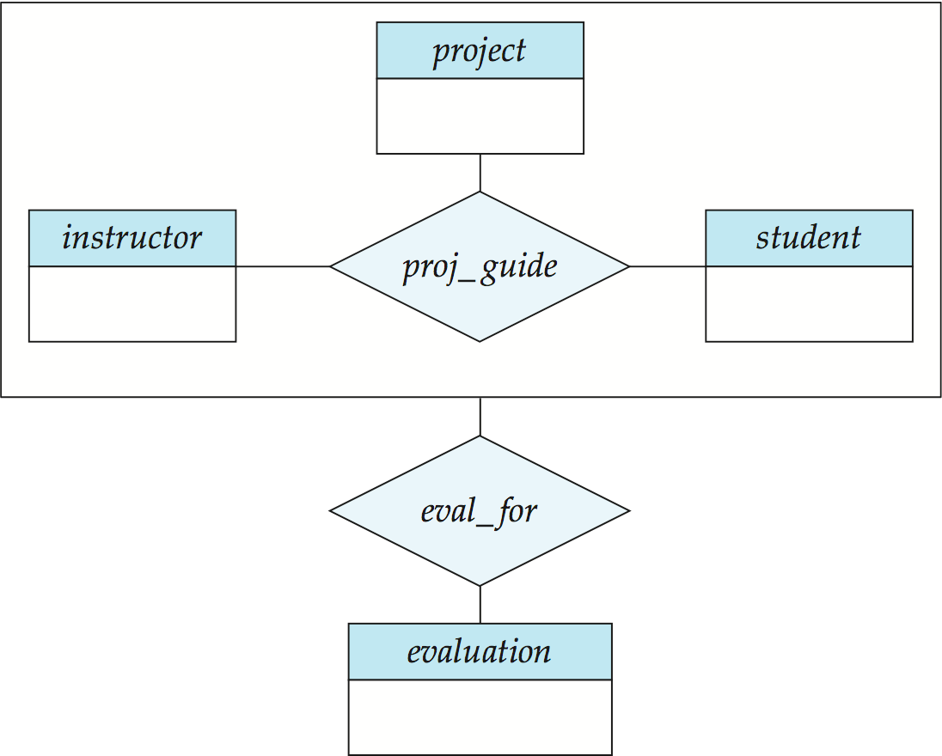
Aggregation (Cont.)
Eliminate this redundancy via aggregation without introducing redundancy, the following diagram represents:
A student is guided by a particular instructor on a particular project
A student, instructor, project combination may have an associated evaluation

Slide 32
Identify Entities
Identify attributes
Identify Relationships
Draw ER Diagram

