Slide 1
UNIT-III
Relational Database Design

Slide 2
Features of Good Relational Designs
The goal of relational database design is to generate a set of relation schemas that allows us to store information without unnecessary redundancy, yet also allows us to retrieve information easily.
This is accomplished by designing schemas that are in an appropriate normal form.

Slide 3
classroom(building, room number, capacity)
department(dept name, building, budget)
course(course id, title, dept name, credits)
instructor(ID, name, dept name, salary)
section(course id, sec id, semester, year, building, room number, time slot id)
teaches(ID, course id, sec id, semester, year)
student(ID, name, dept name, tot cred)
takes(ID, course id, sec id, semester, year, grade)
advisor(s ID, i ID)
time slot(time slot id, day, start time, end time)
prereq(course id, prereq id)

Slide 4
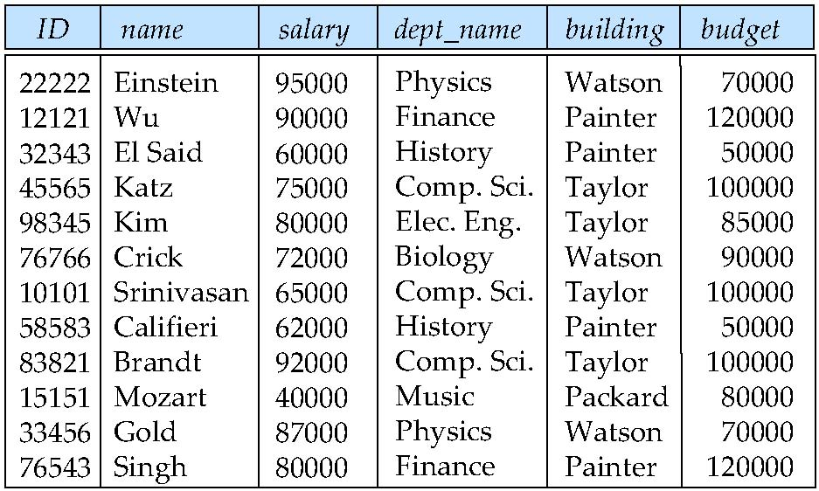
Combine Schemas?
Design Alternative: Larger Schemas
Suppose we combine instructor and department into inst_dept
inst dept (ID, name, salary, dept name, building, budget)
(No connection to relationship set inst_dept)
Result is possible repetition of information
Create inconsistency while updates.
repeat the department information
create inconsistency in updating Budget..

Slide 5
What About Smaller Schemas?
Suppose we had started with inst_dept. How would we know to split up (decompose) it into instructor and department?
Write a rule “if there were a schema (dept_name, building, budget), then dept_name would be a candidate key”
Denote as a functional dependency:
dept_name → building, budget
In inst_dept, because dept_name is not a candidate key, the building and budget of a department may have to be repeated.
This indicates the need to decompose inst_dept
Not all decompositions are good. Suppose we decompose employee(ID, name, street, city, salary) into
employee1 (ID, name)
employee2 (name, street, city, salary)
The next slide shows how we lose information -- we cannot reconstruct the original employee relation -- and so, this is a lossy decomposition.

Slide 6
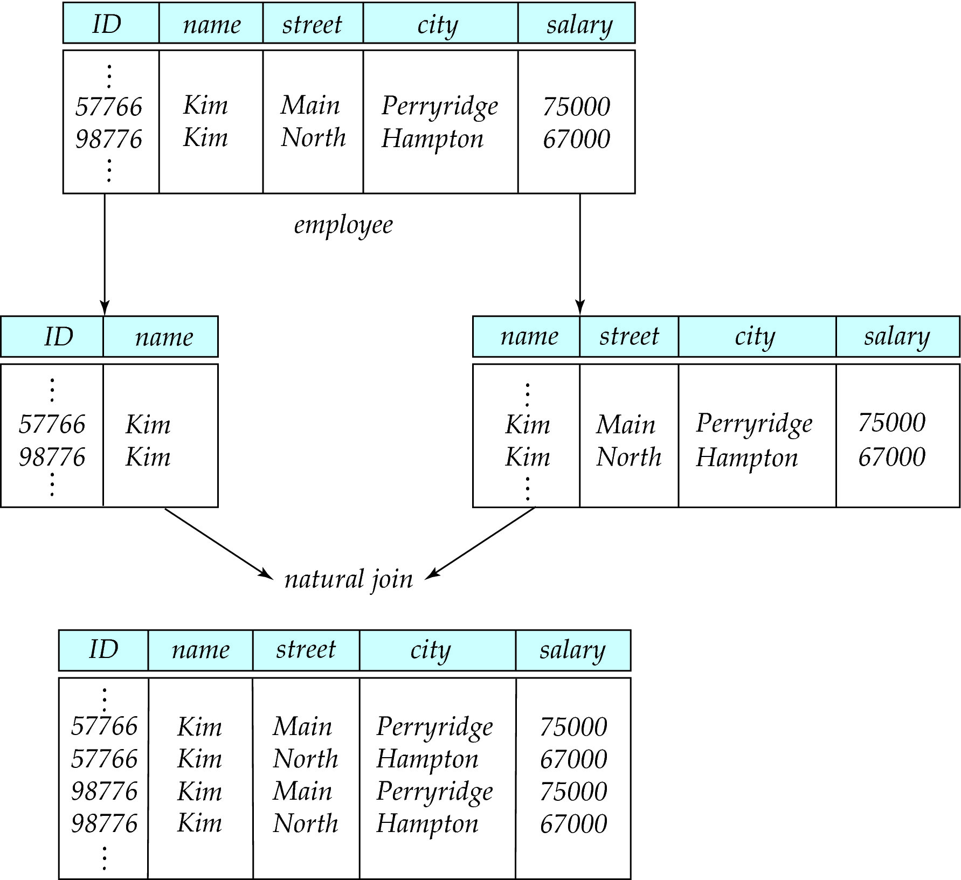
A Lossy Decomposition

Slide 7
Design goals of relational database design are:
Avoid redundant Data
Ensure that relationship among attributes are represented
Facilitate the checking of updates for violation of database integrity constraint.

Slide 8
Atomic Domain and 1NF
The E-R model allows entity sets and relationship sets to have attributes that have some degree of substructure.
multivalued attributes: phone number
composite attributes: address(street, city, state, and zip)
When we create tables from E-R designs that contain these types of attributes, we eliminate this substructure.
In the relational model, we formalize this idea that attributes do not have any substructure.
A domain is atomic if elements of the domain are considered to be indivisible units. We say that a relation schema R is in first normal form (1NF) if the domains of all attributes of R are atomic.

Slide 9
First Normal Form
Domain is atomic if its elements are considered to be indivisible units
Examples of non-atomic domains:
Set of names, composite attributes
Identification numbers like CS101 that can be broken up into parts
A relational schema R is in first normal form if the domains of all attributes of R are atomic
Non-atomic values complicate storage and encourage redundant (repeated) storage of data
Example: Set of accounts stored with each customer, and set of owners stored with each account

Slide 10
First Normal Form (Cont’d)
Atomicity is actually a property of how the elements of the domain are used.
Example: Strings would normally be considered indivisible
Suppose that students are given roll numbers which are strings of the form CS0012 or EE1127
If the first two characters are extracted to find the department, the domain of roll numbers is not atomic.
Doing so is a bad idea: leads to encoding of information in application program rather than in the database.

Slide 11
Codd’s Rule
Every database which has tables and constraints need not be a relational database system. Any database which simply has relational data model is not a relational database system (RDBMS).
“Is Your DBMS Really Relational?” and “Does Your DBMS Run By the Rules?” by E. F. Codd, Computerworld, October 14 and October 21, 1985.
All these rules are based upon what’s sometimes referred to as the foundation principle, which states that for any system to be called a relational database management system, the relational capabilities must be able to manage it completely.
But no RDBMS can obey all his rules.
EF Codd has developed 13 rules for a database to be a RDBMS.
Oracle follows only 8.5 Codd’s rules.

Slide 12
Codd's Rule 0
This is the foundational Rule. This rule states that any database system should have characteristics as relational, as a database and as a management system to be RDBMS.
That means a database should be a relational by having the relation / mapping among the tables in the database. They have to be related to one another by means of constraints/ relation. There should not be any independent tables hanging in the database.
RDBMS is a database i.e.; it stores the data in a well organized form called tables. It should be able to handle large amount of information too. In short, it should meet the objectives of a database.
RDBMS is management system – that means it should be able to manage the data, relation, retrieval, update, delete, permission on the objects. It should be able handle all these administrative tasks without affecting the objectives of database. It should be performing all these tasks by using query languages.

Slide 13
Codd's Rule 1: The Information Rule
All information in the relational database is represented in exactly one and only one way—by values in tables.
The order of rows and columns in the table should not affect the meaning of the table.
Each cell should have single data. There should not be any group/range of values separated by comma, space or hyphen (Normalized data).
This should be the only way to store the data in a database.

Slide 14
Codd's Rule 2: Guaranteed Access Rule
Each and every datum (atomic value) is guaranteed to be logically accessible by resorting to a combination of table name, primary key value, and column name.
This rule stresses the importance of primary keys for locating data in the database. The table name locates the correct table, the column name finds the correct column, and the primary key value finds the row containing an individual data item of interest.
In other words, each (atomic) piece of data is accessible by the combination of table name, primary key value, and column name.

Slide 15
Codd's Rule 3: Systematic Treatment of NULL Values
NULL values (distinct from empty character string or a string of blank characters and distinct from zero or any other number) are supported in the fully relational RDBMS for representing missing information in a systematic way, independent of data type.
If any of the cell value is unknown, or not applicable or missing, it cannot be represent as zero or empty. It will be always represented as NULL.
This NULL should be acting irrespective of the datatype used for the cell. When used in logical or arithmetical operation, it should result the value correctly.
For example:
Adding NULL to numeric 5 should result NULL –
5+ unknown = unknown 5+ NULL = NULL
5+ NULL! = 5 or 0
It should not result in any zero or numeric value. DBMS should be strong enough to handle these NULLs according to the situation and the datatypes.

Slide 16
Codd’s Rule 4: Dynamic Online Catalog Based on the Relational Model
The database description is represented at the logical level in the same way as ordinary data, so authorized users can apply the same relational language to its interrogation as they apply to regular data.
This rule requires that a relational database be self-describing i.e. data dictionary.
Metadata should be maintained for all the data in the database and must be stored as tables, rows and columns.
It should also have access privileges.
In short, these metadata also obey all the characteristics of a database.
We should be able to access these metadata by using same query language that we use to access the database.

Slide 17
Codd’s Rule 5: Comprehensive Data Sublanguage Rule
A relational system may support several languages and various modes of terminal use. However, there must be at least one language whose statements are expressible, per some well-defined syntax, as character strings and whose ability to support all of the following is comprehensible: a. data definition b. view definition c. data manipulation (interactive and by program) d. integrity constraints e. authorization f. transaction boundaries (begin, commit, and rollback).
Any RDBMS database should always be accessed by using some strong query language for accessing the data, manipulate the data and maintain the consistency and integrity of the database. They query should make sure that the transaction is fully complete or not done at all.
For example:
SQL is a structured query language which support creating tables / views/ constraints/indexes, accessing the records of tables/views (SELECT), manipulating the records by insert/delete/update, provides security by giving different level of access rights (GRANT and REVOKE) and integrity and consistency by using constraints.
Any database without any query language is not a RDBMS. Database can be accessed by using query language directly or using them in the application.

Slide 18
Codd's Rule 6: View Updating Rule
All views that are theoretically updateable are also updateable by the system.
Views are the virtual tables created by using queries to show the partial view of the table. That is views are subset of table, it is only partial table with few rows and columns. This rule states that views are also be able to get updated as we do with its table.
updating the view will update the table used for creating it, it is not recommended by most of the database. Hence this rule is not used in most of the database.

Slide 19
Codd’s Rule 7: High-Level Insert, Update, and Delete
The capability of handling a base relation or a derived relation as a single operand applies not only to the retrieval of data but also to the insertion, update, and deletion of data.
This rule stresses the set-oriented nature of a relational database.
It requires that rows be treated as sets in insert, delete, and update operations. The rule is designed to prohibit implementations that support only row-at-a-time, navigational modification of the database.
Suppose employees got 5% hike in a year. . A single query should be strong enough to update the entire employee’s salary at a time.

Slide 20
Codd’s Rule 8: Physical Data Independence
Application programs and terminal activities remain logically unimpaired whenever any changes are made in either storage representation or access methods.
If there is any change in the physical storage of the data, it should not affect the data at the logical or external view.
For example:
If the data stored in one disk is transferred to another disk, then the user viewing the data should not feel the difference or delay in access time. The user should be able to access the data as he was accessing before. Similarly, if the file name for the table is changed in the memory, it should not affect the table or the user viewing the table. This is known as physical independence and database should support this feature.
Adding indexes, Changing the file group of an object, Using partitioning, Modifying the storage engine

Slide 21
Codd’s Rule 9: Logical Data Independence
Application programs and terminal activities remain logically unimpaired when information preserving changes of any kind that theoretically permit unimpairment are made to the base tables.
This is similar to physical data independence. Here if there are any changes to the logical view, then it should not be reflected in the user view.
For example:
If we split the EMPLOYEE table according to his department into multiple employee tables, the user viewing the employee table should not feel that these records are coming from different tables. These split tables should be able to get joined and show the result. In our example we can use UNION and display the results to the user.
But in ideal scenario, this is difficult to achieve since all the logical and user view will be tied so strongly that they will be almost same.

Slide 22
Codd’s Rule 10: Integrity Independence
Integrity constraints specific to a particular relational database must be definable in the relational data sublanguage and storable in the catalog, not in the application programs.
The database must support a minimum of the following two integrity constraints:
Entity integrity: No component of a primary key is allowed to have a NULL value.
Referential integrity: For each distinct non-NULL foreign key value in a relational database, there must exist a matching primary key value from the same domain.
It requires that the database be able to implement constraints to protect the data from invalid values and that careful database design is needed to ensure that referential integrity is achieved.

Slide 23
Codd’s Rule 11: Distribution Independence
The data manipulation sublanguage of a relational DBMS must enable application programs and terminal activities to remain logically unimpaired whether and whenever data are physically centralized or distributed.
This rule says that the database language must be able to manipulate data located on other computer systems. In essence, we should be able to split the data on the RDBMS out onto multiple physical systems without the user realizing it.
The database can be located at the user server or at any other network. The end user should not be able to know about the database servers. He should be able to get the records as if he is pulling the records locally. Even if the database is located in different servers, the accessibility time should be comparatively less.

Slide 24
Codd’s Rule 12: Non-Subversion Rule
If a relational system has or supports a low-level (single-record-at-a-time) language, that low-level language cannot be used to subvert or bypass the integrity rules or constraints expressed in the higher-level (multiple-records-at-a-time) relational language.
This rule requires that alternate methods of accessing the data are not able to bypass integrity constraints, which means that users can’t violate the rules of the database in any way.
When a query is fired in the database, it will be converted into low level language so that it can be understood by the underlying systems to retrieve the data. In such case, when accessing or manipulating the records at low level language, there should not be any loopholes that alter the integrity of the database.
In other words, even thought the query written does not change the integrity of the tables, the converted low level language should be same as the query written. It should not be converted into some other low level language which changes the data integrity in the database or performs some unwanted actions in the database.

Slide 25
Relational Integrity
Integrity constraints ensure that changes made to the database by authorized users do not result in a loss of data consistency. Thus, integrity constraints guard against accidental damage to the database.
Examples of integrity constraints are:
An instructor name cannot be null.
No two instructors can have the same instructor ID.
Every department name in the course relation must have a matching department name in the department relation.
The budget of a department must be greater than $0.00.
In general, an integrity constraint can be an arbitrary predicate pertaining to the database. However, arbitrary predicates may be costly to test. Thus, most database systems allow one to specify integrity constraints that can be tested with minimal overhead.

Slide 26
Domain Constraints.
A domain of possible values must be associated with every attribute (for example, integer types, character types, date/time types).
Declaring an attribute to be of a particular domain acts as a constraint on the values that it can take.
Domain constraints are the most elementary form of integrity constraint.
They are tested easily by the system whenever a new data item is entered into the database.

Slide 27
Referential Integrity.
There are cases where we wish to ensure that a value that appears in one relation for a given set of attributes also appears in a certain set of attributes in another relation. This condition is called referential integrity.
create table department
(dept name varchar (20),
building varchar (15),
budget numeric (12,2) check (budget > 0),
primary key (dept name))
create table course
(course id varchar (8),
title varchar (50),
dept name varchar (20),
credits numeric (2,0) check (credits > 0),
primary key (course id),
foreign key (dept name) references department)

Slide 28
When a referential-integrity constraint is violated, the normal procedure is to reject the action that caused the violation (that is, the transaction performing the update action is rolled back). However, a foreign key clause can specify that if a delete or update action on the referenced relation violates the constraint, then, instead of rejecting the action, the system must take steps to change the tuple in the referencing relation to restore the constraint.
Consider this definition of an integrity constraint on the relation course:
create table course
( . . .
foreign key (dept name) references department
on delete cascade
on update cascade,
. . . );

Slide 29
Because of the clause on delete cascade associated with the foreign-key declaration, if a delete of a tuple in department results in this referential-integrity constraint being violated, the system does not reject the delete. Instead, the delete “cascades” to the course relation, deleting the tuple that refers to the department that was deleted.
If there is a chain of foreign-key dependencies across multiple relations, a deletion or update at one end of the chain can propagate across the entire chain.
If a cascading update or delete causes a constraint violation that cannot be handled by a further cascading operation, the system aborts the transaction. As a result, all the changes caused by the transaction and its cascading actions are undone.
Referential integrity is only checked at the end of the transaction. Intermediate steps are allowed to violate referential integrity provided later steps remove the violation. Otherwise it would be impossible to create some database states.

Slide 30
Enterprise Constraint:
They are additional rules specified by users or database administrators of a database.
It is also possible for users to specify additional constraints that the data must satisfy.
Example:
If limit on number of staff working at a branch is 20, then the user must be able to specify it and expect DBMS to enforce it. In this case, it should not be possible to add a new staff at that branch.

Slide 31
Functional Dependencies
Constraints on the set of legal relations.
Require that the value for a certain set of attributes determines uniquely the value for another set of attributes.
A functional dependency is a generalization of the notion of a key.

Slide 32
Functional Dependencies
Let R be a relation schema
α ⊆ R and β ⊆ R
The functional dependency
α → β holds on R if and only if for any legal relations r(R), whenever any two tuples t₁ and t₂ of r agree on the attributes α, they also agree on the attributes β. That is,
t₁[α] = t₂ [α] ⇒ t₁[β ] = t₂ [β ]
Using the functional-dependency notation, we say that K is a superkey of r (R) if the functional dependency K→R holds on r (R).
In other words, K is a superkey if, for every legal instance of r (R), for every pair of tuples t1 and t2 from the instance, whenever t1[K] = t2[K], it is also the case that t1[R] = t2[R] (that is, t1 = t2).

Slide 33
Consider schema
Loan_info=(Loan_no, Branch_name, Customer_name, Amount)
Set of functional dependencies hold on this relation:
Loan_no→Branch_name
Loan_no→Amount
There is no functional dependency:
Loan_no→Customer_name
As a given loan can be made to more than one customer.

Slide 34
Closure of a Set of Functional Dependencies
Given a set F set of functional dependencies, there are certain other functional dependencies that are logically implied by F.
For e.g.: If A → B and B → C, then we can infer that A → C
The set of all functional dependencies logically implied by F is the closure of F.
We denote the closure of F by F⁺.

Slide 35
Use of Functional Dependencies
We use functional dependencies to:
test relations to see if they are legal under a given set of functional dependencies.
If a relation r is legal under a set F of functional dependencies, we say that r satisfies F.
specify constraints on the set of legal relations
We say that F holds on R if all legal relations on R satisfy the set of functional dependencies F.
Note: A specific instance of a relation schema may satisfy a functional dependency even if the functional dependency does not hold on all legal instances.
For example, a specific instance of instructor may, by chance, satisfy name → ID.

Slide 36
Functional Dependencies (Cont.)
A functional dependency is trivial if it is satisfied by all instances of a relation
Example:
ID, name → ID
name → name
In general, α → β is trivial if β ⊆ α

Slide 37
Closure of a Set of Functional Dependencies
We can find F^{+,} the closure of F, by repeatedly applying Armstrong’s Axioms:
if β ⊆ α, then α → β (reflexivity)
if α → β, then γ α → γ β (augmentation)
if α → β, and β → γ, then α → γ (transitivity)
These rules are
sound (generate only functional dependencies that actually hold), and
complete (generate all functional dependencies that hold).

Slide 38
Example
R = (A, B, C, G, H, I) F = { A → B A → C CG → H CG → I B → H}
some members of F⁺
A → H
by transitivity from A → B and B → H
AG → I
by augmenting A → C with G, to get AG → CG and then transitivity with CG → I
CG → HI
by augmenting CG → I to infer CG → CGI,
and augmenting of CG → H to infer CGI → HI,
and then transitivity

Slide 39
Closure of Functional Dependencies (Cont.)
Additional rules:
Union Rule:
If α → β holds and α → γ holds, then α → β γ holds
Decomposition Rule:
If α → β γ holds, then α → β holds and α → γ holds
Pseudo transitivity:
If α → β holds and γ β → δ holds, then α γ → δ holds ()
The above rules can be inferred from Armstrong’s axioms.

Slide 40
Canonical Cover
Sets of functional dependencies may have redundant dependencies that can be inferred from the others
For example: A → C is redundant in: {A → B, B → C, A→ C}
Parts of a functional dependency may be redundant
E.g.: on RHS: {A → B, B → C, A → CD} can be simplified to {A → B, B → C, A → D}
E.g.: on LHS: {A → B, B → C, AC → D} can be simplified to {A → B, B → C, A → D}
Intuitively, a canonical cover of F is a “minimal” set of functional dependencies equivalent to F, having no redundant dependencies or redundant parts of dependencies

Slide 41
Extraneous Attributes
Consider a set F of functional dependencies and the functional dependency α → β in F.
Attribute A is extraneous in α if A ∈ α and F logically implies (F – {α → β}) ∪ {(α – A) → β}.
Attribute A is extraneous in β if A ∈ β and the set of functional dependencies (F – {α → β}) ∪ {α →(β – A)} logically implies F.
Note: implication in the opposite direction is trivial in each of the cases above, since a “stronger” functional dependency always implies a weaker one
Example: Given F = {A → C, AB → C }
B is extraneous in AB → C because {A → C, AB → C} logically implies A → C (I.e. the result of dropping B from AB → C).
Example: Given F = {A → C, AB → CD}
C is extraneous in AB → CD since AB → C can be inferred even after deleting C

Slide 42
Computing a Canonical Cover
R = (A, B, C) F = {A → BC B → C A → B AB → C}
Combine A → BC and A → B into A → BC
Set is now {A → BC, B → C, AB → C}
A is extraneous in AB → C
Check if the result of deleting A from AB → C is implied by the other dependencies
Yes: in fact, B → C is already present!
Set is now {A → BC, B → C}
C is extraneous in A → BC
Check if A → C is logically implied by A → B and the other dependencies
Yes: using transitivity on A → B and B → C.
Can use attribute closure of A in more complex cases
The canonical cover is: A → B B → C

Slide 43
Partial Dependency
It is a type of functional dependency where a non-key (non-prime) attribute is functionally dependent on a subset of the primary key (or candidate key) attribute.
For example, we would say that a functional dependency XY → A as a partial functional dependency, if there exists other FDs like X → A or Y → A.
<StudentProject>
In the given table, we have partial dependency; let us see how −
The prime key attributes are StudentID and ProjectNo.
As stated, the non-prime attributes i.e. StudentName and ProjectName should be functionally dependent on part of a candidate key, to be Partial Dependent.
The StudentName can be determined by StudentID that makes the relation Partial Dependent.
The ProjectName can be determined by ProjectID, which that the relation Partial Dependent.
StudentID | ProjectNo | StudentName | ProjectName
S01 | 199 | Katie | Geo Location
S02 | 120 | Ollie | Cluster Exploration

Slide 44
Fully-functionally Dependency
If X is a set of attributes and Y is another set of attributes, then any functional dependency such that X → Y is said to be a full functional dependency if and only if all the attributes of Y is functionally dependent on complete X.
In other words, X → Y becomes invalid if we remove any attribute from X.

Slide 45
<ProjectCost>
ProjectID | ProjectCost
001 | 1000
002 | 5000
<EmployeeProject>
EmpID | ProjectID | Days (spent on the project)
E099 | 001 | 320
E056 | 002 | 190
The above relations states:
EmpID, ProjectID, ProjectCost -> Days
However, it is not fully functional dependent.
Whereas the subset {EmpID, ProjectID} can easily determine the {Days} spent on the project by the employee.
This summarizes and gives our fully functional dependency −
{EmpID, ProjectID} -> (Days)

Slide 46
Data Redundancy and Update Anomalies
A major aim of relational database design is to group attributes into relations to minimize data redundancy.
Updates with a minimal number of operations thus reducing the opportunities for data inconsistencies.
Reduction in the file storage space required by the base relations thus minimizing costs.
Certain amount of data redundancy form of copies of primary keys (or candidate keys) acting as foreign keys in related relations.

Slide 47

Problems associated with unwanted data redundancy by comparing the Staff and Branch relations shown in Figure

Slide 48
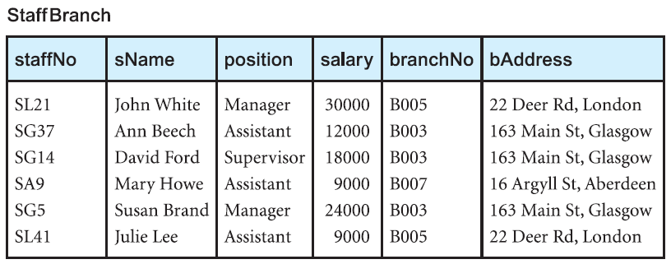
The StaffBranch relation is an alternative format of the Staff and Branch relations.
The relations have the form:
Staff (staffNo, sName, position, salary, branchNo)
Branch (branchNo, bAddress)
StaffBranch (staffNo, sName, position, salary, branchNo, bAddress)
In the StaffBranch relation there is redundant data; the details of a branch are repeated for every member of staff located at that branch.
Relations that have redundant data may have problems called update anomalies, which are classified as insertion, deletion, or modification anomalies.

Slide 49
Insertion Anomalies
There are two main types of insertion anomaly:
To insert the details of new members of staff into the StaffBranch relation.
To insert details of a new branch that currently has no members of staff into the StaffBranch relation.
Deletion Anomalies
If we want to change the value of one of the attributes of a particular branch in the StaffBranch relation.
Modification Anomalies
If we want to change the value of one of the attributes of a particular branch in the StaffBranch relation

Slide 50
Staff and Branch relations have more desirable properties than the StaffBranch relation.
StaffBranch relation is subject to update anomalies we can avoid these anomalies by decomposing the original relation into the Staff and Branch relations.
Two important properties associated with decomposition.
The lossless-join property ensures that any instance of the original relation can be identified from corresponding instances in the smaller relations.
The dependency preservation property ensures that a constraint on the original relation can be maintained by simply enforcing some constraint on each of the smaller relations.

Slide 51
Normalization
Database Normalization is a technique of organizing the data in the database. Normalization is a systematic approach of decomposing tables to eliminate data redundancy and undesirable characteristics like Insertion, Update and Deletion anomalies. It is a multi-step process that puts data into tabular form by removing duplicated data from the relation tables.
Normalization is used for mainly two purposes,
Eliminating redundant (useless) data.
Ensuring data dependencies make sense i.e data is logically stored.
Normalization rule are divided into following normal form.
1. First Normal Form
2. Second Normal Form
3. Third Normal Form
4. BCNF

Slide 52
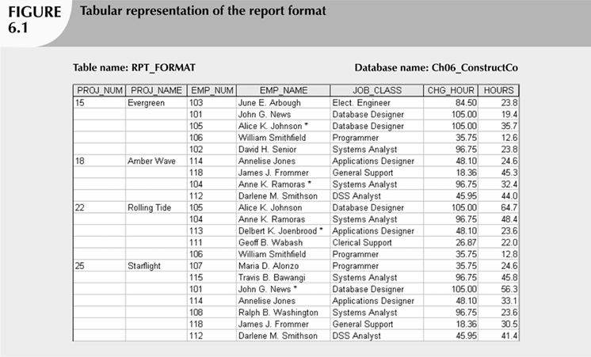

Slide 53
First Normal Form (1NF):
This rule defines that all the attributes in a relation must have atomic domains. The values in an atomic domain are indivisible units.
No two Rows of data must contain repeating group of information i.e each set of column must have a unique value, such that multiple columns cannot be used to fetch the same row. Each table should be organized into rows, and each row should have a primary key that distinguishes it as unique.
There are two common approaches to removing repeating groups from unnormalized tables:
(1) By entering appropriate data in the empty columns of rows containing the repeating data. In other words, we fill in the blanks by duplicating the nonrepeating data, where required. This approach is commonly referred to as ‘flattening’ the table.
(2) By placing the repeating data, along with a copy of the original key attribute(s), in a separate relation.

Slide 54
First Normal Form (1NF)(cont..)
Conversion to First Normal Form:
• Step 1: Eliminate the Repeating Groups
– Eliminate nulls: each repeating group attribute contains an appropriate data value
• Step 2: Identify the Primary Key
– Must uniquely identify attribute values
– New key can be composed of multiple attributes
• Step 3: Identify All Dependencies
– Dependencies are depicted with a diagram

Slide 55
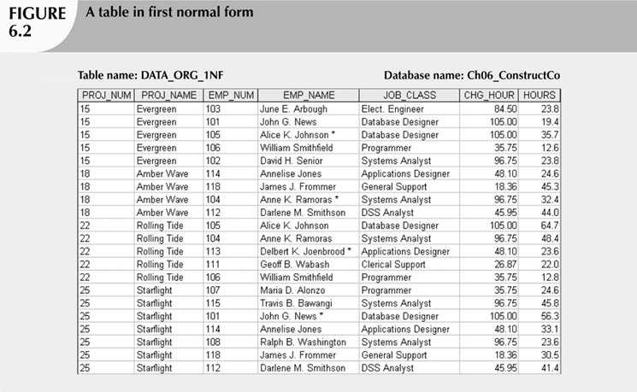
First Normal Form (1NF)(cont..)

Slide 56
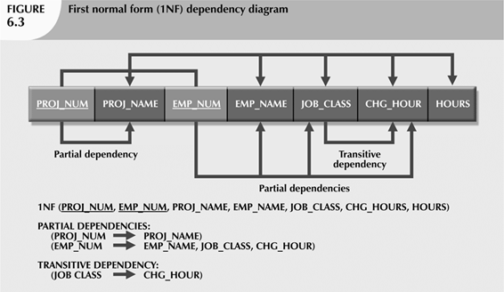
First Normal Form (1NF)(cont..)

Slide 57
Second Normal Form (2NF)
Before we learn about the second normal form, we need to understand the following −
Prime attribute − An attribute, which is a part of the prime-key, is known as a prime attribute.
Non-prime attribute − An attribute, which is not a part of the prime-key, is said to be a non-prime attribute.
If we follow second normal form, then every non-prime attribute should be fully functionally dependent on prime key attribute. That is, if X → A holds, then there should not be any proper subset Y of X, for which Y → A also holds true.
There must not be any partial dependency of any column on primary key. It means that for a table that has concatenated primary key, each column in the table that is not part of the primary key must depend upon the entire concatenated key for its existence. If any column depends only on one part of the concatenated key, then the table fails Second normal form.

Slide 58
Second Normal Form (2NF)(cont..)
Conversion to Second Normal Form:
• Step 1: Eliminate Partial Dependencies
– Start with 1NF format and convert by:
• Write each part of the composite key on it’s own line.
• Write the original (composite) key on last line
– Each component will become key in new table
• Step 2: Assign Dependent Attributes
– From the original 1NF determine which attributes are
dependent on which key attributes
• Step 3: Name the tables to reflect its contents & function

Slide 59
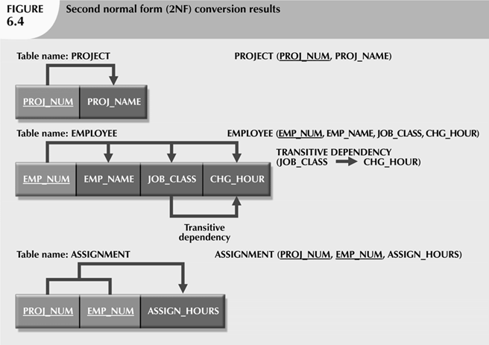
Second Normal Form (2NF)(cont..)
PROJECT (PROJ_NUM, PROJ_NAME)
EMPLOYEE (EMP_NUM, EMP_NAME, JOB_CLASS, CHG_HOUR)
ASSIGN (PROJ_NUM, EMP_NUM, HOURS)

Slide 60
Third Normal Form (3NF)
For a relation to be in Third Normal Form, it must be in Second Normal form and the following must satisfy −
No non-prime attribute is transitively dependent on prime key attribute.
For any non-trivial functional dependency, X → A, then either −
X is a superkey or,
A is prime attribute.
Every non-prime attribute of table must be dependent on primary key, or we can say that, there should not be the case that a non-prime attribute is determined by another non-prime attribute. So this transitive functional dependency should be removed from the table and also the table must be in Second Normal form.
The normalization of 2NF relations to 3NF involves the removal of transitive dependencies. If a transitive dependency exists, we remove the transitively dependent attribute(s) from the relation by placing the attribute(s) in a new relation along with a copy of the determinant.

Slide 61
Third Normal Form (3NF)(cont..)
Conversion to Third Normal Form
• Step 1: Eliminate Transitive Dependencies
– Write its determinant as PK for new table.
– And Leave it in the Original Table
• Step 2: Reassign Corresponding Dependent Attributes
– Identify attributes dependent on each determinant identified in Step1, and list on new table.
• Step 3: Name the new table(s) to reflect its contents and function
PROJECT (PROJ_NUM, PROJ_NAME)
EMPLOYEE (EMP_NUM, EMP_NAME, JOB_CLASS)
ASSIGN (PROJ_NUM, EMP_NUM, HOURS)
JOB(JOB_CLASS, CHG_HOUR)

Slide 62
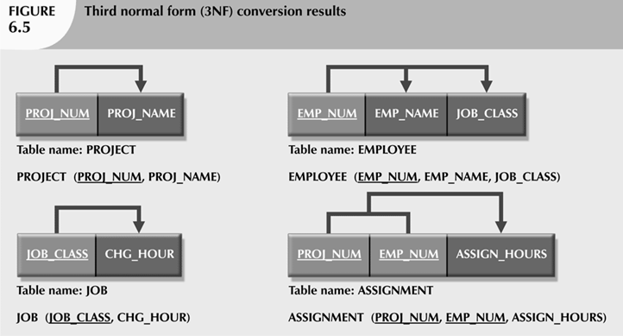
Third Normal Form (3NF)(cont..)

Slide 63
Boyce–Codd Normal Form
Boyce–Codd Normal Form (BCNF) is based on functional dependencies that take into account all candidate keys in a relation; however, BCNF also has additional constraints compared with the general definition of 3NF.
A relation is in BCNF, if and only if, every determinant is a candidate key.

Slide 64
Boyce-Codd Normal Form BCNF is an extension of Third Normal Form on strict terms. BCNF states that −
For any non-trivial functional dependency, X → A, X must be a super-key.
Student_Detail (Student_id, Student_name, DOB, Street, city, State, Zip)
Student_Detail (Student_id, Student_name, DOB, Zip)
Address (Zip, Street, city, state)
In the above image, Stu_ID is the super-key in the relation Student_Detail and Zip is the super key in the relation ZipCodes. So,
Stu_ID → Stu_Name, DOB, Zip
and
Zip → Street, city, state
Which confirms that both the relations are in BCNF.

Slide 65
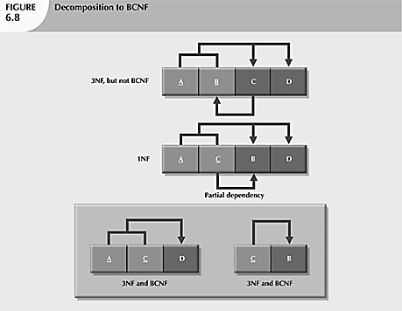

Slide 66
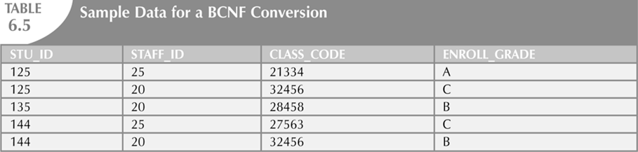
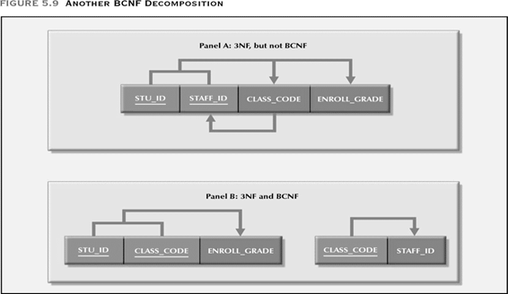

Slide 67
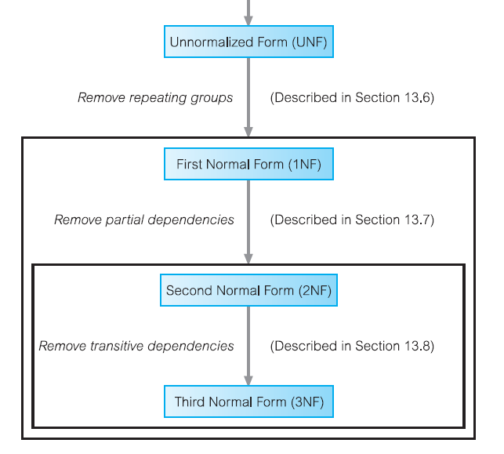

Slide 68
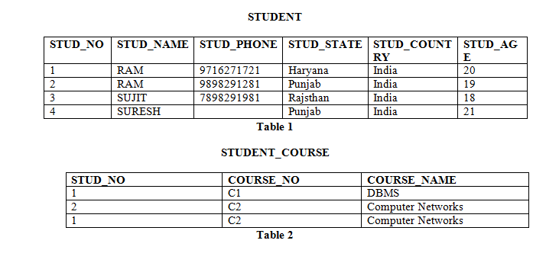
Keys
Candidate Key: The minimal set of attribute which can uniquely identify a tuple is known as candidate key. For Example, STUD_NO in STUDENT relation.
The value of Candidate Key is unique and non-null for every tuple.
There can be more than one candidate key in a relation. For Example, STUD_NO as well as STUD_PHONE both are candidate keys for relation STUDENT.
The candidate key can be simple (having only one attribute) or composite as well. For Example, {STUD_NO, COURSE_NO} is a composite candidate key for relation STUDENT_COURSE.

Slide 69
It can be defined as minimal Super Key or irreducible Super Key. In other words an attribute or a combination of attribute that identifies the record uniquely but none of its proper subsets can identify the records uniquely.
E.g. of Candidate Key
1 Code
2 Name, Address
For above table we have only two Candidate Keys (i.e. Irreducible Super Key) used to identify the records from the table uniquely. Code Key can identify the record uniquely and similarly combination of Name and Address can identify the record uniquely, but neither Name nor Address can be used to identify the records uniquely as it might be possible that we have two employees with similar name or two employees from the same house.

Slide 70
Keys
Super Key: The set of attributes which can uniquely identify a tuple is known as Super Key. For Example, STUD_NO, (STUD_NO, STUD_NAME) etc.
Adding zero or more attributes to candidate key generates super key.
A candidate key is a super key but vice versa is not true.
E.g. of Super Key
1 ID
2 ID, Name
3 ID, Address
4 ID, Department_ID
5 ID, Salary
6 Name, Address
7 Name, Address, Department_ID ………… So on as any combination which can
identify the records uniquely will be a Super Key.

Slide 71
Keys
Primary Key: There can be more than one candidate key in a relation out of which one can be chosen as primary key.
For Example, STUD_NO as well as STUD_PHONE both are candidate keys for relation STUDENT but STUD_NO can be chosen as primary key (only one out of many candidate keys).
Alternate Key: The candidate key other than primary key is called as alternate key.
For Example, STUD_NO as well as STUD_PHONE both are candidate keys for relation STUDENT but STUD_PHONE will be alternate key (only one out of many candidate keys).

Slide 72
Keys
Foreign Key: If an attribute can only take the values which are present as values of some other attribute, it will be foreign key to the attribute to which it refers. The relation which is being referenced is called referenced relation and corresponding attribute is called referenced attribute and the relation which refers to referenced relation is called referencing relation and corresponding attribute is called referencing attribute.
Referenced attribute of referencing attribute should be primary key. For Example, STUD_NO in STUDENT_COURSE is a foreign key to STUD_NO in STUDENT relation.

Slide 73
Foreign Key – A foreign key is an attribute or combination of attribute in
one base table that points to the candidate key (generally it is the primary key) of another table.
The purpose of the foreign key is to ensure referential integrity of the data i.e. only values that are supposed to appear in the database are permitted.
E.g. of Foreign Key – Let consider we have another table i.e. Department Table with Attributes “Department_ID”, “Department_Name”, “Manager_ID”, ”Location_ID” with Department_ID as an Primary Key. Now the Department_ID attribute of Employee Table (dependent or child table) can be defined as the Foreign Key as it can reference to the Department_ID attribute of the Departments table (the referenced or parent table), a Foreign Key value must match an existing value in the parent table or be NULL.

Slide 74
Modeling Temporal Data

